Slide 1
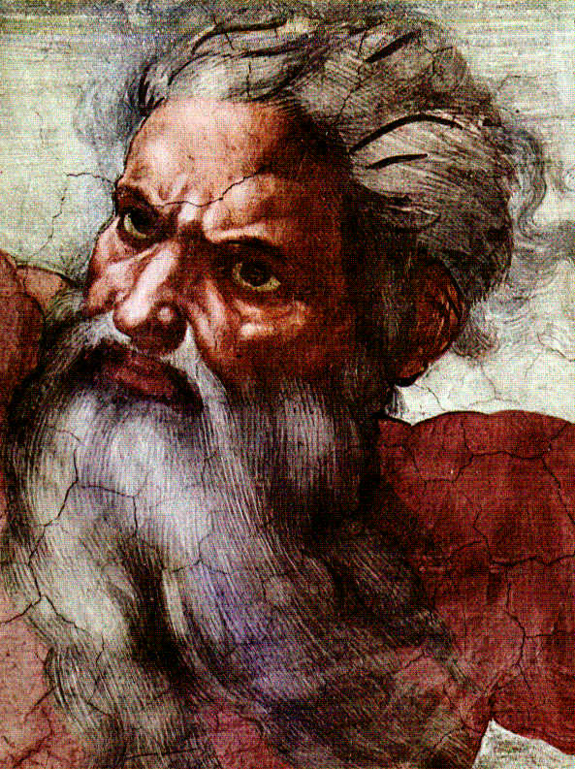
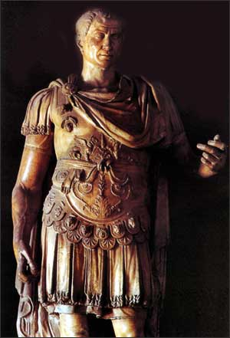
God & Caesar:
The ancient modern clash

Slide 2
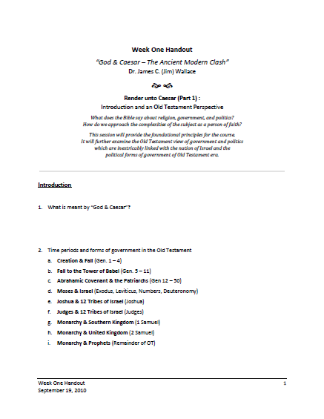
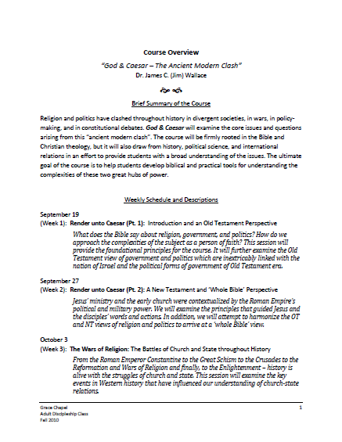
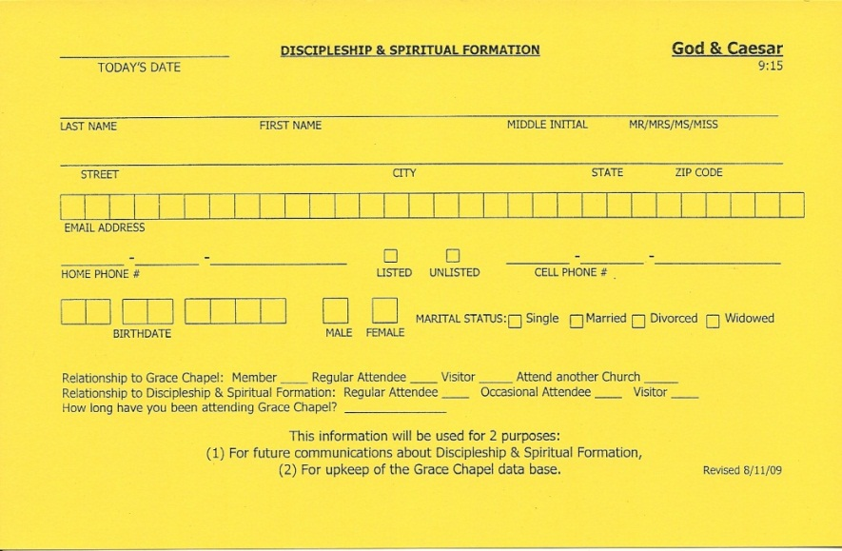
Welcome!
Handouts
Registration Card
Notes:
Welcome – thanks for coming – Week #4
Take a moment and fill out a name tag – if you haven’t filled out a registration card please do so
Handouts for previous weeks material online – link in email sent to you last week
Signup sheet for refreshments – Thank you this week to Janet, Steve and Pauline

Slide 3
A New Testament Perspective
Triumphal Entry
    Luke 19:29-44
    Donkey – Animal ridden by a King
    “Hosannah” – “nah” was a syllable reserved for a King, this is why the Pharisees urged Jesus to rebuke his disciples
    Ceremony enacts the reception of a guest of state
    Jesus is acting out his royal claim to be King

Slide 4
A New Testament Perspective
Jesus’ arrest & trial –
  Matt. 26:47 – 27:26 ; Mark 14:43 – 15:15 ; Luke 22:47 – 23:25 ; John 18:2 – 19:16
    Question of authority & sovereignty – state vs. religion
    Only the Roman state possess the ultimate power to legally put someone to death
    The enacting of the “problem of dirty hands”

Slide 5
A New Testament Perspective
Question:
Does the admonition
“give to Caesar what is Caesar’s,
and to God what is God’s” (Matt. 22:21, Mark 12:17)
apply only to paying taxes or is it a broader principle that can be applied to other areas
of church-state relations?
Notes:
NOTE: I know we are 2 weeks behind on the original schedule – will catch up – wanted to make sure and not short-change the biblical material
This week I just have to camp out on a portion of the material. Will pick up with the historical material next week. Video is postponed at this point.

Slide 6
A New Testament Perspective
Paul’s claim of Roman citizenship
  Acts 22:22-29
    Civitas = citizenship
    Roman citizens numbered only 6 million men in AD 47
    Roman citizens had particular rights, privileges, and duties
    Paul took advantage of his Civitas
Notes:
Roman citizenship a very special concept; a unique status; Rome was first to codify “citizenship” in this way
Civitas was only given to certain Romans and to less foreigners (NOTE – My citizenship – U.S. & Canada – how foreigners work hard to get it – we take for granted
Only 6 million men had Roman citizenship in AD 47 – Persons act in Canada 1927-28 – does “persons” in law include female persons – Supreme court ruled unanimously NOT persons – overturned by British Privy Council
Paul took advantage of the “rights” he had under Roman law to his advantage
One of Paul’s ancestors (father, grandfather) may have been granted civitas as a reward for distinguished service. Paul was from a family of good social position. He was treated as a person of consequence by Felix, Festus, Agrippa, and Julius.

Slide 7
A New Testament Perspective
Paul’s claim of Roman citizenship
  Acts 25:1 – 26:32
    Paul’s trial before Felix and Festus
    Paul’s appeal to be heard before Caesar
    Was Paul’s appeal to Roman citizenship self-defense or
    was it strategic?
      Acts 19:21
      Romans 1:10-15
      Romans 15:20-29
Notes:
See printed hand notes

Slide 8
A New Testament Perspective
Submission to governing authorities
  Romans 13:1-7
    “The thirteenth chapter of the Epistle of Romans contains what are perhaps the most important words ever written for the history of political thought.
    “This is the most notable passage in the NT on Christian civic responsibility.”
    Respublica Christiana and the Doctrine of the “two swords”

Slide 9
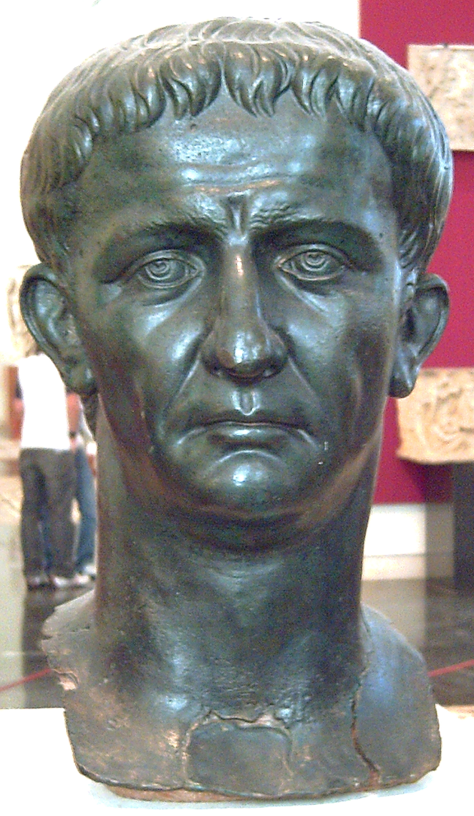
A New Testament Perspective
  Roman law and the Jews
  Emperor Claudius
  (41-54 AD)
  Paul and his exhortation to the Roman Christians and Jews

Slide 10
A New Testament Perspective
Key words
  Romans 13:1-7
    (13:1) Everyone
    (13:1) Must submit
    (13:1) Governing authorities
    (13:1) Authorities
    (13:1) Established
    (13:2) Rebel
    (13:4) Servant
    (13:5) Necessary
    (13:5) Submit
    (13:5) Wrath and conscience

Slide 11
A New Testament Perspective
Discussion Questions
On
Handout

Slide 12
A Whole Bible Interpretation
Jim’s Principles
  Use the whole Bible - Incorporate both the Old and New Testaments into your understanding of the relationship between church and state.
  Understand and apply the historical context – Include a proper understanding of the time period and the attendant concept of state, the political powers, rulers and authorities of that day, the concept of law and citizenship, and the concept of sovereignty. This is crucial for proper interpretation.

Slide 13
A Whole Bible Interpretation
Jim’s Principles
  Wrestle with the textual complexities – Some of the passages in the Bible seem to contradict one another on issues of state, government, and political power. If the whole Bible is true, then there must be an answer which harmonizes conflicting passages and ideas.
  Be a Christ-imitator in this arena – Make sure your mind, heart, speech, attitude, and demeanor honorably reflect you as a subject and servant of the King of Kings, the Lord of Lords, and the Prince of Peace.

Slide 14
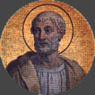
A Whole Bible Interpretation
  1 Timothy 2:1-4
  Clement of Rome
  (d. 99 AD)
  Consecrated by Peter
  Pope from 92-99 AD
  Clement’s Prayer for Leaders –
  1 Clement 60:2 – 61:2

Slide 15

God & Caesar
Let’s take a moment to pray for our leaders
Notes:
Story of Al Duerr – Geoff Bruins – Praying on steps for leaders

