Slide 1
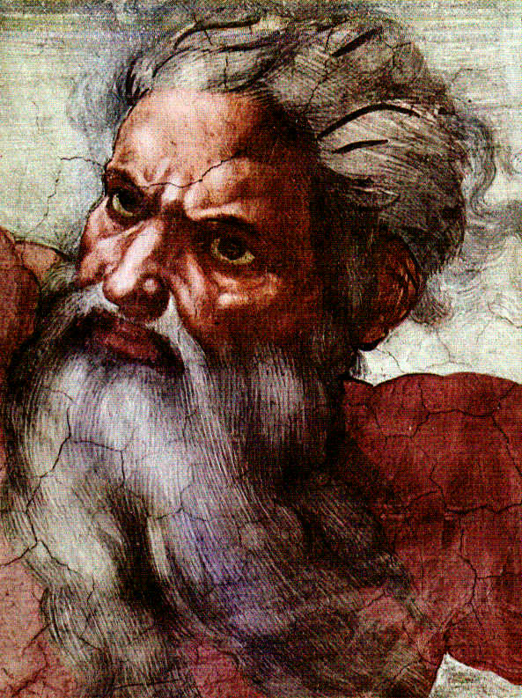
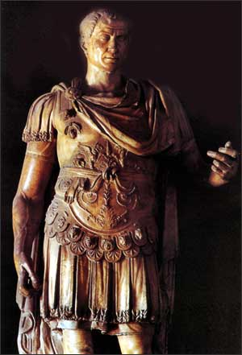
God & Caesar:
The ancient modern clash

Slide 2
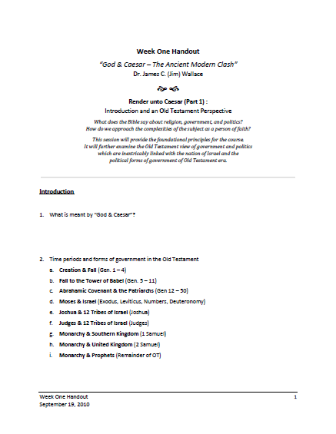
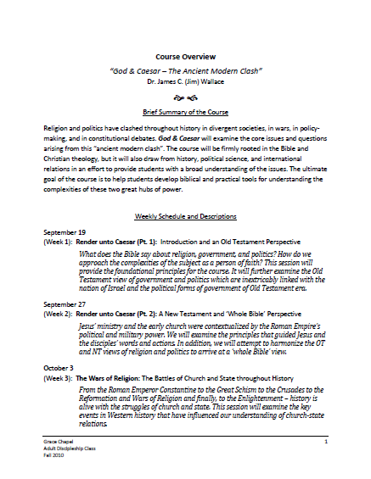
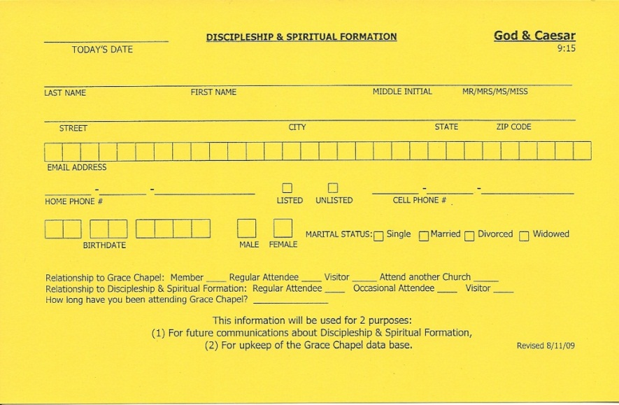
Welcome!
Handouts
Registration Card
Notes:
Welcome – thanks for coming – Week #3 (but Week #2 on the syllabus)
Take a moment and fill out a name tag – if you haven’t filled out a registration card please do so
Handouts on the table for Week #3 – all the rest of the materials online – link in email sent to you last week

Slide 3

Question / Comments
GodandCaesar@gmail.com
Notes:
If didn’t get the link or have any questions, just email me at this email address and I will get you the info
Class refreshments – sign up sheet going around
Larry Brock for bringing last week
Glenn and Nancy Cunningham for bringing this week

Slide 4
Ishmael & Islam
Genesis 16, 21-22
Qu’ran teaches –
  Hagar and Ishmael ended up in the vicinity of Mecca when the angel appeared and gave them water
  Abraham and Ishael are later reunited
  Together they rebuilt the Kaaba, believed to have originally been built by Adam – a temple to the one true God
  Today the Kaaba is the holiest site in Islam – the direction to which Muslims pray
  Ishmael was the intended victim of sacrifice on Mt. Moriah
Surah 2:124, 127
Surah 37:99-113

Slide 5

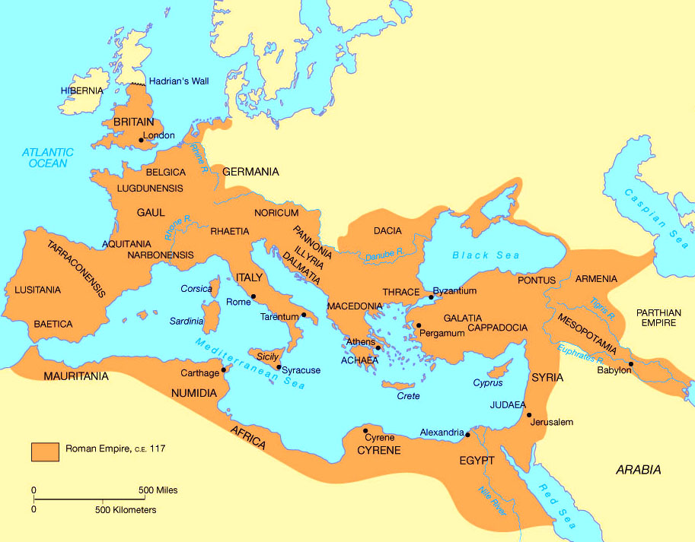
The Roman Empire

Slide 6
The Historical-Political Context
Roman Rulers
  Julius Caesar – 60-44 BC
  Caesar Augustus (Octavian) – 44 BC – 14 AD
  Tiberius – 12-37 AD
  Caligula – 37-41 AD
  Claudius – 41-54 AD
  Nero – 54-68 AD

Slide 7
The Historical-Political Context
Jewish Rulers
  Maccabees (167-140 BC)
  Hasmonean Kingdom of Israel (140-37 BC)
  Herodian Dynasty (37 BC – 92 AD)

Slide 8
The Historical-Political Context
Roman Governors and Officials
  Four Jewish sects
  Jewish Tax Revolt in 6 AD instigated by the Pharisees and Zealots
  Zealots committed to eradicating Israel of foreign rule – Great Jewish Revolt (66-70 AD)
  Roman Governors were appointed by Rome to maintain military control after the Tax Revolt

Slide 9
A New Testament Perspective
The ministries of John the Baptizer and Jesus were firmly anchored in the religio-political context of the day:
    The beginning of John the Baptizer’s ministry
    (Luke 3:1-3)
    The beheading of John (Matthew 14:1-12)
    The birth of Jesus (Luke 2:1-7)

Slide 10
A New Testament Perspective
The Temptation of Jesus
    Matthew 4:8-10
    Luke 4:5-8
    A temptation to use / rely on temporal power to accomplish his mission on earth
    Jesus was very aware of the power of governments to coerce people towards a goal

Slide 11
A New Testament Perspective
Paying Taxes to Caesar
    Matthew 22:15-22
    Mark 12:13-17
    Luke 20:20-26
A trap set by the Pharisees and the Herodians
    If “yes” – Pharisees and Jewish nationalists would denounce Jesus
    If “no” – Herodians would report Jesus for treason

Slide 12
A New Testament Perspective
The coin
    Denarius; a day’s wage; the amount of the poll tax
    Bore the emperor’s image and the inscription “Tiberius Caesar, son of the divine Augustus” on one side
    On the other side “Pontifex Maximus” = “high priest”
“Give”
    Apodidomi = “Render”
    To give up, give back, pay back, return, restore
    Recognized the authority of the state
    God & Caesar – two realms, two authorities,
    sacred & secular

Slide 13
A New Testament Perspective
Questions & implications
    What does Jesus’ answer mean for us in 2011?
    Are there times we are to yield to God rather than Caesar?
      Acts 5:29
      Acts 4:19

Slide 14
A New Testament Perspective
Triumphal Entry
    Luke 19:29-44
    Donkey – Animal ridden by a King
    “Hosannah” – “nah” was a syllable reserved for a King, this is why the Pharisees urged Jesus to rebuke his disciples
    Ceremony enacts the reception of a guest of state
    Jesus is acting out his royal claim to be King

Slide 15
A New Testament Perspective
Jesus’ arrest & trial –
  Matt. 26:47 – 27:26 ; Mark 14:43 – 15:15 ; Luke 22:47 – 23:25 ; John 18:2 – 19:16
    Question of authority & sovereignty – state vs. religion
    Only the Roman state possess the ultimate power to legally put someone to death
    The enacting of the “problem of dirty hands”

Slide 16

God & Caesar
Question? Comments?
What have we learned?

