Slide 1
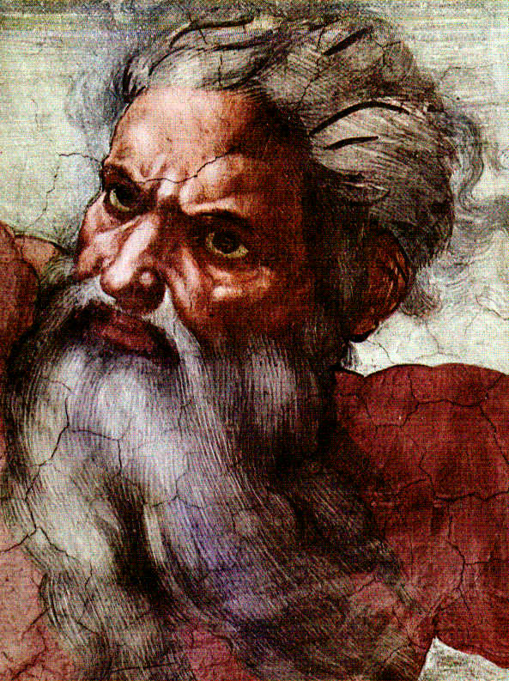
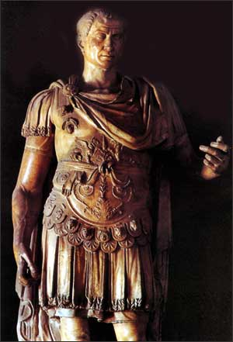
God & Caesar:
The ancient modern clash

Slide 2
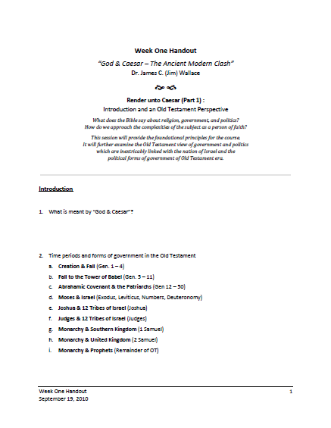
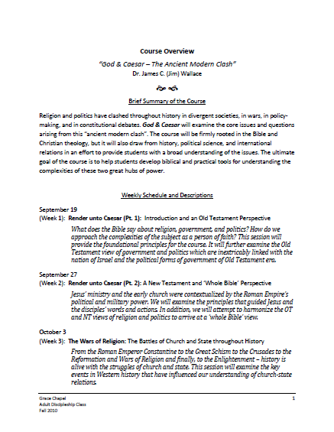
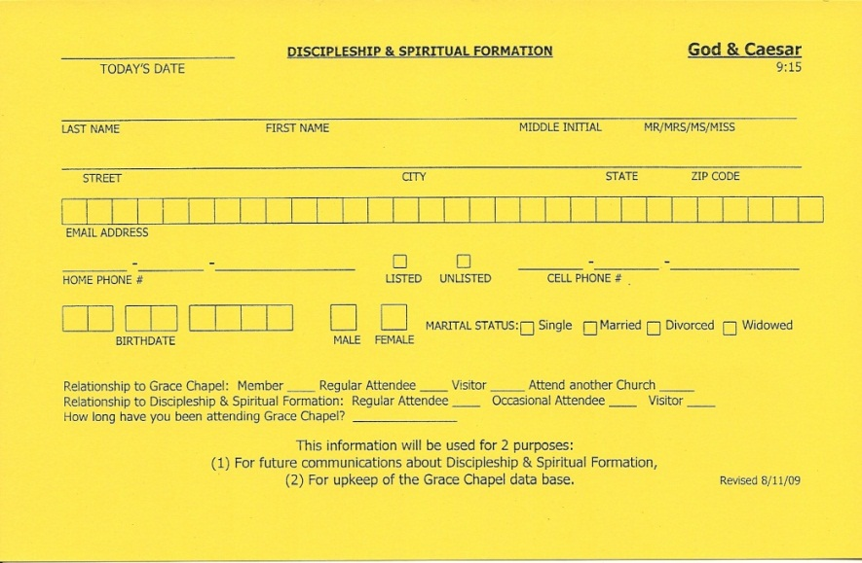
Welcome!
Handouts
Registration Card
Notes:
Tim will handle welcome and intro Glen
Glen will lead in prayer

Slide 3

Question / Comments
GodandCaesar@gmail.com
Notes:
I created a special email account for this class for you to contact me – questions, comments, clarifications
I will also be emailing you during the course with brief emails and additional information that may be helpful; don’t worry, I won’t clog your mailbox or add you to any kind of distribution list

Slide 4

A Special Resource
AMERICAN EXPERIENCE & FRONTLINE
present
God in America
on PBS
http://www.pbs.org/godinamerica/
Notes:
First-of-its kind, six-hour documentary series explores 400-year history of religion in the public life of the United States
Produced in Boston by WGBH; ran for the first time last fall
Available online – all 6 sessions – additional material available also
For the first time on television, God in America explores the tumultuous 400-year history of the intersection of religion and public life in America, from the first European settlements to the 2008 presidential election. A co-production of AMERICAN EXPERIENCE and FRONTLINE, this six-hour series examines how religious dissidents helped shape the American concept of religious liberty and the controversial evolution of that ideal in the nation’s courts and political arena; how religious freedom and waves of new immigrants and religious revivals fueled competition in the religious marketplace; how movements for social reform--from abolition to civil rights--galvanized men and women to put their faith into political action; and how religious faith influenced conflicts from the American Revolution to the Cold War.

Slide 5
An Old Testament View
Genesis 12:1-3, 18:18
  Nation = Goy – peoples, tribes, gentiles
  Country / Land = Erets – earth, land, dust countryside
  People = Moldeth – kindred, birth, offspring, relatives
  Household = Bayith – house, home, family, residence
Notes:
When interpreting the scripture, it is important to differentiate between the meaning of words – particularly as found in the original languages of Hebrew, Aramaic, and Greek
This verse illustrates the difference in . . . Nation – Country – People – Household

Slide 6
An Old Testament View
Genesis 12:1-3, 18:18
Genesis 17:20
  Ishmael as Father
  Ishmael as Nation
Notes:
Genesis 17:20
NIV
[20] And as for Ishmael, I have heard you: I will surely bless him; I will make him fruitful and will greatly increase his numbers. He will be the father of twelve rulers, and I will make him into a great nation.
Nation (Strong’s #1471)
1471. goy (156c); from the same as 1458 ; nation, people :—every nation(2), Gentiles(1), Goiim(1), Harosheth-hagoyim*(3), herds(1), nation(120), nations(425), people(4).

Slide 7
An Old Testament View
Genesis 12:1-3, 18:18
Genesis 17:20
Genesis 13:14-17, 15:18-20, 17:8
  Israel as a land or political entity
  The current political debate over the land
  A Peace to End all Peace: The Fall of the Ottoman Empire and the Creation of the Modern Middle East. David Fromkin. New York: Holt and Company, 1989.
Notes:
Genesis 13:14-17, 15:18-20, 17:8
Genesis 13:14-17
[14] The LORD said to Abram after Lot had parted from him, “Lift up your eyes from where you are and look north and south, east and west. [15] All the land that you see I will give to you and your offspring forever. [16] I will make your offspring like the dust of the earth, so that if anyone could count the dust, then your offspring could be counted. [17] Go, walk through the length and breadth of the land, for I am giving it to you.” (NIV translation)
The word “land” in these verses is the Hebrew word erets –
earth, land :—common(1), countries(15), countries and their lands(1), country(44), countryside(1), distance*(3), dust(1), earth(655), earth the ground(1), earth's(1), fail*(1), floor(1), ground(119), land(1581), lands(57), lands have their land(2), open(1), other*(2), piece(1), plateau*(1), region(1), territories(1), wild(1), world(3).
The primary meaning of the word has to do with the physical earth or land, even though it is sometimes translated “country.” Certainly the meaning of “country” has to do with the physical property and not the political unit as we would think of the “country” (i.e., nation-state) of England or France or the United States.
The word erets occurs twice in Genesis 12:1 which we looked at last Sunday – the first time it is translated “country” and the second time it is translated “land.” It is the same Hebrew word although it is translated differently.

Slide 8
An Old Testament View
Genesis 12:1-3, 18:18
Genesis 17:20
Genesis 13:14-17, 15:18-20, 17:8
Exodus 19:3-6
  Kingdom & sovereignty
  Kingdom – spiritual vs. political
Notes:
Exodus 19:3-6
NIV
Kingdom (Strong’s #4467)
4467. hkflfm;ma mamlakah (575a); from the same as 4428 ; kingdom, sovereignty, dominion, reign :—dominion(1), kingdom(58), kingdoms(48), reign(2), royal(6), rule(1), sovereignty(1).
Nation (Strong’s #1471)
1471. goy (156c); from the same as 1458 ; nation, people :—every nation(2), Gentiles(1), Goiim(1), Harosheth-hagoyim*(3), herds(1), nation(120), nations(425), people(4).

Slide 9
An Old Testament View
Genesis 12:1-3, 18:18
Genesis 17:20
Genesis 13:14-17, 15:18-20, 17:8
Exodus 19:3-6
1 Samuel 8-10
  Saul – King of the ‘nation’
  Israel – A nation like all others
Notes:
Story of Saul being made King “like all the other nations”
1 Samuel 8: 19-20
[19] But the people refused to listen to Samuel. “No!” they said. “We want a king over us. [20] Then we will be like all the other nations, with a king to lead us and to go out before us and fight our battles.”
1471. goy (156c); from the same as 1458 ; nation, people :—every nation(2), Gentiles(1), Goiim(1), Harosheth-hagoyim*(3), herds(1), nation(120), nations(425), people(4).
People wanted a “king” of their people – nation – not a political unit (nation-state) tied to the land. However, because of the promise to Abraham, it could be called a PROTO-nation-state.
NOTE: Illustrates how people want to fit in and be like others; this applies to ideas of government and politics – domestically and internationally

Slide 10
An Old Testament View
Genesis 12:1-3, 18:18
Genesis 17:20
Genesis 13:14-17, 15:18-20, 17:8
Exodus 19:3-6
1 Samuel 8-10
Daniel 4:17, 6:4
  Kingdoms, sovereignty, and governmental affairs
Notes:
Daniel 4:17
Sovereign (Strong’s #7990)
7990. +y©i¾a shallit (1115d); (Ara.) corr. to 7989 ; having mastery, ruling :—allowed(1), authority(1), commander(1), governing(1), ruler(5), rules(1).
Daniel 6:4
Government affairs (Strong’s #4437)
4437. ²kl;ma malku (1100b); (Ara.) corr. to 4438 ; royalty, reign, kingdom :—government affairs(1), kingdom(38), kingdoms(3), realm(4), reign(4), royal(3), sovereignty(4).

Slide 11
An Old Testament View
Genesis 12:1-3, 18:18
Genesis 17:20
Genesis 13:14-17, 15:18-20, 17:8
Exodus 19:3-6
1 Samuel 8-10
Daniel 4:17, 6:4
Isaiah 9:6-7
  Kingdom, sovereignty and government
Notes:
Isaiah 9:6-7
Government (Strong’s #4951)
4951. hrF¿;mi misrah (976a); from an unused word; rule, dominion :—government(2).
Kingdom (Strong’s #4467)
4467. hkflfm;ma mamlakah (575a); from the same as 4428 ; kingdom, sovereignty, dominion, reign :—dominion(1), kingdom(58), kingdoms(48), reign(2), royal(6), rule(1), sovereignty(1).

Slide 12
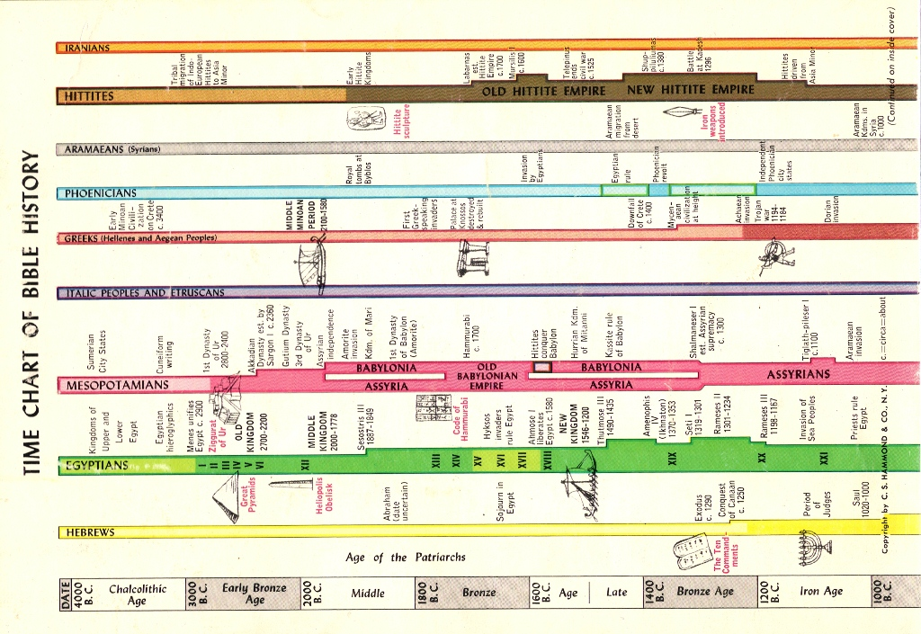
Historical Empires
Notes:
Time Chart of Bible History (from Hammond Atlas of the Bible Lands)
Empire had two dimensions – (1) geographical [area], (2) political [ruling peoples / land & conquered peoples / land]
Hittites were non-Semetic, non-Indo-European peoples who lived in Anatolia (eastern Turkey / Iraq)

Slide 13
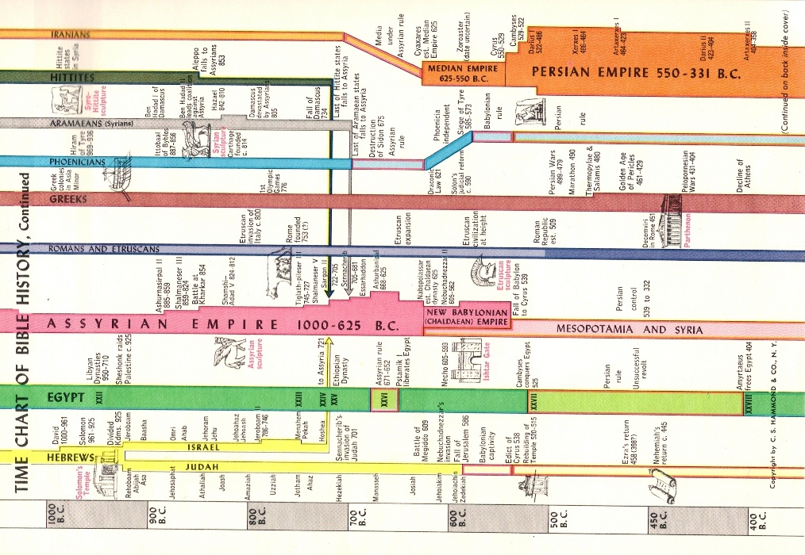
Historical Empires
Notes:
Time Chart of Bible History (from Hammond Atlas of the Bible Lands)

Slide 14
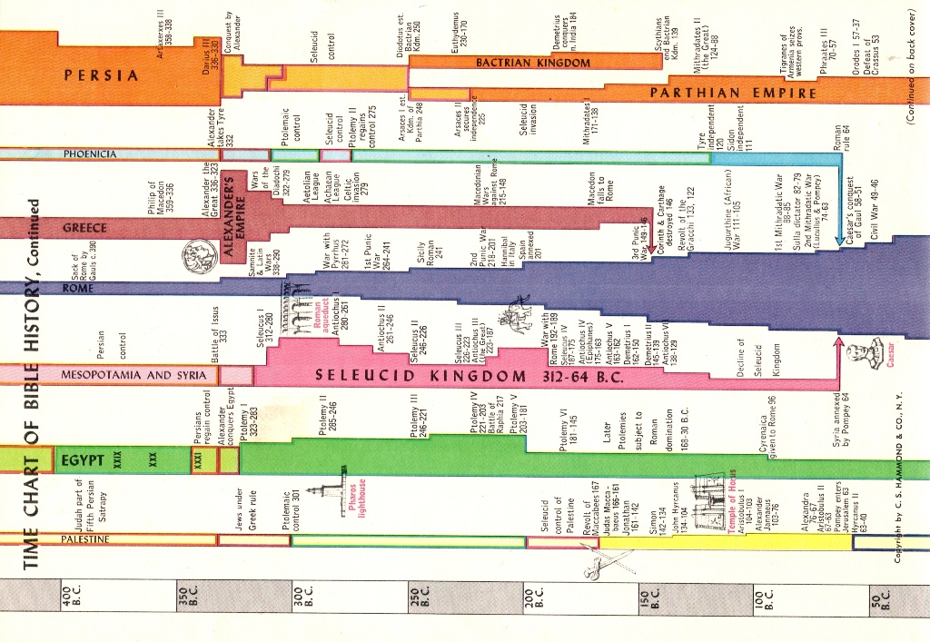
Historical Empires
Notes:
Time Chart of Bible History (from Hammond Atlas of the Bible Lands)

Slide 15
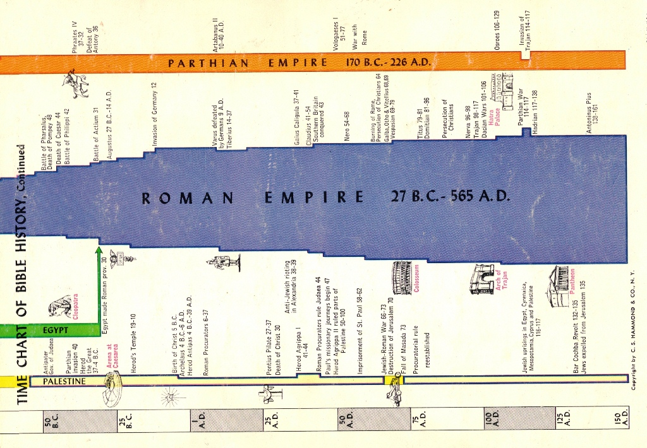
Historical Empires
Notes:
Time Chart of Bible History (from Hammond Atlas of the Bible Lands)

Slide 16
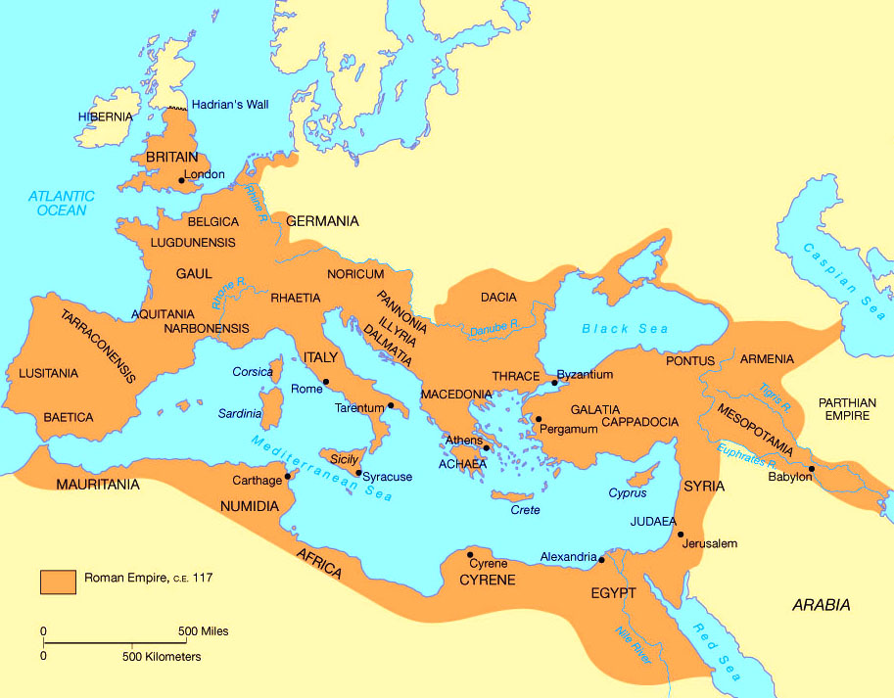
The Roman Empire

Slide 17

God & Caesar
Question? Comments?
What have we learned?

