Slide 1
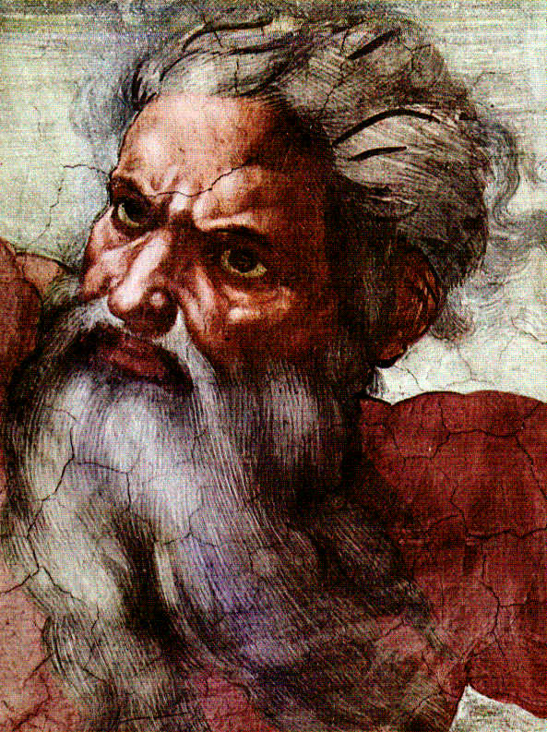
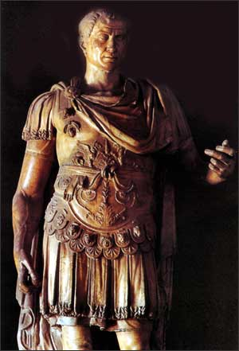
God & Caesar:
The ancient modern clash

Slide 2
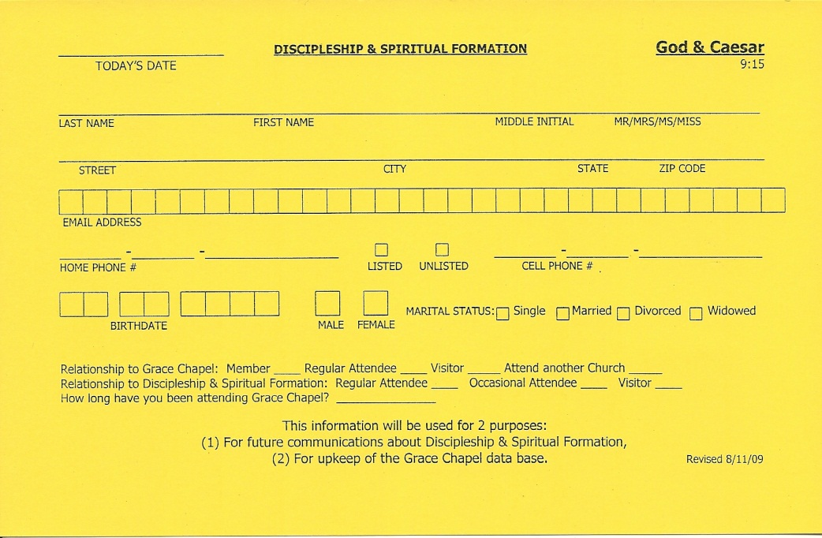
Welcome!
Registration Card
Please fill out a REGISTRATION CARD
for the class.
Take a Moment to fill out
a name tag
and to
meet those around you
Notes:
Tim Castner will handle this part

Slide 3
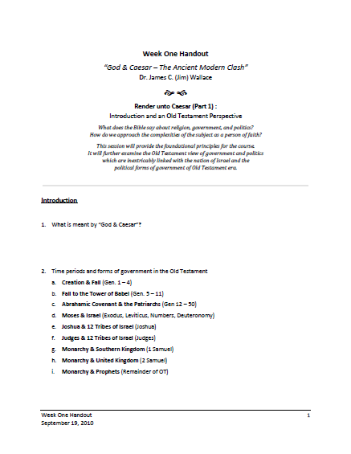
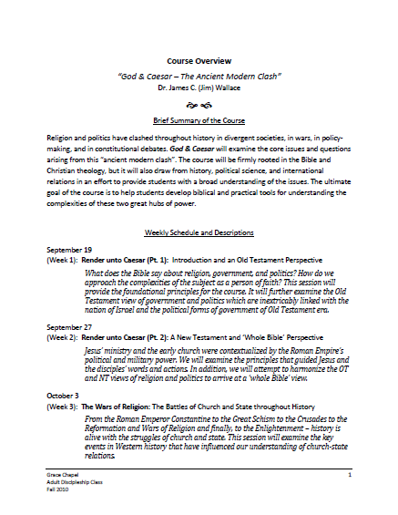
Introduction
Handouts
Notes:
Tim Castner will handle this
Tim will then lead in prayer
Also highlight – bio sketches
Explain joint teaching

Slide 4
Core Teaching Principles
Rooted and grounded in historical, orthodox biblical theology – each session will be based on and incorporate the biblical text and its principles
Taught in keeping with and not contrary to the Statement of Faith of Grace Chapel
Sourced from the most authoritative religious and non-religious resources including a variety of books and media – a bibliography for each session will be provided
Designed to inform and educate, but more importantly to provide principles and practical steps of action for daily life
Presented in a way that allows space for a variety of viewpoints, questions, and even disagreements to be expressed (courteously and Christianly) by the participants
Notes:
Because of the nature of this course . . . And the controversy involved in the subject matter . . . I want to take a minute and go over the core teaching principles I am using for this course

Slide 5

Question / Comments
GodandCaesar@gmail.com
Notes:
I created a special email account for this class for you to contact me – questions, comments, clarifications

Slide 6

A Special Resource
AMERICAN EXPERIENCE & FRONTLINE
present
God in America
on PBS
http://www.pbs.org/godinamerica/
Notes:
First-of-its kind, six-hour documentary series explores 400-year history of religion in the public life of the United States
Produced in Boston by WGBH; ran for the first time last fall
Available online – all 6 sessions – additional material available also
For the first time on television, God in America explores the tumultuous 400-year history of the intersection of religion and public life in America, from the first European settlements to the 2008 presidential election. A co-production of AMERICAN EXPERIENCE and FRONTLINE, this six-hour series examines how religious dissidents helped shape the American concept of religious liberty and the controversial evolution of that ideal in the nation’s courts and political arena; how religious freedom and waves of new immigrants and religious revivals fueled competition in the religious marketplace; how movements for social reform--from abolition to civil rights--galvanized men and women to put their faith into political action; and how religious faith influenced conflicts from the American Revolution to the Cold War.

Slide 7

God & Caesar
RELIGION:
A religion involves a doctrine (system of beliefs),
an ethic (system of norms and regulations),
a ritual (system of worship and observances),
and an institutional structure.
By religion, I mean formal (vs. informal),
official (vs. non-official), corporate (vs. personal).
Notes:
God & Caesar = religion & politics
So what do we mean by religion?
Example of difficulty of informal religion – Folk religionists in China are largest group / family & village based / local gods / syncretism / no unified system of belief

Slide 8
God & Caesar
POLITICS:
the art or science of government
the art of adjusting and ordering relationships between individuals and groups in a political community
the art or science of guiding or influencing governmental policy
Notes:
What is meant by politics?
Definitions from Webster’s Dictionary

Slide 9
God & Caesar
TIME PERIODS and FORMS OF GOV’T IN THE OT:
Creation & Fall (Gen. 1 – 4)
Fall to the Tower of Babel (Gen. 5 – 11)
Patriarchs (Gen 12 – 50)
Moses & Israel (Ex., Lev., Num., Deut.)
Joshua & 12 Tribes of Israel (Joshua)
Judges & 12 Tribes of Israel (Judges)
Monarchy & Southern Kingdom (1 Samuel)
Monarchy & United Kingdom (2 Samuel)
Monarchy & Prophets (Remainder of OT)
Notes:
Creation & Fall (Gen. 1 – 4) – Direct, personal rule by God
Fall to the Tower of Babel (Gen. 5 – 11) – Personal and family nomadic government and religion / other forms of government exist (Gen. 10)
Patriarchs (Gen 12 – 50) – Family and clan nomadic government and religion
Moses & Israel (Exodus, Leviticus, Numbers, Deuteronomy) – Tribal theocracy with religio-politico-judicial leader, Moses
Joshua & 12 Tribes of Israel (Joshua) – Tribal theocracy / Centralized military, centralized religion
Judges & 12 Tribes of Israel (Judges) – Tribal theocracy / Centralized military, judiciary and religion
Monarchy & Southern Kingdom (1 Samuel) – Monarchy like other nations / 1 Sam. 8:4-5, 19-20 / Centralized government, centralized religion
Monarchy & United Kingdom (2 Samuel) – Monarchy over all 12 tribes / 2 Sam. 5:3 / Centralized government, centralized religion
Monarchy & Prophets (Remainder of OT) – Civil government (monarchy) and religion (prophets) became more separate

Slide 10
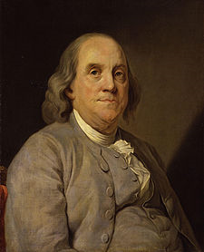
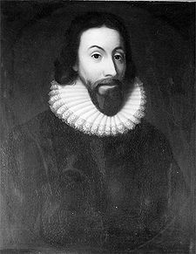
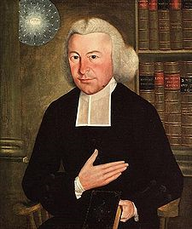
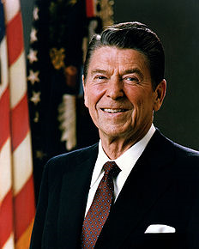
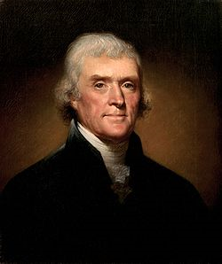
God & Caesar
Notes:
Why is it important to look at the OT & NT view separately?
Different theology – Jewish, Christian
Person of Jesus
If you hold one approach to religion and politics – particularly in America – you use the OT and if you hold another you use the NT
My goal is to use the whole Bible
This is particularly true for those who view . . . America as the New Israel

Slide 11
An Old Testament View
Genesis 12:1-3, 18:18
  Nation
    Modern concept of “nation” emerged in 1648 = nation-state
    Peace of Westphalia
    Cuius regio, Eius religio
  Country
  People
  Household
Notes:
When interpreting the scripture, it is important to differentiate between the meaning of words – particularly as found in the original languages of Hebrew, Aramaic, and Greek
This verse illustrates the difference in . . . Nation – Country – People – Household

Slide 12
God & Caesar
Questions?
Discussion?
What have we learned today?

