Slide 1
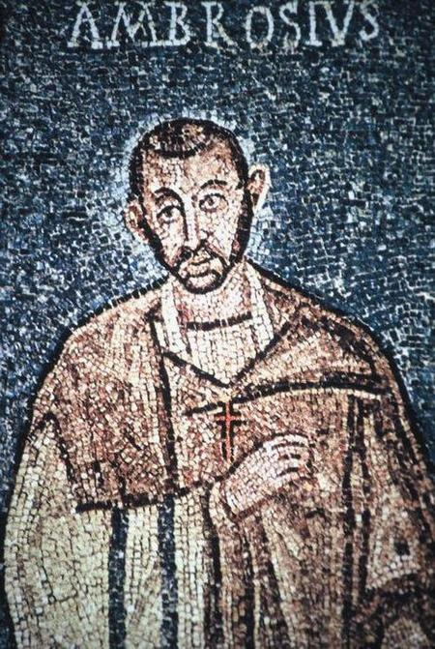
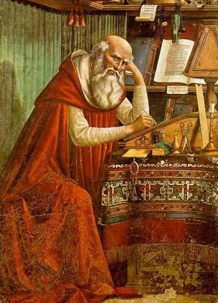
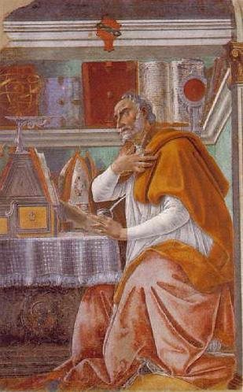
A Cloud of Witnesses: A History of the Early Church
Ambrose of Milan
(337-397 A.D.)
Jerome
(347-420 A.D.)
Augustine of Hippo
(354-430 A.D.)

Slide 2

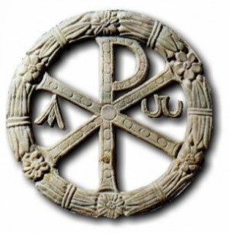
Three Latin Fathers
Why I have chosen these three examples:
All “Church Fathers”, great writers/apologists/theologians
indicative of Christianity c. 400AD in the West
All major theologians, two of them great Bishops
All had important contact with one another

Slide 3
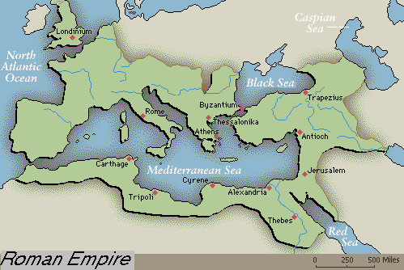
Geographical Distribution

Slide 4
Ambrose of Milan
Ambrose:
Governor of Milan in 373 A.D. (36yrs old)
Elevated from Catechumen to Bishop
Battle with Valentinian’s mother
Neoplatonist interpretation of Old Testament
Most Influential Convert
Ambrose of Milan
(337-397 A.D.)

Slide 5
Ambrose of Milan
Ambrose:
Two great Ambrose stories:
The Goths take Captives:
It is better to preserve for the Lord souls rather than gold. He who sent the apostles without gold also gathered the churches without gold. The church has gold, not to store it, but to give it up to those who are in need…. It is better to keep the living vessels, than the gold ones.
3. Theodosius and Thessalonica
Ambrose of Milan
(337-397 A.D.)

Slide 6
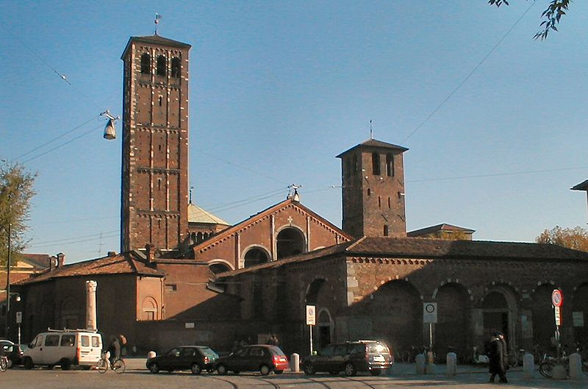
Ambrose of Milan

Slide 7
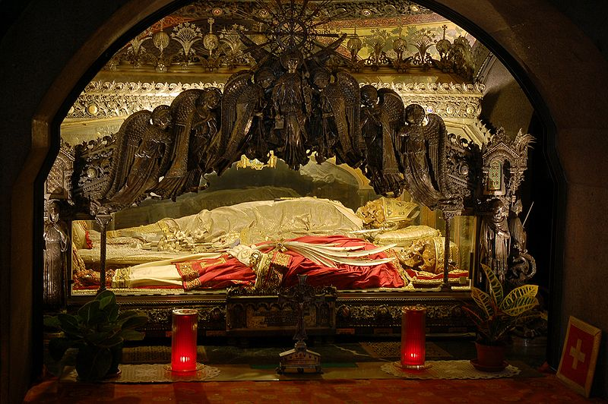
Ambrose of Milan

Slide 8
Jerome
Jerome:
Was born an old man and scholar
Loved classical learning, but had a dream when deathly sick…
Befriended two nuns, Paula and Eustochium
Founded a Monestary with the two women in Bethlehem
Would author the Latin Vulgate, THE translation of the Bible for the church of the middle ages.
Jerome
(327-420 A.D.)

Slide 9
Jerome
Augustine to Jerome:
“I pray you not to devote your energies to translating the sacred books to Latin, unless you do as you did earlier in you translation of the book of Job, that is, adding notes that show clearly where your version differs from the Septuagint, whose authority has no equal…. Besides, I cannot imagine how, after so long, someone can find in the Hebrew manuscripts anything which so many translators did not see before, especially since they knew Hebrew so well.”
Jerome
(327-420 A.D.)

Slide 10
Jerome
Reaction to the Fall of Rome in 410:
Who could have believed that Rome, built by the conquest of the world, would fall? That the mother of many nations has turned to her grave? … My eyes are dimmed by my advanced age … and with the light that I have t night I can no longer read Hebrew books, which are difficult to read for the smallness of their letters.
Jerome
(327-420 A.D.)

Slide 11
Augustine of Hippo
Augustine:
Born of Monica…
Studied rhetoric and philosophy
Became Manichean and Neo-platonism
Heard Ambrose preach while living in Milan and was Baptized by him
When visiting Hippo in 391 AD, Valerius Bishop of Hippo, convinces him to become co-bishop
Augustine of Hippo
(354-430 A.D.)

Slide 12
Augustine of Hippo
Augustine on the Free will of the Soul:
God cannot create evil, therefore evil must be the result of free will
Therefore evil is a choice to turn against God, not a substance or “thing”
In the Garden:
  Freedom to sin or not to sin
After the Fall:
  Freedom only to Sin (God’s Ir. Grace)
After redemption:
  Freedom to sin or not to sin
In Heaven:
  Freedom only not to sin
Augustine of Hippo
(354-430 A.D.)

Slide 13
Augustine of Hippo
Augustine vs Pelagius:
Pelagius: from birth we are free to sin or not to sin, no such things as “original sin” We are criminals not victims
One could theoretically never sin, or stop sinning completely and reach perfection
Both Augustine and Jerome vehemently wrote against Pelagius
Pelagius’ view makes God’s grace useful, but not theoretically necessary
Augustine of Hippo
(354-430 A.D.)

Slide 14
Augustine of Hippo
Augustine’s Two Great Works:
Confessions: Spiritual Autobiography addressed as a prayer to God (ch. 3,4)
The City of God:
  Two cities one of God and One of Earth
  Earth built on love of self, God built on love of God
  They stand in irreconcilable opposition
  Rome had flourished to spread the Gospel
  At the end of History only the City of God will stand
Augustine of Hippo
(354-430 A.D.)

