Slide 1
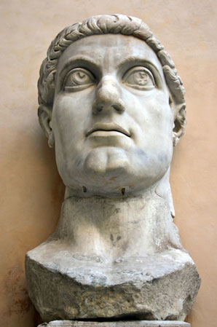
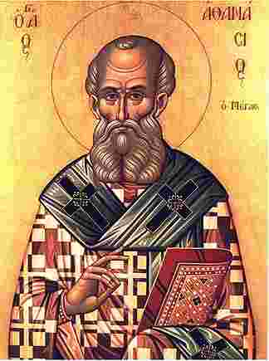
A Cloud of Witnesses: A History of the Early Church

Slide 2
I believe in one God, the Father Almighty, Maker of heaven and earth, and of all things visible and invisible.
And in one Lord Jesus Christ, the only-begotten Son of God, begotten of the Father before all worlds; God of God, Light of Light, very God of very God; begotten, not made, being of one substance with the Father, by whom all things were made.
Who, for us men and for our salvation, came down from heaven, and was incarnate by the Holy Spirit of the virgin Mary, and was made man; and was crucified also for us under Pontius Pilate; He suffered and was buried; and the third day He rose again, according to the Scriptures; and ascended into heaven, and sits on the right hand of the Father; and He shall come again, with glory, to judge the quick and the dead; whose kingdom shall have no end.
And I believe in the Holy Ghost, the Lord and Giver of Life; who proceeds from the Father and the Son; who with the Father and the Son together is worshipped and glorified; who spoke by the prophets.
And I believe in one holy catholic and apostolic Church. I acknowledge one baptism for the remission of sins; and I look for the resurrection of the dead, and the life of the world to come. Amen.

Slide 3

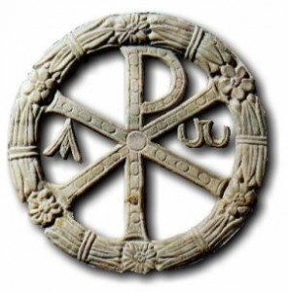
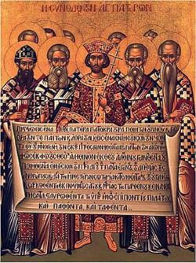
The Council of Nicea
Constantine gets word of the conflict and calls a general council
Solve the date of Easter, approve procedure for re-admission of lapsed, election and ordination of bishops and presbyters; and solve the Arian problem creating a common creed
Bishops reaction to Eusebius of Nicomedia.
Eusebius and Arius Exiled/Excommunicated

Slide 4
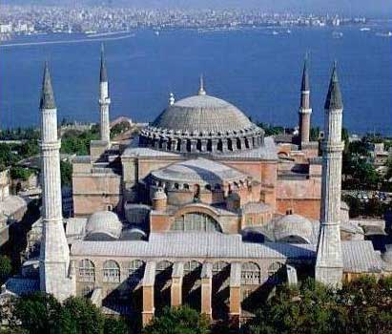

Slide 5
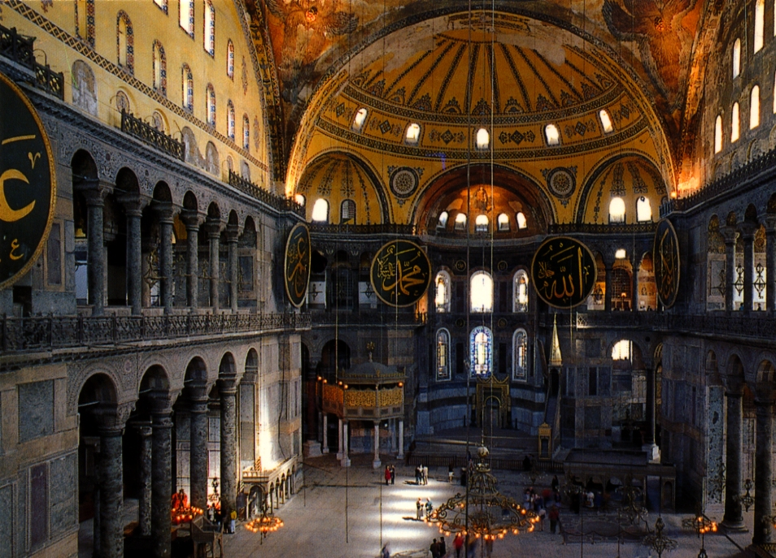

Slide 6
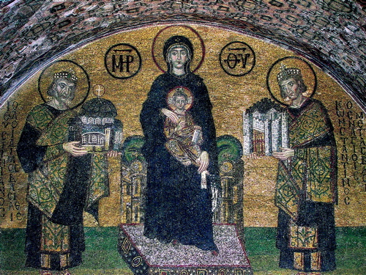

Slide 7
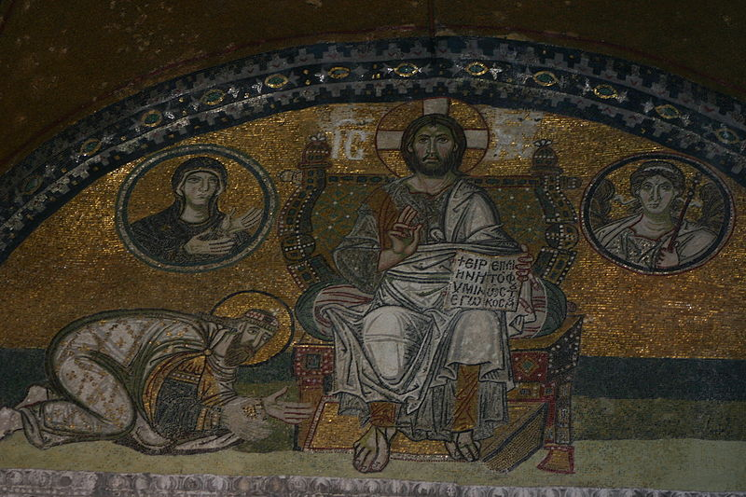
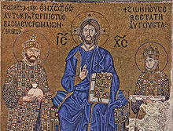
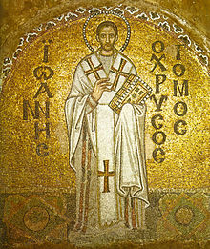
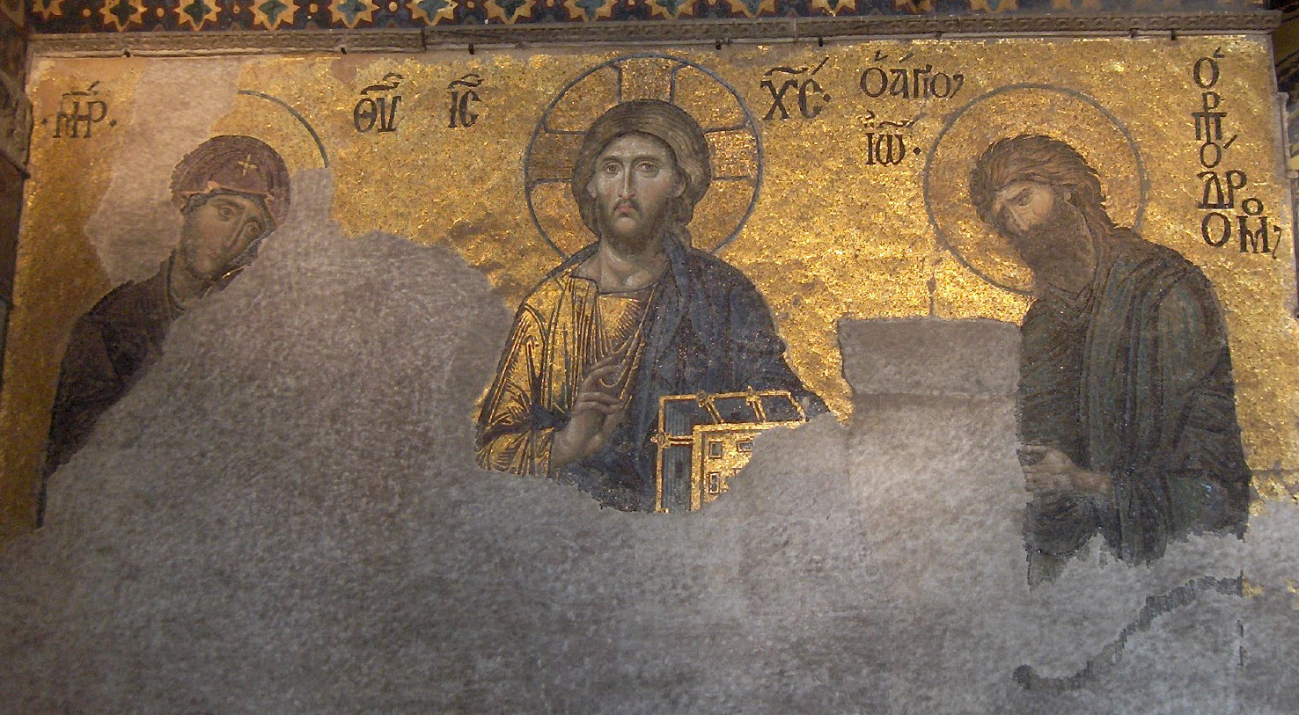

Slide 8
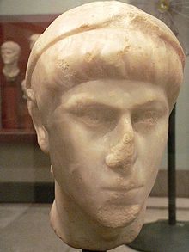
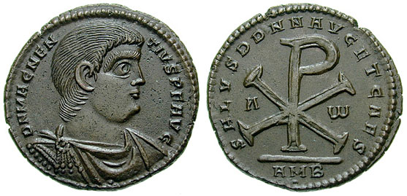
Return from Exile
Emperor 337-361 AD
Constantius II, becomes sole emperor. Staunch supporter of Arianism.
Exiles non-Arian bishops and pressures bishops to revoke Nicene creed. (read Letter)

Slide 9
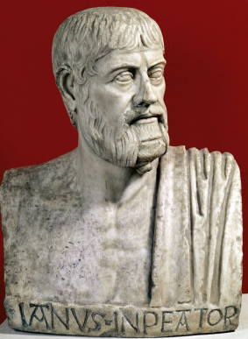
Julian “the Apostate”
Emperor 361-363 AD
Wanted to restore Rome to former glory
Despised Christianity, worked actively to restore paganism
Established pagan hierarchy, with himself as high priest
Planned to rebuild the Temple in Jerusalem
Died suddenly in campaign against Persia

Slide 10
Notes

Slide 11
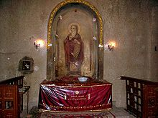
Athanasius of Alexandria
(296-373 AD)
Athanasius grew up involved with the monks in the desert
Young deacon at the Council of Nicea
Opponents called him “The Black Dwarf”
Wrote “On the Incarnation” (Read Excerpt)

Slide 12
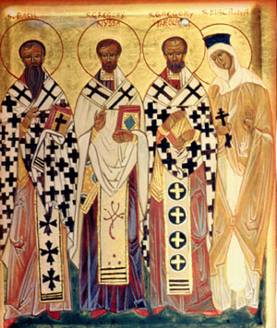
The “Great Cappadocians”
Macrina
Basil “The Great” Bishop of Cesarea
Gregory of Nyssa, Bishop of Nissa (small Town)
Gregory of Nazianzus, presbyter and Bishop
All four monastics, the three men eventually pressed into service

Slide 13
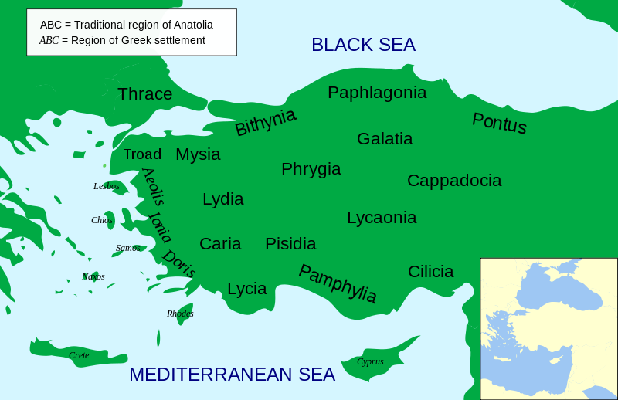

Slide 14
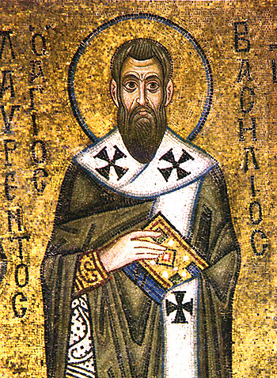
The “Great Cappadocians”
“All that I have that you can confiscate are these rags and a few books. Nor can you exile me, for wherever you send me, I shall be God’s guest. As to tortures, you should know that my body is already in Christ. And death would be a great boon to me, leading me sooner to God”
“Perhaps that is because you have never met a true bishop”

Slide 15
Notes

Slide 16
The Council of Constantinople
Arianism, Apollonarianism, and Pneumatomachians, all condemned.
Confirmed Nicene Creed, Affirmed Homoousias, and affirmed the divinity of the Holy Spirit.

Slide 17
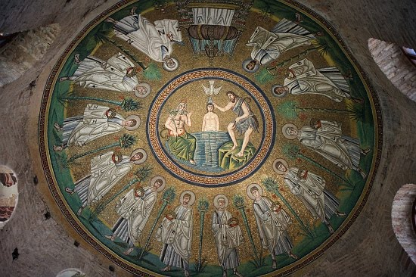
Arian vs. Orthodox

Slide 18
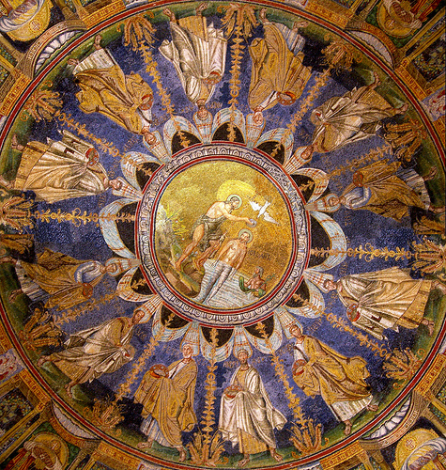

Slide 19
Notes

