Slide 1
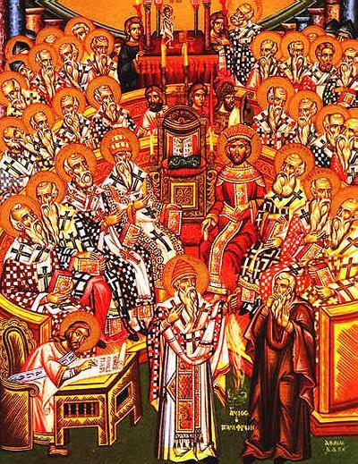
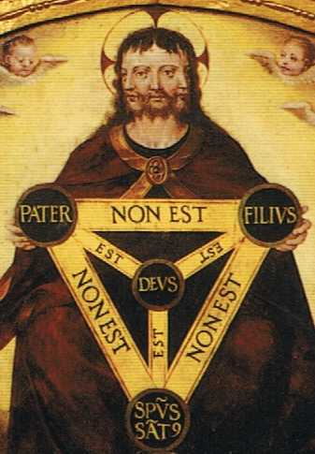
A Cloud of Witnesses: A History of the Early Church

Slide 2
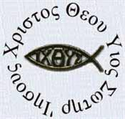
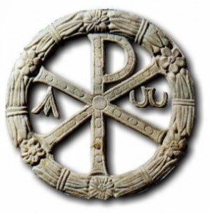
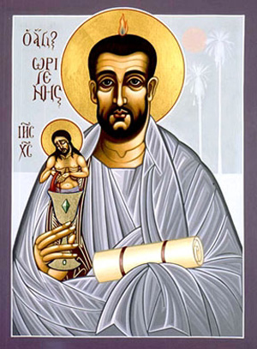
Origen of Alexandria
Origen (184-253)
Head of catechetical school in Alexandria, after Clement.
Matthew 19:12 ¹² For there are eunuchs who have been so from birth, and there are eunuchs who have been made eunuchs by men, and there are eunuchs who have made themselves eunuchs for the sake of the kingdom of heaven. Let the one who is able to receive this receive it."

Slide 3
Origen of Alexandria
The Theology of Origen
The Pre-existence of souls (Two-part creation)
All might eventually be saved including Satan and Demons
Logos Theology
  - Jesus one soul that did not fall
  - Became united with God in Love
  - Eventually manifested in the flesh to show us the way
As we maintain our free will after resurrection, there could be another fall in a possibly endless cycle.
Typology: Ark Built in three stages; Noah means “rest” “righteousness” or Abraham (Christian) Sarah (Christian Wisdom) and Hagar (Human Wisdom). Isaac only after Ishmael.

Slide 4
Notes

Slide 5
The Arian Controversy
It all begins with the Greek Apologists (Who?).
  Linked God with Supreme Being of philosophers
  Created a scholarly stream within Christianity
Logos Theology
  The Logos was the intermediary between the Supreme Being and humanity
  What is the nature of “the Logos?”
John 1:1-4
In the beginning was the Word, and the Word was with God, and the Word was God. ² He was in the beginning with God. ³ All things were made through him, and without him was not any thing made that was made. ⁴ In him was life, and the life was the light of men.

Slide 6
The Arian Controversy
  Arius (~250-325)
  An Alexandrian presbyter who came into conflict with the Bishop Alexander.
  Arius taught that Jesus, being “begotten” of the father is clearly a “created” being, thus not co-eternal with the Father, and thus not fully sharing in his attributes or divinity. Jesus is therefore subordinated to the father.
  “The Logos is capable of change, as are we all, but of his own free will he continues to be good as long as he wishes. He is capable of change even as we are, but God foreknowing that he would remain good gave him in anticipation the glory which as man and in consequence of his virtue he afterwards possessed. God from foreknowledge of his works made him what he afterwards was.”

Slide 7
The Arian Controversy
  Colossians 1:13-20 ¹³ For he has rescued us from the dominion of darkness and brought us into the kingdom of the Son he loves, ¹⁴ in whom we have redemption, the forgiveness of sins. ¹⁵ He is the image of the invisible God, the firstborn over all creation. ¹⁶ For by him all things were created: things in heaven and on earth, visible and invisible, whether thrones or powers or rulers or authorities; all things were created by him and for him. ¹⁷ He is before all things, and in him all things hold together. ¹⁸ And he is the head of the body, the church; he is the beginning and the firstborn from among the dead, so that in everything he might have the supremacy. ¹⁹ For God was pleased to have all his fullness dwell in him, ²⁰ and through him to reconcile to himself all things, whether things on earth or things in heaven, by making peace through his blood, shed on the cross.

Slide 8
The Arian Controversy
Acts 2:36 ³⁶ "Therefore let all Israel be assured of this: God has made this Jesus, whom you crucified, both Lord and Christ."
John 14:28 ²⁸ "You heard me say, 'I am going away and I am coming back to you.' If you loved me, you would be glad that I am going to the Father, for the Father is greater than I.
Mark 13:31-32 ³¹ Heaven and earth will pass away, but my words will never pass away. ³² "No one knows about that day or hour, not even the angels in heaven, nor the Son, but only the Father.

Slide 9
The Arian Controversy
John 1:1-4 In the beginning was the Word, and the Word was with God, and the Word was God. ² He was with God in the beginning. ³ Through him all things were made; without him nothing was made that has been made. ⁴ In him was life, and that life was the light of men.
Matthew 28:19 ¹⁹ Therefore go and make disciples of all nations, baptizing them in the name of the Father and of the Son and of the Holy Spirit,
John 8:58-59 ⁵⁸ "I tell you the truth," Jesus answered, "before Abraham was born, I am!" ⁵⁹ At this, they picked up stones to stone him, but Jesus hid himself, slipping away from the temple grounds.
John 20:28-29 ²⁸ Thomas said to him, "My Lord and my God!" ²⁹ Then Jesus told him, "Because you have seen me, you have believed; blessed are those who have not seen and yet have believed."
Read John 14:8

Slide 10
The Arian Controversy
Implications of Arianism:
We are not separated from God and can have real knowledge about him. “Anyone who has seen me has seen the father”
Redemption: God himself took on the burden of sin. God crossed the chasm of sin to recue humanity (Exodus)
Worship of Christ is appropriate: Not true if Christ is a created being.

Slide 11
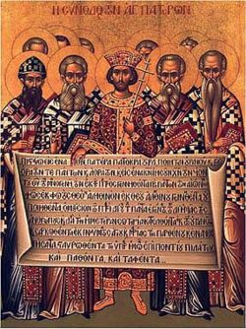
The Council of Nicea
Constantine gets word of the conflict and calls a general council
Solve the date of Easter, approve procedure for re-admission of lapsed, election and ordination of bishops and presbyters; and solve the Arian problem creating a common creed
Bishops reaction to Eusebius of Nicomedia.
Eusebius and Arius Exiled/Excommunicated

Slide 12
The Council of Nicea
The Faith dictated in the Council.
We believe in One God, the Father Almighty, Maker of all things visible and invisible:—
And in One Lord Jesus Christ, the Son of God, begotten of the Father, Only-begotten, that is, from the essence of the Father; God from God, Light from Light, Very God from Very God, begotten not made, One in essence (Homoousias) with the Father, by Whom all things were made, both things in heaven and things in earth; Who for us men and for our salvation came down and was made flesh, was made man, suffered, and rose again the third day, ascended into heaven, and comes to judge quick and dead.
And in the Holy Ghost.
And those who say, 'Once He was not,' and 'Before His generation He was not,' and 'He came to be from nothing,' or those who pretend that the Son of God is 'Of other subsistence or essence ,' or 'created' or 'alterable,' or 'mutable,' the Catholic Church anathematizes.

Slide 13
Notes

Slide 14
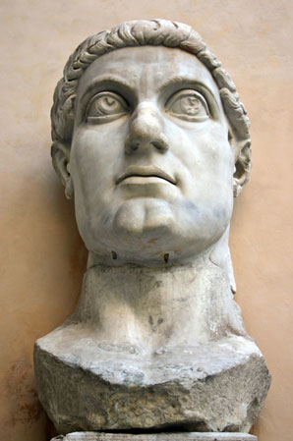
The Council of Nicea
Implications – Church states in the Creed an “un-biblical” tenant.
Sets a precedent – Church appeals to the authority of a magistrate to solve theological conflict
Council and Creed the order of the day for solving theological conflict. The church will now emphasize homogeneity and uniformity.
Not the end of the story… really only the beginning

Slide 15
The Monastic Movement
Begins about Middle of Third Century (250 AD)
Population of Christians is burgeoning
Celibacy, Asceticism, Martyrdom, Desert Solitude, Rejection of Wealth, Anti-establishment, Belief in Carnality of “Flesh”
The Life of St. Anthony
  At 34, sold everything and moved to desert
  Matthew 19:21 ²¹ Jesus said to him, "If you would be perfect, go, sell what you possess and give to the poor, and you will have treasure in heaven; and come, follow me."

Slide 16
Notes

Slide 17
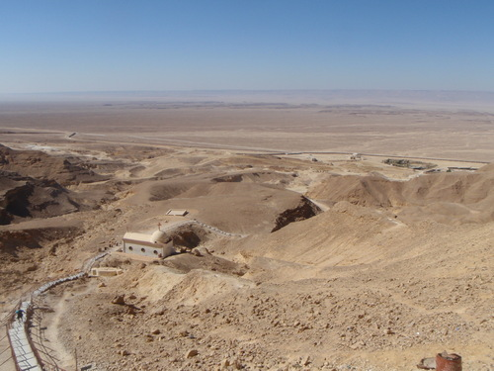

Slide 18
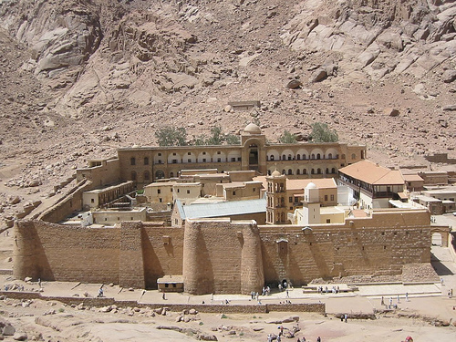

Slide 19
The Monastic Movement
Pachomius (Born in 286 AD)
Pachomius and younger brother began “communal” monastic movement.
Established the pattern of Work and Devotion, economy
Created Hierarchy that extended to multiple monasteries
Those who wished to join would stand at Gate for days before admittance
Monastics vs Church Heirarchy

