Slide 1
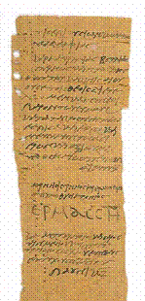
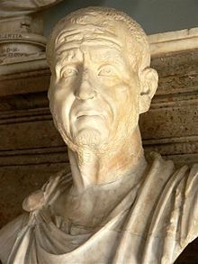
A Cloud of Witnesses: A History of the Early Church
Matthew 7:22-23 ²² Many will say to me on that day, 'Lord, Lord, did we not prophesy in your name, and in your name drive out demons and perform many miracles?' ²³ Then I will tell them plainly, 'I never knew you. Away from me, you evildoers!'

Slide 2

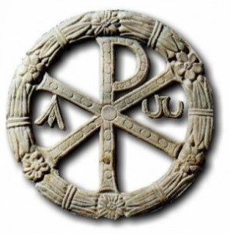
The Decian Persecution
Decius Emperor of Rome from
(249-251)
Empire facing increasing pressure from Gothic invaders, and economic problems
Decius wants to restore the former glory of Rome; sees Christianity as a corruption of tradition
Issues and edict that all people must offer incense before the image of the emperor
Those who had sacrificed would be given a “certificate” signed by an official which affirmed their loyalty.

Slide 3
The Decian Persecution
Christian Response:
They confessed their faith and refused to sacrifice (Confessors)
They fled and went into hiding (Cyprian)
They falsified certificates
They offered incense to the emperor thus denying their faith (The Lapsed)

Slide 4
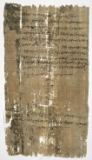
The Decian Persecution
“It has always been my practice to sacrifice to the gods. Now, in your presence, and in accordance with the command, I have sacrificed, poured a libation, and tasted the offering. I beg you to certify this statement…
…I, Aurelia Demos, have presented this declaration. I, Aurelius Ireneus (her husband), have written for her since she is illiterate. I, Arelius Sabinus, the commissioner, saw you sacrificing”

Slide 5
The Decian Persecution
The Controversy:
What to do with the lapsed? (Read Cyprian)
Should lapsed be re-admitted? How long should it take? (Penitential System)
Final Compromise:
  False Documents: Immediately Re-admitted
  Lapsed Repentant: Re-admitted on deathbed, or upon new persecution
  Lapsed Un-Repentant: Never readmitted

Slide 6
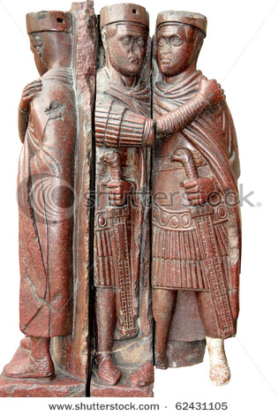
The Decian Persecution
Diocletian (284-305 AD)
Split the Empire into Four: Diocletian, Maximian, Galerius, Constantius Chlorus
Galerius begins persecuting Christians in the Army
Christians removed from governments positions and positions of authority. All books and buildings destroyed.
Christians maimed and enslaved by Galerius.

Slide 7
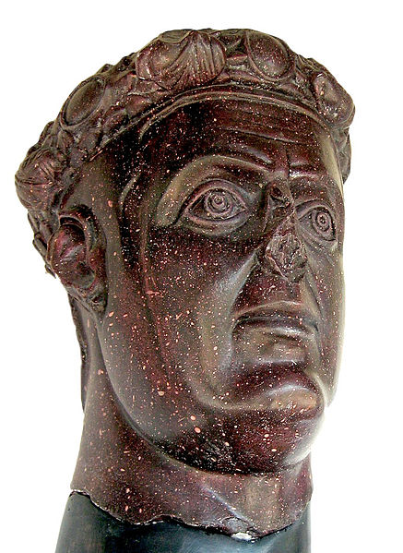
The Decian Persecution
Galerius becomes painfully ill and in 311 and has a change of heart concerning Christianity (Read Galerius Edict)
Galerius Died 5 days later creating a vacuum that Constantine would fill

Slide 8
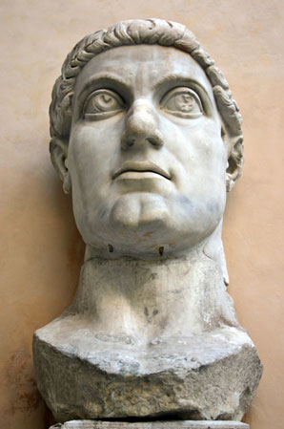
Constantine
Becomes emperor in 312 AD
Establishes Edict of Milan in 313 AD
Read “Edict of Milan”
Eusebius writes Panegyric “Life of Constantine”
The Faith of Constantine

