Slide 1
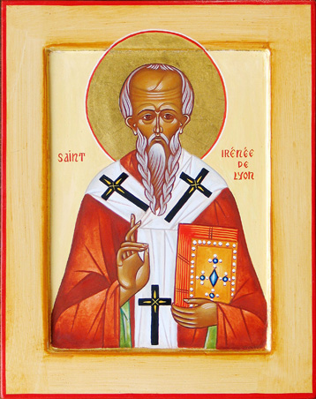
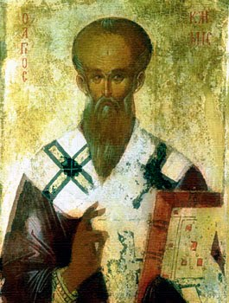
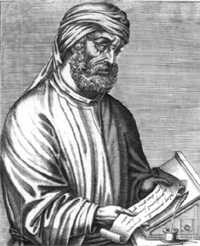
A Cloud of Witnesses: A History of the Early Church
Irenaeus of Lyon
(130-200 A.D.)
Clement of Alexandria
(150-215 A.D.)
Tertullian of Carthage
(150-215 A.D.)

Slide 2

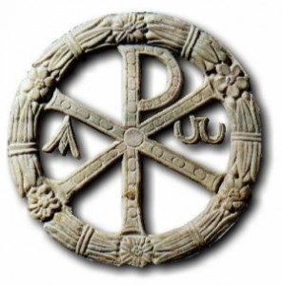
Three Great Men
Why I have chosen these three examples:
All “Church Fathers”, great writers/apologists/theologians
Geographical distribution indicative of Christianity c. 200AD
All connected in some way with heresies discussed last class
Representative of growing theological tension within the church
Their background to a great degree informs their theological approach

Slide 3
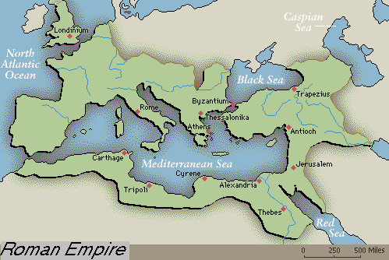
Geographical Distribution

Slide 4
Three Great Men
Irenaeus:
Wrote Against Heresies, mostly against gnostics
Was a Bishop and Pastor, Disciple of Polycarp
Read Excerpt #1
Seems to admonish superfluous inquiry
Begins to expound theologically
  - Trinity, Dual Nature of Christ
  - (read excerpt #2)
  - Creation and Humanity
Irenaeus of Lyon
(130-200 A.D.)

Slide 5
Three Great Men
Clement:
From Athens… (much in common w/ Justin)
Head of catechetical school in Alexandria, Egypt
Well versed in pagan philosophy and literature as well as the Bible
Embraces philosophy, but rejects gnosticism (OT Typology) (Excerpts)
Indicative of the emerging Alexandrian school of Theology
Clement of Alexandria
(150-215 A.D.)

Slide 6
Three Great Men
Tertullian:
From Carthage and reflect Roman pragmatism/conservatism
A Lawyer and exemplary orator
Wrote several works and spoke out against Gnostics and Marcionites
Rejects philosophy as destructive and unnecessary (read excerpt)
Fundamentalist in his approach, follows Montanus and is rejected as “heretic”
Tertullian of Carthage
(150-215 A.D.)

Slide 7
Three Great Men
In Conclusion:
There is increasing tension building in the church between the philosophical approach to theology (Alexandrian) and a traditional approach (Hellenistic Jewish)
By 200AD, humanity’s place in the Universe, Nature of the Trinity, and Dual Nature of Christ increasingly topics of interest
Next Week: Continued Persecution in 3rd Century and the growth of the Church.

