Slide 1
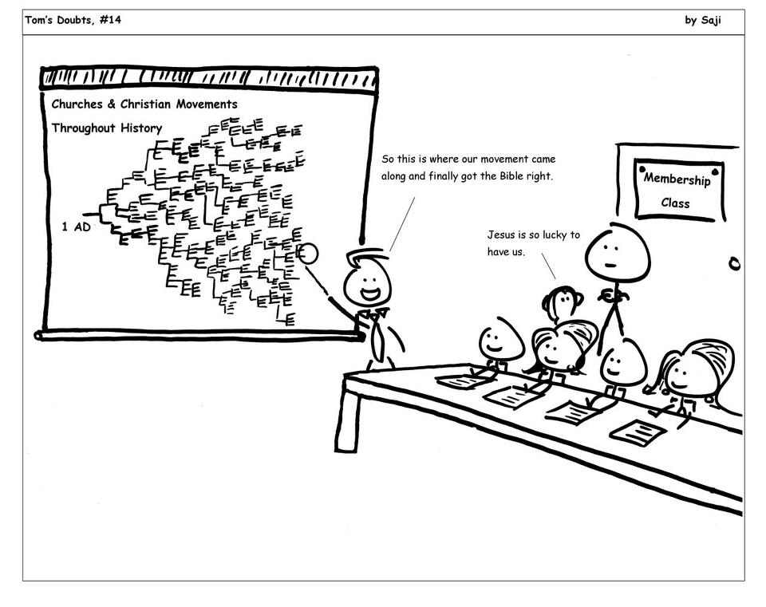
A Cloud of Witnesses: A History of the Early Church

Slide 2

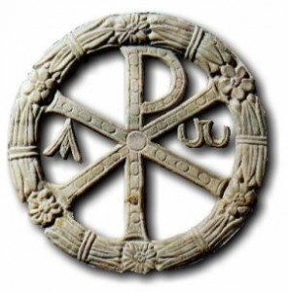
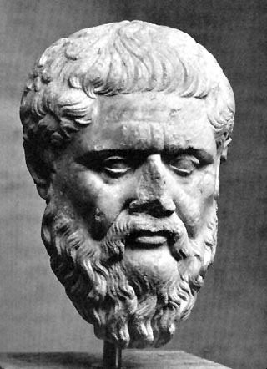
A New Threat
The Benefit and Detriment of Hellenization
Benefits
Church is Interacting with Greco-Roman Religious Thought
Church Attracting Educated Greeks
Greek Philosophy a Rational Tool
Detriments
Anti-Semitism
Syncretism
Heresy

Slide 3
Marcionites
Marcion (80-165 AD)
Son of a Christian bishop in Sinope
Wealthy ship owner and merchant
Began contemplating the nature of evil and teaching contrary to Orthodox Christianity
Irenaeus claims Polycarp called him “the first born of Satan”
Traveled to Rome around 135 AD accepted as Christian
Made a gift of 200,000 Sesterces ($300,000?)
Expelled in 144 AD and given his money back

Slide 4
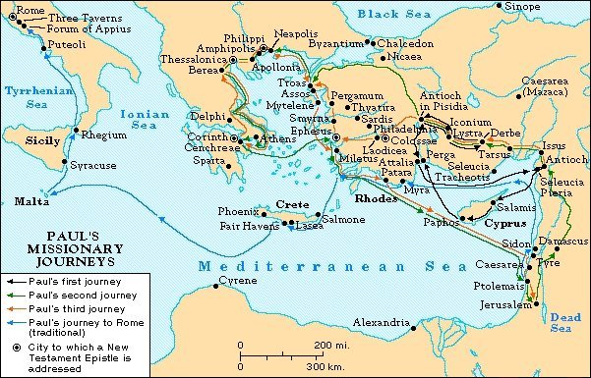
2nd Century Beliefs

Slide 5
Marcionites
Marcion (80-165 AD)
Marcion felt that the OT and the NT contradicted one another
How can we explain a good god allowing evil to exist?
OT God represents justice and retribution
God of the Jews alone, not Christianity
Christ represents God of Love and Mercy
Marcion’s Canon
  Luke, 10 Letters of Paul, Contradictions

Slide 6
Marcionites
2 Thessalonians 1:6-9 ⁶ God is just: He will pay back trouble to those who trouble you ⁷ and give relief to you who are troubled, and to us as well. This will happen when the Lord Jesus is revealed from heaven in blazing fire with his powerful angels. ⁸ He will punish those who do not know God and do not obey the gospel of our Lord Jesus. ⁹ They will be punished with everlasting destruction and shut out from the presence of the Lord and from the majesty of his power
Galatians 3:16-17 ¹⁶ The promises were spoken to Abraham and to his seed. The Scripture does not say "and to seeds," meaning many people, but "and to your seed," meaning one person, who is Christ. ¹⁷ What I mean is this: The law, introduced 430 years later, does not set aside the covenant previously established by God and thus do away with the promise. … ²⁹ If you belong to Christ, then you are Abraham's seed, and heirs according to the promise.

Slide 7
Notes

Slide 8
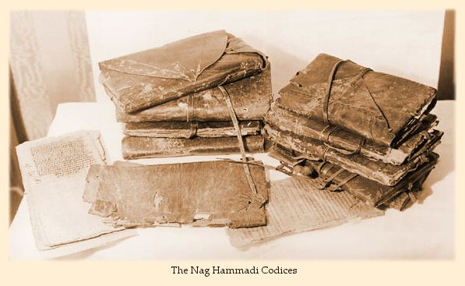
The Gnostics
Nag Hammadi Codices discovered in Egypt in 1945

Slide 9
The Gnostics
Question: What do the Gnostics believe?
Answer: That’s a very good question!
There is no such thing as a centralized gnostic theology, and that’s part of the problem with Gnosticism.
My Opinion: Gnostics represent an ill-attempted yet highly imaginative effort to syncretize paganism, Hellenistic philosophy, Judaic mythology, and Christianity.

Slide 10
Review of Platonism
Platonists -- believed in “forms” or transcendent, perfect archetypes, of which objects in the everyday world are imperfect copies. In the Republic the highest form is identified as the Form of the Good, the source of all other forms, which could be known by reason.
The Demiurge: Creator and maintainer of the Physical World.

Slide 11

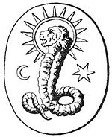
Ultimate, Unknowable, Good, Perfect, God, VERY remote from humanity and material Universe
First Thought
Or
“Barbelo”
Contemplates Perfection
Jesus
Aeon
Aeon
Aeon
Arc
Aeon
Arc
Arc
Aeon
Arc
Arc

Slide 12
Notes

Slide 13
The Gnostics
“First I went up to this perfect aeon. And it is to you ( John) that I speak these things so that you might write them down and give them in secret to your fellow spirits. For this mystery belongs to the immovable generation.”
-- The Secret Gospel of John
Gnosis: “Knowledge” insinuates “spiritual enlightenment”
This was knowledge for the elect
“There is no bridal chamber for the beast for the slaves” but for “free men and virgins”
-- Gospel of Phillip

Slide 14
The Montanists
Montanus: Ex- Cybele Priest, accompanied by two “prophetesses” Prisca and Maximilla.
The “Parousia” would take place 15 miles east of Philadelphia
Prophesied in gibberish, God spoke to them in Ecstasy or in dreams
“I am driven as a wolf from the sheep. I am not a wolf. I am word, spirit, and power.”

Slide 15
The Montanists
The character of the times in which we live is such as to call forth from us even this admonition, that we ought not to be astonished at the heresies (which abound) neither ought their existence to surprise us, for it was foretold that they should come to pass; nor the fact that they subvert the faith of some, for their final cause is, by affording a trial to faith, to give it also the opportunity of being approved. (1 Corinthians 11:19) Groundless, therefore, and inconsiderate is the offense of the many who are scandalized by the very fact that heresies prevail to such a degree. How great might their offense have been if they had not existed. When it has been determined that a thing must by all means be, it receives the final cause for which it has its being. This secures the power through which it exists, in such a way that it is impossible for it not to have existence..
-- Tertullian Prescription Against Heretics
1 Corinthians 11: ¹⁸In the first place, I hear that when you come together as a church, there are divisions among you, and to some extent I believe it. ¹⁹ No doubt there have to be differences among you to show which of you have God’s approval.

Slide 16
Resources
Judas and the Gospel of Jesus: Have We Missed the Truth about Christianity?
-- N.T. Wright
Cities of God: The Real Story of How Christianity Became an Urban Movement and Conquered Rome
-- Rodney Stark
The Truth About Jesus and the "Lost Gospels": A Reasoned Look at Thomas, Judas, and the Gnostic Gospels
-- David Marshall
The Gnostic Gospels
-- Elaine Pagels
The Lost Gospel of Judas Iscariot: A New Look at Betrayer and Betrayed
-- Bart Ehrman

