Slide 1
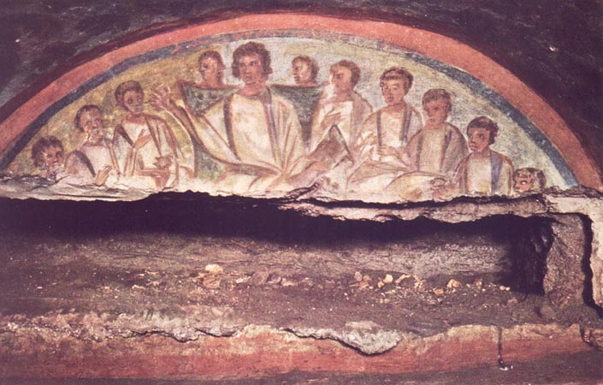
A Cloud of Witnesses: A History of the Early Church
They live in their own countries, but as sojourners. They fulfill all their duties as citizens, but they suffer as foreigners. They find their homeland wherever they are, but their homeland is not in any one place… they are in the flesh, but do not live according to the flesh. Thy live on earth, but are citizens of heaven. They obey all laws, but they live at a level higher than that required by the law. They love all, yet all persecute them.
- To Diognetus V. 1-11

Slide 2

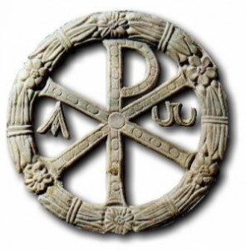
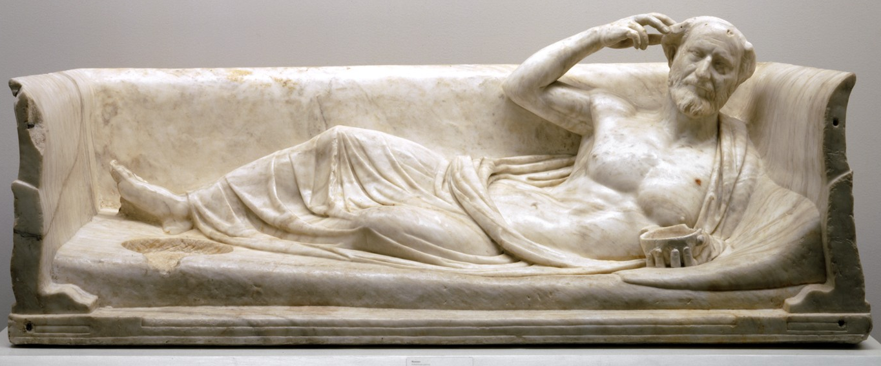
2nd Century Culture
Tibur is my native place, Flavius Agricola my name. Yes. I’m the one you see reclining here, just as I did all the years of life fate granted me, taking good care of my little self and never going short of wine. Primitiva, my darling wife, passed away before me, a Flavian too, a chaste worshiper of Isis, attentive to my needs and graced with every beauty. Thirty blissful years we spent together… Friend who reads this, do my bidding. Mix the wine, drink deep, wreathed with flowers, and do not refuse to pretty girls the sweets of love. When death comes, earth and fire devour everything.

Slide 3
2nd Century Culture
2nd Century Roman empire was a unprecedented time of peace and relative prosperity.
“Wars have so far vanished as to be legendary affairs of the past… A man simply travels from one country oanother as though it were his native land. We are no longer frightened by the Cilician pass or by the narroe sandy tracks that lead from Arabia into Egypt. We are not dismayed by the height of mountains, or by the vast breadth of river or by inhospitable tribes of barbarians. To be a Roman citizen, nay even one of your [Rome’s] subjects is a sufficient guarantee of personal safety.”
- Aelius Aristides of Smyrna c. 150AD

Slide 4
Notes

Slide 5
2nd Century Beliefs
Cynics – The purpose of life was to live a life of virtue in agreement with nature. This meant rejecting all conventional desires for wealth, power, health, and fame, and by living a simple life free from all possessions. As reasoning creatures, people could gain happiness by rigorous training and by living in a way which was natural for humans.
Stoics – The Stoics believed that destructive emotions resulted from errors in judgment, and that a sage, or person of "moral and intellectual perfection," would not suffer such emotions. Stoics were concerned with the active relationship between cosmic determinism and human freedom, and the belief that it is virtuous to maintain a will that is in accord with nature. Because of this, the Stoics presented their philosophy as a way of life, and they thought that the best indication of an individual's philosophy was not what a person said but how he behaved.

Slide 6
2nd Century Beliefs
Sophists – a category of teachers who specialized in using the tools of philosophy and rhetoric for the purpose of teaching excellence, or virtue predominantly to young statesmen and nobility. The practice of charging money for education (and providing wisdom only to those who can pay) led to the condemnations made by Plato (through Socrates in his dialogues)
Epicureans -- believed that pleasure is the greatest good. But the way to attain pleasure was to live modestly and to gain knowledge of the workings of the world and the limits of one's desires. This leads one to attain a state of tranquility and freedom from fear, as well as absence of bodily pain. The combination of these two states is supposed to constitute happiness in its highest form.

Slide 7
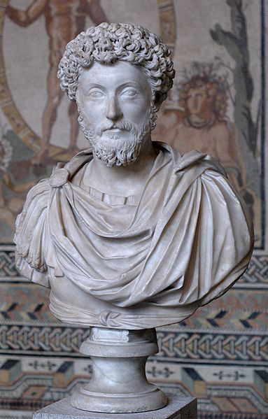
2nd Century Beliefs
Platonists -- believed in “forms” or transcendent, perfect archetypes, of which objects in the everyday world are imperfect copies. In the Republic the highest form is identified as the Form of the Good, the source of all other forms, which could be known by reason.
Marcus Aurelius
“There is one cosmos made up of all things, and one God that goes through all things, and on substance, one law, reason common to all intelligible beings”
(yet how far Providence or the gods were concerned with individual and their problems was a mystery)

Slide 8
Notes

Slide 9
Christianity and Culture
“By the mid-second century, the various philisophical schools seemed to have reached the end of the road. Their debates led to endless questioning without the possibility of finding answers. Exasperation turned at times into mockery of their predicament… others, however were less amused, and it was from these angry and disillusioned individuals as well as from plebeians and educated but dissatisfied women that Christianity was beginning to draw it’s recruits.”
- W.H.C. Frend The Rise of Christianity
Conversion story of Justin Martyr

Slide 10
Accusation #1
Accusation:
Christians are Atheists, they worship no visible Gods
Response:
Many of your own philosophers don’t believe in the Gods
Your “gods” are morally reprehensible and only created to give license to human vice
“gods” that are made of gold and precious stone have to be guarded from thieves. Why can’t they protect themselves?

Slide 11
Accusation #2
Accusation:
Christians are immoral and incestuous: They have secret orgies and eat the flesh of children
Response:
It is the pagans who are immoral, in fact you worship gods who do such things and practice them under the guise of worship.
Christians are distinctly moral, the rules of our conduct are such that even evil thoughts are not permissible.
We do not eat flesh and in fact we abhor bloodshed, in fact it is the pagans who expose their unwanted infants.

Slide 12
Accusation #3
Accusation:
Christians are socially subversive because they refuse to worship the emperor
Response:
True we do not worship the emperor or anything else but God, BUT
We are loyal subjects of the empire, who pray for the emeror and empire alike
What the emperor really need is not to be worshiped but to be served and the best service we can give to him is to pray for the empire to the only true God.

Slide 13
Accusation #4
Accusation:
Christianity is a barbarian religion and not in the same class as Greek learned philosophies
Response:
The only things the Greeks know they learned from barbarians: Geometry: Egyptians, Writing: Phoenicians
In fact the writings of Moses predate those of Plato and Homer so must be the origin of Greek “Wisdom.” Even worse the Greeks have twisted that wisdom because the have misunderstood it. What you know in part, we know in full.

Slide 14
Apologists
List of Apologists for further study:
Epistle to Diognetus (150 A.D.)
Justin Martyr (1st & 2nd Apology, Dialogue with Trypho)
Tatian Address to the Greeks
Athenagoras Plea for the Christians, On the Resurrection of the Dead.
Theophilus Bishop of Antioch Three Books to Autolycus

Slide 15
Notes

