Slide 1

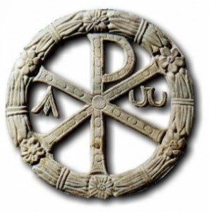
Theology of the Early Church
By c. 100, “normative Christianity” was beginning to emerge as a distinct religion within the general cultural framework of Hellenistic Judaism. A body of teaching was becoming established to which appeal could be made. Its authenticity could be guaranteed by reference to the apostles and to Christ himself. It was represented by an ordered hierarchy that could claim descent from apostolic times. Geographically, its strength lay in the main seaport towns of the eastern Mediterranean, where communications were relatively swift, and in cities such as Philippi that were situated on the main trunk routes of the empire. Bishops of these cities were already in communication with each other, ensuring thereby a certain uniformity of outlook within their congregations.
-- W.H.C Frend The Rise of Christianity
c. 100 A.D. ~7,434 Christians/ 60 million Population of Roman Empire

Slide 2
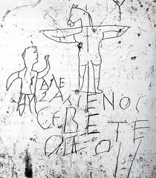
A Cloud of Witnesses: A History of the Early Church
“Alexamenos Worships God”
c. 200 AD Rome

Slide 3
Persecution
Reclaiming the term “Martyr”
Marturew = Bear witness to, declare, confirm
Two particular ways the church would bear witness:
Apology: apologia = a verbal defense
Execution: Not only did the church bear theological persecution but physical persecution.

Slide 4
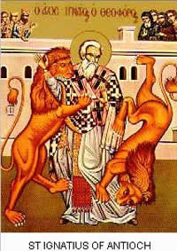
Martyrdom
Three Documents that highlight early Christian persecution:
Letter of Pliny the Younger to Emperor Trajan c. 110AD
Letters of Ignatius of Antioch c. 110 AD
Martyrdom of Polycarp c 150 AD

Slide 5
Notes

Slide 6
Notes

