Slide 1
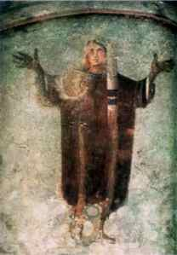
A Cloud of Witnesses: A History of the Early Church
“In the catacombs, the most frequent image is the figure of a woman in prayer, the Orant; she represents the one true attitude of the human soul. It is not enough to say prayers; one must become, be prayer, prayer incarnate. It is not enough to have moments of praise. All of life, each act, every gesture, even the smile of the human face, must become a hymn of adoration, an offering, a prayer. One should offer not what one has, but what one is.”
- Paul Evdokimov, The Sacrament of Love , p. 62.

Slide 2
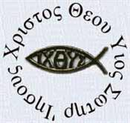
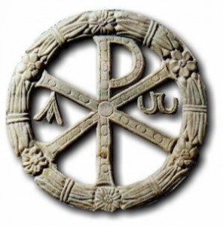
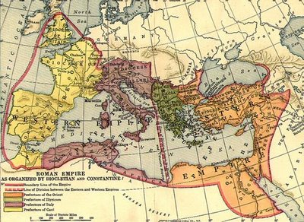
The Early Christian World
Common Language
Diaspora Judaism
Relative Peace (Pax Romana)
Trade Routes / Roads
Ripe with Philosophy / Religion
Matthew Chapter 9
³⁷ Then he said to his disciples, “The harvest is plentiful but the workers are few. ³⁸ Ask the Lord of the harvest, therefore, to send out workers into his harvest field.”

Slide 3
Theology of the Early Church
A Few Points:
The theology of the church has never been perfectly uniform
Jesus did not leave the church with a manual and a catechism (Peter’s Kosher Experience)
Challenges:
    Widespread Illiteracy, lack of education
    Geographical Dispersion
    Cultural Differences
    Lack of real authority
    Few Resources
    Constant Resistance from Jewish/Pagan Authorities
    Creep of Philosophical/Religious Ideas
    Cultural Isolation
How was there uniformity at all?

Slide 4
Theology of the Early Church
Theological Tension in the New Testament:
Paul: Apostle to the Gentiles
Romans 3:28 ²⁸ For we maintain that a man is justified by faith apart from observing the law…..
4:2-5 ² If, in fact, Abraham was justified by works, he had something to boast about-- but not before God. ³ What does the Scripture say? "Abraham believed God, and it was credited to him as righteousness." ⁴ Now when a man works, his wages are not credited to him as a gift, but as an obligation. ⁵ However, to the man who does not work but trusts God who justifies the wicked, his faith is credited as righteousness.

Slide 5
Theology of the Early Church
James: Leader of the Jerusalem Church
James 2:17-26 ¹⁷ In the same way, faith by itself, if it is not accompanied by action, is dead. ¹⁸ But someone will say, "You have faith; I have deeds." Show me your faith without deeds, and I will show you my faith by what I do. ¹⁹ You believe that there is one God. Good! Even the demons believe that-- and shudder. ²⁰ You foolish man, do you want evidence that faith without deeds is useless? ²¹ Was not our ancestor Abraham considered righteous for what he did when he offered his son Isaac on the altar? ²² You see that his faith and his actions were working together, and his faith was made complete by what he did. ²³ And the scripture was fulfilled that says, "Abraham believed God, and it was credited to him as righteousness," and he was called God's friend. ²⁴ You see that a person is justified by what he does and not by faith alone. ²⁵ In the same way, was not even Rahab the prostitute considered righteous for what she did when she gave lodging to the spies and sent them off in a different direction? ²⁶ As the body without the spirit is dead, so faith without deeds is dead.

Slide 6
Notes

Slide 7
Theology of the Early Church
The Jerusalem Council (Cultural/Theological Tension)
Please Read Acts 15:1-33
We begin to see the formation of a church structure… why? To govern correct teaching.
2 Peter 3:15-17 ¹⁵ Bear in mind that our Lord's patience means salvation, just as our dear brother Paul also wrote you with the wisdom that God gave him. ¹⁶ He writes the same way in all his letters, speaking in them of these matters. His letters contain some things that are hard to understand, which ignorant and unstable people distort, as they do the other Scriptures, to their own destruction. ¹⁷ Therefore, dear friends, since you already know this, be on your guard so that you may not be carried away by the error of lawless men and fall from your secure position.

Slide 8
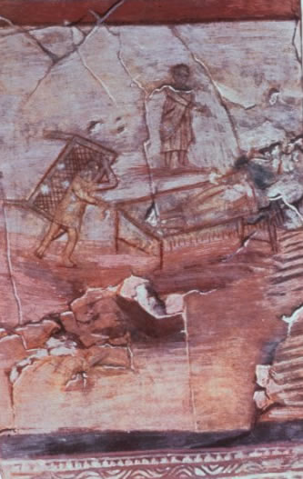
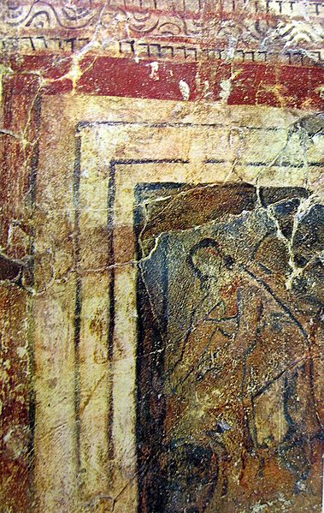

Slide 9
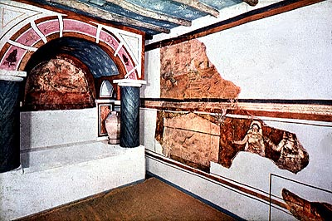

Slide 10
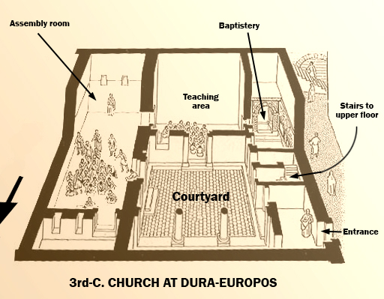

Slide 11
Notes

Slide 12
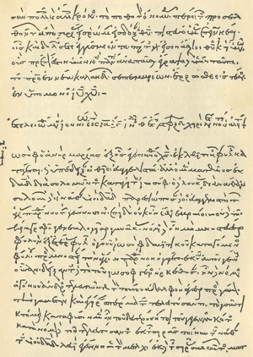
Theology of the Early Church
The Didache (90AD):
Discuss:
What stuck out to you about this passage?
What are the major concerns of the Author?
How is he asking the church to respond?

Slide 13
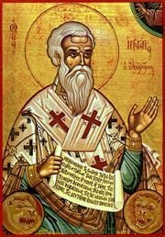
Theology of the Early Church
Ignatius of Antioch (110 AD):
Docetism:
From Greek DOKEO meaning “to seem”
What was his solution to “Heresy?”
The Rule of Faith

Slide 14
Notes

