Slide 1
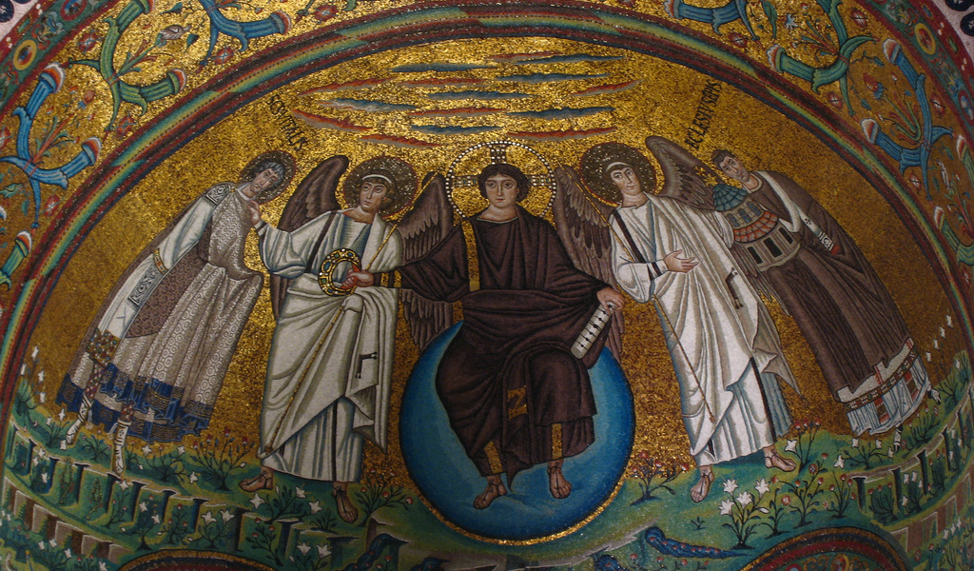
A Cloud of Witnesses: A History of the Early Church
Hebrews 12:11
Therefore, since we are surrounded by such a great cloud of witnesses, let us throw off everything that hinders and the sin that so easily entangles. And let us run with perseverance the race marked out for us

Slide 2

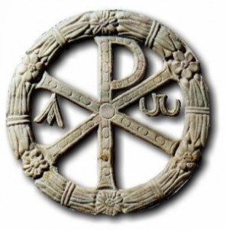
Introduction
Table Discussions:
  Who are you?
  Where you from?
  What do you hope to learn in this class?
Now tell me: What are you hoping to get out of this class?

Slide 3
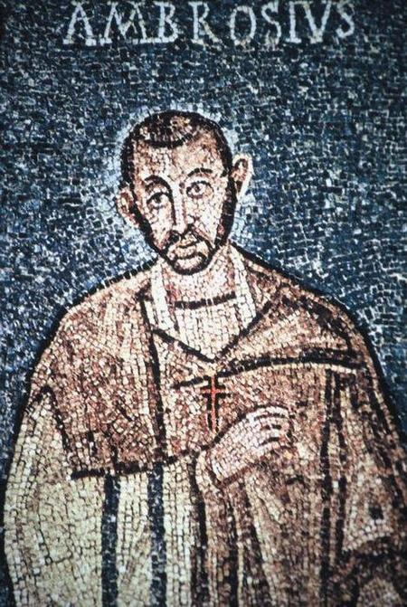
Course Content: What I Hope to Share
~ 70 AD to ~400 AD
How the Church grew and changed over time
How the Church was organized over time.
Heresies and Church’s Response (Doctrine)
Persecution of the Church
Fathers of the Church
Art and Architecture

Slide 4
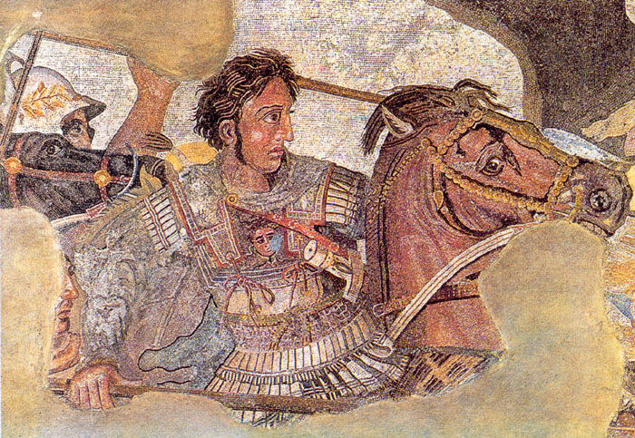
In Medias Res
We are starting at A Beginning but not THE Beginning
We have to establish context, or set the stage for our play
Four key historical turning points that helped shape the world we will be studying for the next twelve weeks.
  722 B.C. and 586 B.C.
  323 B.C.
  63 B.C.
  70 A.D.
The church existed in a historical context and was to a great degree shaped by that context.

Slide 5
Notes

Slide 6
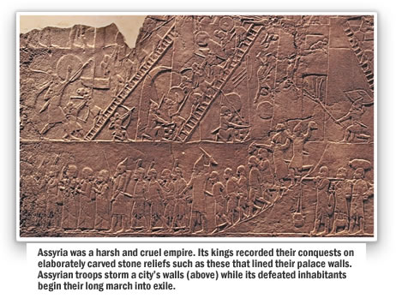
722 B.C. & 586 B.C.
722 BC: Destruction of Northern Israel by Assyria, Subsequent Exile
586 BC: Destruction of Judah or Southern Israel, but the Babylonians “Babylonian Captivity”

Slide 7
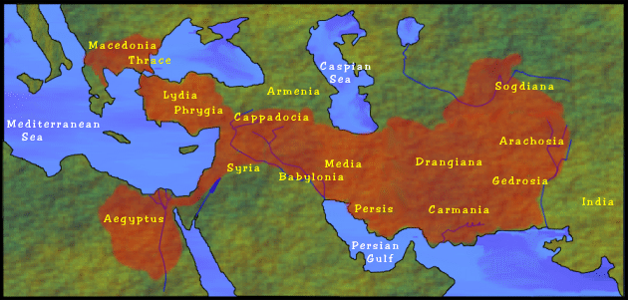
323 B.C.
Alexander the Great of Macedon Conquers his empire

Slide 8
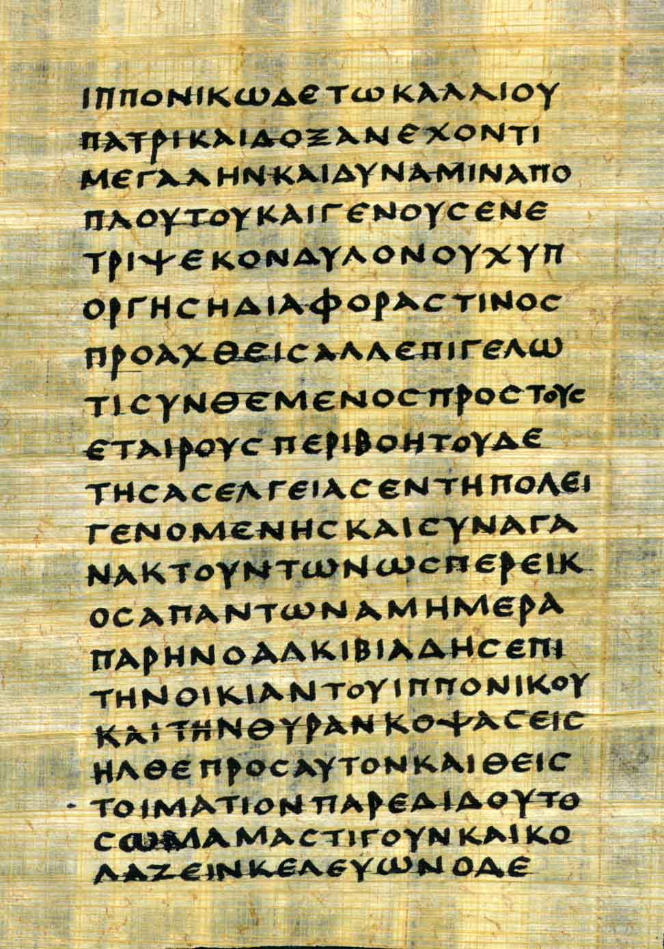
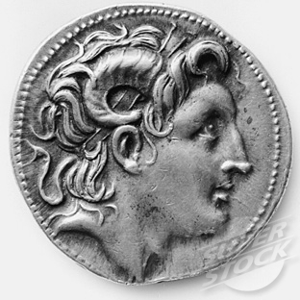
323 B.C.
Why is this important?
Spreads the Greek language (a common language)
Facilitates trade/exchange of cultures and ideas
Alexander Established idea of Monarch as God

Slide 9
Notes

Slide 10
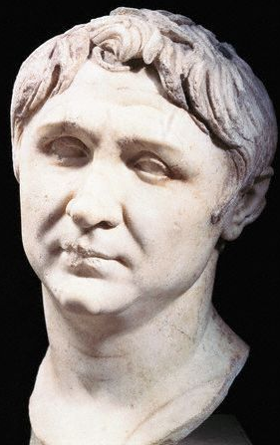
63 B.C.
"Roman control of Judaea was first established by Gnaeus Pompey. As victor he claimed the right to enter the Temple, and this incident gave rise to the common impression that it contained no representation of the deity - the sanctuary was empty and the Holy of Holies unattended.“
-Tacitus

Slide 11
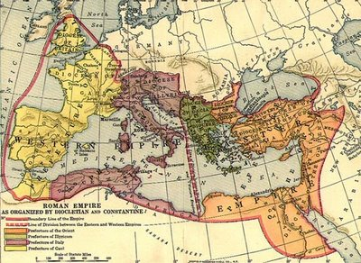
63 B.C.

Slide 12
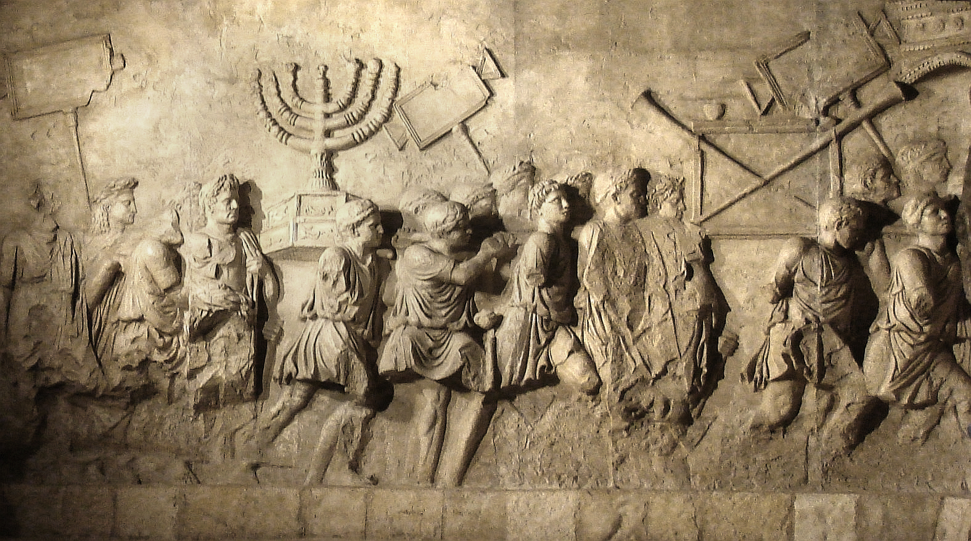
70 A.D.
Roman Destruction of Jerusalem, Temple Destroyed

Slide 13
The Early Christian World
Common Language
Diaspora Judaism
Relative Peace (Pax Romana)
Trade Routes / Roads
Ripe with Philosophy / Religion
Matthew Chapter 9
³⁷ Then he said to his disciples, “The harvest is plentiful but the workers are few. ³⁸ Ask the Lord of the harvest, therefore, to send out workers into his harvest field.”

Slide 14
Notes

