Slide 1
Mobile Marketing

Slide 2
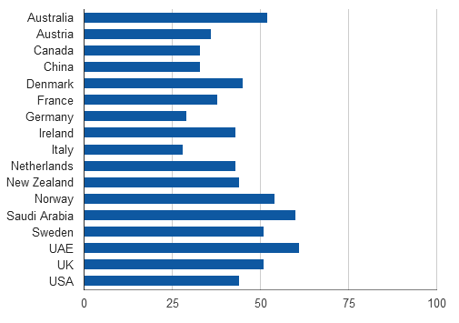
Smartphone Penetration
Notes:
http://www.thinkwithgoogle.com/mobileplanet/en/
http://www.thinkwithgoogle.com/insights/library/infographics/mobile-movement/

Slide 3
Smartphone Penetration
Australia, UK, Sweden, Norway, Saudi Arabia and UAE each have more than 50 percent of their population on smartphones.
An additional seven countries—U.S., New Zealand, Denmark, Ireland, Netherlands, Spain and Switzerland—now have greater than 40 percent smartphone penetration.
In the U.S., 80 percent of smartphone owners say they don’t leave home without their device—and one in three would even give up their TV before their mobile devices!

Slide 4
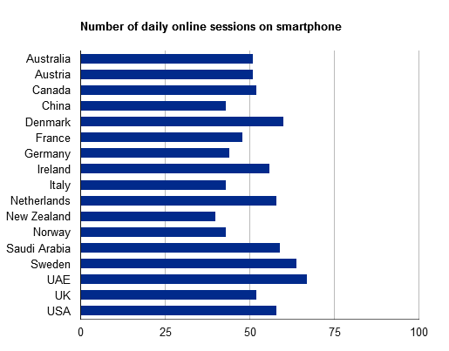
Internet Usage on Smartphone

Slide 5
Internet Usage on Smartphone
More than 60% of smartphone users in Denmark, UAE and Sweden access internet multiple times a day.
More than 50% Smartphone users in Australia, Austria, Canada, Ireland, Netherlands, Saudi Arabia, UK and US access internet multiple times in a day.
All of the shown countries are above 40% mark which means atleast 40% of users access internet multiple times a day on their phones.

Slide 6
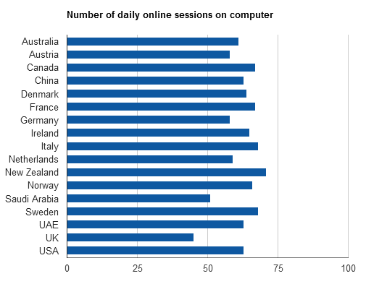
Internet Usage – Smartphone v/s Computers

Slide 7
Internet Usage – Smartphone v/s Computers
Although for most of the countries, more than 60% users use their computers to access internet multiple times a day but this number is just a little ahead of the smartphone usage to access the internet
Moreover, in some countries like UK and Saudi Arabia, internet access on smartphone has become more as compared to internet access through computers.

Slide 8
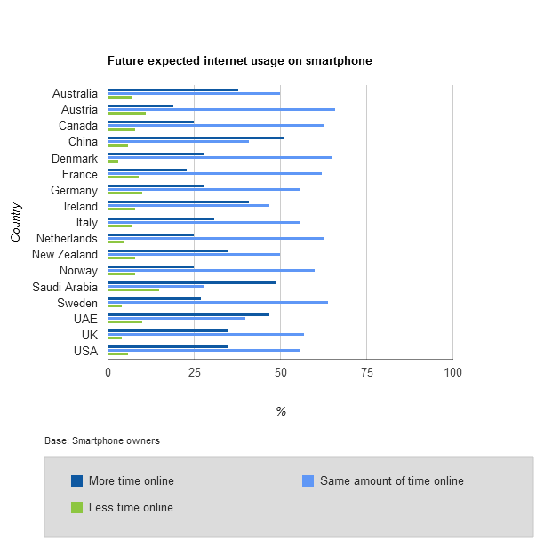
Future Expected Internet Usage On Smartphone

Slide 9
Future Expected Internet Usage On Smartphone
In most of the countries, more than 25% users expect to increase their internet usage on smartphones.
Whereas in most of the countries, only less than 10% users expect to lessen their internet usage on smartphones.

Slide 10
Browsing Satisfaction on Smartphones

Slide 11
Browsing Satisfaction on Smartphones
More than 35% users in most countries are satisfied with browsing on smartphones.
Whereas only less than 10% users in most countries are dissatisfied with browsing on smartphones. Only Sweden and France seem to have high dissatisfaction rates.
15 – 30% users are completely satisfied with their browsing experience on the smartphones.
Whereas only less than 5% users are completely dissatisfied in most of the cases.

Slide 12
General Smartphone Activities

Slide 13
General Smartphone Activities
More than 50% of users in almost all countries do a product search on their smartphones.
25% - 35% of users make a purchase through their smartphones.
65% - 75% percent users make general searches on their smartphones.
Nearly 8 – 30% users make use of online/mobile coupons.

Slide 14
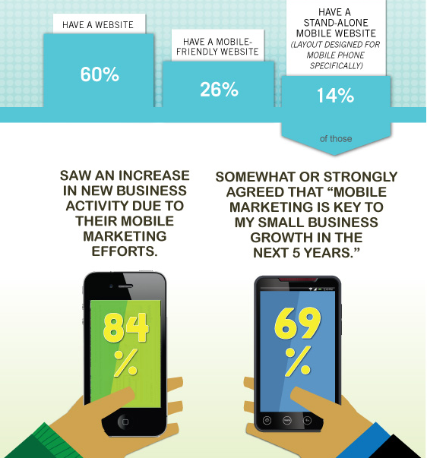
A Survey By Web.com
Web.com released the results of its small business mobile survey in May 2012.
This survey was conducted among 500 small business owners.
While 60% of small businesses surveyed have a website, only 26% have a mobile-friendly website (same layout/content as standard site adjusted to suit your smartphone screen) while an even smaller percentage - 14% of small business owners have a stand-alone mobile website (content/layout designed specifically for mobile purposes)
Notes:
http://ir.web.com/releasedetail.cfm?ReleaseID=670104
http://www.networksolutions.com/smallbusiness/smbmobileinfographic/?channelid=P99C425S627N0B142A1D38E0000V100

Slide 15
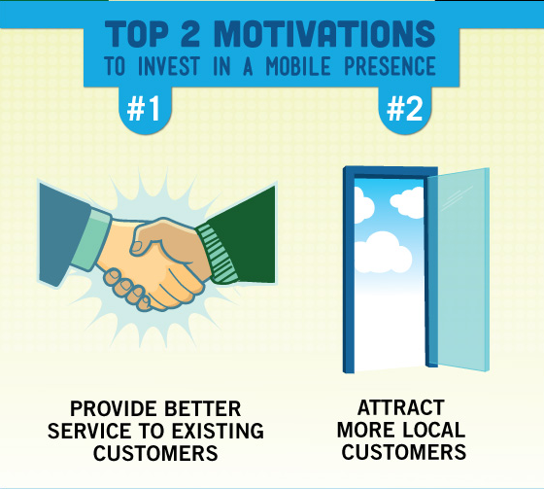
Motivations to Invest in Mobile Marketing
Small business owners indicated the following as their top three motivations to invest in mobile marketing:
Provide better service to existing customers (38%)
Attract more local customers (36%)
Gain competitive advantage (34%)
Notes:
http://ir.web.com/releasedetail.cfm?ReleaseID=670104

Slide 16
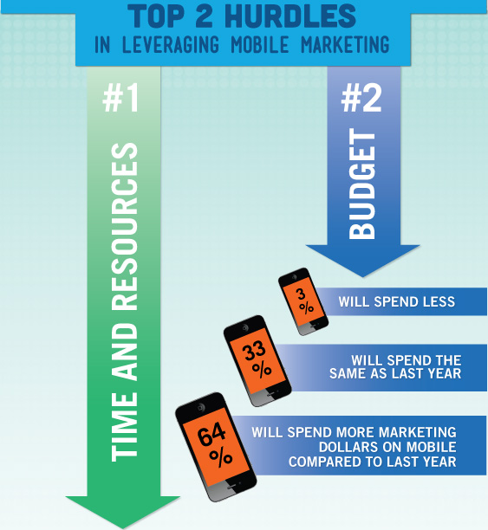
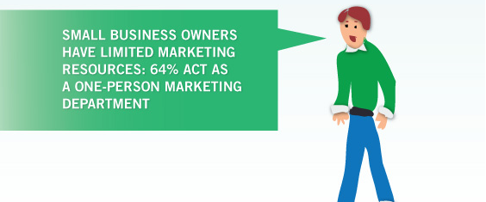
Hurdles in Implementing Mobile Marketing
Time and resource limitations prevent small businesses from entertaining new solutions to market themselves
64% of small business owners surveyed expressed an intention to increase their mobile investments this year, with only 33% indicating that their mobile spend this year will remain the same as last year.

Slide 17
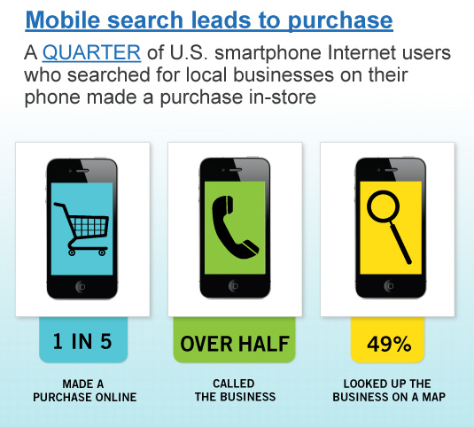
Mobile Search Leads to Purchase
Out of the 500 small business owners surveyed, 14% have a stand-alone mobile website, of which 84% indicated that they have seen an increase in new business activity due to their mobile marketing efforts.

Slide 18
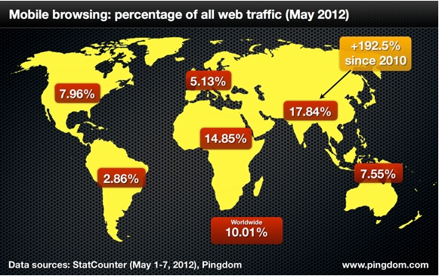
Increasing Share of Mobile Devices In Web Traffic
Notes:
http://royal.pingdom.com/2012/05/08/mobile-web-traffic-asia-tripled/

Slide 19
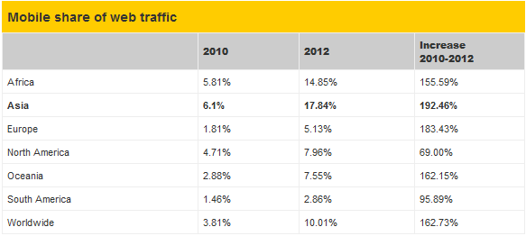
Increasing Share of Mobile Devices In Web Traffic
Notes:
http://royal.pingdom.com/2012/05/08/mobile-web-traffic-asia-tripled/

Slide 20
Increasing Share of Mobile Devices In Web Traffic
In the U.S., 7.96% of all Web traffic comes from mobile devices, according to data from StatCounter.
In Asia mobile traffic climbed from 6.1% to 17.84% between 2010 and 2012, an increase of 192%.
The percentage of mobile Web traffic in Africa climbed from 5.81% to 14.85% between 2010 and 2012, an increase of 156%.
Every region saw increased mobile traffic, with South America falling in last place with 2.86%.
Some countries have already passed 50% of web traffic coming from mobiles.
Notes:
http://www.informationweek.com/news/mobility/smart_phones/240000155

Slide 21

Case Study – The Los Angeles County Fair
Notes:
http://www.mobilemarketer.com/cms/resources/case-studies/7900.html

Slide 22
Case Study – Why Heals.co.uk Switched to a Mobile Website
Heals.co.uk is a furniture and interiors ecommerce store.
Heals.co.uk was experiencing an increased mobile traffic to their website.
About 15% of their traffic was coming from mobile devices
So they decided to switch to a mobile-optimized web site as they felt it important to give their customers using smartphones a better, faster and easier shopping experience.
Notes:
http://www.internetretailer.com/2012/02/23/five-fold-increase-mobile-traffic-spurs-retailer-act

Slide 23
Case Study – New Look Increased Sales by 45% After Launching a Mobile Site
New Look is a fashion retailer who launched their mobile website in April 2011
The retailer claimed mobile sales increased 500% year-on-year, with a 60% increase in orders and 45% increase in sales between April and July 2011.
"We've seen some incredible results since going live with our mobile internet site in April, totally exceeding initial key performance indicators (KPIs)," said Dom McBrien, multi-channel director at New Look.

Slide 24
Case Study – Gap Triples Online Conversions With Mobile
Specialty retailer Gap Inc. claims that the increase in shopping on its mobile site is one of the major reasons why it has tripled its online conversions.
Gap pointed out that online conversion rate lifts can also be attributed to the company’s new mobile commerce platform.
Notes:
http://www.mobilemarketer.com/cms/news/commerce/11224.html

Slide 25
Mobile is Growing
According to Deloitte - Mobile influence factor” (or effect of smartphones on in-store sales) on retail purchases will increase to $689 billion (or 19% of total store sales) by 2016, up from the current influence factor of $159 billion (or 5.1% of sales).
Notes:
http://www.mediapost.com/publications/article/177740/deloitte-smartphones-helping-not-hurting-retail.html#ixzz1zwv6TKVY

