Slide 1

BIOL 1132
Lab Syllabus
Fall 2025
Section: 308
Lab Day/Time: Tuesday 4:00-5:50PM
Instructor Name: Ben Hendrickson
Email: BenHendrickson@my.unt.edu
Office: ENV 334 “The Pit”
Office Hours: Friday 2-4PM
- Virtual by appointment (preferred)

Slide 2
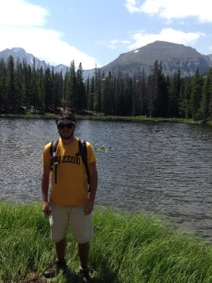
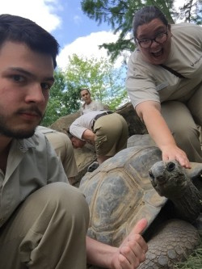
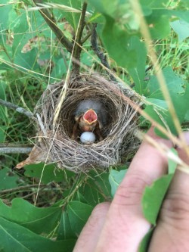
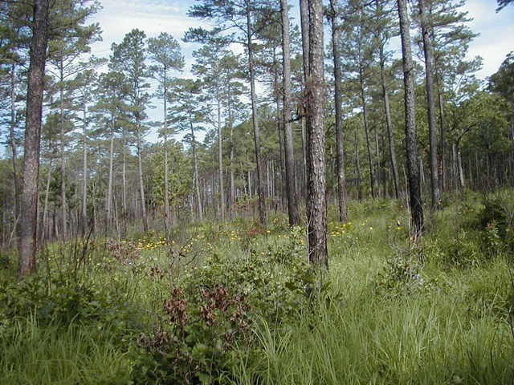
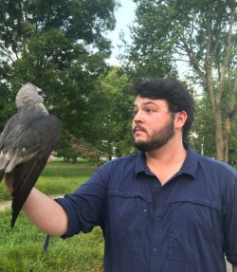
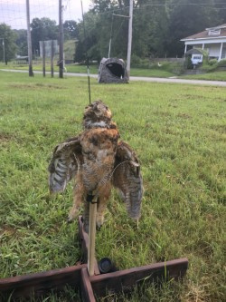
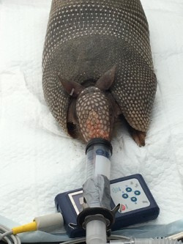
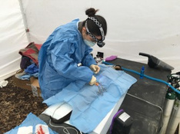
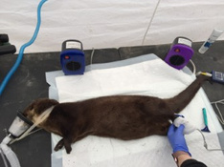
Ben Hendrickson – TA for .502
B.A. in Biological Sciences - University of Missouri - Columbia (Mizzou). While there, I studied...
Other Activities: Academic Peer Advisor - Department of Biological Sciences
Rocky Mountain ecology in Colorado
Animal behavior at the St. Louis Zoo
Avian ecology with the Missouri Ozark Forest Ecosystem Project
Shortleaf Pine population genetic diversity and population structure
M.S. in Biological Sciences - Southern Illinois University - Carbondale (SIUC). While there...
Other Activities:
Director of K-12 Outreach (Vice-President) and Director of Community Outreach (President) - SIU Graduate Research Assistants Supporting Science
Zoology Department Representative - SIU Graduate and Professional Student Council
Graduate Representative - SIU Graduate Council
Studied Mississippi Kite distribution, abundance, and habitat selection in southern Illinois.
Helped implant transmitters in River Otter and Armadillo

Slide 3
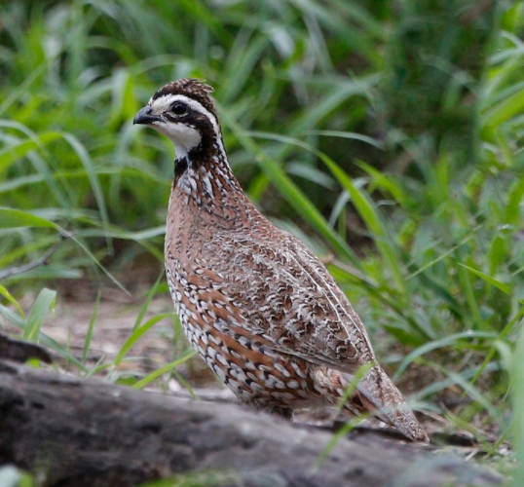
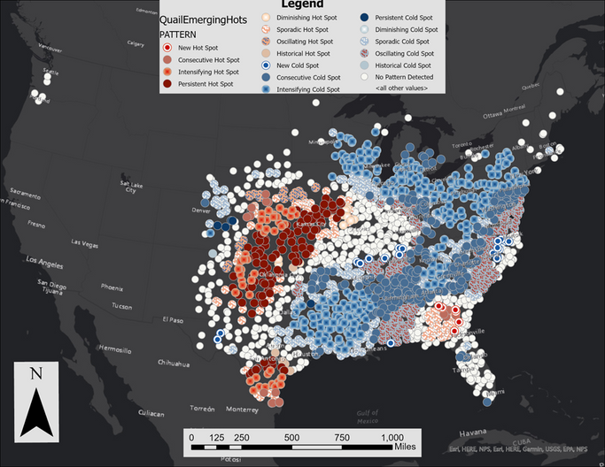
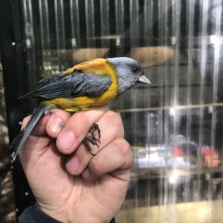
From the Midwest to Texas...
PhD Student in the Department of Biological Sciences (Dr. Andrew Gregory’s lab)
studying wildlife (avian) spatial ecology.
Dissertation title: From North American Grasslands to Sub-Antarctic Forests: Ecological Insights and Conservation Strategies for Avian Populations in Changing Landscapes
I use large, long-term avian count datasets (Breeding Bird Survey data and banding station data) and spatial/statistical models (Emerging Hotspot Analysis, N-mixture models, State Space Models, Random Forest models) to determine factors influencing bird population dynamics (e.g. landscape composition and structure, land-use change, climate, weather, and plant phenology) across multiple spatial scales.

Slide 4
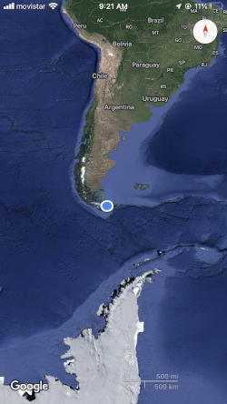
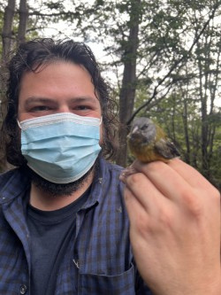
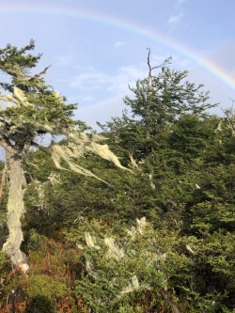
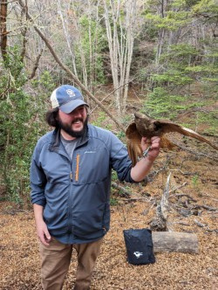

On top of my dissertation work...
UNT Subantarctic Biocultural Conservation Program
Three research trips to Puerto Williams, Chile
Two publications and three “micro-publications” currently under review or published:
First Detection of Avian Malaria Parasites Plasmodium and Haemoproteus in Resident Forest Birds of Cape Horn Biosphere Reserve, Chile - Hendrickson et al. (Under Review)
A Multicultural Analysis of Avian Nomenclature - Hendrickson et al. (Under Review)
Founder and President -
University of North Texas
Student Chapter of
The Wildlife Society

Slide 5
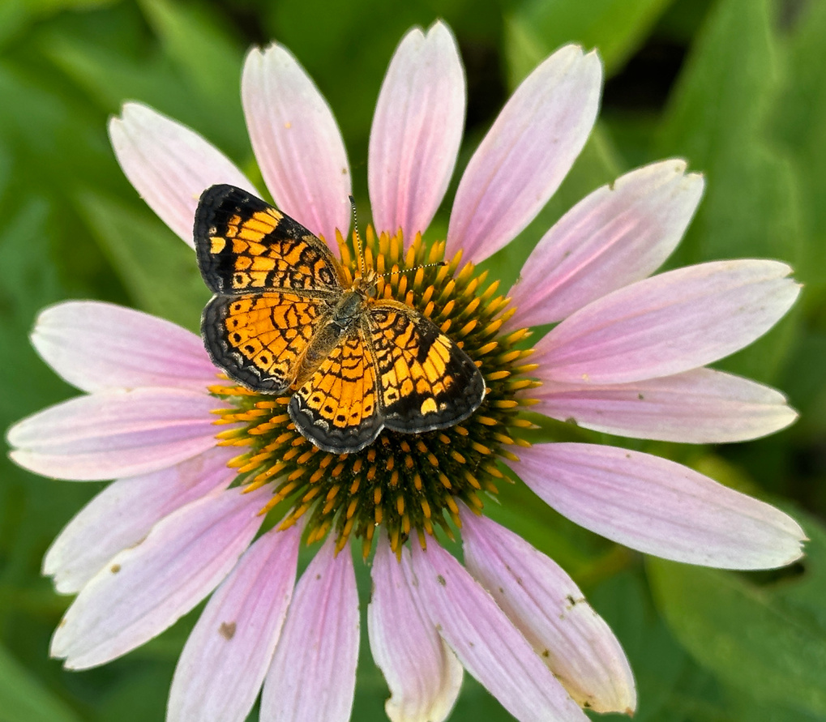
Frequently Asked Questions:
1) Are BIOL1132 lecture and a lab the same class?
No! The lecture and the lab are separate classes, each with a unique professor/TA, meeting time, and location. We can only answer questions about the lab. See your lecture professor for lecture information.
2) Is lab attendance mandatory?
Yes! You must be present in lab to earn participating points (80% of each lab). However, if you are ill, do not come to lab, but contact your TA immediately to arrange for a make-up lab.
3) Do I need to purchase a NEW lab manual?
Yes! You must buy a new lab manual. Since you must enter original answers/data used manuals are not allowed.
Pearl Cresent butterfly on Purple Coneflower

Slide 6
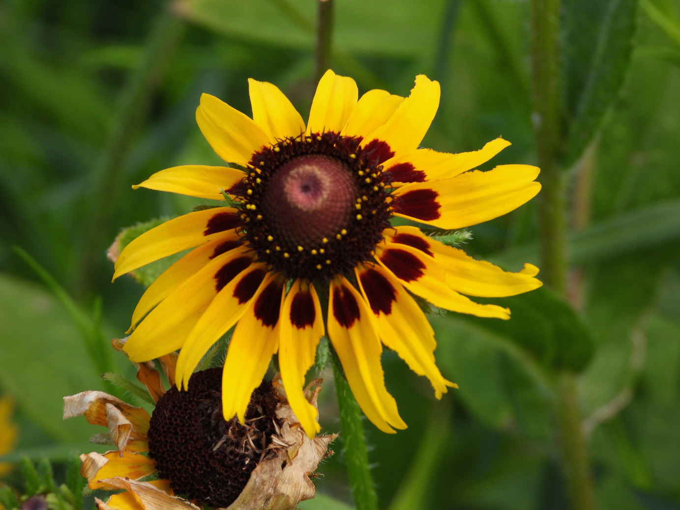
Course Info:
  You must be enrolled in both the lecture and the lab.
  The lab is in-person.
  Weekly lab content is provided via Canvas
  UNT IT Help Desk
  Email: helpdesk@unt.edu
  Live Chat: https://it.unt.edu/helpdesk/chatsupport
  Phone: 940-565-2324
  In Person: Sage Hall, Room 330
  Hours and Availability: Visit https://it.unt.edu/helpdesk for up-to-date hours and availability
  For additional support, visit Canvas Technical Help (https://community.canvaslms.com/docs/DOC-10554-4212710328)
Black-eyed Susan

Slide 7

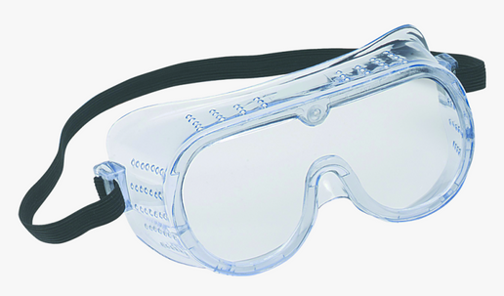
What supplies do I need?
Access to Canvas.
The lab course is organized in your Canvas section.
Purchasing a new lab manual is mandatory.
Field and Laboratory Methods for Environmental Science for Non-Majors. Third Edition. 2025. Jennifer Gnau and Jaime L. Baxter-Slye, Kendall Hunt Publishing.
ISBN: 9798385164
  Manuals may be purchased at the UNT Bookstore
  Old or used lab manuals are NOT accepted
  Using an old manual with pre-filled information is cheating and will result in a 0 for any assignment that uploads previous semester’s data and answers
  We are not currently using an e-book version
Goggles will occasionally be required.
  Sanitized goggles are available in the lab, or, you are welcome to purchase your own pair from the UNT Bookstore.

Slide 8
Lab Manuals REQUIRED in-class every lab starting NEXT WEEK
You cannot effectively participate without your own lab manual
No lab manual = 0/40 participation
Absolutely no exceptions

Slide 9
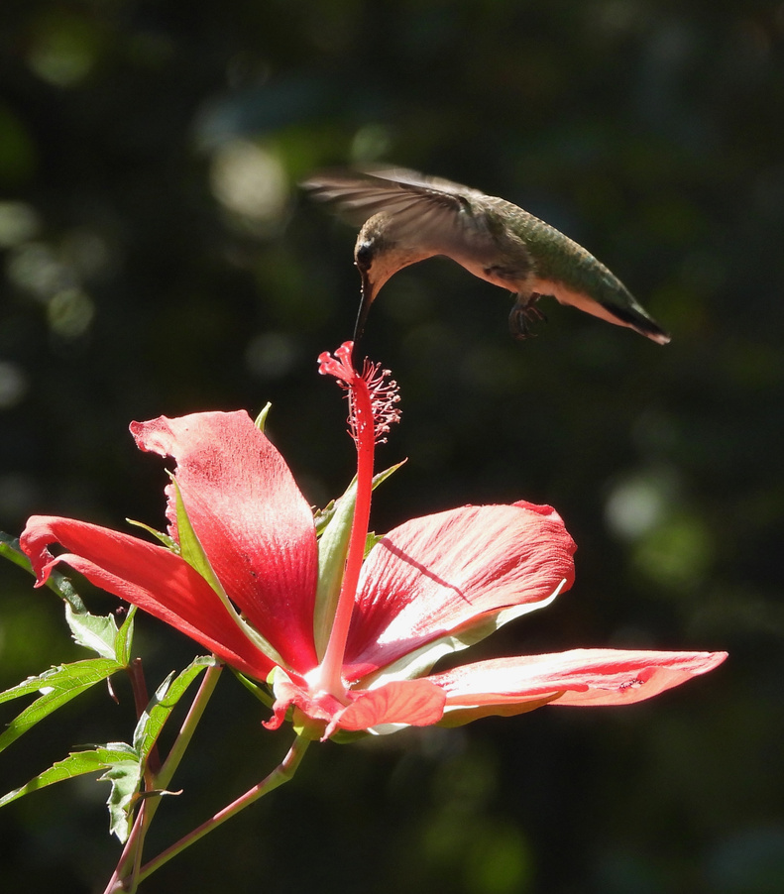
What are the objectives of the lab?
This lab will offer experiences to enhance your understanding of the concepts covered in lecture.
OBJECTIVES
1) Discover principles of environmental science and how they are applied to our everyday lives.
2) Explore hands-on how scientists study environmental problems and use the scientific method to find solutions.
3) Learn how to logically and intellectually contribute to discussions about current environmental issues as an informed citizen
Ruby-throated Hummingbird feeding
on Texas Star Hibiscus

Slide 10
How will I be graded?
IMPORTANT
Your overall grade for the course is combined between lecture & lab. The lab is worth 30% of your final and lecture is worth 60%.
YOU MUST PASS BOTH LECTURE AND LAB TO PASS THE COURSE!!
Ex) 60% or better is passing; ≤59.4% is rounded to ≤59 and is not passing
Item | Points
Quizzes | 10 x 10 = 100
Lab Participation | 10 x 40 = 400
Exams | 2 x 100 = 200
Group Project: Outline Presentation Peer Evaluation | 25 100 25
Total Possible Points | 850
How to calculate your overall course grade (lecture + lab):
(Total grade points in lab) x (0.3)
+
(Total grade points in lecture) x (0.6)
= Total Course Grade

Slide 11
LABS WON’T ALWAYS CORRESPOND TO YOUR LECTURE TOPIC; SOME MAY BE A WEEK OFF. ALWAYS CHECK LAB SCHEDULE AND COMPLETE PRE-LAB QUIZ TO PREPARE FOR WEEKLY LABS
Weekly Quizzes &
Participation
A CANVAS course has been created for each week covering the 9 labs. There you will find grades, announcements, group project info, resources, etc.
Prepare for the weekly pre-lab quiz by reading the background information in your lab manual. The quiz is on Canvas and is due at 11:59pm the day before your lab meets.
To receive full participation points, YOU MUST ATTEND LAB. Your TA grade your participation based on use of your lab manual and active participation in lab. If students are not actively participating, points will be reduced.

Slide 12
Lowest Quiz & Participation Grades Dropped!
The lowest quiz grade and the lowest participation grade will be dropped!
**Grades will be drop automatically in gradebook
WARNING: This is to help offset missed points for 1 missed lab.
*If a student misses more than 1 lab, missed points will quickly affect overall grade. Long-term absences will be addressed with the Dean of Students

Slide 13
Read
Read the lab manual as required before taking the quiz
How to succeed in lab:
Participate
Take the quiz the day before lab. Participate in the weekly lab meetings
Ask
Ask questions if you don’t understand
Complete
Review weekly lab concepts and study for the mid-term and final exams.
Group Work
Work effectively with your group.
Communicate
If you have an emergency, let me know (sooner than later)!
Notes:
17

Slide 14
More Exam Info...
Tests are cumulative and questions will cover any material we have previously learned in lab.
Test material will come from the lab manual, lab activities/experiments, and presentations.
Once you begin the exam, you have the entire lab time to complete. When you are finished, that is all for lab that week and you may leave.
***IMPORTANT: If you miss an exam, the exam must be made up during the same week. If you must miss an exam: email your TA as soon as you are aware of the expected absence.
ONLY applies to University excused absences!

Slide 15
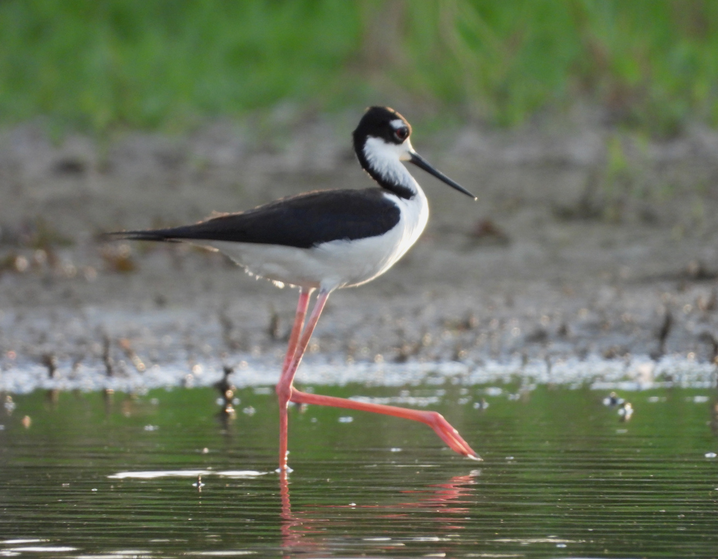
Are there attendance grades?
No, participation grades are “essentially” attendance grades
In the event you miss a lab, you can either:
a. drop the lowest participation grade (can use only 1 time!)
b. make up the lab by attending another ENV 1132 lab that week
(MUST BE SCHEDULED 1 WEEK IN ADVANCE WITH TA AND APPROVED BY ALTERNATE TA)
c. make up the lab with your TA during their office hours within 7 days. (ONLY for UNIVERSITY EXCUSED ABSENCES - NO EXCEPTIONS)
Please email your TA within or before the same week of expected absence. If the missed lab is not made up within 7 days, no points will be awarded. If you miss more than one lab, we will send an “Early Alert” and document your absences.
Contact your TA if you:
  Have a university excused absence such as active military service, a religious holy day, or an official university function as stated in the Student Attendance and Authorized Absences Policy (PDF) (https://policy.unt.edu/policy/06-039).
  Cannot attend a class due to an emergency or major illness. Your safety and well-being are important to us.
Black-necked Stilt

Slide 16
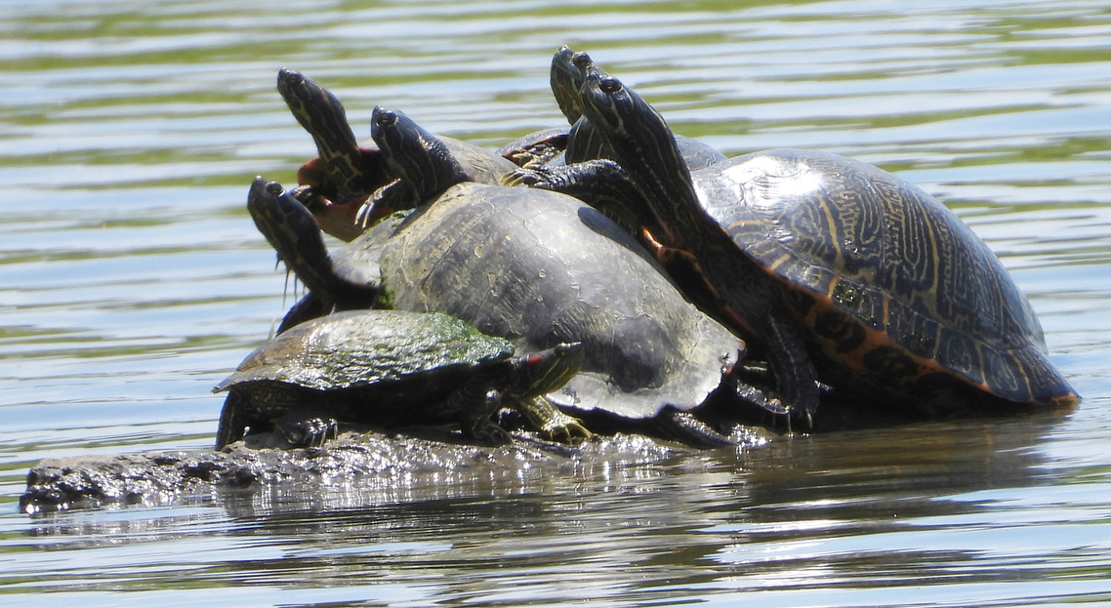
How can I discuss my grades with my TA?
The Family Educational Rights and Privacy Act (FERPA) (1974), is designed to protect students’ personal and sensitive information. Below are guidelines stated by FERPA. Educators must meet these guidelines without exception.
  Teachers are prohibited from discussing student grades with family members (ex. parents).
  Discussing grades with your TA is only allowed in-person or via online meeting. If meeting online, you must use your camera to verify ID. TA will only meet with student enrolled in course.
  To discuss your grade in person (recommended) you can:
    Email your TA to request an appointment or visit during office hours.
    Request to speak to your TA before or after class.
Red-eared Sliders on a log

Slide 17
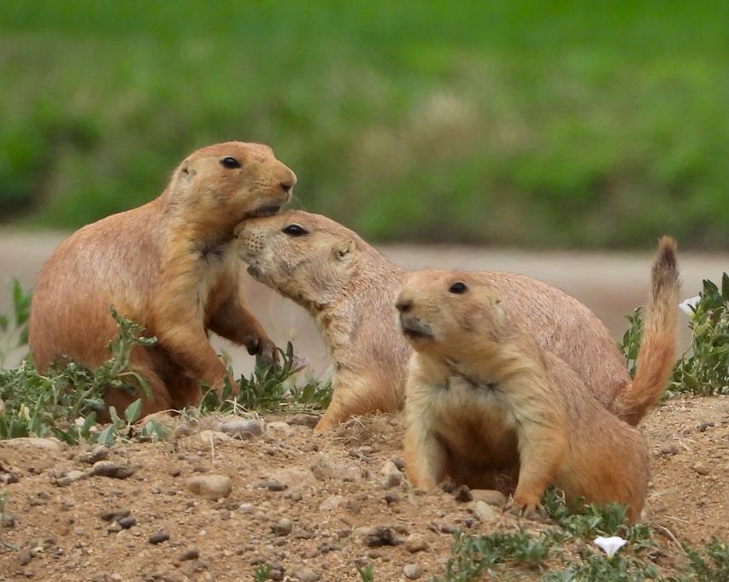
“The University of North Texas makes reasonable academic accommodation for students with disabilities.
  Students seeking accommodation must first register with the Office of Disability Accommodation (ODA) to verify their eligibility.
  If a disability is verified, the ODA will provide you with an accommodation letter to be delivered to faculty to begin a private discussion regarding your specific needs in a course.
  You may request accommodations at any time, however, ODA notices of accommodation should be provided as early as possible in the semester to avoid any delay in implementation.
  Note that students must obtain a new letter of accommodation for every semester and must meet with each faculty member prior to implementation in each class.
For additional information see the Office of Disability Accommodation website at http://www.unt.edu/oda. You may also contact them by phone at 940.565.4323.”
ODA Information
Black-tailed Prairie Dogs

Slide 18
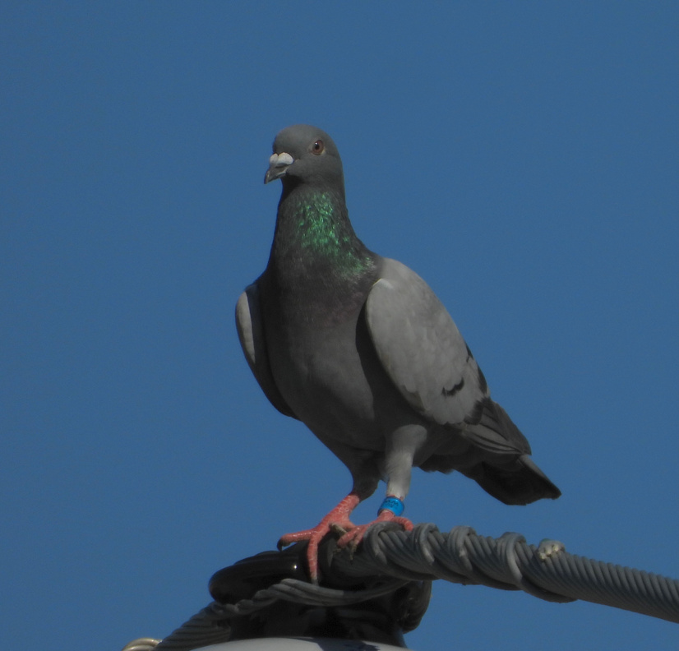
BIOL 1132 labs have a zero-tolerance policy for scholastic dishonesty
  Copying students data and answers.
  Turning in used lab manual worksheets.
  Taking quizzes together.
  Taking exams together.
  Providing answers to another student.
  Plagiarizing on group projects.
  Using a device while taking an exam.
The term ‘plagiarism’ includes, but is not limited to:
  The knowing or negligent use by paraphrase or direct quotation of the published or unpublished work of another person without full and clear acknowledgment
  The knowing or negligent unacknowledged use of materials prepared by another person or agency engaged in the selling of term papers or other academic materials
  Ex: copying word for word or even a phrase from a publication (including a web page) without referencing the source.
If we suspect you of cheating:
  An email will be sent to you and you will receive a 0 for the assignment
  You may be reported to the Dean of Students and fail the entire BIOL1132 course, including lecture.
Scholastic Dishonesty
Feral Pigeon

Slide 19
Scholastic Dishonesty
Any perceived scholastic dishonesty during exams will result in an automatic 0/100
Any plaigerism or AI misuse during the final project will result in a 0 for the entire group

Slide 20
UNT Fall 2025 Semester Key Dates:
Labor Day Holiday (no class) : September 1
Last day to drop course a “W” : November 7
Final Exam Week : December 6 - 12

Slide 21
Week of | Lab Description | Points
8/18 - 8/22 | Lab 1, pt. 1 : Introduction to Environmental Science Lab Class introductions Syllabus & safety Must sign syllabus & safety agreement in-lab Syllabus & safety quiz (due @11:59pm before lab day) | Syllabus & safety quiz= 10 pts
8/25 - 8/29 | Lab 1, pt. 2 : Introduction to Environmental Science Lab Introduction to environmental science Introduction to the scientific method Introduce group project & form groups | Pre-lab quiz= 10pts Participation= 40 pts
9/1 - 9/5 | Lab 2: Environmental Ethics and Paradigm Shifts Pre- lab Reading Quiz (due @ 11:59pm before lab day) Environmental ethic discussion Fishing game Groups meet to discuss presentation outline | Pre-lab Quiz= 10 pts Participation= 40 pts
Notes:
80

Slide 22
Week of | Lab Description | Points
9/8 - 9/12 | Lab 3: Trophic Transfer of Energy Part 1: Photosynthesis and Producers Pre- lab Reading Quiz (due @ 11:59pm before lab day) Photosynthesis discussion Photosynthesis experiment | Pre-lab Quiz = 10 pts Participation= 40 pts
9/15 - 9/19 | Lab 4: Trophic Transfer of Energy Part 2: Consumers Pre- lab Reading Quiz (due @ 11:59pm before lab day) Consumers discussion Owl pellet experiment Group Project Outline due (turn in on Canvas) | Pre-lab Quiz= 10 pts Participation= 40 pts Group outline= 25 pts
9/22 - 9/26 | Lab 5: Water Pollution and Conservation Pre- lab Reading Quiz (due @ 11:59pm before lab day) BGI demonstration Water pollution & conservation discussion Water quality experiment | Pre-lab Quiz= 10 pts Participation= 40 pts
Notes:
320

Slide 23
Week of | Lab Description | Points
9/29 - 10/3 | MIDTERM Mandatory Attendance! | Midterm Exam= 100 pts
10/6 - 10/10 | In-Class Group Workday- bring device to work on project Mandatory Attendance! | Participation= 40 pts
10/13 - 10/17 | Lab 6: Ecological Assessment & Trophic Transfer of Contaminants Pre- lab Reading Quiz (due @ 11:59pm before lab day) Ecosystem exchange discussion Macroinvertebrate experiment Midterm review | Pre-lab Quiz= 10 pts Participation= 40 pts
10/20 - 10/24 | Lab 7: Land Use, conservation, and manangement: Investigating Soil characteristics Pre- lab Reading Quiz (due @ 11:59pm before lab day) Soil discussion Soil experiment | Pre-lab Quiz= 10 pts Participation= 40 pts
Notes:
390

Slide 24
Week of | Lab Description | Points
10/27 - 10/31 | Lab 8: Pollinative Prairie Field Trip Pre- & Post- lab Quiz (in lab) Open-air Prairie lab discussion Prairie walk-through Prairie plot restoration | In-lab Quiz= 10 pts Participation= 40 pts
11/3 - 11/7 | Lab 9: Understanding Global Climate Change Pre- lab Reading Quiz (due @ 11:59pm before lab day) Climate Change discussion Climate Change experiment | Pre-lab Quiz= 10 pts Participation= 40 pts
11/10 - 11/14 | Group Presentations **Discuss final review and post on Canvas in the Final module | Presentation= 100 pts Peer Evaluation= 25 pts
11/17 - 11/21 | Final Exam (combination of short answer, multiple choice, fill-in the blank) | Final Exam= 100 pts
Notes:
320

Slide 25
UNT Policy
Academic Integrity Policy
Academic Integrity Standards and Consequences. According to UNT Policy 06.003, Student Academic Integrity, academic dishonesty occurs when students engage in behaviors including, but not limited to cheating, fabrication, facilitating academic dishonesty, forgery, plagiarism, and sabotage. A finding of academic dishonesty may result in a range of academic penalties or sanctions ranging from admonition to expulsion from the University. [Insert specific sanction or academic penalty for specific academic integrity violation.]
ADA Policy
UNT makes reasonable academic accommodation for students with disabilities. Students seeking accommodation must first register with the Office of Disability Accommodation (ODA) to verify their eligibility. If a disability is verified, the ODA will provide a student with an accommodation letter to be delivered to faculty to begin a private discussion regarding one’s specific course needs. Students may request accommodations at any time, however, ODA notices of accommodation should be provided as early as possible in the semester to avoid any delay in implementation. Note that students must obtain a new letter of accommodation for every semester and must meet with each faculty member prior to implementation in each class. For additional information see the ODA website (https://disability.unt.edu/).
Prohibition of Discrimination, Harassment, and Retaliation (Policy 16.004)
The University of North Texas (UNT) prohibits discrimination and harassment because of race, color, national origin, religion, sex, sexual orientation, gender identity, gender expression, age, disability, genetic information, veteran status, or any other characteristic protected under applicable federal or state law in its application and admission processes; educational programs and activities; employment policies, procedures, and processes; and university facilities. The University takes active measures to prevent such conduct and investigates and takes remedial action when appropriate.
Emergency Notification & Procedures
UNT uses a system called Eagle Alert to quickly notify students with critical information in the event of an emergency (i.e., severe weather, campus closing, and health and public safety emergencies like chemical spills, fires, or violence). In the event of a university closure, please refer to Canvas for contingency plans for covering course materials.
Retention of Student Records
Student records pertaining to this course are maintained in a secure location by the instructor of record. All records such as exams, answer sheets (with keys), and written papers submitted during the duration of the course are kept for at least one calendar year after course completion. Course work completed via the Canvas online system, including grading information and comments, is also stored in a safe electronic environment for one year. Students have the right to view their individual record; however, information about student’s records will not be divulged to other individuals without proper written consent. Students are encouraged to review the Public Information Policy and the Family Educational Rights and Privacy Act (FERPA) laws and the University’s policy. See UNT Policy 10.10, Records Management and Retention for additional information.

Slide 26
UNT Policy
Acceptable Student Behavior
Student behavior that interferes with an instructor’s ability to conduct a class or other students' opportunity to learn is unacceptable and disruptive and will not be tolerated in any instructional forum at UNT. Students engaging in unacceptable behavior will be directed to leave the classroom and the instructor may refer the student to the Dean of Students to consider whether the student's conduct violated the Code of Student Conduct. The University's expectations for student conduct apply to all instructional forums, including University and electronic classroom, labs, discussion groups, field trips, etc. Visit UNT’s Code of Student Conduct (https://deanofstudents.unt.edu/conduct) to learn more.
Access to Information - Eagle Connect
Students’ access point for business and academic services at UNT is located at: my.unt.edu. All official communication from the University will be delivered to a student’s Eagle Connect account. For more information, please visit the website that explains Eagle Connect and how to forward e-mail Eagle Connect (https://it.unt.edu/eagleconnect).
Student Evaluation Administration Dates
Student feedback is important and an essential part of participation in this course. The student evaluation of instruction is a requirement for all organized classes at UNT. The survey will be made available during weeks 13, 14 and 15 of the long semesters to provide students with an opportunity to evaluate how this course is taught. Students will receive an email from "UNT SPOT Course Evaluations via IASystem Notification" (no-reply@iasystem.org) with the survey link. Students should look for the email in their UNT email inbox. Simply click on the link and complete the survey. Once students complete the survey they will receive a confirmation email that the survey has been submitted. For additional information, please visit the SPOT website (http://spot.unt.edu/) or email spot@unt.edu.
Survivor Advocacy
UNT is committed to providing a safe learning environment free of all forms of sexual misconduct. Federal laws and UNT policies prohibit discrimination on the basis of sex as well as sexual misconduct. If you or someone you know is experiencing sexual harassment, relationship violence, stalking and/or sexual assault, there are campus resources available to provide support and assistance. The Survivor Advocates can be reached at SurvivorAdvocate@unt.edu or by calling the Dean of Students Office at 940-5652648.

Slide 27
Additional UNT Services
Academic Support & Student Services
Student Support Services
Mental Health
UNT provides mental health resources to students to help ensure there are numerous outlets to turn to that wholeheartedly care for and are there for students in need, regardless of the nature of an issue or its severity. Listed below are several resources on campus that can support your academic success and mental well-being:
Student Health and Wellness Center (https://studentaffairs.unt.edu/student-health-and-wellness-center)
Counseling and Testing Services (https://studentaffairs.unt.edu/counseling-and-testing-services)
UNT Care Team (https://studentaffairs.unt.edu/care)
UNT Psychiatric Services (https://studentaffairs.unt.edu/student-health-and-wellness-center/services/psychiatry)
Individual Counseling (https://studentaffairs.unt.edu/counseling-and-testing-services/services/individual-counseling)
Chosen Names
A chosen name is a name that a person goes by that may or may not match their legal name. If you have a chosen name that is different from your legal name and would like that to be used in class, please let the instructor know. Below is a list of resources for updating your chosen name at UNT.
UNT Records
UNT ID Card
UNT Email Address
Legal Name
*UNT euIDs cannot be changed at this time. The collaborating offices are working on a process to make this option accessible to UNT community members.

Slide 28
Additional UNT Resources
Additional Student Support Services
Registrar (https://registrar.unt.edu/registration)
Financial Aid (https://financialaid.unt.edu/)
Student Legal Services (https://studentaffairs.unt.edu/student-legal-services)
Career Center (https://studentaffairs.unt.edu/career-center)
Multicultural Center (https://edo.unt.edu/multicultural-center)
Counseling and Testing Services (https://studentaffairs.unt.edu/counseling-and-testing-services)
Pride Alliance (https://edo.unt.edu/pridealliance)
UNT Food Pantry (https://deanofstudents.unt.edu/resources/food-pantry)
Academic Support Services
Academic Resource Center (https://clear.unt.edu/canvas/student-resources)
Academic Success Center (https://success.unt.edu/asc)
UNT Libraries (https://library.unt.edu/)
Writing Lab (http://writingcenter.unt.edu/)

