Slide 1


BIOL 1132 Lab Syllabus
Fall 2026
Section: BIOL 1132: 302
Lab Day/Time: 16:00 AM - 18:00 AM Every Monday
Instructor Name: Samira Saleh
Email:Samiraalsadatsaleh@my.unt.edu
Office: ENV 338
Office Hours: 10-12 (Monday)

Slide 2
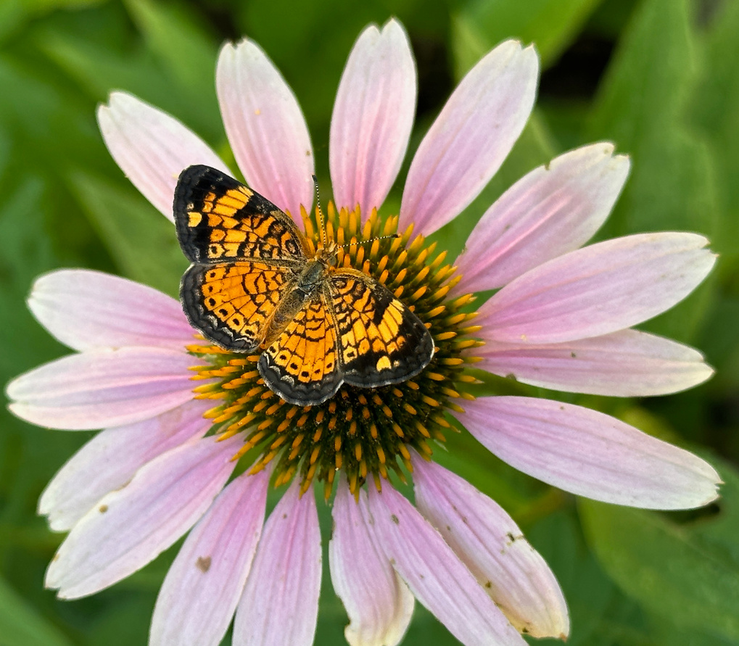
Frequently Asked Questions:
1) Are BIOL1132 lecture and a lab the same class?
No, but they are the same course. The lecture and the lab are separate classes, each with a unique professor/TA, meeting time, and location. See your lecture professor for lecture information.
2) Is lab attendance mandatory?
Yes! You must be present, on time, and active in lab to earn participating points. However, if you are ill, do not come to lab, but contact your TA immediately to arrange for a make-up lab.
3) Do I need to purchase a NEW lab manual?
Yes! You must buy a new lab manual. Since you must enter original answers/data used manuals are not allowed.
Pearl Cresent butterfly on Purple Coneflower

Slide 3

Course Info:
  You must be enrolled in both the lecture and the lab.
  The lab is in-person.
  Weekly lab content is provided via Canvas
  UNT IT Help Desk
  Email: helpdesk@unt.edu
  Live Chat: https://it.unt.edu/helpdesk/chatsupport
  Phone: 940-565-2324
  In Person: Sage Hall, Room 330
  Hours and Availability: Visit https://it.unt.edu/helpdesk for up-to-date hours and availability
  For additional support, visit Canvas Technical Help (https://community.canvaslms.com/docs/DOC-10554-4212710328)
Black-eyed Susan

Slide 4

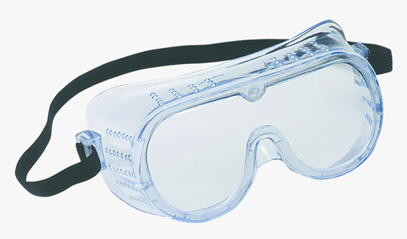
What supplies do I need?
Access to Canvas.
The lab course is organized in your Canvas section.
Purchasing a new lab manual is mandatory.
Field and Laboratory Methods for Environmental Science for Non-Majors. Third Edition. 2025. Jennifer Gnau, Jaime L. Baxter-Slye, Kendall Hunt Publishing. ISBN 979-8-3851-6425-7.
  Manuals may be purchased at the UNT Bookstore
  Old or used lab manuals are NOT accepted
  Using an old manual with pre-filled information is cheating and will result in a 0 for any assignment that uploads previous semester’s data and answers
  We are not currently using an e-book version
Goggles will occasionally be required.
  Sanitized goggles are available in the lab, or, you are welcome to purchase your own pair from the UNT Bookstore.

Slide 5
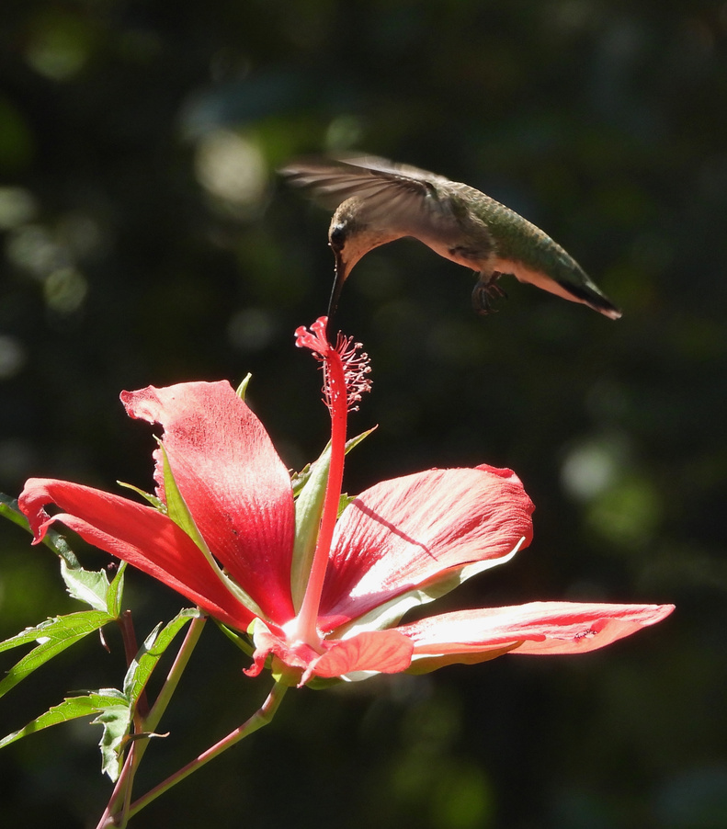
What are the objectives of the lab?
This lab will offer experiences to enhance your understanding of the concepts covered in lecture.
OBJECTIVES
1) Discover principles of environmental science and how they are applied to our everyday lives.
2) Explore hands-on how scientists study environmental problems and use the scientific method to find solutions.
3) Learn how to logically and intellectually contribute to discussions about current environmental issues as an informed citizen
Ruby-throated Hummingbird feeding
on Texas Star Hibiscus

Slide 6
How will I be graded?
IMPORTANT
Your overall grade for the course is combined between lecture & lab. The lab is worth 30% of your final and lecture is worth 60%.
YOU MUST PASS BOTH LECTURE AND LAB TO PASS THE COURSE!!
Ex) 60% or better is passing; ≤59.4% is rounded to ≤59 and is not passing
Item | Points
Quizzes | 10 x 10 = 100
Lab Participation | 10 x 40 = 400
Exams | 2 x 100 = 200
Group Project: Outline Presentation Peer Evaluation | 25 100 25
Total Possible Points | 850
How to estimate your overall course grade (lecture + lab):
(Total grade points in lab) x (0.3)
+
(Total grade points in lecture) x (0.7)
= Total Course Grade

Slide 7
Labs and lectures won’t always be covering the exact same topics. Some labs or lectures may be a week off from one another. Always check the lab schedule to prepare for lab.
Canvas access and the lab notebook are all that is needed to complete labs. Using these resources, you can find instructions, complete online quizzes, upload assignments, etc.
Weekly
Participation Expectations
Complete the pre-lab quiz after reading the background information in your lab manual. The quiz is available on Canvas until 11:59pm the day before your lab meet. . The quiz will not be reopened if missed, no exceptions.
Weekly attendance is mandatory. During lab, you must actively participate. Any disruption caused by a student (ex. phone & headphone use, interrupting instruction, sleeping, etc.) will result in a loss of participation point based on the instructor discretion.
Lab notebooks will be graded one week after attending lab. This gives ample time to provide well-thought answers to question. One word answers are not enough, answer questions thoroughtly or points will be deducted based on instructor discretion.

Slide 8
Attendance is mandatory for all 9 labs.
However, if an emergency absence is necessary, you may earn back the 40 missed participation points by completing an external assignment based on the missed lab topic.
Attendance and Emergency Makeup Policy
Lab Makeup Policy Rules:
Deadline: You must email your instructor within 24 hours of the missed lab and submit the makeup assignment with 7 days. Failing to follow these instructions will result in 0 for the missed lab, no exceptions.
Limits: This policy applies to a maximum of one missed labs due to emergency (illness, injury, major life event, transporation emergency, etc.)
Content: If the deadline is met, the assignment will be provided by your instructor. The tasks involve evaluating real-world from a data set and interpreting the data into real-world applications.

Slide 9
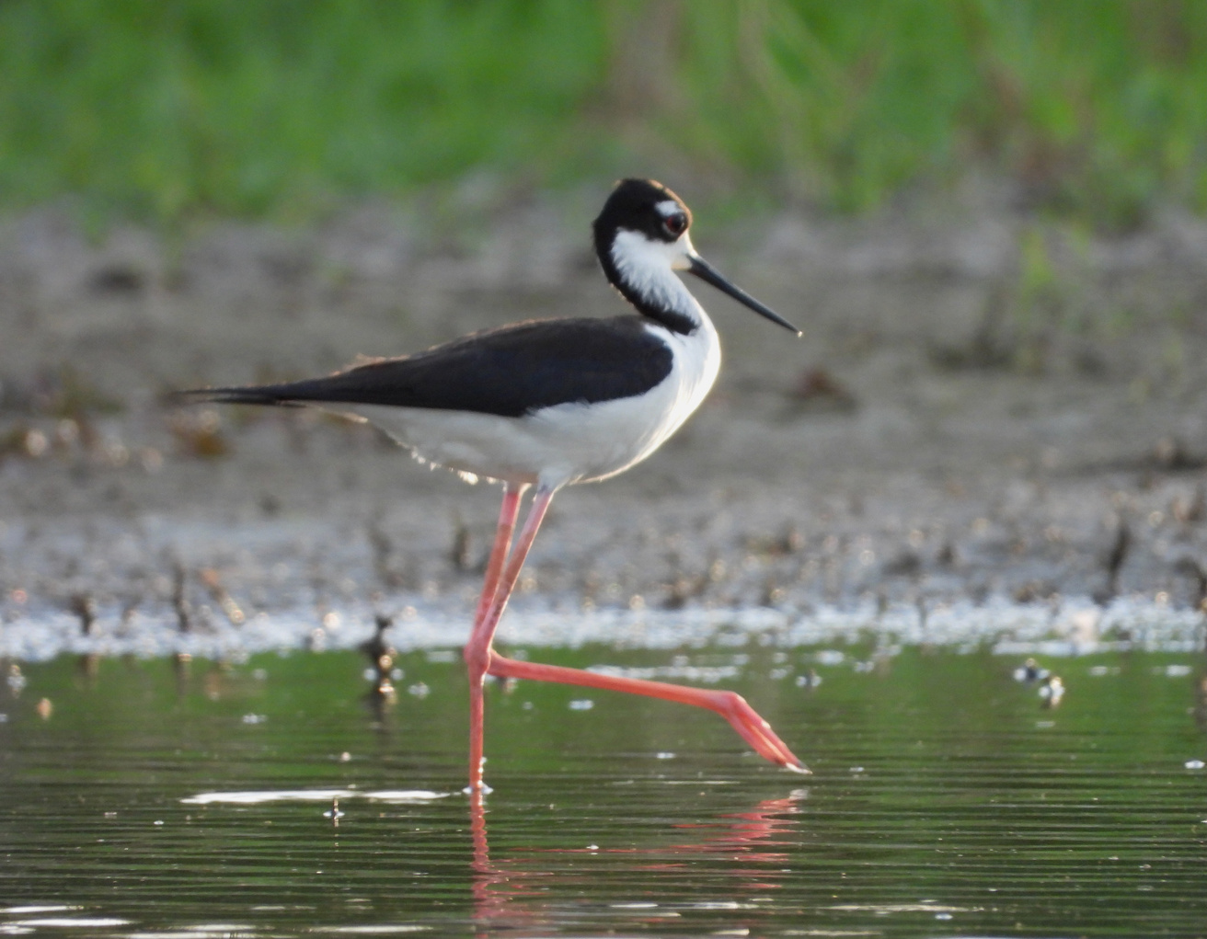
Are there attendance grades?
No, participation grades are “essentially” attendance grades
Please email your TA within or before the same week of expected absence. If the missed lab is not made up within 7 days, no points will be awarded. If you miss more than one lab, we will send an “Early Alert” and document your absences.
Contact your TA if you:
  Have a university excused absence such as active military service, a religious holy day, or an official university function as stated in the Student Attendance and Authorized Absences Policy (PDF) (https://policy.unt.edu/policy/06-039).
  Cannot attend a class due to an emergency or major illness. Your safety and well-being are important to us.
Black-necked Stilt

Slide 10
Exam Information
Tests are cumulative and multiple choice.
Test material will come from the lab manual, lab activities/experiments, and presentations.
Once you begin the exam, you have the entire lab time to complete. When your test is complete, you may leave.
No break will be allowed while the test is being taken. If you leave the classroom for any reason, your test will be graded based on what is completed and finishing will be allowed.
Any use of a phone during exam will result in an automatic grade of 0 and be assumed as cheating. If an emergency break is needed during an exam students must leave their phones and any other devices with the instructor until they return.
*IMPORTANT* If you miss an exam, the student must contact the instructor within 24hrs of the scheduled test and reschedule a make up within 1 week. If you expect to miss an exam you should inform your instructor prior to missing.

Slide 11
Read
Read the lab manual as required before taking the quiz
Participate
Take the quiz the day before lab. Participate in the weekly lab meetings
Steps to Lab Success:
Ask
Ask questions if you don’t understand
Complete
Review weekly lab quizzes, lab manuals, and reviews for the exams.
Group Work
Work effectively with your group.
Communicate
If you have an emergency, let me know (sooner than later)!
Notes:
17

Slide 12
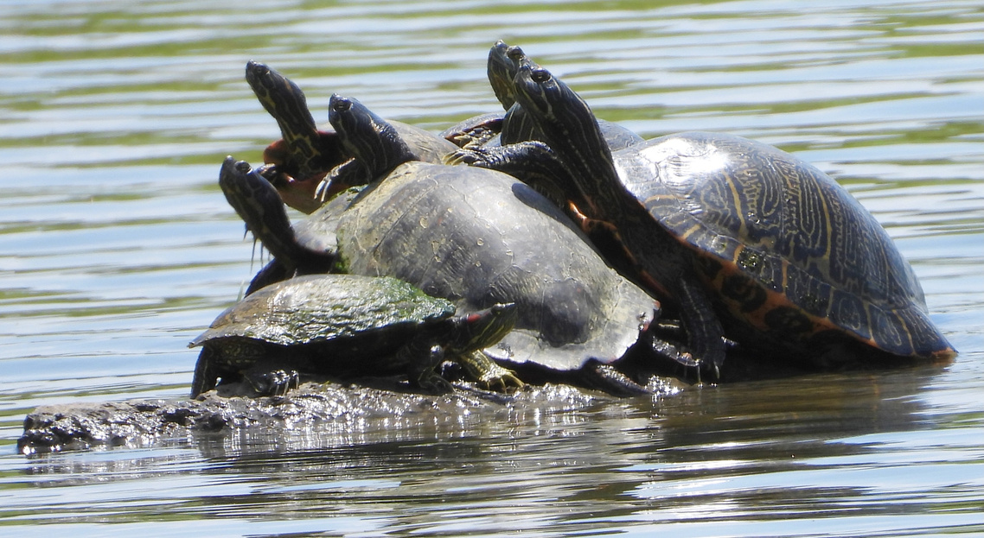
How can I discuss my grades with my TA?
The Family Educational Rights and Privacy Act (FERPA) (1974), is designed to protect students’ personal and sensitive information. Below are guidelines stated by FERPA. Educators must meet these guidelines without exception.
  Teachers are prohibited from discussing student grades with family members (ex. parents).
  Discussing grades with your TA is only allowed in-person or via online meeting. If meeting online, you must use your camera to verify ID.
  To discuss your grade in person (recommended) you can:
    Email your TA to request an appointment or visit during office hours.
    Request to speak to your TA before or after class.
Red-eared Sliders on a log

Slide 13
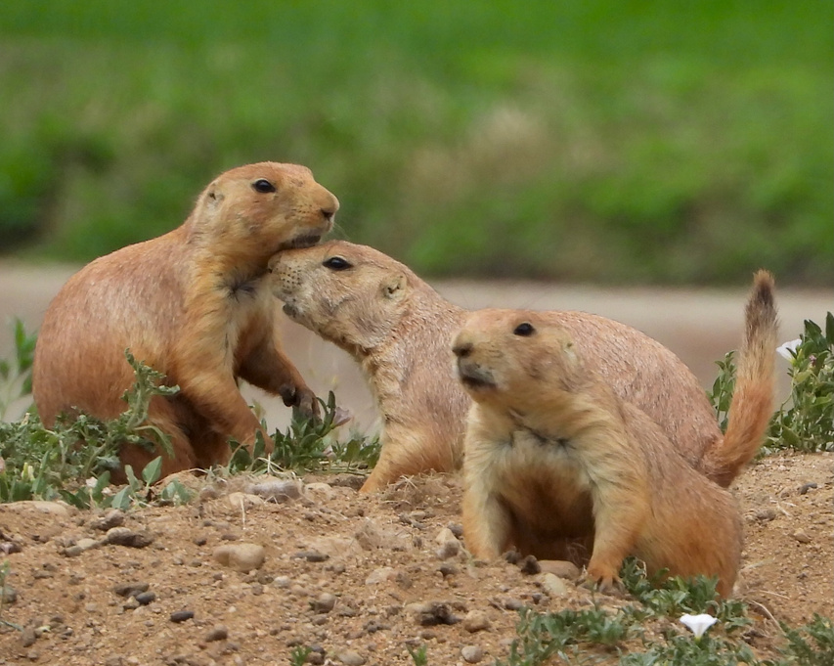
“The University of North Texas makes reasonable academic accommodation for students with disabilities.
  Students seeking accommodation must first register with the Office of Disability Accommodation (ODA) to verify their eligibility.
  If a disability is verified, the ODA will provide you with an accommodation letter to be delivered to faculty to begin a private discussion regarding your specific needs in a course.
  You may request accommodations at any time, however, ODA notices of accommodation should be provided as early as possible in the semester to avoid any delay in implementation.
  Note that students must obtain a new letter of accommodation for every semester and must meet with each faculty member prior to implementation in each class.
For additional information see the Office of Disability Accommodation website at http://www.unt.edu/oda. You may also contact them by phone at 940.565.4323.”
ODA Information
Black-tailed Prairie Dogs

Slide 14
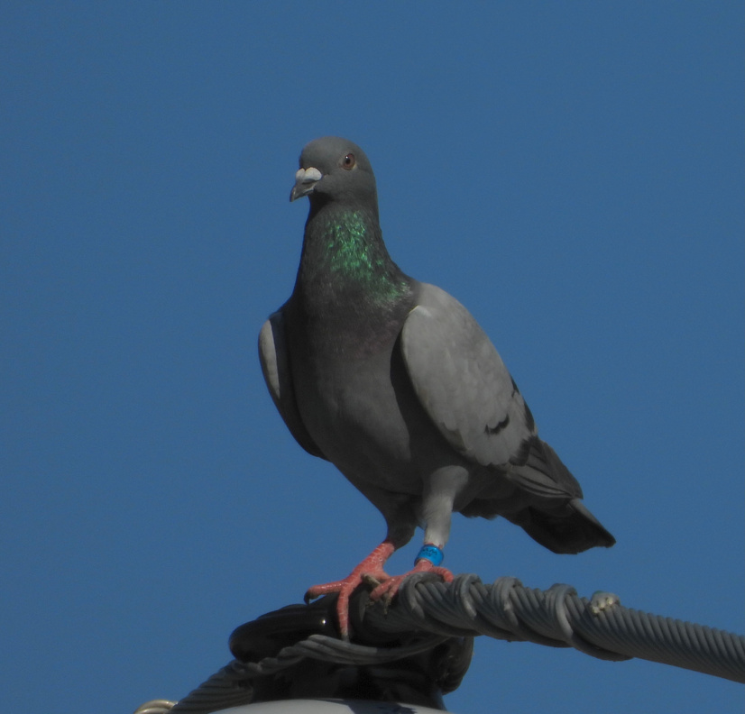
BIOL 1132 labs have a zero-tolerance policy for scholastic dishonesty
  Copying students data and answers.
  Turning in used lab manual worksheets.
  Taking quizzes together.
  Taking exams together.
  Providing answers to another student.
  Plagiarizing on group projects.
  Using a device while taking an exam.
The term ‘plagiarism’ includes, but is not limited to:
  The knowing or negligent use by paraphrase or direct quotation of the published or unpublished work of another person without full and clear acknowledgment
  The knowing or negligent unacknowledged use of materials prepared by another person or agency engaged in the selling of term papers or other academic materials
  Ex: copying word for word or even a phrase from a publication (including a web page) without referencing the source.
If we suspect you of cheating:
  An email will be sent to you and you will receive a 0 for the assignment
  You may be reported to the Dean of Students and fail the entire BIOL1132 course, including lecture.
Scholastic Dishonesty
Feral Pigeon

Slide 15
UNT Fall Semester Key Dates:
Labor Day Holiday (no class) : September 7
Last day to drop course a “W” : November 6
Final Exam Week : December 7 - 11
**This lab will conclude the week prior to the Thanksgiving break.

Slide 16
Week of | Lab Description | Points
8/17 - 8/21 | Intro. Lab : Introduction to Environmental Science Lab Class introductions Syllabus & safety Must sign syllabus & safety agreement in-lab Syllabus & safety quiz (due @11:59pm before lab day) | Syllabus & safety quiz= 10 pts
8/24 - 8/28 | Lab 1 : Introduction to Environmental Science Lab Introduction to environmental science Introduction to the scientific method Introduce group project & form groups | Group project quiz= 10pts Participation= 40 pts
8/31 - 9/4 | Lab 2: Environmental Ethics and Paradigm Shifts Pre- lab Reading Quiz (due @ 11:59pm before lab day) Environmental ethic discussion Fishing game | Pre-lab Quiz= 10 pts Participation= 40 pts
Notes:
80

Slide 17
Week of | Lab Description | Points
9/7 - 9/11 | Lab 3: Trophic Transfer of Energy: Photosynthesis and Producers Pre- lab Reading Quiz (due @ 11:59pm before lab day) Photosynthesis discussion Photosynthesis experiment | Pre-lab Quiz = 10 pts Participation= 40 pts
9/14 - 9/18 | Lab 4: Trophic Transfer of Energy: Consumers Pre- lab Reading Quiz (due @ 11:59pm before lab day) Consumers discussion Owl pellet experiment Group Project Set Up & Outline Discussion | Pre-lab Quiz= 10 pts Participation= 40 pts
9/21 - 9/25 | Lab 5: Water Pollution and Conservation Pre- lab Reading Quiz (due @ 11:59pm before lab day) BGI demonstration Water pollution & conservation discussion Water quality experiment | Pre-lab Quiz= 10 pts Participation= 40 pts Group Outline= 25 pts
Notes:
320

Slide 18
Week of | Lab Description | Points
9/28 - 10/2 | MIDTERM Mandatory Attendance! | Midterm Exam= 100 pts
10/5 - 10/9 | In-Class Group Workday- bring device to work on project Mandatory Attendance! | Participation= 40 pts
10/12 - 10/16 | Lab 6: Ecological Assessment & Trophic Transfer of Contaminants Pre- lab Reading Quiz (due @ 11:59pm before lab day) Ecosystem exchange discussion Macroinvertebrate experiment Midterm review | Pre-lab Quiz= 10 pts Participation= 40 pts
10/19 - 10/23 | Lab 7: Land Use, conservation, and manangement: Investigating Soil characteristics Pre- lab Reading Quiz (due @ 11:59pm before lab day) Soil discussion Soil experiment | Pre-lab Quiz= 10 pts Participation= 40 pts
Notes:
390

Slide 19
Week of | Lab Description | Points
10/26 - 10/30 | Lab 8: Pollinative Prairie Field Trip Pre- & Post- lab Quiz (in lab) Open-air Prairie lab discussion Prairie walk-through Prairie plot restoration | In-lab Quiz= 10 pts Participation= 40 pts
11/2 - 11/6 | Lab 9: Understanding Global Climate Change Pre- lab Reading Quiz (due @ 11:59pm before lab day) Climate Change discussion Climate Change experiment | Pre-lab Quiz= 10 pts Participation= 40 pts
11/9 - 11/13 | Group Presentations | Presentation= 100 pts Peer Evaluation= 25 pts
11/16 - 11/20 | Final Exam | Final Exam= 100 pts
Notes:
320

Slide 20
UNT Policy
Academic Integrity Policy
Academic Integrity Standards and Consequences. According to UNT Policy 06.003, Student Academic Integrity, academic dishonesty occurs when students engage in behaviors including, but not limited to cheating, fabrication, facilitating academic dishonesty, forgery, plagiarism, and sabotage. A finding of academic dishonesty may result in a range of academic penalties or sanctions ranging from admonition to expulsion from the University. [Insert specific sanction or academic penalty for specific academic integrity violation.]
ADA Policy
UNT makes reasonable academic accommodation for students with disabilities. Students seeking accommodation must first register with the Office of Disability Accommodation (ODA) to verify their eligibility. If a disability is verified, the ODA will provide a student with an accommodation letter to be delivered to faculty to begin a private discussion regarding one’s specific course needs. Students may request accommodations at any time, however, ODA notices of accommodation should be provided as early as possible in the semester to avoid any delay in implementation. Note that students must obtain a new letter of accommodation for every semester and must meet with each faculty member prior to implementation in each class. For additional information see the ODA website (https://disability.unt.edu/).
Prohibition of Discrimination, Harassment, and Retaliation (Policy 16.004)
The University of North Texas (UNT) prohibits discrimination and harassment because of race, color, national origin, religion, sex, sexual orientation, gender identity, gender expression, age, disability, genetic information, veteran status, or any other characteristic protected under applicable federal or state law in its application and admission processes; educational programs and activities; employment policies, procedures, and processes; and university facilities. The University takes active measures to prevent such conduct and investigates and takes remedial action when appropriate.
Emergency Notification & Procedures
UNT uses a system called Eagle Alert to quickly notify students with critical information in the event of an emergency (i.e., severe weather, campus closing, and health and public safety emergencies like chemical spills, fires, or violence). In the event of a university closure, please refer to Canvas for contingency plans for covering course materials.
Retention of Student Records
Student records pertaining to this course are maintained in a secure location by the instructor of record. All records such as exams, answer sheets (with keys), and written papers submitted during the duration of the course are kept for at least one calendar year after course completion. Course work completed via the Canvas online system, including grading information and comments, is also stored in a safe electronic environment for one year. Students have the right to view their individual record; however, information about student’s records will not be divulged to other individuals without proper written consent. Students are encouraged to review the Public Information Policy and the Family Educational Rights and Privacy Act (FERPA) laws and the University’s policy. See UNT Policy 10.10, Records Management and Retention for additional information.

Slide 21
UNT Policy
Acceptable Student Behavior
Student behavior that interferes with an instructor’s ability to conduct a class or other students' opportunity to learn is unacceptable and disruptive and will not be tolerated in any instructional forum at UNT. Students engaging in unacceptable behavior will be directed to leave the classroom and the instructor may refer the student to the Dean of Students to consider whether the student's conduct violated the Code of Student Conduct. The University's expectations for student conduct apply to all instructional forums, including University and electronic classroom, labs, discussion groups, field trips, etc. Visit UNT’s Code of Student Conduct (https://deanofstudents.unt.edu/conduct) to learn more.
Access to Information - Eagle Connect
Students’ access point for business and academic services at UNT is located at: my.unt.edu. All official communication from the University will be delivered to a student’s Eagle Connect account. For more information, please visit the website that explains Eagle Connect and how to forward e-mail Eagle Connect (https://it.unt.edu/eagleconnect).
Student Evaluation Administration Dates
Student feedback is important and an essential part of participation in this course. The student evaluation of instruction is a requirement for all organized classes at UNT. The survey will be made available during weeks 13, 14 and 15 of the long semesters to provide students with an opportunity to evaluate how this course is taught. Students will receive an email from "UNT SPOT Course Evaluations via IASystem Notification" (no-reply@iasystem.org) with the survey link. Students should look for the email in their UNT email inbox. Simply click on the link and complete the survey. Once students complete the survey they will receive a confirmation email that the survey has been submitted. For additional information, please visit the SPOT website (http://spot.unt.edu/) or email spot@unt.edu.
Survivor Advocacy
UNT is committed to providing a safe learning environment free of all forms of sexual misconduct. Federal laws and UNT policies prohibit discrimination on the basis of sex as well as sexual misconduct. If you or someone you know is experiencing sexual harassment, relationship violence, stalking and/or sexual assault, there are campus resources available to provide support and assistance. The Survivor Advocates can be reached at SurvivorAdvocate@unt.edu or by calling the Dean of Students Office at 940-5652648.

Slide 22
Additional UNT Services
Academic Support & Student Services
Student Support Services
Mental Health
UNT provides mental health resources to students to help ensure there are numerous outlets to turn to that wholeheartedly care for and are there for students in need, regardless of the nature of an issue or its severity. Listed below are several resources on campus that can support your academic success and mental well-being:
Student Health and Wellness Center (https://studentaffairs.unt.edu/student-health-and-wellness-center)
Counseling and Testing Services (https://studentaffairs.unt.edu/counseling-and-testing-services)
UNT Care Team (https://studentaffairs.unt.edu/care)
UNT Psychiatric Services (https://studentaffairs.unt.edu/student-health-and-wellness-center/services/psychiatry)
Individual Counseling (https://studentaffairs.unt.edu/counseling-and-testing-services/services/individual-counseling)
Chosen Names
A chosen name is a name that a person goes by that may or may not match their legal name. If you have a chosen name that is different from your legal name and would like that to be used in class, please let the instructor know. Below is a list of resources for updating your chosen name at UNT.
UNT Records
UNT ID Card
UNT Email Address
Legal Name
*UNT euIDs cannot be changed at this time. The collaborating offices are working on a process to make this option accessible to UNT community members.

Slide 23
Additional UNT Resources
Additional Student Support Services
Registrar (https://registrar.unt.edu/registration)
Financial Aid (https://financialaid.unt.edu/)
Student Legal Services (https://studentaffairs.unt.edu/student-legal-services)
Career Center (https://studentaffairs.unt.edu/career-center)
Multicultural Center (https://edo.unt.edu/multicultural-center)
Counseling and Testing Services (https://studentaffairs.unt.edu/counseling-and-testing-services)
Pride Alliance (https://edo.unt.edu/pridealliance)
UNT Food Pantry (https://deanofstudents.unt.edu/resources/food-pantry)
Academic Support Services
Academic Resource Center (https://clear.unt.edu/canvas/student-resources)
Academic Success Center (https://success.unt.edu/asc)
UNT Libraries (https://library.unt.edu/)
Writing Lab (http://writingcenter.unt.edu/)

