Slide 1

Safe With Me: My Body, My Feelings, My Helpers
Elementary Curriculum: Grades K-2
Mk Galli, Youth Outreach & Mentor Specialist
Notes:
Audience: All
Facilitator: Introduces themselves and the training topic

Slide 2
Compliance with Utah Administrative Rule 277-630
Adherence to State Guidelines:
Our training materials fully comply with Utah Administrative Rule 277-630 for Child Sexual Abuse and Human Trafficking Prevention.
Age-Appropriate & Sensitive:
All content is designed to be developmentally appropriate and sensitive to children who may have experienced prior abuse. Utah Code 53G-9-207 (a)(I) and (II)
Prohibited Practices Avoided:
The materials do not include any explicit content or practices that encourage personal disclosures or role-playing of abusive scenarios. Utah Code 53G-9-207 (Utah Code 76-5-406)
Legal & Reporting Requirements:
We adhere to mandatory reporting laws and clearly outline safe adult behaviors, reporting procedures, and legal responsibilities.
Continuous Review:
Our content is regularly reviewed to ensure ongoing compliance with updated state statutes and administrative rules.
USBE, 2024
Notes:
This is the disclaimer that some of the instruction material is sensitive. If you need to step out or take a break, please do. We like to highlight every adult is responsible for the safety of children. Youth should not have the burden of preventing child sexual abuse/trafficking. By becoming educated ASY can help create a safer world for children and recognize that abuse usually comes from someone the child knows. Children often turn to other trusted adults for help. Its not the adult's job to investigate or prove abuse, only to report suspected abuse
Rubric: 1.1,1.3,1.4,1.5

Slide 3
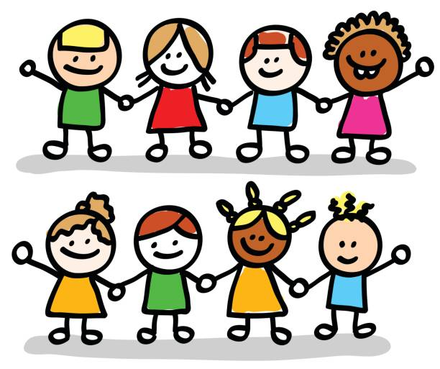
Group Rules
Be Kind: Use kind words and gentle actions.
Take Turns Talking: Listen when it’s someone else’s turn.
Talk to a Grown Up: If something makes you think of your own story, share it with a trusted adult.
Keep It Safe: What we talk about here stays here, unless someone might get hurt.
Pay Attention: Look and listen to your teacher or helper.
Notes:
Begin by welcoming everyone and explaining that the group agreement is here to help everyone feel safe and respected while we learn together. Explain that these rules help make sure everyone has a chance to share, listen, and learn without feeling scared or left out.
Summarize the group agreements briefly: “We are here to be kind, listen carefully, share only if we want to, and keep our space safe. These rules help us all learn together. "Invite any questions or clarifications. Remind the group that these agreements are meant to help everyone feel comfortable and safe while learning.
Rubric: 1.2,1.3,1.4,1.5

Slide 4
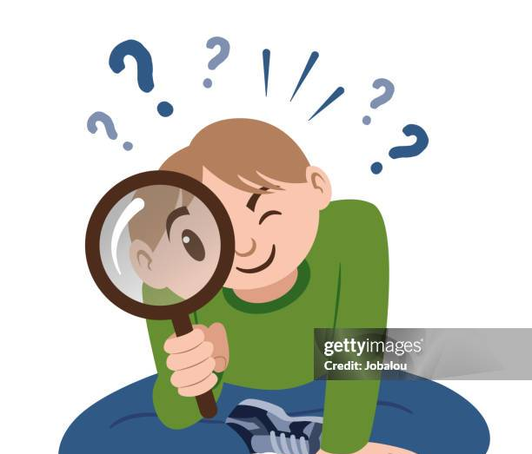

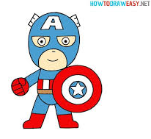
Goals
Notice if someone is asking you to keep a secret that feels bad.
Build
Practice asking for help from safe adults (parents, teachers, helpers).
Spot
Understand
Recognize when an adult or older kid is being bossy in an unsafe way.
See when a friend looks scared, sad, or uncomfortable
Use your voice to say “stop” or “no” when you need to.
Be a good friend by telling a grown-up if someone might not be safe.
Know that every kid deserves to be safe and cared for.
Learn the difference between safe and unsafe touches, words, and actions.
Understand that it’s okay to say “no” if something feels wrong.
Notes:
Facilitator: Introduce goals to audience/youth
Rubric: 1.2,1.3

Slide 5
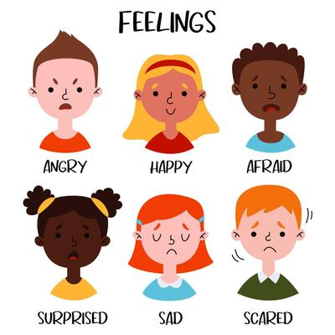
What Does it mean to Be Safe ?
Being safe means knowing who our helpers are and what to do if someone makes us feel uncomfortable, tries to trick us, or tells us to keep a secret.
Notes:
Rubric: 1.3
Ask audience what they think it means to be safe?
Examples
Listening
Following Rules
Keeping body to themselves

Slide 6

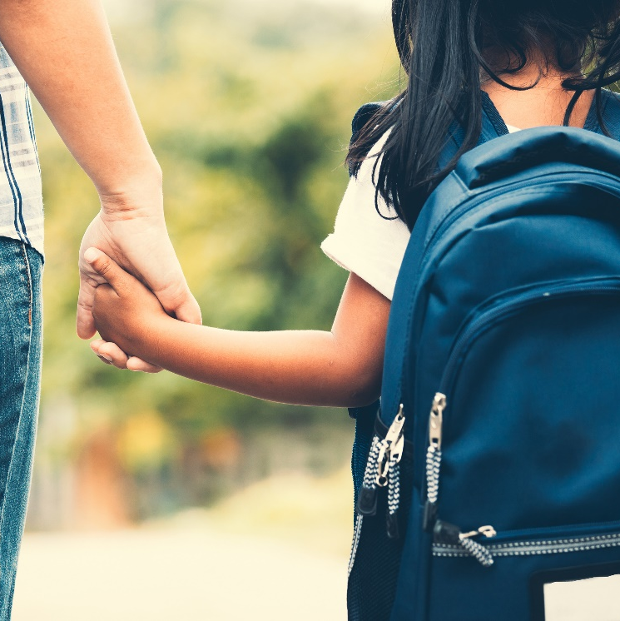
Why Learn About Staying Safe?
A Hidden Secret:
Sometimes people do unsafe things or trick kids and try to keep it a secret. That’s why it's important to know who our helpers are.
How It Affects Us:
This can happen anywhere even places that seem safe, like a school or park.
Learning Helps Us:
When we know what safe and unsafe looks like, we can help each other and ask a grown up for help.
Notes:
Facilitator: Introduce goals to audience/youth

Slide 7
How Do Unsafe People Act?
What they Do 🤫
How they Do it ⚠️
They can lie, make unfair rules, or try to scare kids.
Why they Do it 🤕
Because they want something for themselves, even if it hurts others
They might try to trick, take, or use kids in ways that aren’t safe
Notes:
Utah Human Trafficking Law §76-5-308

Slide 8
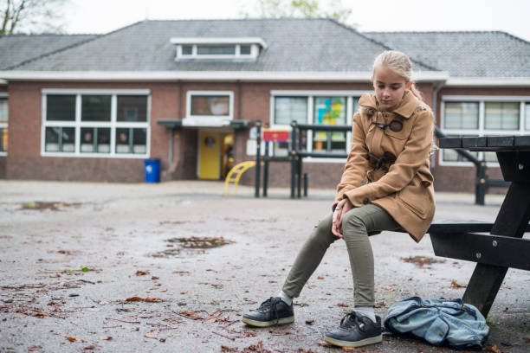
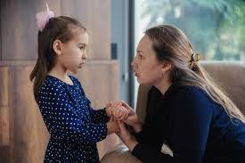
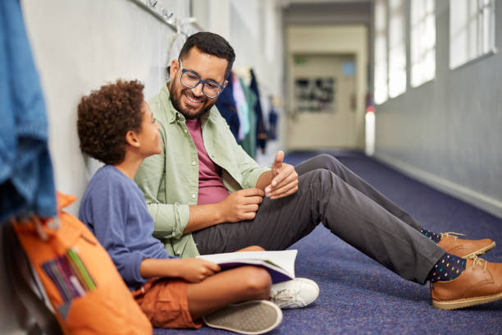
Unsafe People
Who? Unsafe people don’t always look scary. They can pretend to be nice.
Where? Unsafe things can happen at home, school, or even online.
Remember: If something feels wrong, go to a safe helper you trust.
Polari
Notes:
Rubric: 1.7

Slide 9
Why Do Some Kids Need Extra Help?
Some kids don’t always have enough food or safe places.🍎🏡
Some kids see or feel things that not safe. 🚫
That’s why we all need safe helpers in our lives.🤝
Who to Ask for Help?
👮🩺
👴👵
❓
👪
🏫
Polaris Project, 2017; NCMEC, 2020
Notes:
Section 1
Point 5 Sensitivity to prior abuse
Point 6: Risk Factors
Point 7: Vulnerable populations
Some kids have harder times at home — like not enough food or a safe place to live.
Sometimes kids see or hear things at home that don’t feel safe.
Unsafe people may try to take advantage of kids who are having a hard time.
Some kids may feel left out or treated unfairly, and that’s not okay.
Remember: If something feels wrong for you or a friend, safe adults like parents, teachers, or helpers can always help.

Slide 10
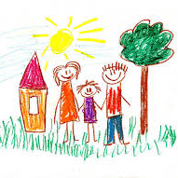
Who Helps you feel Safe?
Draw a picture of 2 grown-ups you can go to if you need help. 🖍️
It might be someone at home, school, or in your neighborhood.
Share (if you want) with a partner or the class.
Notes:
Section 1
Point 8: Identifying trusted adults
Rubric 1.8

Slide 11
Tricks Unsafe People Use
Notes:
.

Slide 12
Simple Tricks
Giving gifts or treats 🎁🍭
01
Asking to keep secrets 🤐
02
They might pretend to be a friend/make kids feel special🤝
03
Promising fun or adventures 🎉
04
Remember to tell a trusted adult!
Notes:
Section 1
Point 13: Grooming red flags
Point 12: Explanation of Grooming
Rubric: 1.10,1.11,1.12,1.13
Facilitator
Sometimes unsafe people try to trick kids to get them to trust them.
They might give gifts or candy, ask kids to keep secrets, pretend to be a special friend, or promise fun adventures.
These are tricks — not true friendship. If someone does these things and it feels “off,” kids should tell a safe adult right away.

Slide 13
Where can it happen?
On the computer
Tablet
Park
Playground
Neighborhoods
Notes:
Facilitator
Unsafe people might try to bother kids in different places. It could happen online, like on the computer or a tablet. It could also happen at the park, the playground, or even in your neighborhood. That’s why it’s important to listen to your feelings and always tell a safe adult if something feels wrong
Rubric: 1.12,1.14

Slide 14
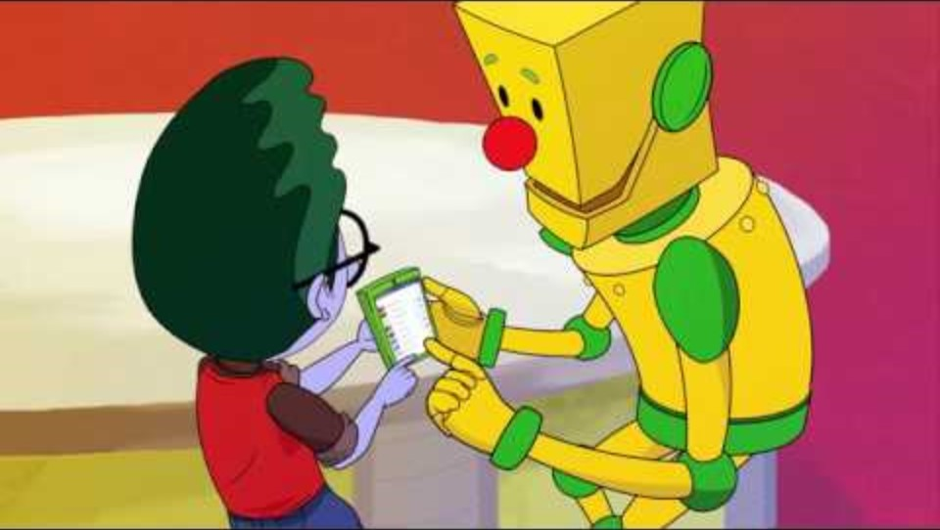
Connecting with New Friends Online📱💻
NetSmartz (National Center for Missing & Exploited Children – NCMEC)
Notes:
Point 14: Appropriate use of Technology
Point 19: The Risk of sharing intimate images or personal information through electronic means
Rubric: 1.14
Facilitator
Now we are going to watch a video about our friend Webster and how he connects with new friends online

Slide 15
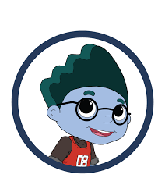

Brainstorm🧠⚡️
💭
How did Webster feel at first?
How did he get help?
What are some ways he is being safe online?
Notes:
Point 19: The risks of sharing intimate images or personal information through electronic means
Possible responses
-scared, nervous, unsure, pressured, sad, mad
-asked a parent/trusted adult if it was safe
-only added his friends and made account private
“Sometimes people online may say they want to be your friend, but we don’t always know who they really are.
Facilitator
*Sharing things like your name, where you live, or pictures can seem safe — but once it’s online, you can’t control who sees it.
Unsafe people might use that information to trick or hurt others.
That’s why it’s important to only connect with people you already know in real life and never share personal information online.
Let’s brainstorm together: what kinds of information should we never share online, and how can we stay safe instead?”

Slide 16
Signs Something May Be Wrong
Notes:
Point 4: Recognizing general warning sings of Human Trafficking
Point: 11 How to recognize general warning sings that a person may be abusing a child

Slide 17
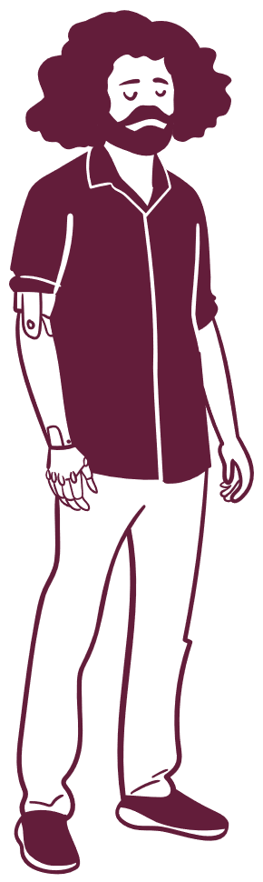
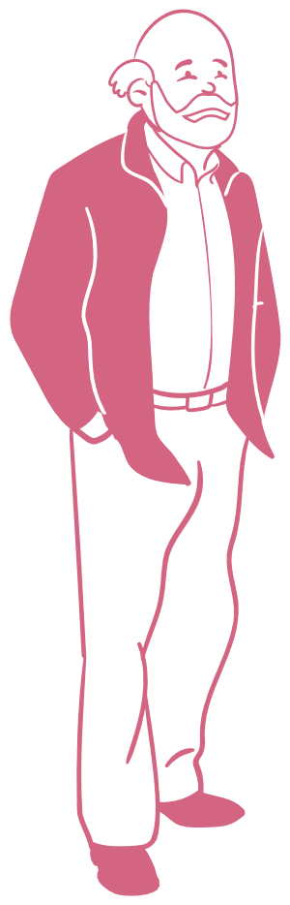
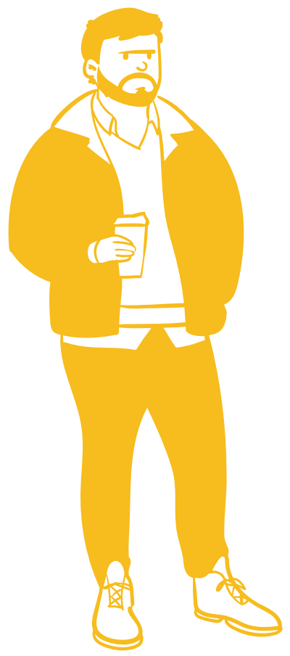
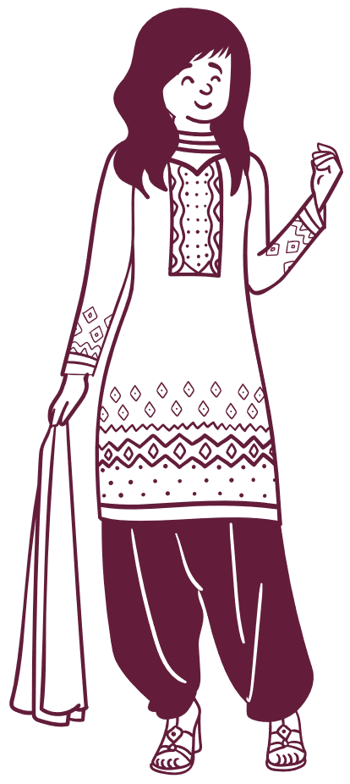
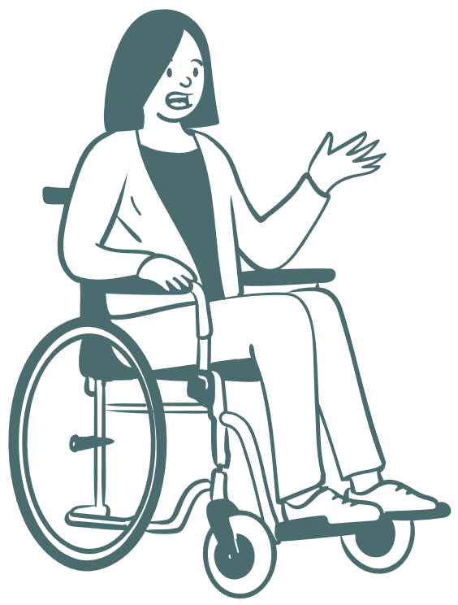
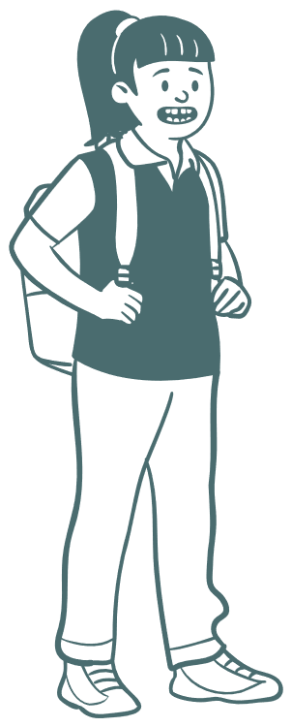
IT CAN HAPPEN TO ANYONE
No matter race, age, or gender.
Notes:
Rubric: 1.11
Unsafe things can happen to any kid.
It doesn’t matter what you look like, where you live, or who your family is.
That’s why it’s important for all kids to know how to stay safe and tell safe adults.

Slide 18
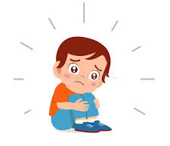
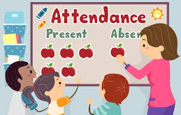
What to Notice if Somone isn’t Safe
A kid is missing a lot of school. 🎒
They seem hurt but don’t want to talk about it. 🤕
They are very tired, hungry, or not cared for. 😴🍎
They keep secrets or seem scared. 😟
👉 If you notice this in yourself or a friend → tell a safe adult.
Polaris Project
Notes:
Point 11: How to recognize general warning signs that a person may be abusing a child
Point 5 Sensitivity to prior abuse
Rubric:1.11
Adapted from Polaris Project, National Human Trafficking Hotline (RecognizPing the Signs of Trafficking).
Facilitator
Read through slide
“Sometimes kids may show signs that something is wrong. For example, they may be absent from school a lot, have injuries they don’t explain, or suddenly act very tired, hungry, or upset.”
“They might seem secretive, scared, or start avoiding people they used to trust.”
“These are warning signs — called ‘red flags’ — and they mean it’s time to talk to a trusted adult who can help.”

Slide 19
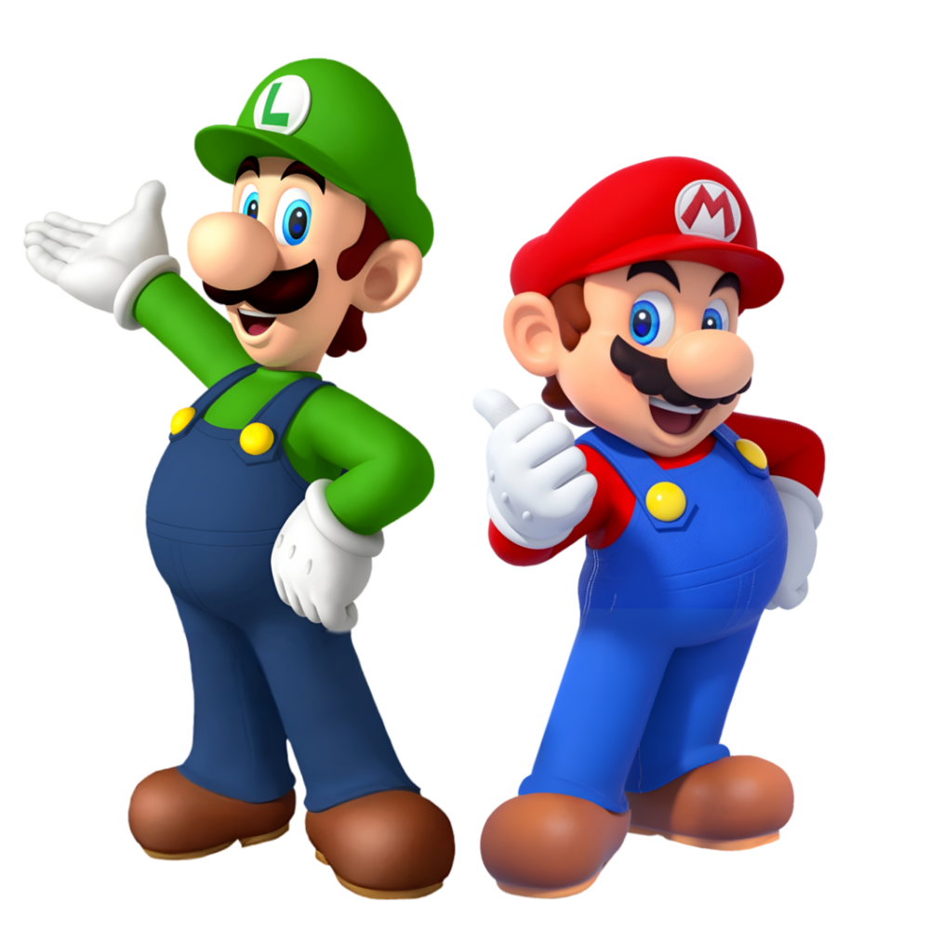
Safe Adult Behavior
Ask
Ask before hugs or high-fives 🤚
Respect
Respect when you say “no” 🚫
Keep
Keep you safe by having other adults nearby 👩‍👩‍👧
Talk in
Talk in a way that makes you feel safe 🤗
NCMEC, 2020
Notes:
Rubric:1.6
Facilitator
Read through slide
Some adults act in ways that help kids feel safe. Safe adults ask before hugs or high-fives, respect when you say no, and make sure you are never alone without other safe people nearby.

Slide 20
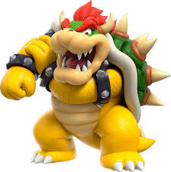
Unsafe Adult Behavior
Want
Don’t
Don’t listen when you say “stop” or “NO.”🛑
Offer
Make
Make you feel scared or “bad” 😟
Want to be alone with you in secret 🤐
Offer gifts but want you to keep secrets 🎁
NCMEC, 2020
Notes:
Rubric: 1.6
Facilitator
Read through slide
Unsafe adults sometimes break those rules. They might want to be alone with you, not listen when you say no, or ask you to keep secrets. If someone does this, tell a safe adult right away

Slide 21
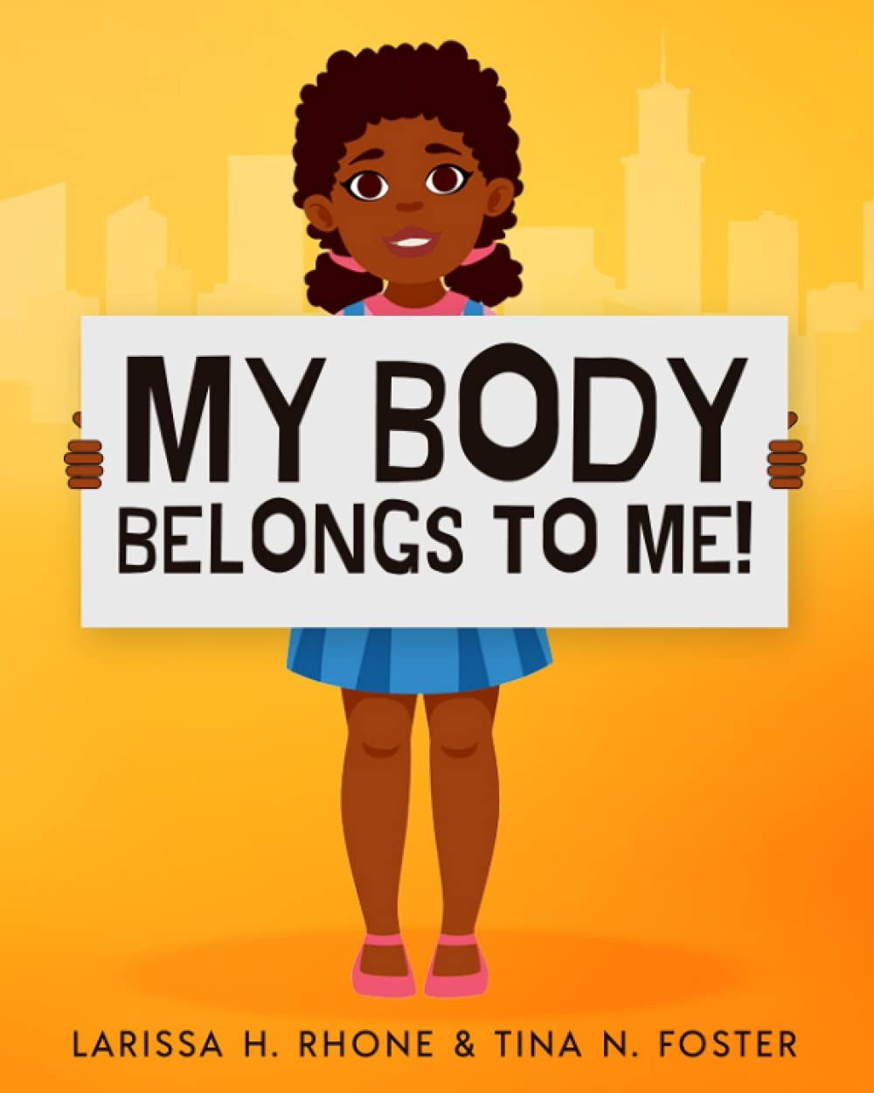
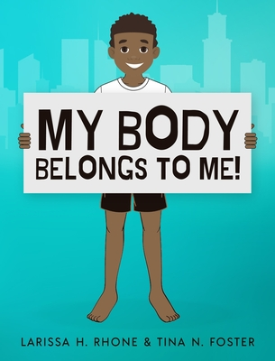
My Body, My Feelings
My body belongs to me. 🙋
I can say “No” to touches I don’t like. 🚫
If something feels wrong, tell a safe adult right away. 🛡️
Some secrets are not safe to keep. 🤐
It’s never my fault if I feel scared or uncomfortable.❤️
My Body Belongs to Me, 2019
Notes:
Point 7: Trust your Feelings
Point 9: Body Ownership
Point 10: No secrets about inappropriate activities (its ok to tell)
Point 5 Sensitivity to prior abuse
Rubric: 1.7,1.9, 1.10
Body Ownership:
“Remember, you’re in charge of your body. If someone’s touch feels uncomfortable, you have the right to say ‘No’ or ‘Stop,’ and then find a grown-up you trust.”
No Secrets About Inappropriate Activities:
“Some secrets, like birthday surprises, can be fun, but if anyone tells you to keep a secret about touching private areas or doing something that feels wrong, that’s not okay. Always tell a trusted adult.”
Trust Your Feelings:
“If you ever get a funny or nervous feeling in your tummy, that might be your body warning you something isn’t right. It’s important to talk to someone you trust—like a parent, teacher, or counselor—right away.”

Slide 22
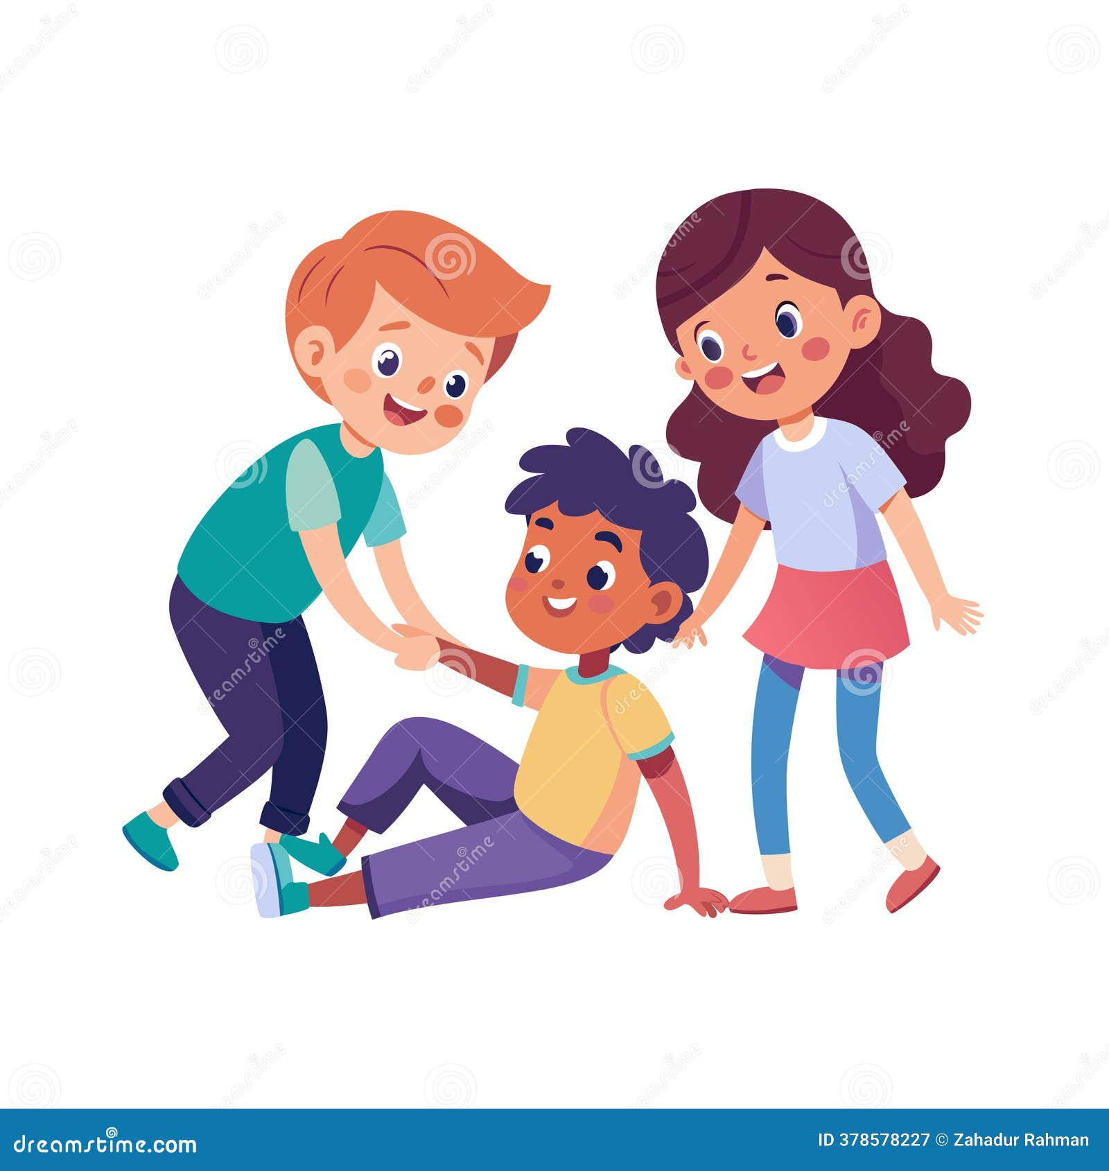
How to Stay Safe and Help a Friend

Slide 23
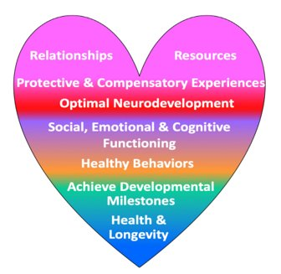
Things that Help Us Feel Safe and Strong
Having someone who loves and cares for you 💖
Playing with friends 👫
Trying fun things like sports, art, or reading 🎨⚽📚
Living in a safe home with food and care 🏡🍎
Having a teacher or mentor to help you learn 🍎👩‍🏫
World Psychiatry, 2023
Notes:
Section I Point 20: Protective Factors
Adapted from PACES diagram and word psychiatry, 2023
Facilitator:
Read Slide
Sometimes kids go through tough times, but there are things that help us feel strong. Having people who care, spending time with friends, trying fun hobbies, and being safe at home all help us feel better. We can also be helpers for others by including friends and being kind.

Slide 24
What You Can Do
Remember:
What you can do:
My body belongs to me 🙋
Safe adults want to help 🛡️
It’s never my fault ❤️
Tell a safe adult if something feels wrong 👩‍👩‍👧
Say “No” to touches or secrets I don’t like 🚫
Don’t keep unsafe secrets 🤐
Notes:
Point 8: Identifying a trusted adult
Point 5: Children are not responsible for human trafficking or abuse
Section III
Point 8: Being Safe in various situations
Point 16: Create a plan to tell a trusted adult
Point 17: What do if a child suggests their friend is being abused
Point 18: Reasons to Report
Rubric:1.9
Children should learn rules that keep them safe from people, places, and situations that make them feel unwelcomed, scared, uncomfortable, or confused. Remind children they have the right to say “no” in any situation that makes them feel unsafe, and they should tell a trusted adult (for example, parent, guardian, relative, teacher, and clergy). Children should learn skills to get them out of situations as fast as possible when the person, place, or situation makes them feel unwelcomed, scared, uncomfortable, or confused.

Slide 25
Verbal and Physical Safety Plans
Go to safe places like school, home, or the library 🏫🏠📚
Remember the names of safe adults who can help you 👩‍👩‍👧
If you can, learn a phone number for a parent or safe adult 📞
You and your safe adult can use a special code word if you ever need help 🔑
Notes:
Rubric: 1.10

Slide 26
Who Do I Tell?
Your job: tell a safe adult.
Their job: get help right away.
Safe adults can call:
📞 911 in an emergency
📞 Utah Human Trafficking Tip Line (24 hours): 801-200-3443
📞 National Human Trafficking Hotline: 1-888-373-7888
You don’t have to remember the numbers—just tell a grown-up.
Notes:
Point 9: How adult can report
Rubric 1.8,1.10
We want kids to know that keeping them safe isn’t their job—it’s an adult’s job. For little ones, just saying tell a safe adult is enough. For older kids, we explain that there are special numbers and hotlines safe adults can use. By middle school, students may want to know how these numbers work, but they still don’t have to handle it alone.”

Slide 27
Questions?
Notes:
MK

Slide 28
Utah Codes
Utah Code 53E-9-203
Utah Code 76-5-308
Utah Code 76-5-308.5
Utah Code 76-5-309
Utah Code 76-5-310
Utah Code 76-5-311
Utah Code 78A-6-105
Notes:
Point 1: Consistency with the law: the materials demonstrate an understanding of Utah Code as it applies to providing the material. They do not have inconsistencies with Utah’s laws regarding human trafficking or the code related to human trafficking prevention instructional materials

Slide 29
CONTACT
.
MK Galli
HTS Youth Outreach & Mentor Specialist
Asian Association of Utah
155 South 300 West
Salt Lake City, UT 84101
Mk.galli@aau-slc.org
(801) 990-9493
.
Notes:
CHANGE CONTACT INFO TO MK GALLI from adult serving youth
Here is my contact information, please feel free to reach out and connect with us, we’d love to hear from you.

Slide 30



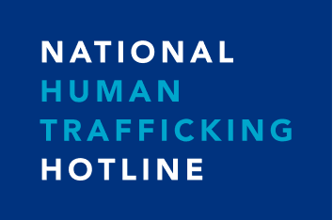
Resources
In the case of an emergency, call 911 or DCFS at 1-855-323-3237
UAGO Human Trafficking Tip Line
801-200-3443
Get Help
801-467-6060
801-281-1206
www.utiptaskforce.org
Respond 24/7 (ENG or SPA)
888-373-7888 or Text 233733

Slide 31
References
Online Safety (Do’s & Don’ts, Safe Sharing, Grooming, etc.)
  National Center for Missing & Exploited Children (NCMEC). NetSmartzKids Resources. 2020.
  Thorn. NoFiltr: Sextortion Awareness Campaign. 2024.
Indicators of Trafficking / Risk Factors
  Polaris Project. Recognizing Human Trafficking: Warning Signs and Vulnerabilities. 2020.
  Shared Hope International; National Human Trafficking Resource Center. Indicators of Sex Trafficking. 2017.
  U.S. Department of Education. Labor Trafficking in Schools: Warning Signs. 2015.
Safe vs. Unsafe Adult Behavior
  National Center for Missing & Exploited Children (NCMEC). Appropriate vs. Inappropriate Adult Behaviors. 2020.
Body Ownership / Secrets / Feelings
  Rhone, L. H., & Foster, T. N. My Body Belongs to Me. 2018.
  NCMEC. Child Safety Resources on Body Boundaries. 2020.
Healthy vs. Unhealthy Relationships (5–6)
  U.S. Department of Homeland Security. Blue Campaign: Healthy Relationships Resources. 2024.
Where Trafficking Can Happen / Vulnerabilities
  NCMEC. Child Safety & Exploitation: Where Grooming Can Occur. 2020.
  Polaris Project. Vulnerable Populations & Risk Factors. 2020.
General Reminders (It Can Happen to Anyone / Taking Action)
  NCMEC. Child Safety Is for Every Kid. 2020.
  Polaris Project. Human Trafficking Affects All Communities. 2020.
  Utah Attorney General’s Office. (2024). Utah Trafficking in Persons Task Force & Tip Line.

