Slide 1

DATA-DRIVEN STORYTELLING
TEACH YOUTH RADIO PRESENTS
SHOW ME THE DATA!

Slide 2


TOO OLD TO TRICK OR TREAT?
How old were you when you stopped trick-or-treating?

Slide 3

TOO OLD TO TRICK OR TREAT?
How do you know you're too old to trick or treat?

Slide 4
NUMBERS GIVE A SENSE OF SCOPE
Quantitative Data
Average = total/#of people Mode = most common # Median = # in the middle
Range = what's the lowest/highest #?

Slide 5
NARRATIVE PROVIDES FLAVOR
Qualitative Data
Examples = what's the narrative? Rationale = what are the reasons? Background = what's the history/context? Emotions = what are the stakes?

Slide 6

DATA
Do you start with a question... and then look for data?
Do you start a data set... and then look for trends?
STORY

Slide 7
Both!

Slide 8
DATA
STORY
TRICK OR TREAT - LEAD IN CANDY GAME
YOUTH RADIO NARCISSISM PODCAST

Slide 9
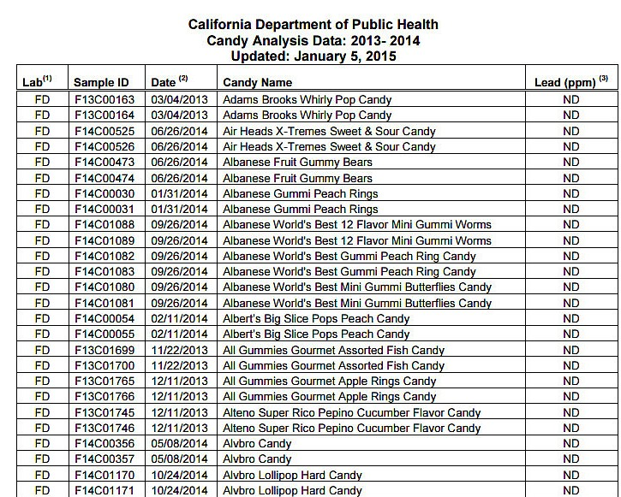

Slide 10
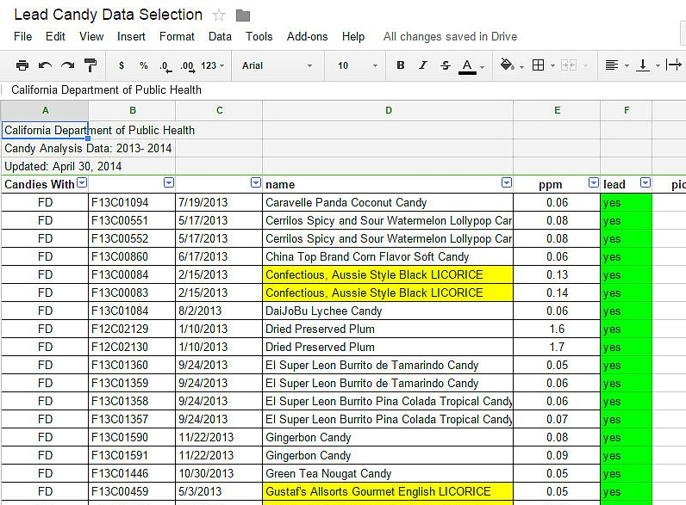

Slide 11
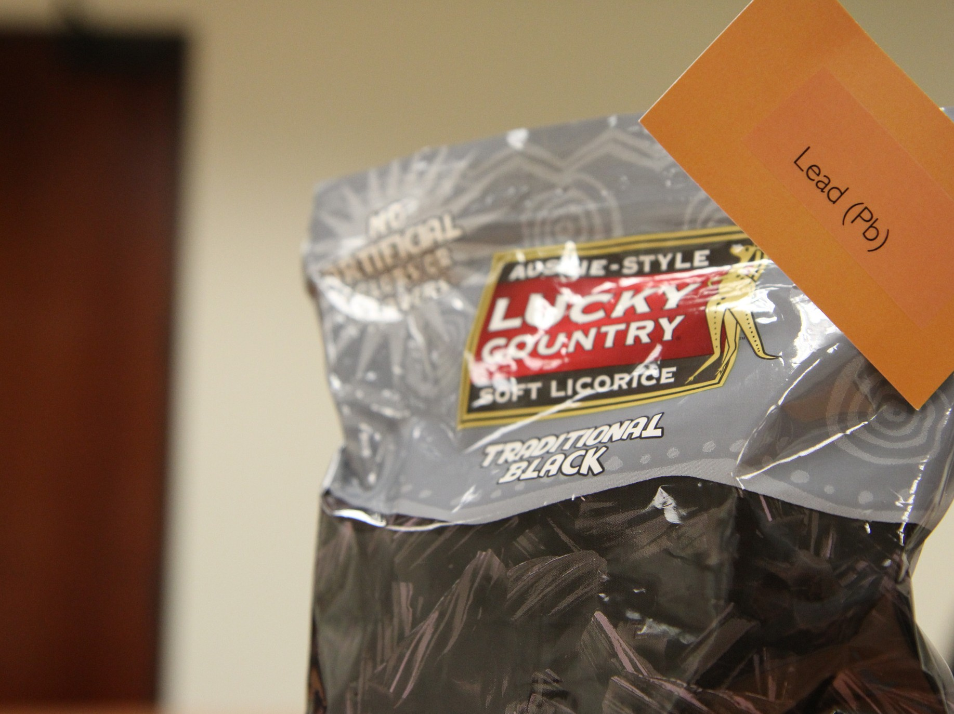

Slide 12
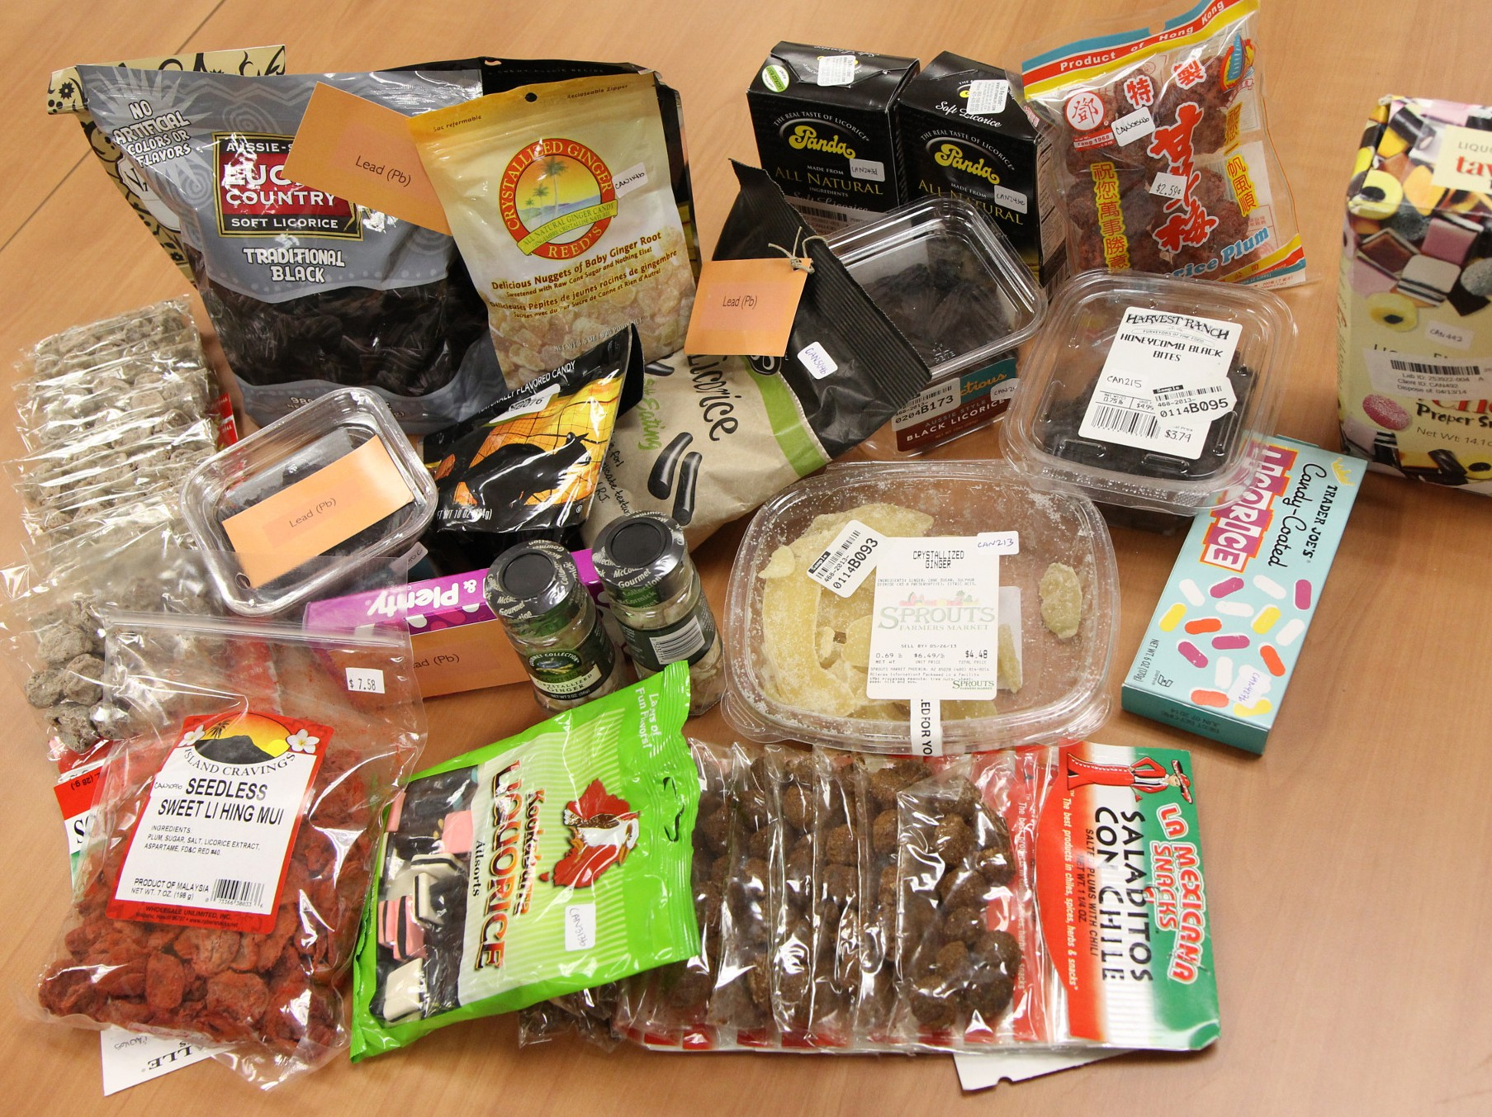

Slide 13
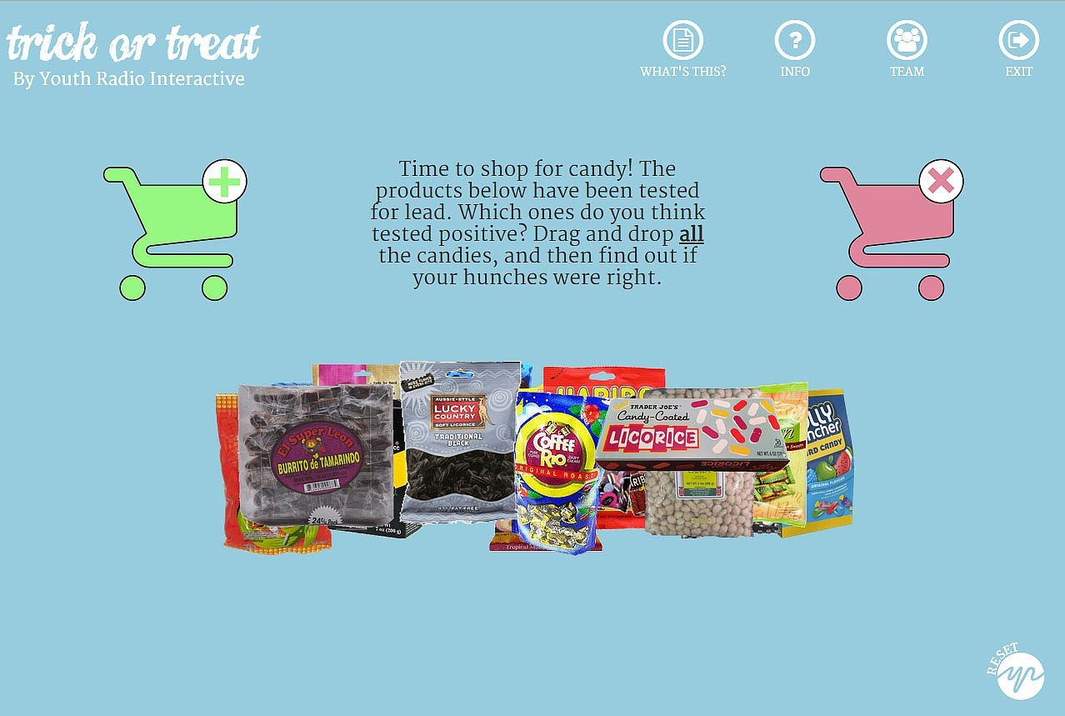
https://youthradio.org/trickortreat/

Slide 14
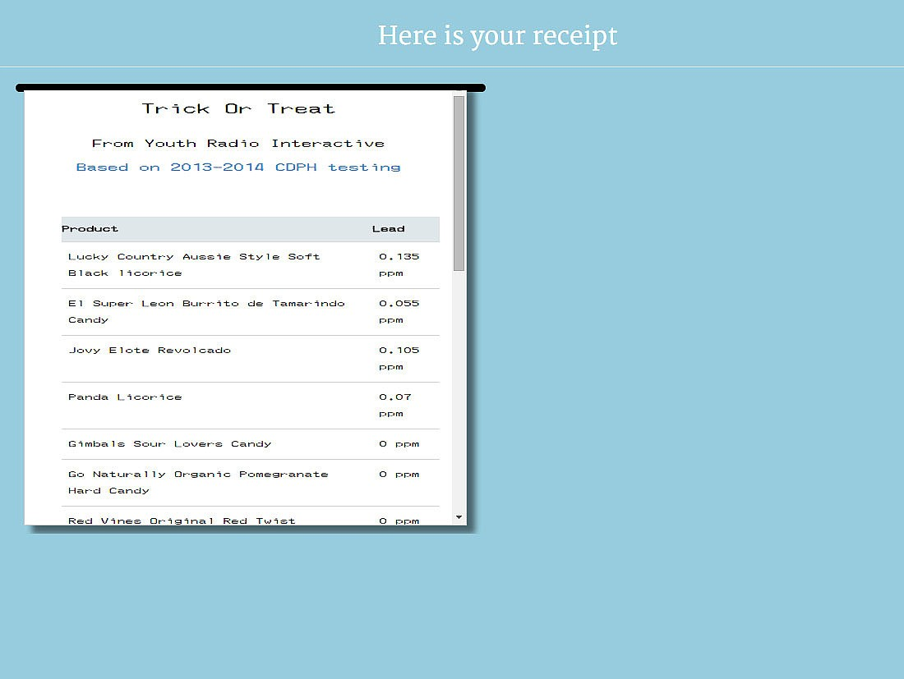

Slide 15
DATA
STORY
TRICK OR TREAT - LEAD IN CANDY GAME
YOUTH RADIO NARCISSISM PODCAST

Slide 16

"By comparing decades of personality test results, Dr. Twenge has concluded, over and over again, that younger generations are increasingly entitled, self-obsessed and unprepared for the realities of adult life."

Slide 17
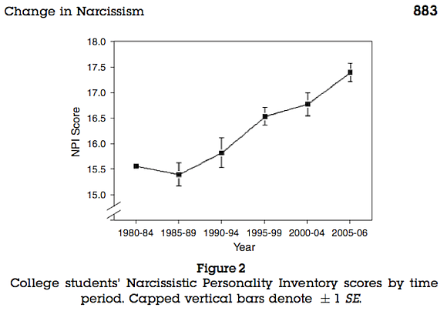

Slide 18
HOLD ON
Do we believe millennials score higher?
And if it IS true, what does it mean?
Why not have Youth Radio Newsroom Interns take the Narcissism Test
and see what they think!

Slide 19
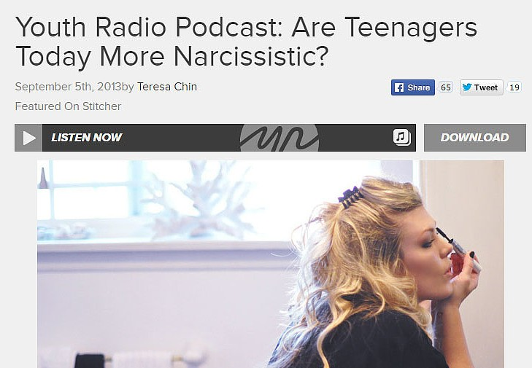
https://youthradio.org/news/article/youth-radio-podcast-millennial-narcissist/

Slide 20
STORY
DATA
UNLOCKED: THE UNDERSTAFFING OF JUVENILE HALL
TOO OLD TO TRICK-OR TREAT?

Slide 21

https://youthradio.org/unlocked/

Slide 22
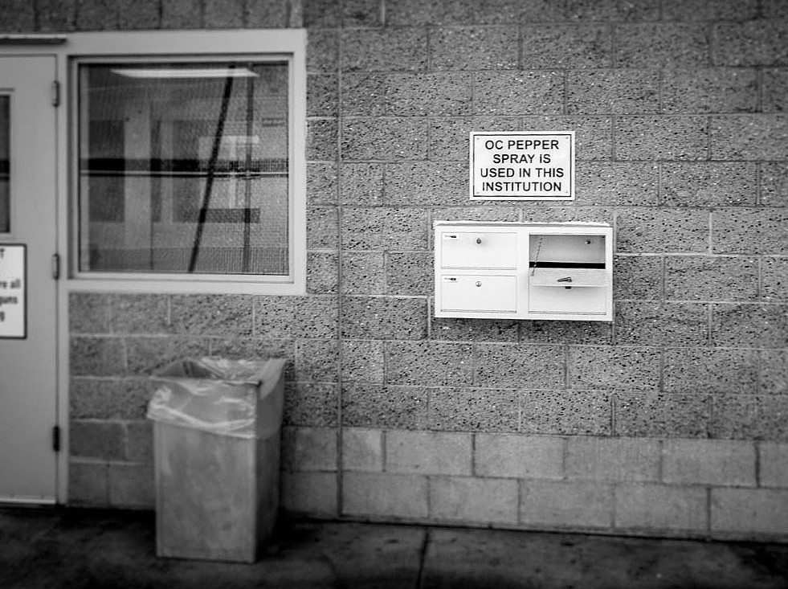

Slide 23
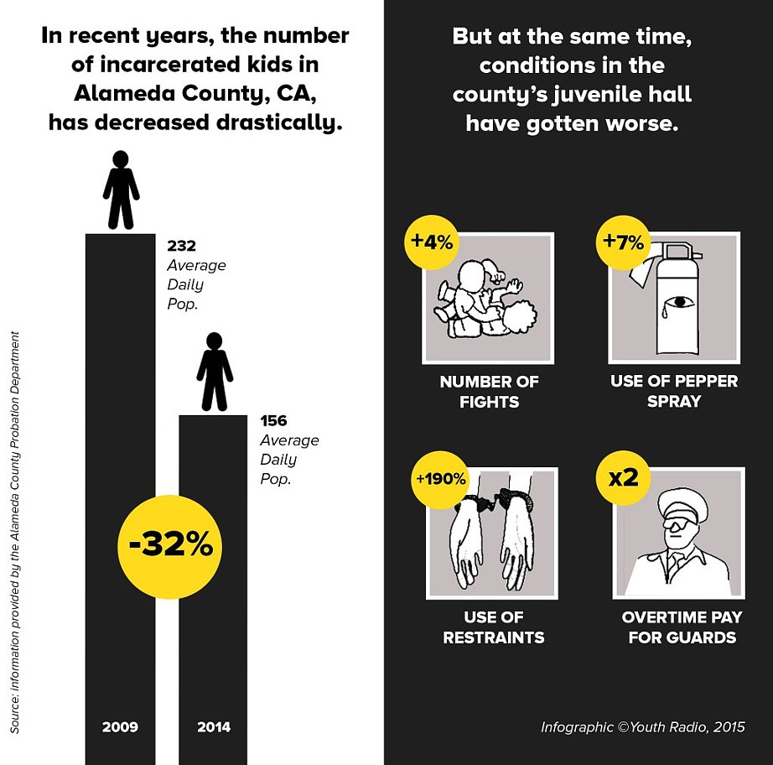

Slide 24
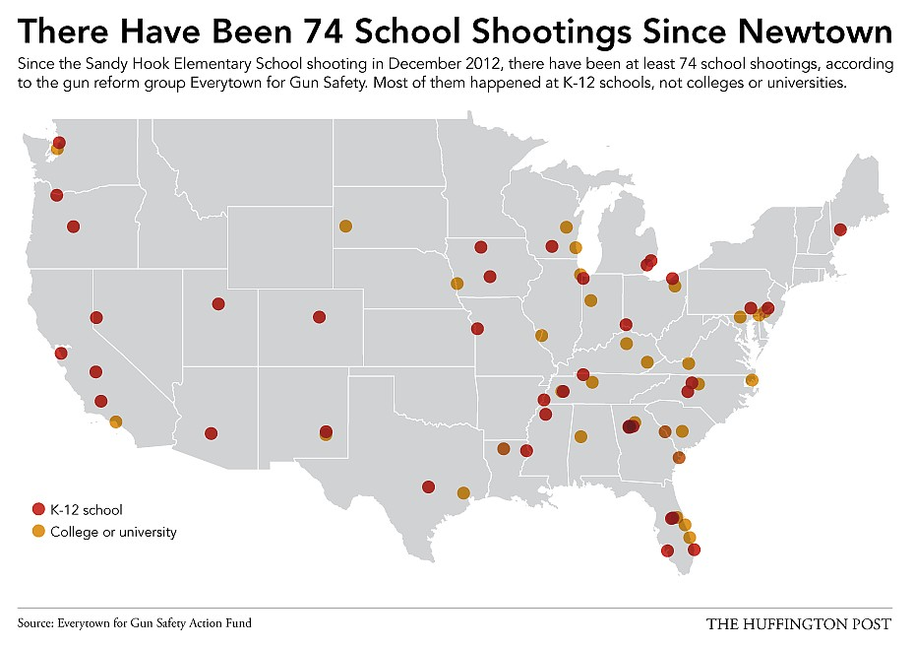
WHAT'S NEXT?

Slide 25
What's it like to grow up with increased awareness of school shootings?
Qualitative data - interviews from across the country Mixed data - timeline of childhood milestones + news events
Other ideas?

