Slide 1
TB-Scale Sorting on AWS
-- An Introduction
Qingye Jiang (John)
Cloud Support Engineer
Sydney Support Centre

Slide 2
TB-Scale Sorting on AWS
https://github.com/qyjohn/AWS_Tutorials/wiki/201.-Large-Scale-Sorting-on-EMR

Slide 3
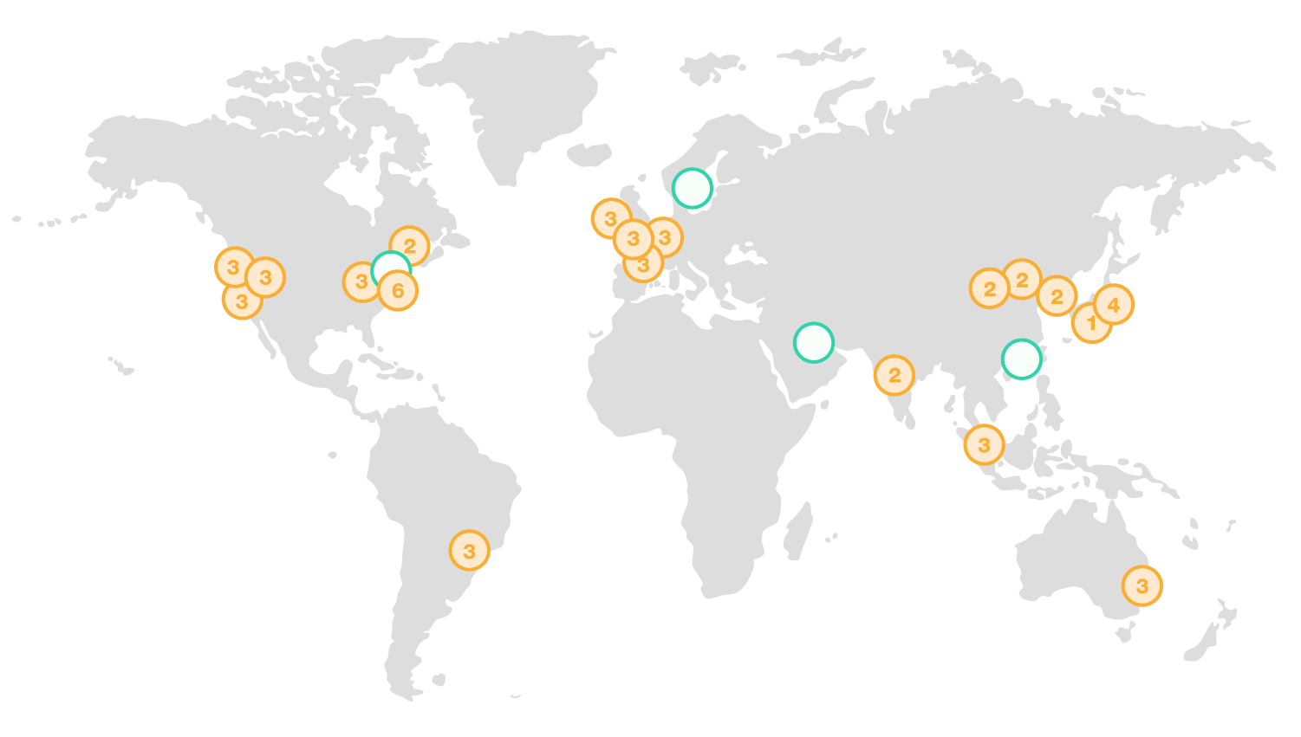
AWS Global Infrastructure - Regions

Slide 4
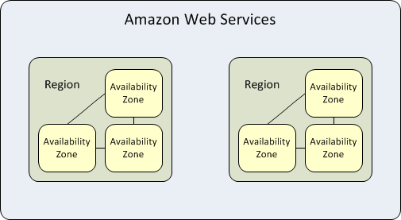
Availability Zones (AZ)
Notes:
MySQL example, you have a table with an integer field and two text field. Your server has 4 GB memory and 100 GB disk space. The total amount in the table is 40 GB. What would you see?
What if you have 50 GB data?

Slide 5
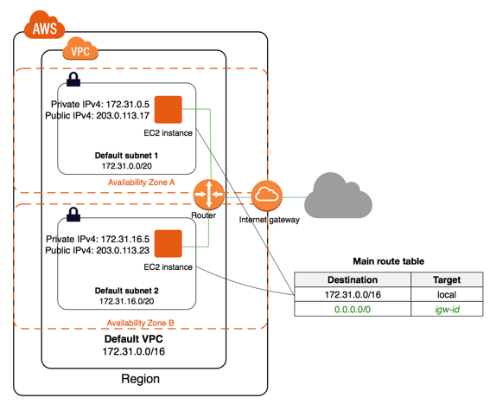
Virtual Private Cloud (VPC)
Notes:
MySQL example, you have a table with an integer field and two text field. Your server has 4 GB memory and 100 GB disk space. The total amount in the table is 40 GB. What would you see?
What if you have 50 GB data?

Slide 6
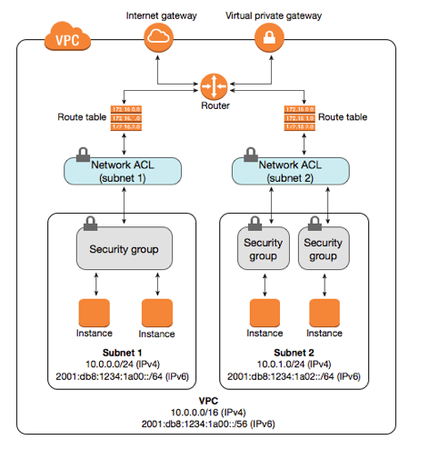
Security Model
Notes:
MySQL example, you have a table with an integer field and two text field. Your server has 4 GB memory and 100 GB disk space. The total amount in the table is 40 GB. What would you see?
What if you have 50 GB data?

Slide 7
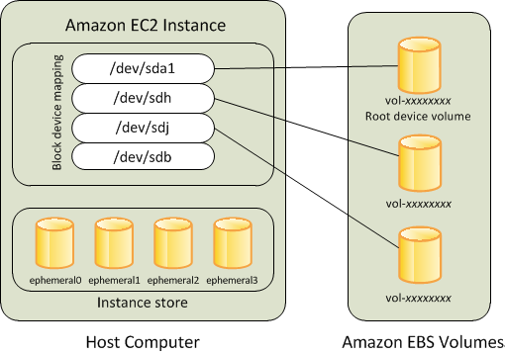
Storage Devices
Notes:
MySQL example, you have a table with an integer field and two text field. Your server has 4 GB memory and 100 GB disk space. The total amount in the table is 40 GB. What would you see?
What if you have 50 GB data?

Slide 8
Launch Your First EC2 Instance
Pick an AWS region for your work.
You need to create or import a key pair.
In the EC2 Console launch an EC2 instance (t2.micro) with your favorite operating system.
Configure the security group to allow SSH connection from your own IP address.
Specify the key pair to use for the EC2 instance.
Use an SSH client to connect to your EC2 instance.
Terminate your EC2 instance after playing with it.
Notes:
MySQL example, you have a table with an integer field and two text field. Your server has 4 GB memory and 100 GB disk space. The total amount in the table is 40 GB. What would you see?
What if you have 50 GB data?

Slide 9
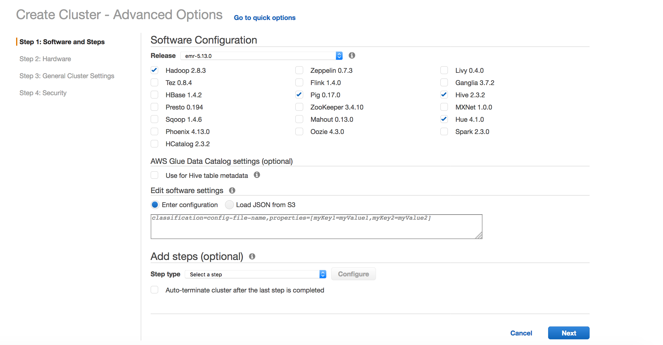
Launch Your First EMR Cluster
Notes:
MySQL example, you have a table with an integer field and two text field. Your server has 4 GB memory and 100 GB disk space. The total amount in the table is 40 GB. What would you see?
What if you have 50 GB data?

Slide 10
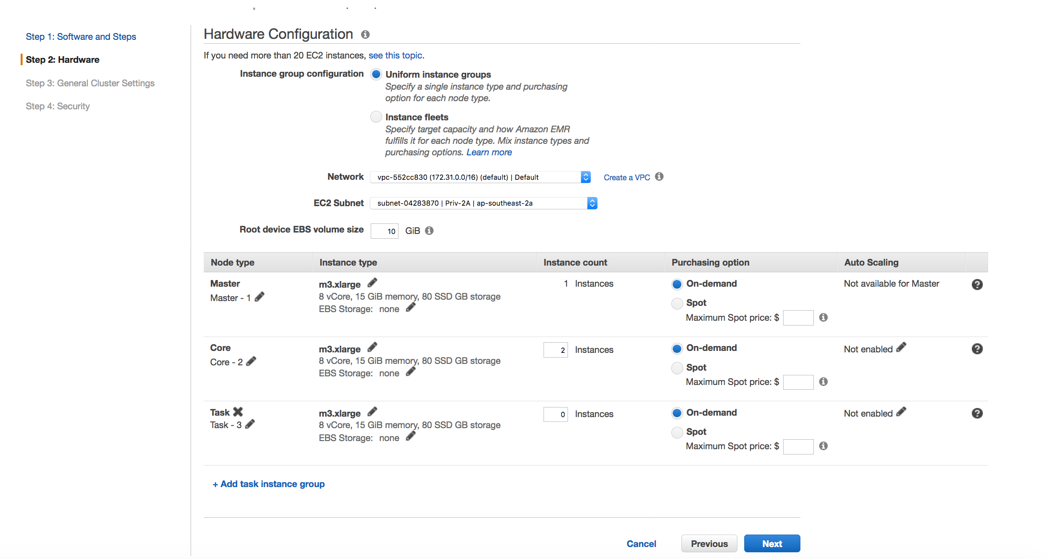
Launch Your First EMR Cluster
Notes:
MySQL example, you have a table with an integer field and two text field. Your server has 4 GB memory and 100 GB disk space. The total amount in the table is 40 GB. What would you see?
What if you have 50 GB data?

Slide 11
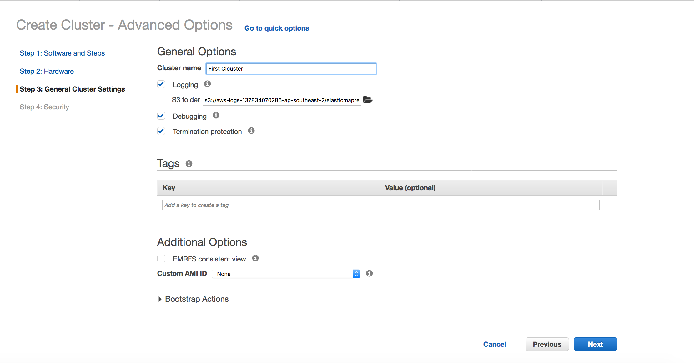
Launch Your First EMR Cluster
Notes:
MySQL example, you have a table with an integer field and two text field. Your server has 4 GB memory and 100 GB disk space. The total amount in the table is 40 GB. What would you see?
What if you have 50 GB data?

Slide 12
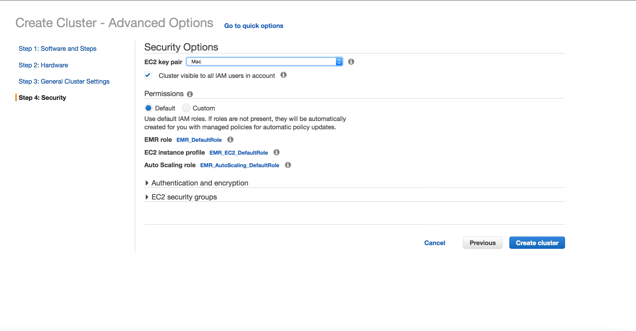
Launch Your First EMR Cluster
Notes:
MySQL example, you have a table with an integer field and two text field. Your server has 4 GB memory and 100 GB disk space. The total amount in the table is 40 GB. What would you see?
What if you have 50 GB data?

Slide 13
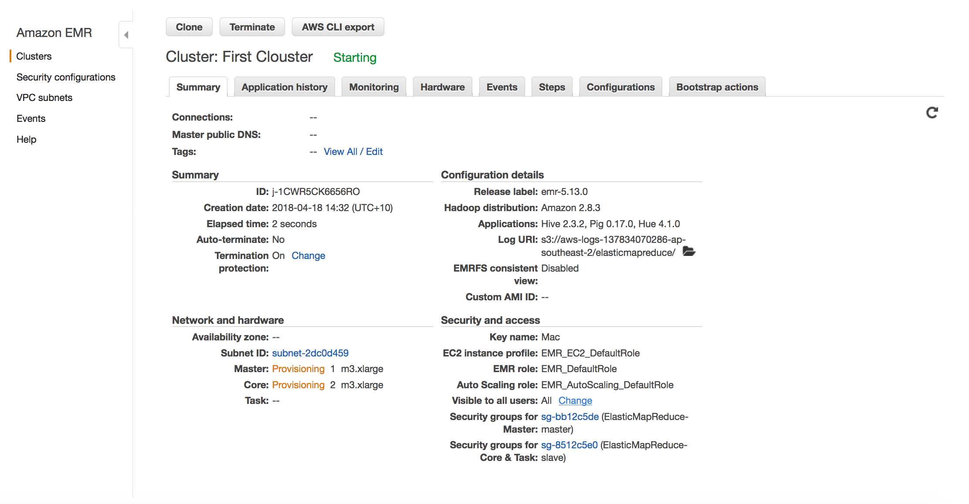
Launch Your First EMR Cluster
Notes:
MySQL example, you have a table with an integer field and two text field. Your server has 4 GB memory and 100 GB disk space. The total amount in the table is 40 GB. What would you see?
What if you have 50 GB data?

Slide 14
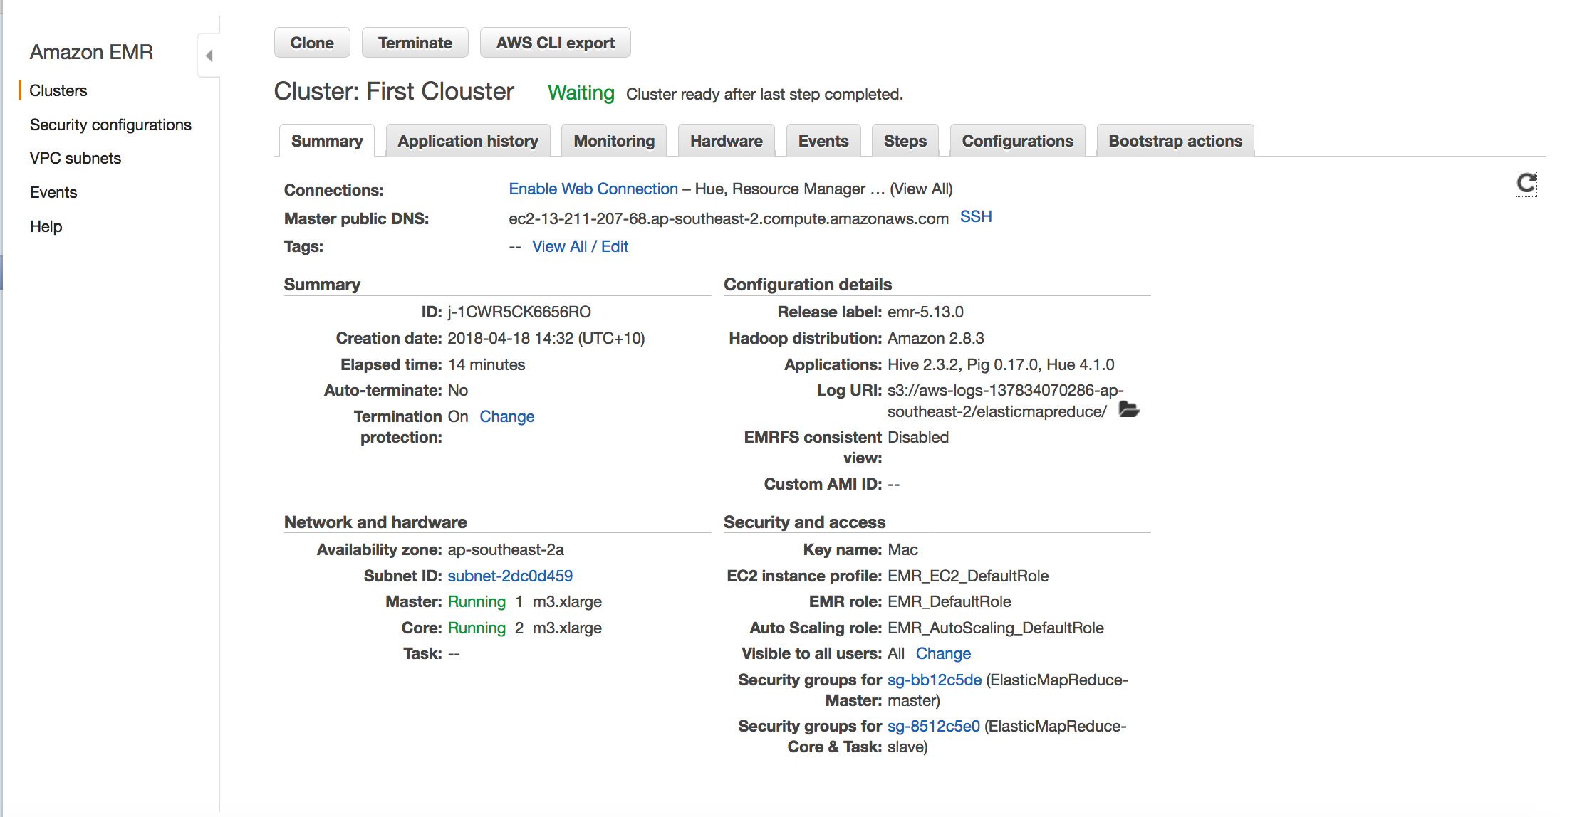
Launch Your First EMR Cluster
Notes:
MySQL example, you have a table with an integer field and two text field. Your server has 4 GB memory and 100 GB disk space. The total amount in the table is 40 GB. What would you see?
What if you have 50 GB data?

Slide 15
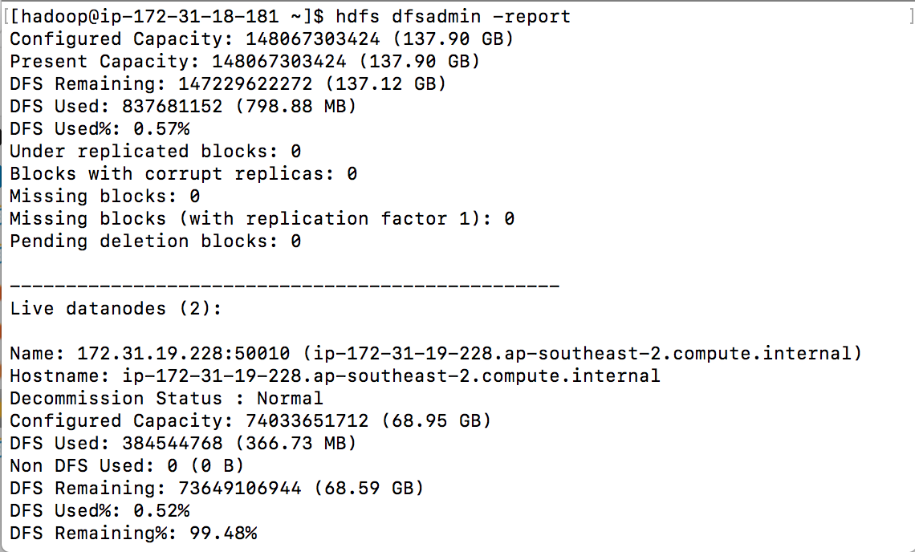
HDFS Report
$ hdfs dfsadmin -report
Notes:
MySQL example, you have a table with an integer field and two text field. Your server has 4 GB memory and 100 GB disk space. The total amount in the table is 40 GB. What would you see?
What if you have 50 GB data?

Slide 16
100 MB - Generate Input Data
$ hadoop jar /usr/lib/hadoop-mapreduce/hadoop-mapreduce-examples.jar teragen 1000000 /teraInput
teragen – The application to run
1000000 – The number of records to generate, 100 bytes per record. With 1000000 records, the data size is 100 MB.
/teraInput – The HDFS folder to store the generated data.
About 30 seconds.
Notes:
MySQL example, you have a table with an integer field and two text field. Your server has 4 GB memory and 100 GB disk space. The total amount in the table is 40 GB. What would you see?
What if you have 50 GB data?

Slide 17
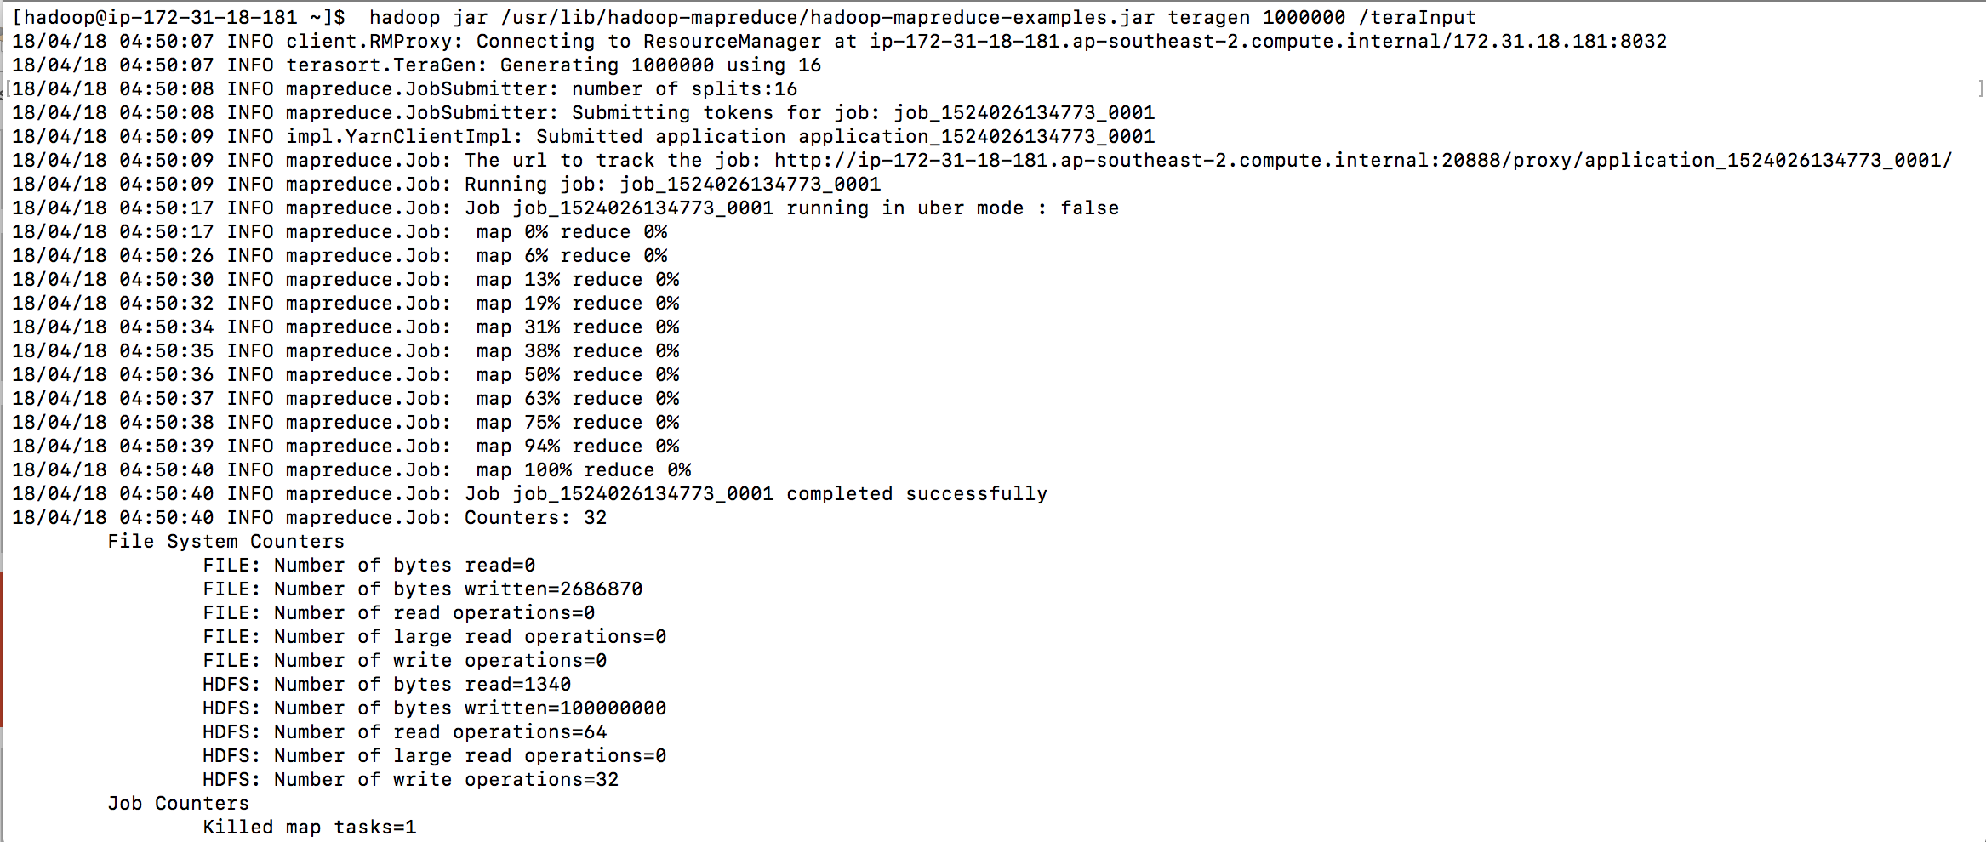
100 MB - Generate Input Data
Notes:
MySQL example, you have a table with an integer field and two text field. Your server has 4 GB memory and 100 GB disk space. The total amount in the table is 40 GB. What would you see?
What if you have 50 GB data?

Slide 18
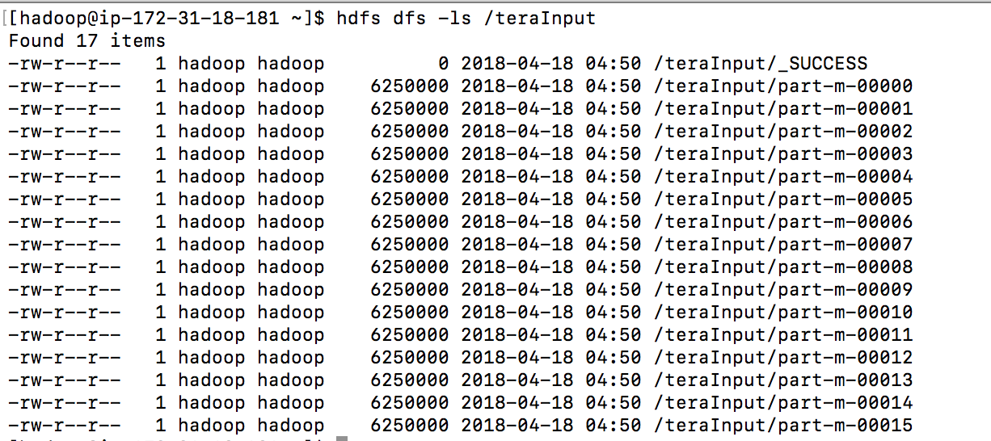
100 MB - Generate Input Data
Notes:
MySQL example, you have a table with an integer field and two text field. Your server has 4 GB memory and 100 GB disk space. The total amount in the table is 40 GB. What would you see?
What if you have 50 GB data?

Slide 19
100 MB - Sorting
$ hadoop jar /usr/lib/hadoop-mapreduce/hadoop-mapreduce-examples.jar terasort /teraInput /teraOutput
terasort – The application to run
/teraInput – The HDFS folder that stores the input data
/teraOutput – The HDFS folder to store the output data
About 40 seconds.
Notes:
MySQL example, you have a table with an integer field and two text field. Your server has 4 GB memory and 100 GB disk space. The total amount in the table is 40 GB. What would you see?
What if you have 50 GB data?

Slide 20
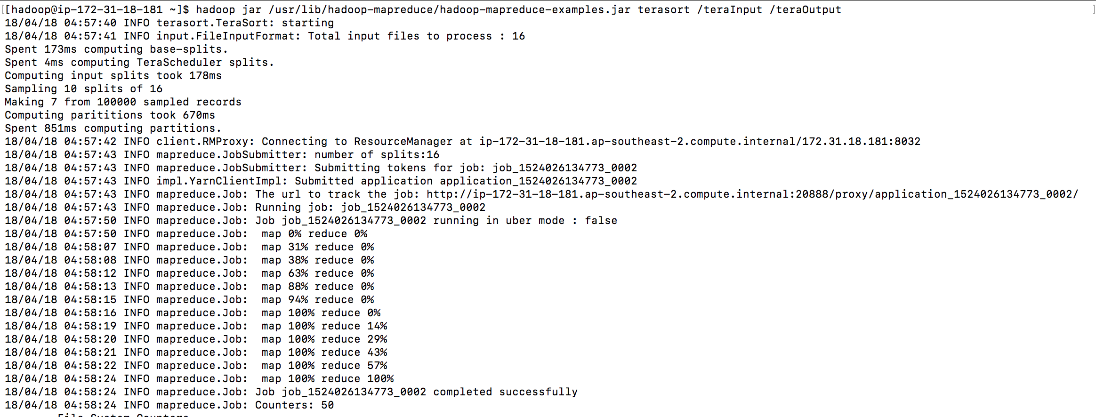
100 MB - Sorting
Notes:
MySQL example, you have a table with an integer field and two text field. Your server has 4 GB memory and 100 GB disk space. The total amount in the table is 40 GB. What would you see?
What if you have 50 GB data?

Slide 21
100 MB - Validation
$ hadoop jar /usr/lib/hadoop-mapreduce/hadoop-mapreduce-examples.jar teravalidate /teraOutput /teraReport
teravalidate – The application to run
/teraOutput – The HDFS folder that stores the sorting results
/teraReport – The HDFS folder to store the validation results
About 20 seconds
Notes:
MySQL example, you have a table with an integer field and two text field. Your server has 4 GB memory and 100 GB disk space. The total amount in the table is 40 GB. What would you see?
What if you have 50 GB data?

Slide 22
100 MB - Validation
Notes:
MySQL example, you have a table with an integer field and two text field. Your server has 4 GB memory and 100 GB disk space. The total amount in the table is 40 GB. What would you see?
What if you have 50 GB data?

Slide 23
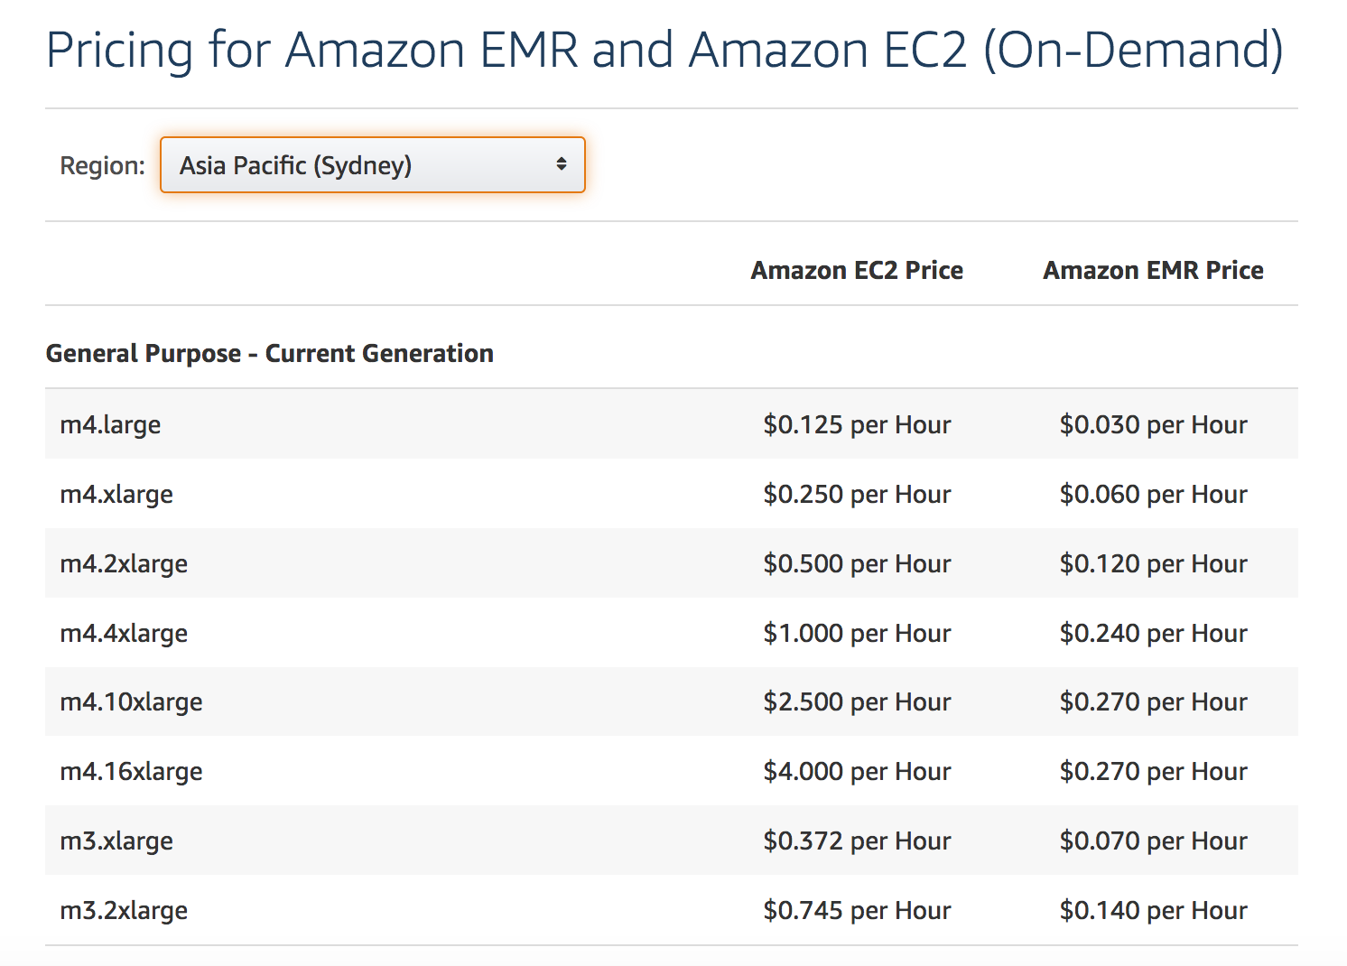
100 MB - Cost Estimation
3 m3.xlarge nodes
3 x (0.372 + 0.070) = $1.326 / hour
3 minutes -> $0.066
Notes:
MySQL example, you have a table with an integer field and two text field. Your server has 4 GB memory and 100 GB disk space. The total amount in the table is 40 GB. What would you see?
What if you have 50 GB data?

Slide 24
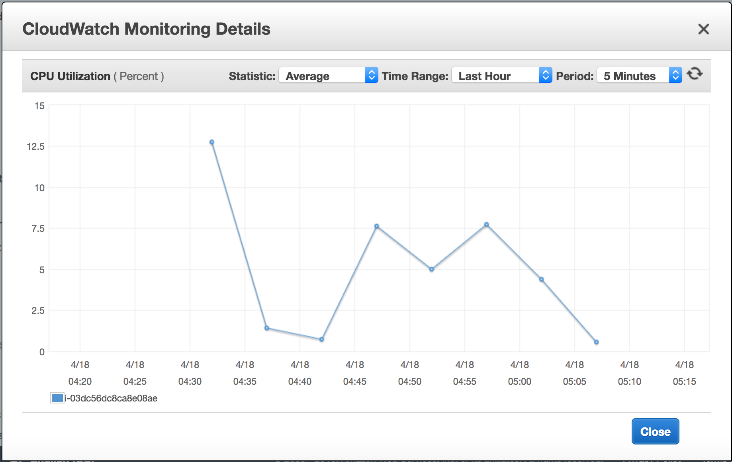
100 MB - CloudWatch Metrics
Notes:
MySQL example, you have a table with an integer field and two text field. Your server has 4 GB memory and 100 GB disk space. The total amount in the table is 40 GB. What would you see?
What if you have 50 GB data?

Slide 25
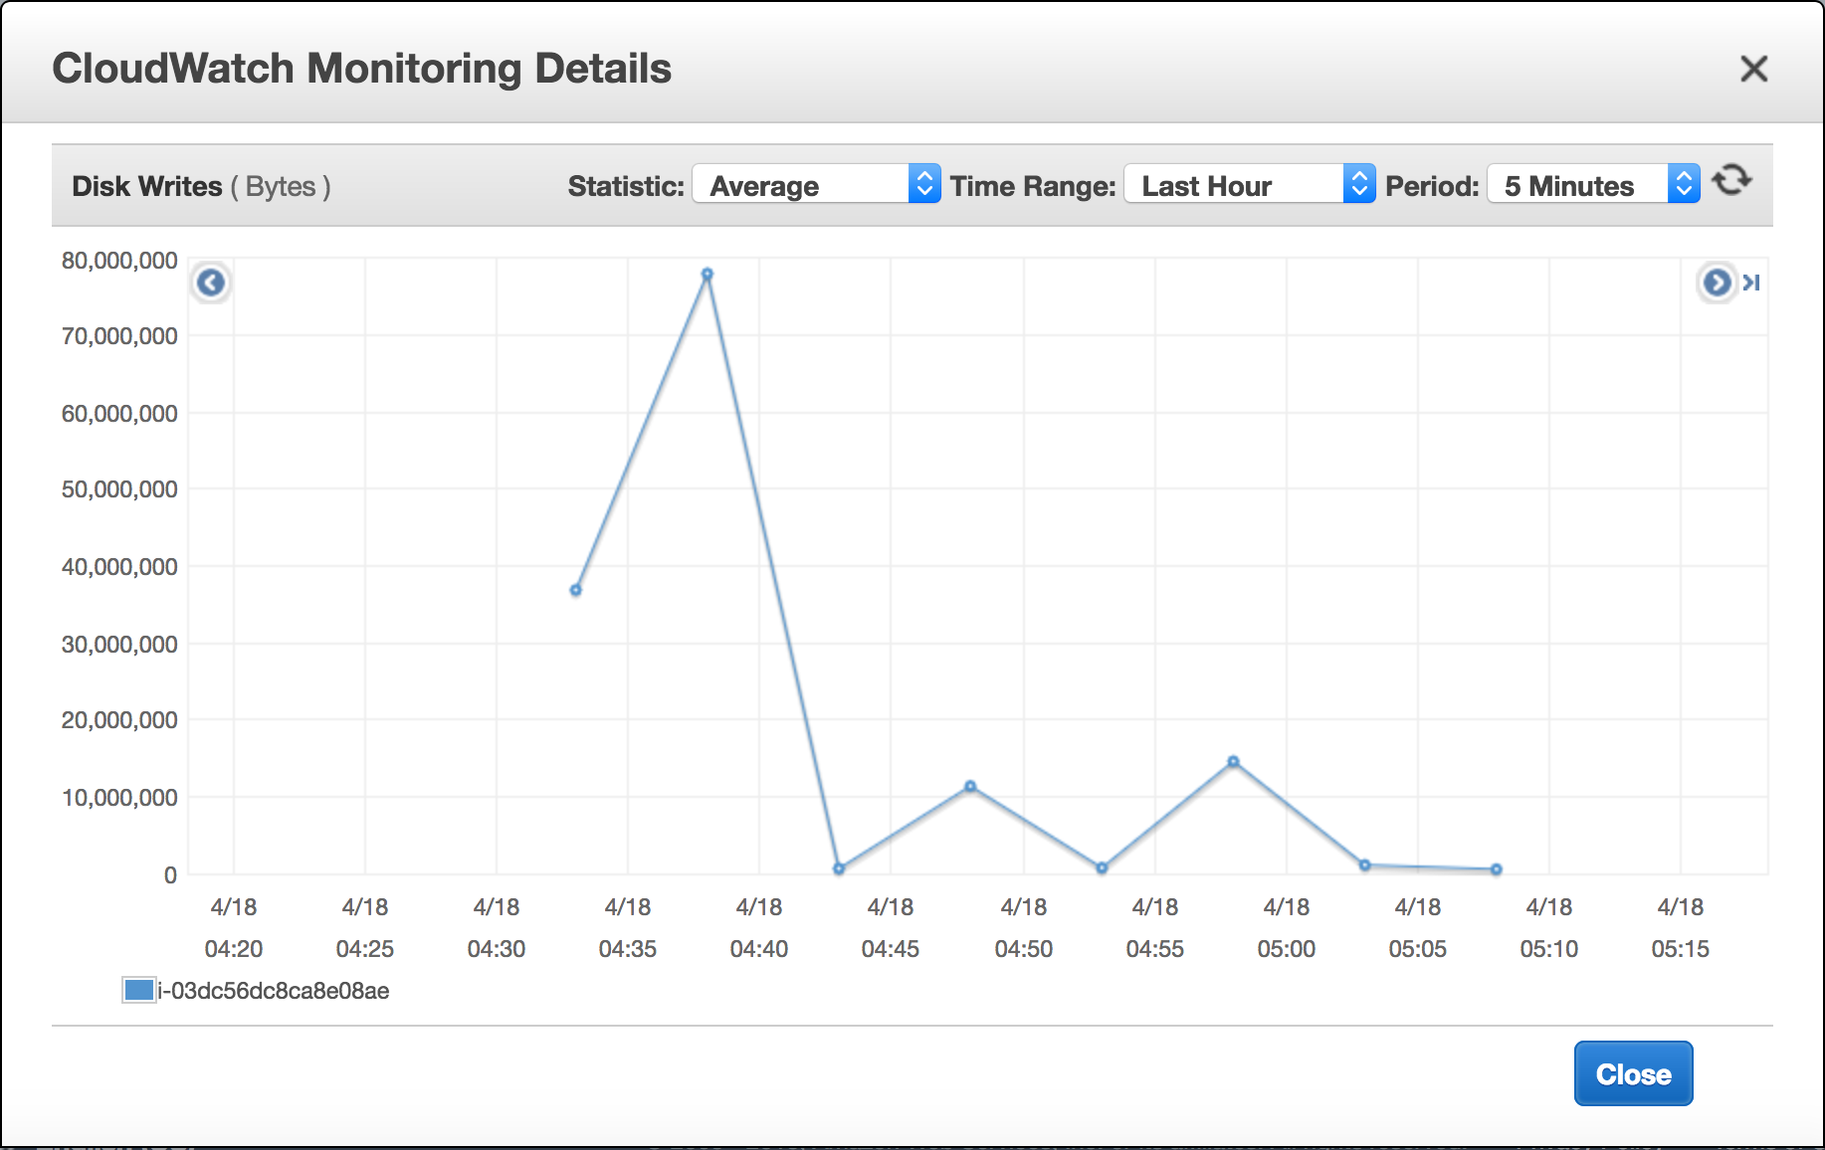
100 MB - CloudWatch Metrics
Notes:
MySQL example, you have a table with an integer field and two text field. Your server has 4 GB memory and 100 GB disk space. The total amount in the table is 40 GB. What would you see?
What if you have 50 GB data?

Slide 26
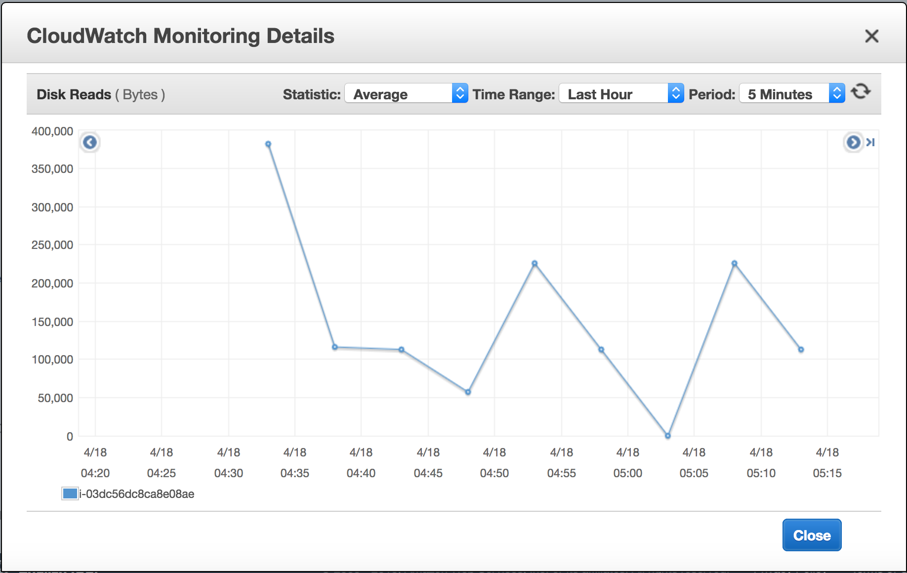
100 MB - CloudWatch Metrics
Notes:
MySQL example, you have a table with an integer field and two text field. Your server has 4 GB memory and 100 GB disk space. The total amount in the table is 40 GB. What would you see?
What if you have 50 GB data?

Slide 27
1 GB Example
Enable Detailed Monitoring for all nodes
$ hadoop jar /usr/lib/hadoop-mapreduce/hadoop-mapreduce-examples.jar teragen 10000000 /1GB-in
$ hadoop jar /usr/lib/hadoop-mapreduce/hadoop-mapreduce-examples.jar terasort /1GB-in /1GB-out
$ hadoop jar /usr/lib/hadoop-mapreduce/hadoop-mapreduce-examples.jar teravalidate /1GB-out /1GB-report
3 minutes -> $0.066
Notes:
MySQL example, you have a table with an integer field and two text field. Your server has 4 GB memory and 100 GB disk space. The total amount in the table is 40 GB. What would you see?
What if you have 50 GB data?

Slide 28
10 GB Example
Enable Detailed Monitoring for all nodes
$ hadoop jar /usr/lib/hadoop-mapreduce/hadoop-mapreduce-examples.jar teragen 100000000 /10GB-in
$ hadoop jar /usr/lib/hadoop-mapreduce/hadoop-mapreduce-examples.jar terasort /10GB-in /10GB-out
$ hadoop jar /usr/lib/hadoop-mapreduce/hadoop-mapreduce-examples.jar teravalidate /10GB-out /10GB-report
7 minutes -> $0.155
Notes:
MySQL example, you have a table with an integer field and two text field. Your server has 4 GB memory and 100 GB disk space. The total amount in the table is 40 GB. What would you see?
What if you have 50 GB data?

Slide 29
20 GB Example
Enable Detailed Monitoring for all nodes
$ hadoop jar /usr/lib/hadoop-mapreduce/hadoop-mapreduce-examples.jar teragen 200000000 /20GB-in
$ hadoop jar /usr/lib/hadoop-mapreduce/hadoop-mapreduce-examples.jar terasort /20GB-in /20GB-out
$ hadoop jar /usr/lib/hadoop-mapreduce/hadoop-mapreduce-examples.jar teravalidate /20GB-out /20GB-report
15 minutes -> $0.34
Notes:
MySQL example, you have a table with an integer field and two text field. Your server has 4 GB memory and 100 GB disk space. The total amount in the table is 40 GB. What would you see?
What if you have 50 GB data?

Slide 30
10/20 GB Example
Look into your CloudWatch metrics to understand what was happening.
What is the biggest data set you can sort on this cluster? What would you see if the data set is bigger than that?
What do you need to do to perform a 1-TB sorting?
What is the estimated cost to perform a 1-TB sorting?
Notes:
MySQL example, you have a table with an integer field and two text field. Your server has 4 GB memory and 100 GB disk space. The total amount in the table is 40 GB. What would you see?
What if you have 50 GB data?

Slide 31
Get Ready for Tomorrow
Terminate your EMR cluster now (to save money)
Learn the basics of Hadoop.
Do you have the passion to achieve better performance with less cost?
Do you want to start from day 1 everyday?
Notes:
MySQL example, you have a table with an integer field and two text field. Your server has 4 GB memory and 100 GB disk space. The total amount in the table is 40 GB. What would you see?
What if you have 50 GB data?

