Slide 1
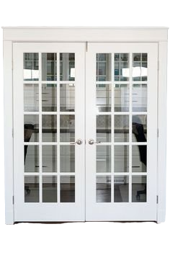
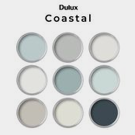
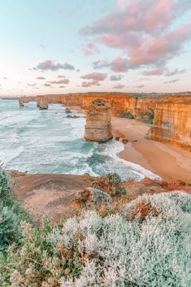
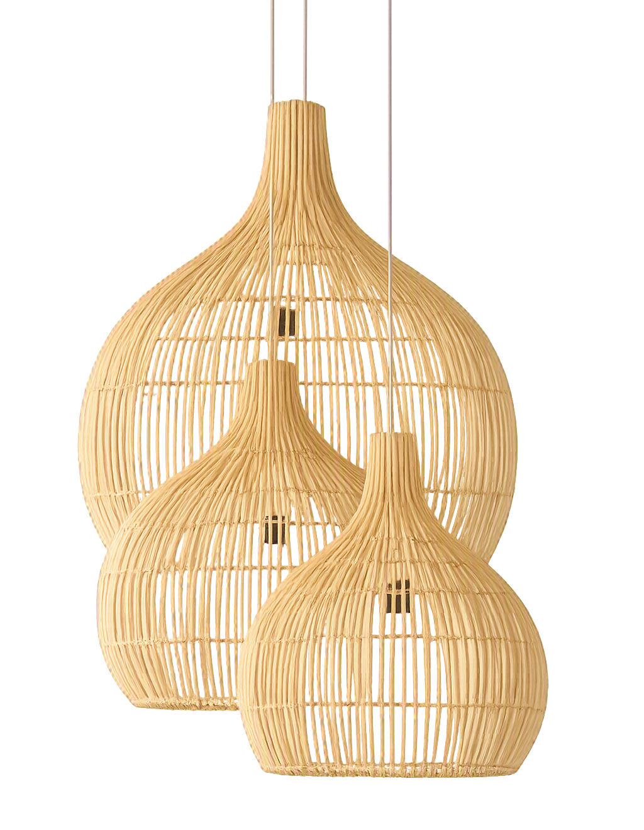
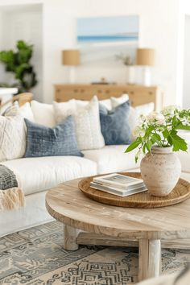
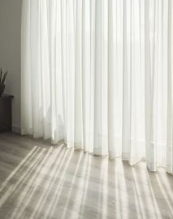
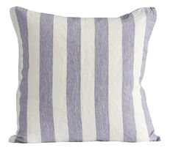
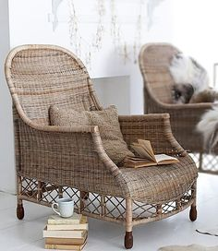
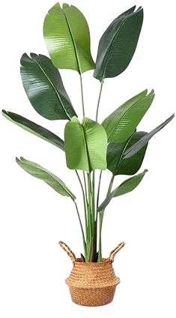
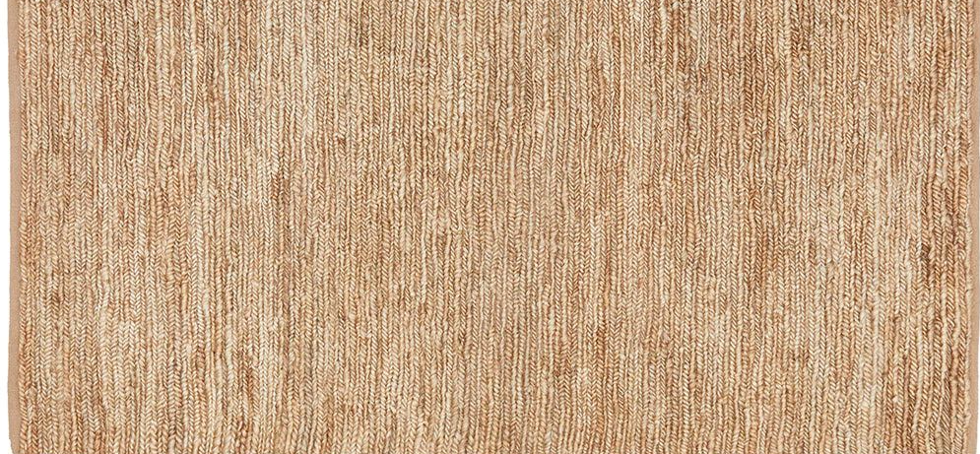
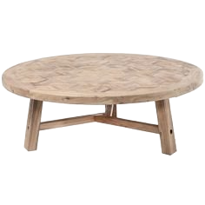
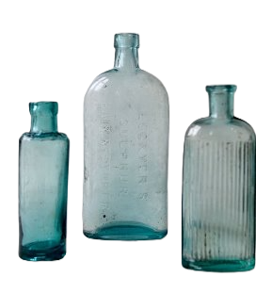
COASTAL

Slide 2
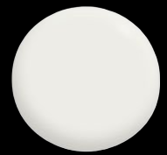
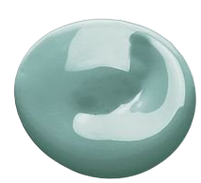
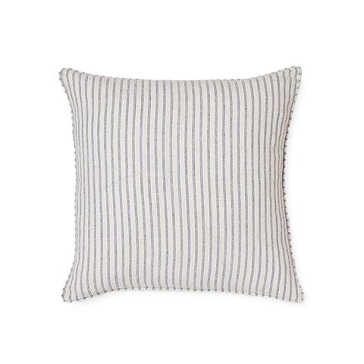
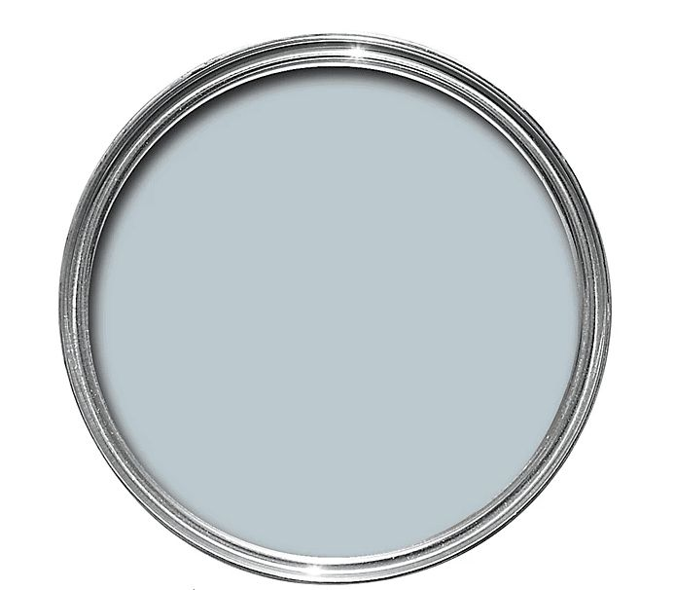
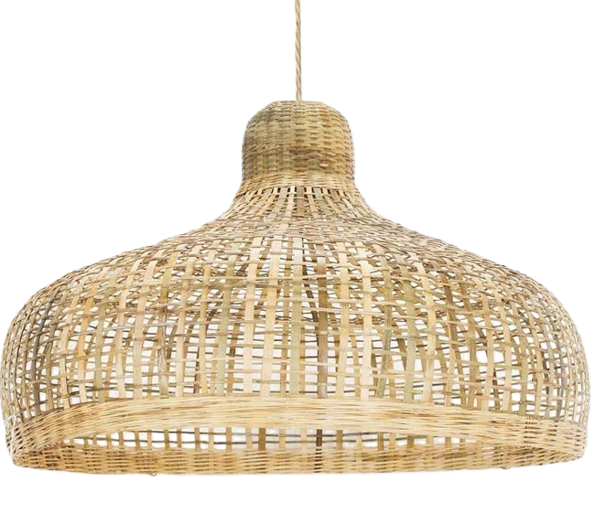
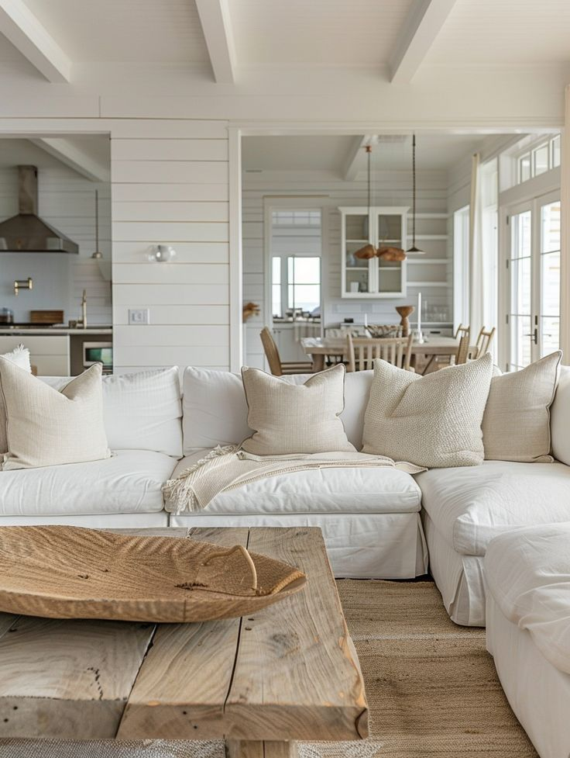
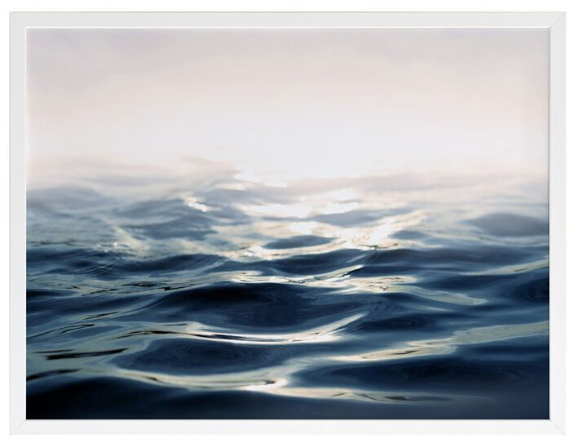
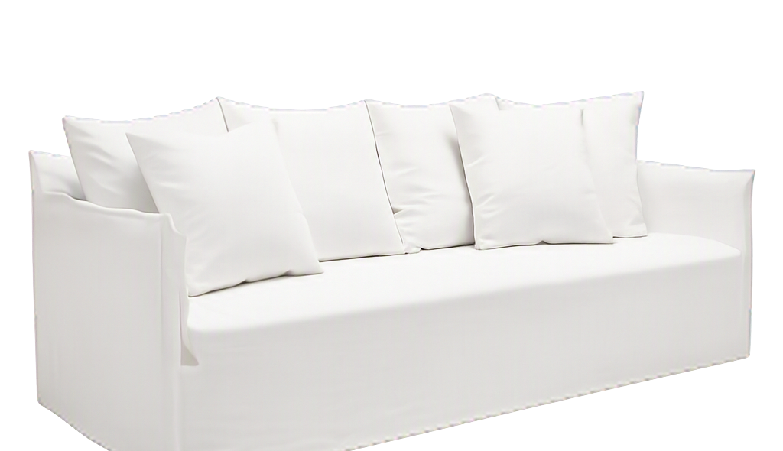
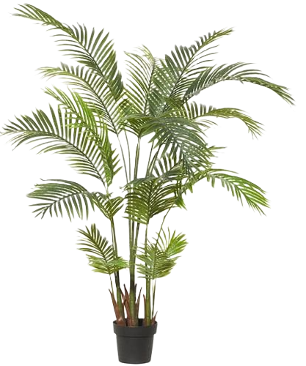
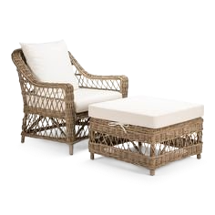
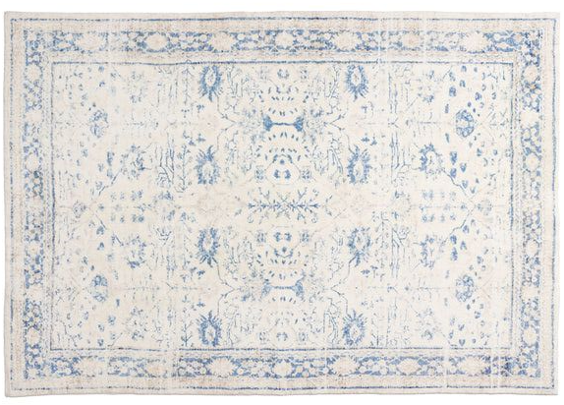
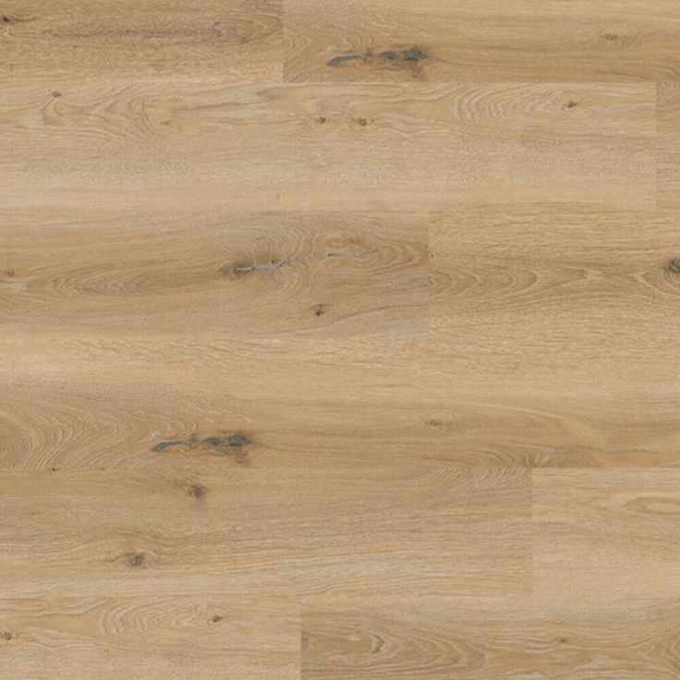
LEGEND
OAK FLOORING, CARPET CALL
FAUX ARECA 2 PALM, TEMPLE & WEBSTER
COMO LINEN SOFA 3.5, JAMES LANE
BAMBOO CURVE RATTAN PENDANT, LIGHTING COLLECTIVE
LINEN STRIPED CUSHION, MADRAS LINK
CASPER WHITE ¼, DULUX
COASTAL GREY, DULUX
LULL FRAMED ART, URBAN ROAD
NAPPA ARMCHAIR, REPUBLIC OF RATTAN
SARAFINA BLUE & GREY WASHABLE RUG, MISS AMARA
BROMPTON ROUND COFFEE TABLE, TEMPLE & WEBSTER
Eggshell Sea turtle, Benjamin Moore
11
COASTAL LIVING

Slide 3
COASTAL STYLE
Coastal style is light, airy and relaxed.
The most noteable area in the world this design style is used is in the Hamptons in New York, however, lots of other seaside locations most likely are drawn to the coastal aesthetic.
Natural light and neutral tones, paired with colours of the Ocean and nature are the stand out of this look.
Bright or creamy whites, blues and turquoises, greens and greys.
Coastal style exudes the indoor / outdoor flow of a home and its laid back aesthetic.
Light filtering sheer curtains on bifold or french doors and windows let in afternoon summer breezes.
Rattan furniture and light fixtures enhance the relaxed look whilst bringing in texture.
DESIGN ELEMENTS
Space: Open plan airy and light rooms with indoor outdoor flow, large windows and natural light
Line: Straight and horizontal lines would dominate, the curved lines of round tables, stools, pendant lights give a nice movement to the overall space.
Shape: Organic shapes are prominent with the use of indoor plants and floral arrangements bringing in nature and greenery.
Colour: neutral bright and creamy whites, blues and greens, coloured glass
Texture: Jute rugs, rattan furniture, linen sofas and cushions
Light: Coastal style focuses on natural light streaming in via big windows. Use artificial lighting via pendants and table lamps for night time ambience.
Pattern: Seen in the use of coastal artworks, furnishings such as cushions, blankets and throws and rugs. Can include coastal elements such as palm trees in the stitching.

Slide 4
REFERENCE
COASTAL SYLE BOOKS OF MY OWN
IDI MODULE 3
PINTEREST
COASTAL MOOD BOARD
Lavendar linen striped cushion, Mint house interiors, UK
Coastal Paint palette, Dulux Australia
Coastal picture, 12 Apostles, Great Ocean Road, Australia
Chrissy rattan pendant lights, My bali living, via Etsy.com
Rygge Jute floor rug, Freedom Australia
Rattan armchair, The gifts of life, Bloglovin.com
Palm in basket, Smile.amazon.com
French doors, doorstop.com.au
IHF Sheer voile curtain, Etsy.com
Brompton round coffee table, Temple & Webster
Trio of aqua glass bottles, jamjaredit.co.uk
Coastal room image, via casuallycoastal.com
COASTAL SAMPLE BOARD
OAK FLOORING, CARPET CALL
FAUX ARECA 2 PALM, TEMPLE & WEBSTER
COMO LINEN SOFA 3.5, JAMES LANE
BAMBOO CURVE RATTAN PENDANT, LIGHTING COLLECTIVE
LINEN STRIPED CUSHION, MADRAS LINK
CASPER WHITE ¼, DULUX
COASTAL GREY, DULUX
LULL FRAMED ART, URBAN ROAD
NAPPA ARMCHAIR, REPUBLIC OF RATTAN
SARAFINA BLUE & GREY WASHABLE RUG, MISS AMARA
BROMPTON ROUND COFFEE TABLE, TEMPLE & WEBSTER
EGGSHELL SEA TURTLE, BENJAMIN MOORE

