Slide 1
Real Estate Trends and Outlook
Lawrence Yun, Ph.D.
Chief Economist
NATIONAL ASSOCIATION OF REALTORS®
Presentation at Cedar Rapids Association of REALTORS®
March 4, 2015

Slide 2
GDP Burst in 2014 Q2, Q3, Q4

Slide 3
Jobs
(8 million lost … 12 million gained)
In thousands

Slide 4
Weekly New Unemployment Insurance Claims
In thousands

Slide 5
Unemployment Rate

Slide 6
Jobs in Cedar Rapids
In thousands

Slide 7
Jobs in Des Moines
In thousands

Slide 8
Household Net Worth at All-Time High

Slide 9
But Wait …
“I am not feeling it”

Slide 10
GDP Still not Robust …
Below 3% for 9 straight years

Slide 11
Sluggish Growth + Gap after Great Recession
($1.5 trillion gap … $4,700 per person)
3% Growth Line
2.2% Growth Line

Slide 12
Employment Rate

Slide 13
Renter Households over 10 years (Increased by 8 million)
In thousands

Slide 14
Homeowner Households over 10 years
(Decreased by 2 million)
In thousands

Slide 15
Homeownership Rate

Slide 16
Household Net Worth
($5,500 vs. $195,500)
Source: Federal Reserve Survey of Consumer Finances

Slide 17
Home Price Index
Cedar Rapids and Phoenix

Slide 18
The Reason for Not Feeling It
Very Slow Housing Market Recovery
Very Slow Commercial Market Recovery
Holds Back Economic Recovery

Slide 19
Home Sales: Two and Out?
Or Multi-year Expansion?
(Single-Family Existing Home Sales Only)

Slide 20
Pent Up Demand
 | 2000 | 2014
Existing Home Sales | 5.2 m | 4.9 m
New Home Sales | 880 K | 440 K
Mortgage Rates | 8.0% | 4.2%
Payroll Jobs | 132.0 m | 138.9 m
Population | 282 m | 319 m
37 million more people living in the country

Slide 21
Housing Starts Rising … Too Slowly
Thousand units

Slide 22
Time to Sell a New Spec Home
(in months)

Slide 23
Sluggish Recovery in Housing Starts
Cost of Construction Rising Faster than CPI
Labor Shortage for construction work
Construction loan difficulty for small local homebuilders … Dodd-Frank financial regulations?

Slide 24
Local Area Housing Statistics
Home Sales in 2014
    Down 3.1%
Median Price in 2014
    2014 … down 1%
Dollar Volume
    2014 … Modestly Lower

Slide 25
Cedar Rapids Housing Permits
(year-to-date)

Slide 26
Multiyear Recovery Likely
More Jobs
Manageable Mortgage Rates
Population Pent-Up Demand
More Inventory
Record High Household Wealth

Slide 27
“Take This Job and Shove It …
I ain’t working here no more”
Quit Rate in thousands

Slide 28
Multiyear Recovery Likely
More Jobs
Manageable Mortgage Rates
Population Pent-Up Demand
More Inventory
Record High Household Wealth

Slide 29
Monetary Policy by Federal Reserve
(zero rate policy for 6 years!)
%

Slide 30
Federal Reserve Balance Sheet from Quantitative Easing
$ million

Slide 31
30-year Mortgage Rates

Slide 32
Non-worrisome CPI Inflation – Yet
COLA of 1.7% in 2015

Slide 33
Rising Renters’ and Homeowners’ Rent Growth
(Above 3%)

Slide 34
Oil Price

Slide 35
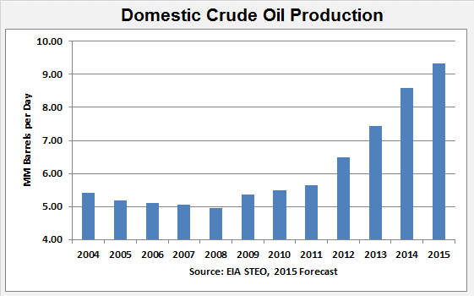
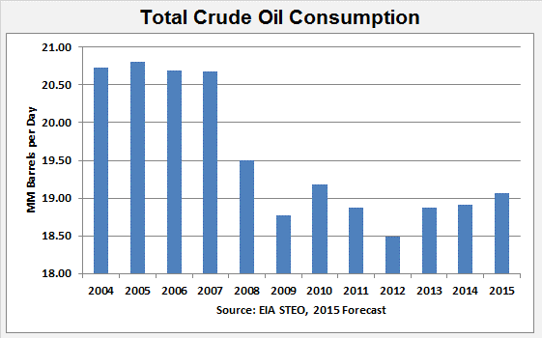
Supply and Demand: Oil in U.S.
9
21
19
5

Slide 36
Monetary Policy
Quantitative Easing … Finished
Fed Funds Rate … hike in mid-2015
Earlier Move to Tighten because of Inflation Pressure
Long-term Steady State Rate (2016 onwards) .. 10 year Treasury at 5.0%
Mortgage Rates reaching 6% by 2016

Slide 37
Erratic Credit Availability
FICO New Method
Mel Watt – New overseer of Fannie/Freddie
  Lower down payment products
Ridiculous FHA premiums … should decline
Historic low mortgage default rates on recent vintages (2010-2014)

Slide 38
Multiyear Recovery Likely
More Jobs
Manageable Mortgage Rates
Population Pent-Up Demand
More Inventory
Record High Household Wealth

Slide 39
U.S. Population

Slide 40
Multiyear Recovery Likely
More Jobs
Manageable Mortgage Rates
Population Pent-Up Demand
More Inventory and Moderate Price Growth
Record High Household Wealth

Slide 41
Low Inventory of Homes for Sale

Slide 42
Shadow Inventory in Iowa

Slide 43
Multiyear Recovery Likely
More Jobs
Manageable Mortgage Rates
Population Pent-Up Demand
More Inventory and Moderate Price Growth
Record High Household Wealth

Slide 44
Vacation Home Sales

Slide 45
Economic Forecast
 | 2013 | 2014 | 2015 Forecast | 2016 Forecast
GDP Growth | 2.2% | 2.6% | 3.0% | 3.0%
Job Growth | +2.3 million | +3.0 million | +2.7 million | +2.7 million
CPI Inflation | 1.5% | 1.2% | 1.4% | 3.2%
Consumer Confidence | 73 | 87 | 95 | 98
10-year Treasury | 2.5% | 2.6% | 2.3% | 3.6%

Slide 46
Housing Forecast
 | 2013 | 2014 Likely | 2015 Forecast | 2016 Forecast
Housing Starts | 925,000 | 990,000 | 1.2 million | 1.4 million
New Home Sales | 430,000 | 440,000 | 600,000 | 720,000
Existing Home Sales | 5.1 million | 4.9 million | 5.3 million | 5.4 million
Median Price Growth | + 11.5% | + 5.3% | + 4% | + 4%
30-year Rate | 4.0% | 4.2% | 4.8% | 5.8%
Underwriting Standards | Strict | Strict | Transition | Normal

Slide 47
How Young Are REALTORS® ?

Slide 48
Let’s Spin the Bottle !

Slide 49
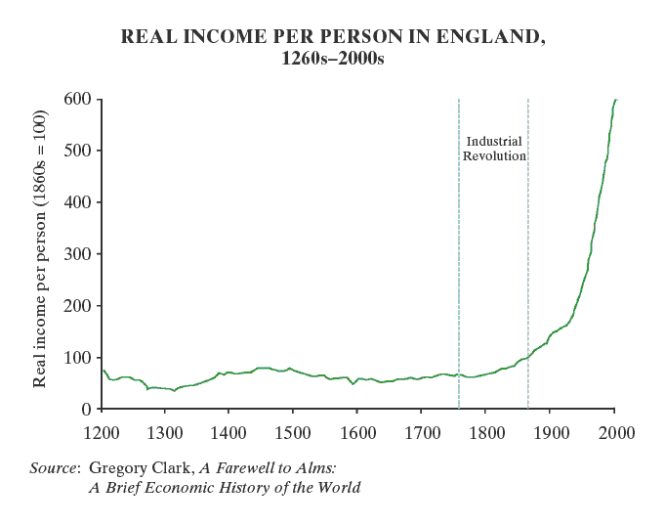

Spin the Globe … Find the Source of Improving Standard of Living

Slide 50
When, How, What, Why?
British Glorious Revolution of 1688
  William and Mary arrives to say …
  Power not with King but with people via Parliament
  No Taxation without Representation
  Life, Liberty, and (Acquire) Property
American Revolution of 1766
  Power resides not with King but with people
  No Taxation without Representation
  Life, Liberty, and the Pursuit of Happiness

Slide 51
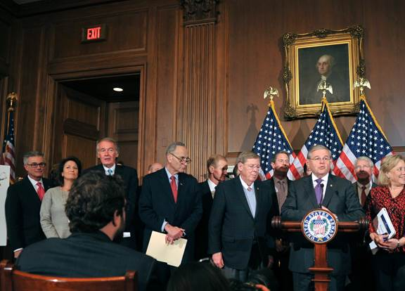

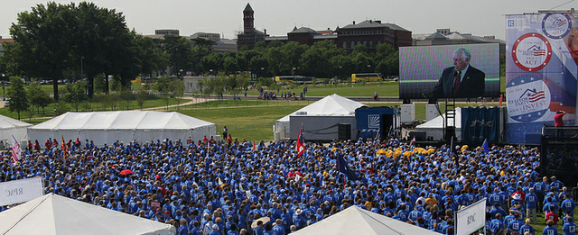

Participants in Democracy to
Protect Property Rights!

