Slide 1
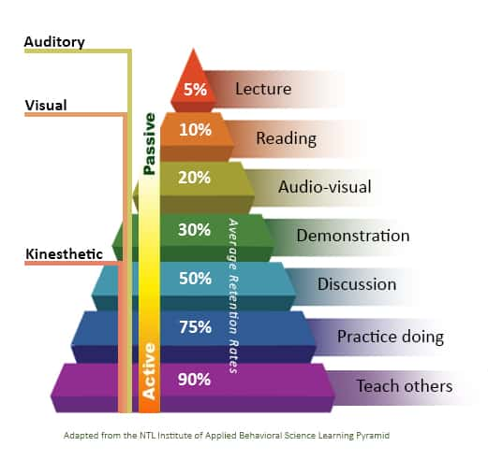

Slide 2

Improve Your Relationship with God
“James 4:8 – Draw near to God, and He will draw near to you.”

Slide 3

Opening Question
“How do you make a friendship stronger?”

Slide 4

Big Idea
“God wants to be close to you.”
“We can improve our relationship with Him by spending time with Him every day.”

Slide 5

Bible Foundation
James 4:8 – “Draw near to God, and He will draw near to you.”

Slide 6
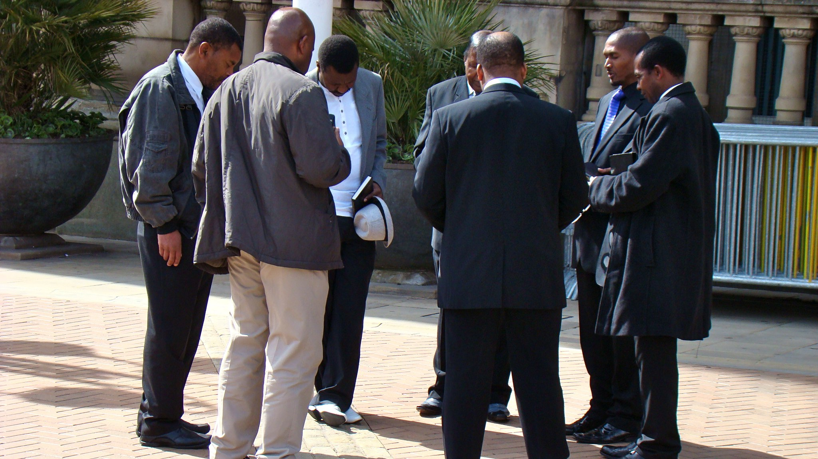
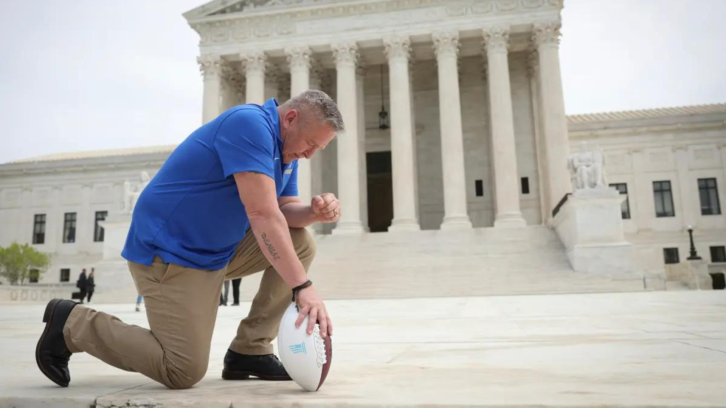

Way #1: Talk to God (Prayer)
Prayer is simply talking to God.
You can pray anywhere, anytime.

Slide 7
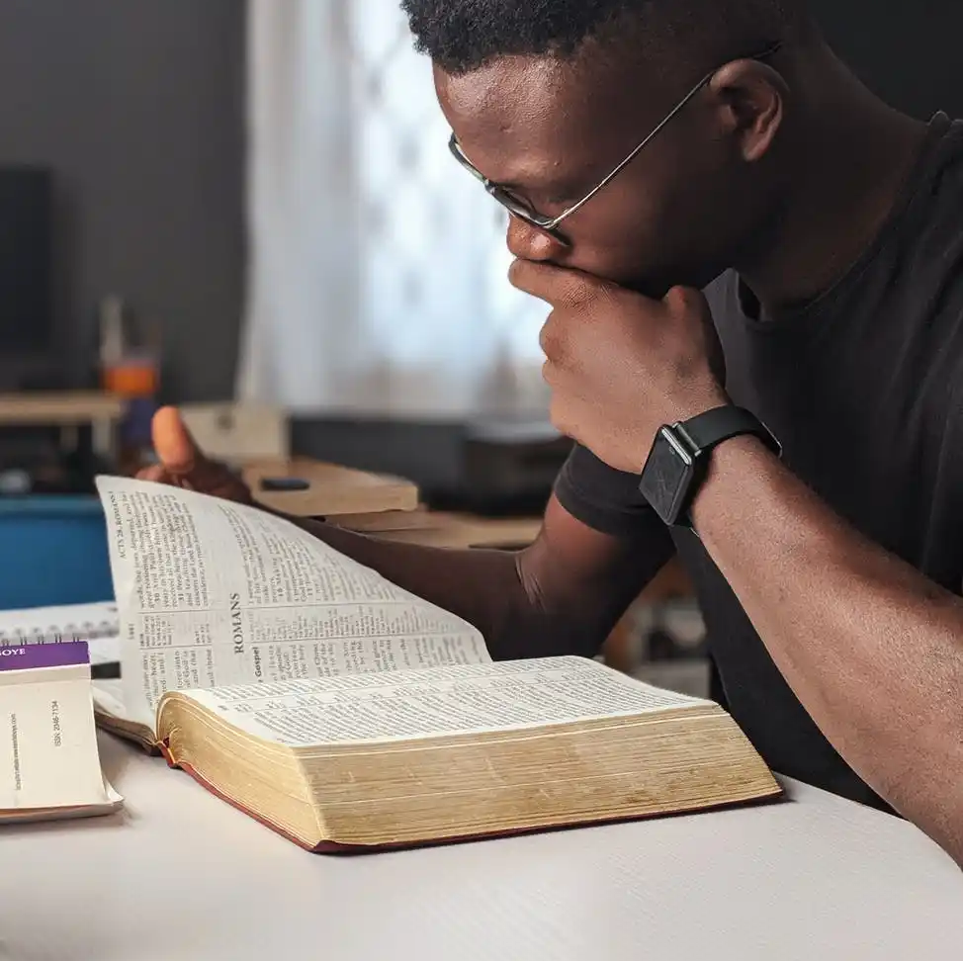
Listen to God (Bible Reading)
The Bible is God’s way of speaking to us.
Reading even a few verses a day helps us know Him better.
Psalm 119:105 “Your word is a lamp to my feet and a light to my path.”

Slide 8
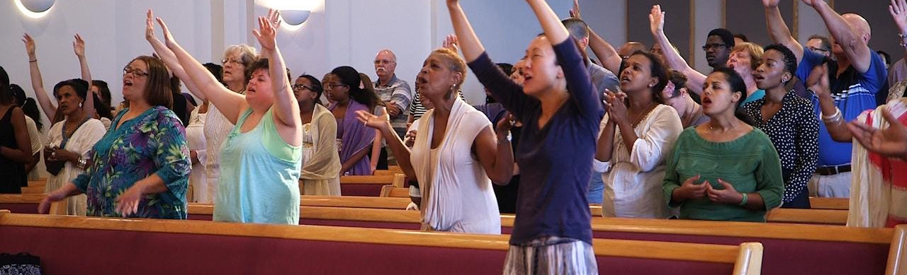
Worship God (Praise & Thankfulness)
Worship is more than singing; it’s showing love to God.
Thank Him for blessings, even small ones.

Slide 9

Obey God (Living His Way)
Actions matter: when we follow His Word, we show love back to Him.
Example: Forgiving someone, being kind, telling the truth.
Roleplay:

Slide 10
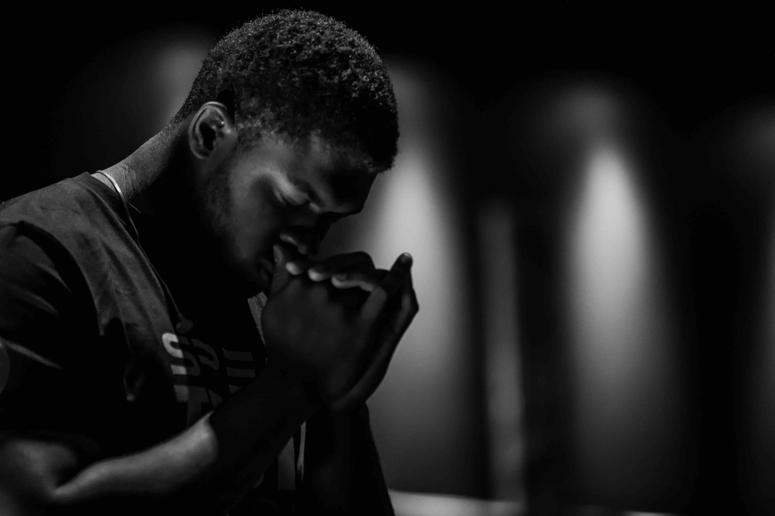
Reflection Question
“Which of these 4 ways do you want to improve this week — prayer, Bible, worship, or obedience?”

Slide 11

Closing Verse & Prayer
Repeat James 4:8
“Come near to God and he will come near to you. Wash your hands, you sinners, and purify your hearts, you double-minded.”

