Slide 1
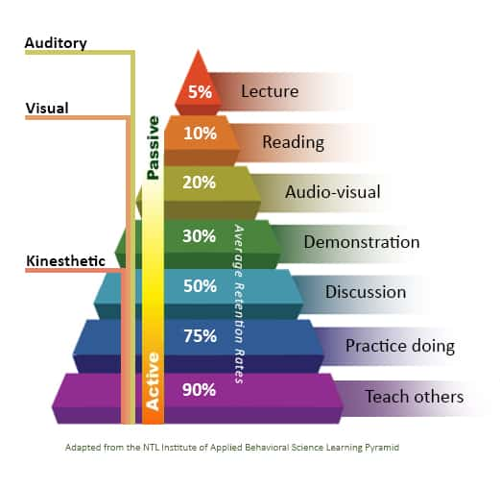

Slide 2

Being the Light
“Living as the Church Outside the Walls”
“Matthew 5:14–16”

Slide 3

What We Learned Last Time
“The church is God’s family.”
“The church has a mission: to worship, help, and share Jesus.”
Ask everyone to share one thing they remember from the last lesson.

Slide 4

Today’s Big Idea
“We don’t just go to church — we are the church wherever we go.”
Key question: How can I live as the church outside the walls?

Slide 5

Bible Verse Foundation
Matthew 5:14–16.
14 “You are the light of the world. A town built on a hill cannot be hidden.
15 Neither do people light a lamp and put it under a bowl. Instead they put it on its stand, and it gives light to everyone in the house.
16 In the same way, let your light shine before others, that they may see your good deeds and glorify your Father in heaven.”

Slide 6
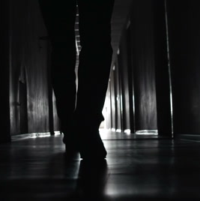
What Does Light Do?
Light shows the way.
Light drives away darkness.
Light gives hope.

Slide 7

Living as Light in Daily Life
Show Love → Helping a classmate or sibling.
Share Jesus → Invite a friend to church.
Pray → Ask God for help and bless others.
Question: Which of these is easiest for you? Hardest?

Slide 8
Roleplay: Light in Action
Scenario examples: Someone feels left out.
Divide students into small groups (2–4 per group).
Explain the scenario:
  “Imagine you are at school, church, or on the playground. You notice someone sitting by themselves, looking sad because they feel left out.”
Challenge the group:
  “How could you shine your light in this situation? What could you say or do to show the love of Jesus?”

Slide 9

Memory Verse Practice
Verse: “Let your light shine before others…” (Matthew 5:16).
"In the same way, let your light shine before others, that they may see your good deeds and glorify your Father in heaven."

Slide 10

Reflection Question
“Where do you need to be a light this week?”

Slide 11
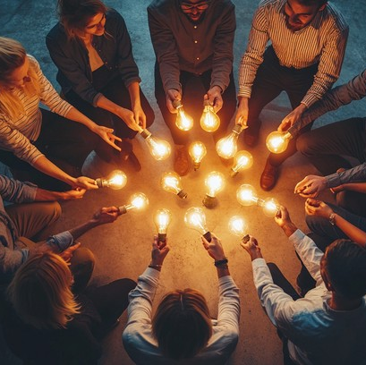
Closing & Prayer
Reminder: “The church isn’t just a building — it’s you being God’s light every day.”
Closing prayer

