Slide 1
God Promises Salvation

Slide 2
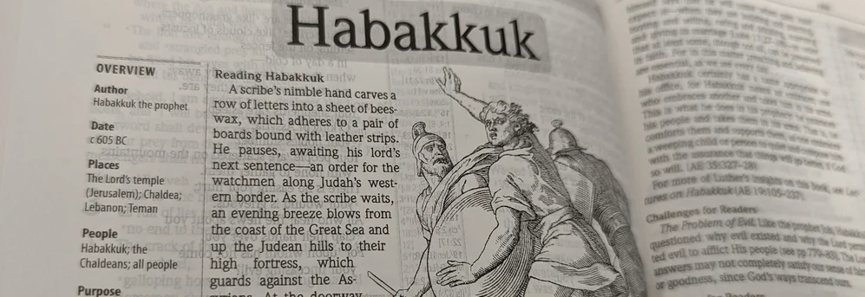
God Promises Salvation Focal Verses – Habakkuk 3:2-6, 17-19
How do Believers Respond to our Troubles?

Slide 3
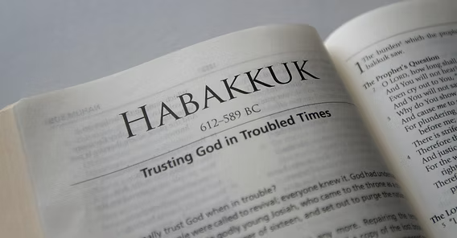
Aim for Change
By the end of the lesson, we will:
RECOGNIZE that there are times when we may not understand how God is moving,
EMPATHIZE with wondering why God allows certain things to happen
DISCOVER that God’s character dictates that unrighteousness will not go forever unpunished, nor charity unrewarded

Slide 4

The People, Places, and Times
Habakkuk, the prophet
Background
In Depth

Slide 5
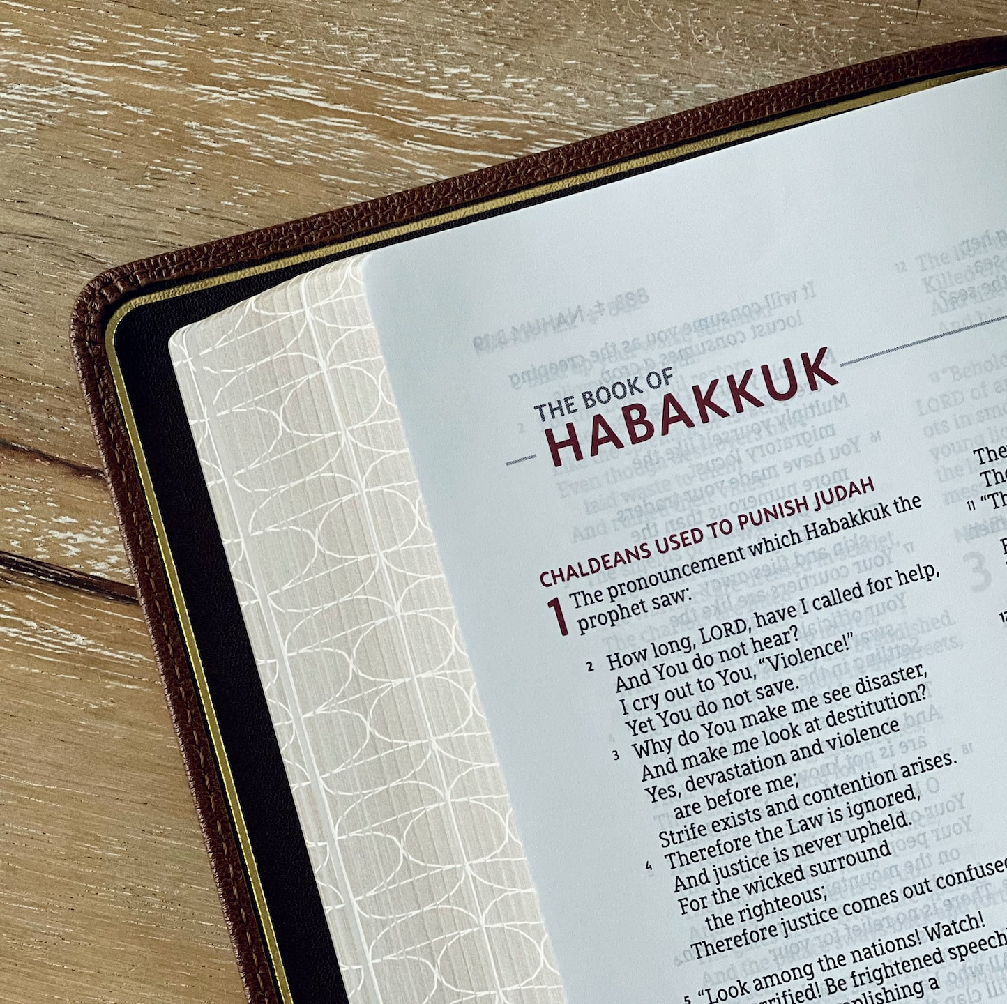
In Depth
Response in Crisis (Habakkuk 3:2-3
Recognition of Judgment (Habakkuk 3:4-6)
Praise in Destruction (Habakkuk 3:17-18)
Strength in Salvation (Habakkuk 3:19)

Slide 6
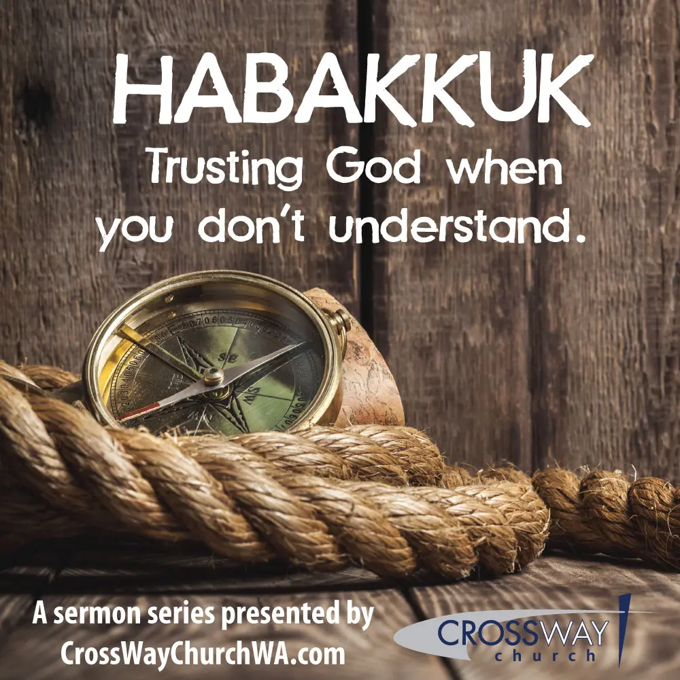
Lesson Summary
God is powerful and faithful, and His mighty works in the past remind us that He is still in control today.
Faith does not depend on circumstances—even when everything fails, God remains worthy of trust and praise.
True joy and strength come from the Lord, who enables His people to stand firm and move forward despite hardship.

