Slide 1


Slide 2
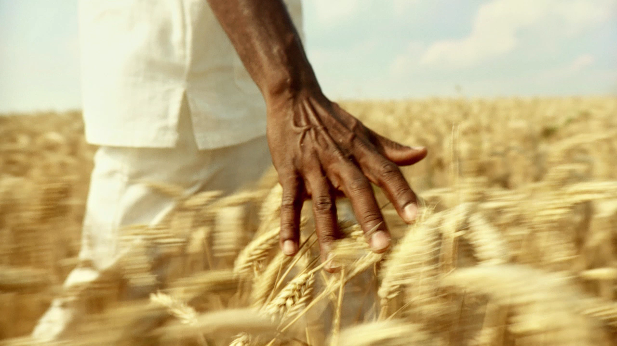
God Creates Everything
HOW DID THE WORLD BEGIN?
GENESIS 1:1-13

Slide 3
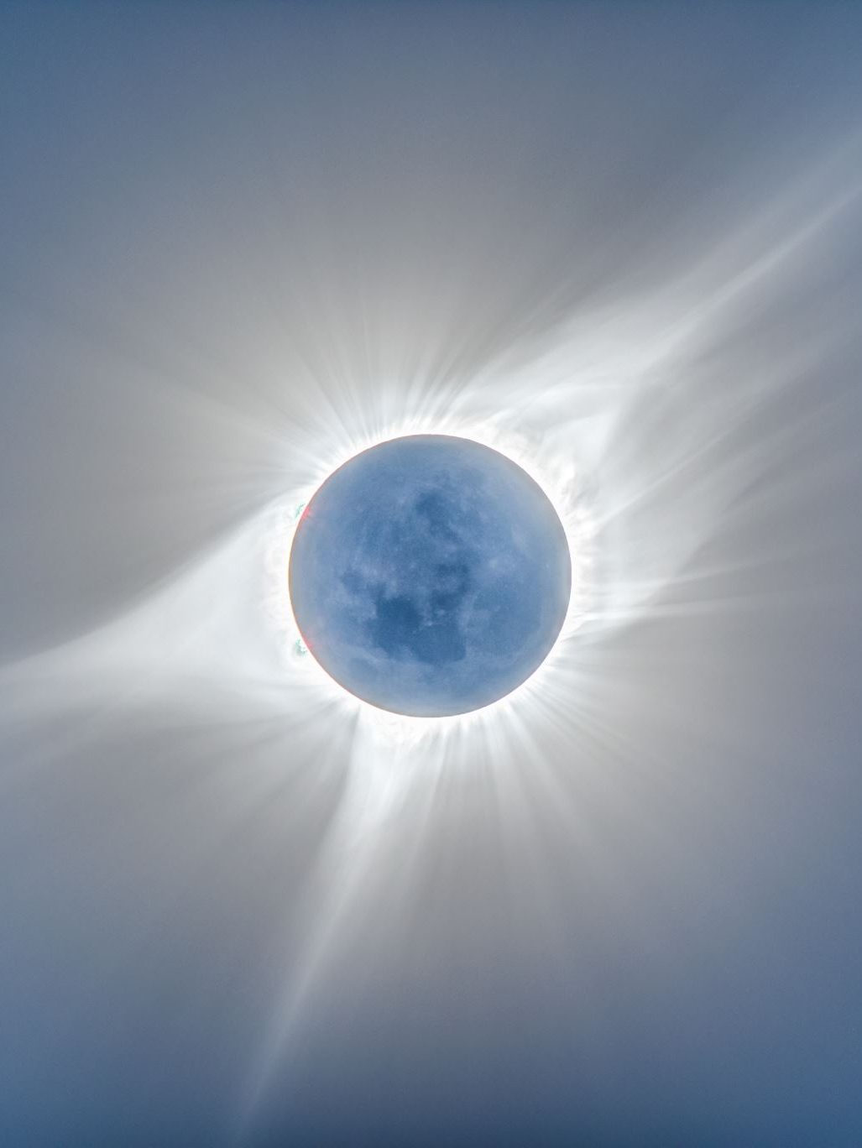
Aim for Change
By the end of the lesson, we will ACKNOWLEDGE God as the creator of the universe, APPRECIATE the created world, and ADMIRE the beauty of the heavens and the earth God created.

Slide 4
The People, Places, and Times
Creation- God’s act of creation is the process by which the universe and humanity came into being. (Genesis 1:1–2:3). Genesis tells of the sole, sovereign Master of the universe directing the work of creation by verbal command. God made the world in six days and rested on the seventh. Bible scholars differ on whether the “days” were 24-hour days or more extended periods. God’s act of creation is unlike other ancient Near Eastern stories, which often depict gods fighting or the creation of humans from the blood of a rebellious god. John 1:1-3, and Psalm 24:1-2

Slide 5
Background
Genesis is the first book in the Bible. Genesis sets the foundation for understanding the rest of the Scriptures. Genesis 1 records God calling creation into existence. He creates from nothing all creation. In addition, God exists apart from creation as God alone. God does not sleep or wake up. He is self-existent, all-powerful, and eternal. God establishes cycles and patterns that make up nature and assigns the functions of each aspect of creation from time to growth. Through creation, God shows that He is both orderly and creative. Each day, God creates and affirms that what He has created is good. God establishes relationships for the created order. The introduction of sin challenges the goodness and order of these relationships in the developed world.

Slide 6

In Depth
God is Creator (Genesis 1:1–2)
God Creates Light (vv. 3–5)
God Creates Heaven (vv. 6–8)
God Creates Earth (vv. 9–13)

Slide 7
Discuss the Meaning
God creates by speaking everything into existence. What impact does that have on how we view the power of God’s Word?
How do you reconcile your understanding of science with your faith as a Christian? Do you believe in any aspects of evolution? Why or why not?
How does knowing that God created diversity influence what we consider differences in life?

Slide 8
Next Week’s Lesson
SEPTEMBER 14 • BIBLE STUDY GUIDE WEEK 2 • EXODUS
God Gives Laws
HOW SHOULD WE LIVE AS GOD’S PEOPLE?
Focal Verses • EXODUS 20:1-21

