Slide 1

Discipline
The Gift of Discipline for Discipleship
Hebrews 12: 1 - 13

Slide 2

Aim for Change
By the end of the lesson, we will DISCUSS what makes a credible leader; REFLECT on what makes Jesus a credible leader; and COMMIT to following Jesus’ example of godly discipline.

Slide 3
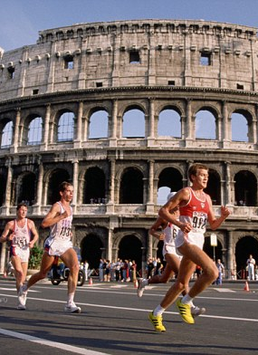
The People, Places, Times
People:
  Jesus Christ is the ultimate model of endurance, having suffered the cross for the joy set before Him.
  Believers and the “great cloud of witnesses” are encouraged to run their race faithfully and embrace God’s loving discipline.
Places:
  Early Christian communities in Rome likely faced persecution and social rejection for their faith.
  The race track metaphor symbolizes the Christian life as a disciplined, enduring journey, much like ancient athletic contests.
Times:
  First-century persecution challenged Jewish Christians to remain faithful despite hardship.
  The post-resurrection era marked a shift from the old covenant to living under grace through Christ.

Slide 4

Background
The Book of Hebrews was written to Jewish Christians who were facing persecution, hardship, and the temptation to abandon their faith and return to Judaism. The author encourages them to remain steadfast by highlighting the superiority of Christ and the necessity of enduring hardship as part of the Christian journey.
In Hebrews 12, the writer uses the metaphor of a race to describe the Christian life. He reminds believers that they are surrounded by a “great cloud of witnesses” (faithful examples from Hebrews 11), and that God's discipline is a sign of His love, not punishment, but correction and training to produce holiness and maturity in His children.

Slide 5

In-Depth
Running the Race with Endurance (Hebrews 12:1 - 3)
God’s Loving Discipline (Hebrews 12:4 - 11)
Strengthen and Stay the Course (Hebrews 12:12 - 13)
Notes:
Verses 11–12: The Call to Pursue Godliness
“Flee” from materialism and evil.
“Pursue” righteousness, faith, love, endurance, gentleness.
Fight the good fight of faith—this is an ongoing battle that requires intentional effort.
Verses 13–16: A Solemn Charge
Paul appeals to Christ’s example and Timothy’s past confession.
God is described as the only Sovereign, immortal, and dwelling in unapproachable light—reminding Timothy of the majesty and seriousness of the calling.
Verses 17–19: Instructions for the Wealthy
Do not trust in riches but in God.
Use wealth for good works, generosity, and building an eternal foundation.
Verses 20–21: Final Warning and Benediction
Guard what has been entrusted to you.
Avoid foolish debates and contradictions of false knowledge.
“Grace be with you” – A closing blessing.

Slide 6

Memory Verse
“No discipline seems pleasant at the time, but painful. Later on, however, it produces a harvest of righteousness and peace for those who have been trained by it.”
— Hebrews 12:11 (NIV)

Slide 7
Discussion Questions
How does viewing discipline as a “gift” change the way we respond to hardship or correction from God?
What are some practical ways we can “lay aside every weight” in our lives today to run our spiritual race more effectively?
Why do you think the author compares the Christian life to a race, and what does this metaphor teach us about endurance and focus?
Can you share a time when God’s discipline helped you grow spiritually? What did you learn through that experience?
How can we support and “strengthen” fellow believers who may be weary or struggling under God’s discipline?

Slide 8

Next Week, July 27, 2025
Patience, Wait with Patience for Wisdom
James 3:13 – 18; 5: 7 - 12

