Slide 1


Slide 2
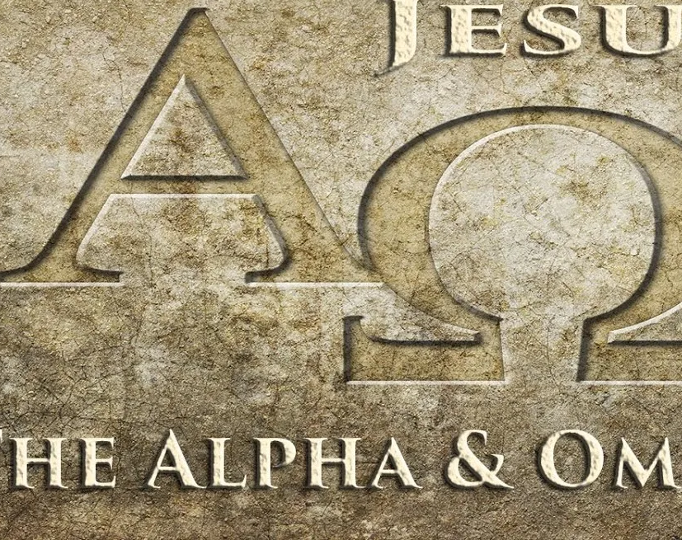
Eternal Life
Eternal Life in the Alpha and Omega
Focus Verses – Revelation 22:12-21

Slide 3

Aim For Change
By the end of this lesson, we will: SURVEY the biblical reference to the Second Coming of Christ to see the importance of this hoped-for reality; REJOICE that the invitation from Jesus to join the new community continues through the end of all things; and EMBRACE the call to become part of God’s kingdom.

Slide 4
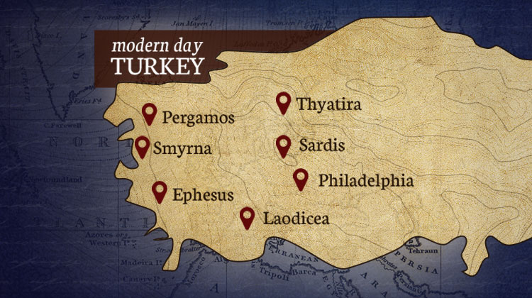
The People, Places and Times
John, who lived in a time of Roman persecution, oppression, and idolatry, began by penning his message as “things which must shortly come to pass” (1:1). Whether the text is interpreted as literal events to take place in the future or a allegorical principles of the kingdom of God, it is clear that initially the text was a prophecy (1:3, 22:18) and a letter (1:4) to the seven churches of Asia Minor, the region we know today as Turkey John writes from the island of Patmos, where he said his visions occurred.

Slide 5
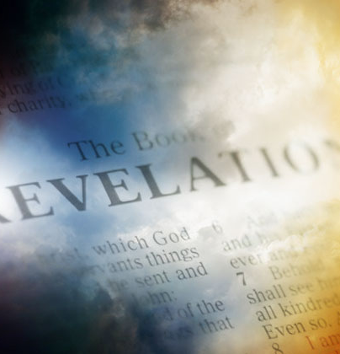
Background
The book of Revelation is considered apocalyptic writing. The term “apocalypse” refers to Jewish and Christian literature that uncovers or unveils future events or unseen realms of heaven and hell; conversely, the word is applied to religious events surrounding the anticipated destruction of the world. Apocalyptic writing is notorious for its use of mysterious language and imagery, which can be perceived and interpreted in many different ways in the Old and New Testaments. There are two full apocalypses (Daniel and Revelation), both of which speak cryptically of corrupt, human political realms in contrast to God’s heavenly and eternal realm.

Slide 6

In Depth:
Alpha and Omega (Revelation 22:12-13)
City Gates (vv. 14-15)
Root and Descendant of David (vv.16-21)

Slide 7

Discussion Question
What does Jesus mean when He says, “Behold, I am coming soon” (v. 12)?
Why is it important that Jesus identifies Himself as “the Alpha and the Omega, the First and the Last, the Beginning and the End” (v. 13)?
Verse 17 says, “Let the one who is thirsty come.” What does it mean to be spiritually thirsty?
John gives a warning not to add or take away from God’s Word (vv. 18–19). Why do you think this warning is provided at the end of Revelation?
John responds to Jesus’ promise with the prayer, “Amen. Come, Lord Jesus!” (v. 20).

Slide 8
Next Week – No Books
Theme: Mission
Topic: Proclaim the Gospel Until He Comes
Scripture: Matthew 28:18-20; Acts 1:6 11
Theme: In light of eternal life, believers are called to live on mission, making disciples of all nations and bearing witness until Christ returns. Eternal life fuels a life of purpose now.
Books are scheduled to arrive on August 26, 2025.

