Slide 1
Relationships: Following Culture or Christ? John 13:31-35
Charles Prichard

Slide 2
Big Things We Always Work on
1) Cleaning The Way
2) Closing The Distance
3) Strengthen The Connection
Adopted from Dr. Paul Maykish

Slide 3
Repentance
As a way of life (1 Jn 1:9)
Prove repentance with deeds (Acts 26:20)
NOT:
Getting caught and coming clean – Col 3:1-5
Denying our sin
Diminishing, downplaying, or partial confession
Managing our sin – Rom 8:1-8, 13
Blame shifting / excusing – Gen 3:12-13
Worldly sorrow – 2 Cor 7:8-10

Slide 4
Forgiveness
Unconditional (Eph 4:32, Col 3:13)
Like Christ / Not based on merit (Rom 5:8)
Anyone can love those who love them (Mt 5:44-46)
NOT:
Forgetting – Jer 31:34, Psalm 103:12, Rom 3:25
One time event – Mat 26:28
Neglecting justice – Rom 13:1, 1 Pt 2:13-17
Reconciliation – Rom 12:18
Approving or diminishing sin
Ceasing to feel pain
Trusting
Waiting for an apology

Slide 5

“Dating”

Slide 6
“Dating”

Slide 7
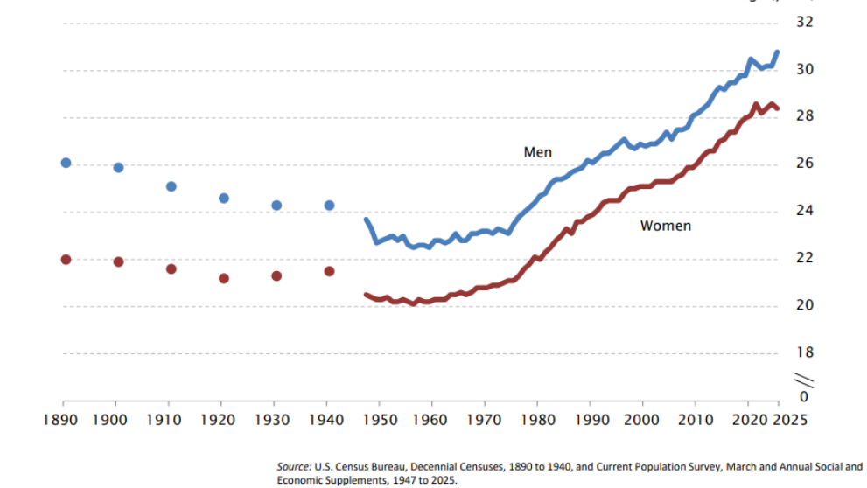

Slide 8
Why?
Cultural norms
Commitment
Economy
Maturity
Distractions
Sin
AND / OR

Slide 9
Where Did Dating Come From?
1896 introduced in English vernacular – pseudonym for “prostitution”
“Dress like this” “Buy these products” – encourages godlessness and sin
1920s – restaurants, movie theaters, dance halls
1930s – automobile, parties
1960s – Playboy
1970s – birth control pill, legalization of murdering babies, no fault divorce
Extended “adolescence” with “no” consequences to sex
Families break apart – courtship dwindles

Slide 10
“Christian” Dating
Grey areas? Drawing lines on what intimacy is “permissible”
“Just don’t have sex”
Looking Christian vs. being Christian
BUT what does God say? He invented intimacy even before sin

Slide 11

WARNING!
Proverbs 31:2-3
What does the strongest (Sampson) most famous (David) and wisest (Solomon) man all have in common?
Fire can burn or warm based on where it’s placed (Prov 6:27)
Sexual desire has power to destroy our life or bless it (Prov 18:22)
Don’t awaken love before its time (SS 2:7, 3:5, 8:4)

Slide 12
The Dating Cycle
Lust Curiosity Pressure
Sin
Shame Regret
Change?
Date

Slide 13
Matthew 7:12-14 – Golden Command
How would you like other men/women to treat your future wife/husband right now?
If you want to follow Jesus, you will treat others the way Jesus treats them (love, respect, honor, purity, nobility)
“This is the Law” – it’s black/white dealing with sexual sin
When you lust (even in your mind) you’ve already crossed the line
What about holding hands/kissing?....

Slide 14
Called To Treat Others Like…
“Do not rebuke an older man harshly, but exhort him as if he were your father. Treat younger men as brothers, older women as mothers, and younger women as sisters, with absolute purity.” – 1 Timothy 5:1-2
Groups or categories of people in your life:
Older men
Younger men (and/or peers)
Older women
Younger women (and/or peers)
Spouse
Scripture is clear how to treat all of them
Parents: Eph 6:1-3 | Friends: Eph 4:29-32, Rom 12:10…etc.

Slide 15
Walk in His Ways
Maximize your singleness for God
Do not pursue a relationship until you are ready to marry
Never enter a relationship with an unbeliever (2 Cor 6:14)
Look at who God puts in front of you (ex. Boaz & Ruth)
Guard your heart (Prov 4:23)
“Dating Questions” Handout

Slide 16
Culture or Christ?
Jesus is the foundation/example (John 13:31-35)
Clear way | Close distance | Strengthen Connection
Choose Jesus’ way, not the world’s

Slide 17
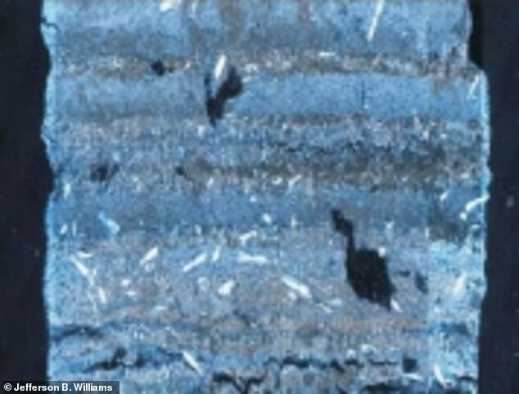
Reasons To Believe

