Slide 1


Slide 2

PFP at Lunch
Pray for a Pastor at Lunch
Please pray each day at lunch for a new pastor and for wisdom for the Pulpit Committee as it conducts the search on behalf of the church.

Slide 3

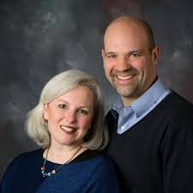
MISSIONARIES FOR THE MONTH OF JUNE
Steve & Becky Dye
PRAISES FOR THE PAST MONTHS
Good attendance, in person and online with a few visitors and new couples
Steve was at Word of Life Bible Institute Germany, teaching
The women’s Bible study was attended (over Zoom) by 15 women from 10 countries
Meeting one on one with some members of their congregation.

Slide 4
CALENDAR EVENTS
Sunday – 9:15 a.m. Sunday School
Sunday – 10:30 a.m. Sunday Morning Service Message
Sunday – June 6 – Honoring 2021 Graduates
Tuesday – 9:30 a.m. Ladies Weekly Prayer Meeting
Wednesday – 7:00 p.m. Church Weekly Prayer Meeting
Thursday – June 10- Men’s Small Group Meeting @ 7:00 p.m. - See Allan Hartong
Wednesday – June 16 – Board Meeting @ 7:30 p.m.
Sunday – June 27– Communion Sunday Morning Service @ 10:30 a.m.
Tuesday – July 6– Church Office Closed (Office closed in celebration of 4th of July
Sunday – July 4 – Holiday – No Evening Activities

Slide 5

THANK YOU FOR PARTICIPATING
YOUR DONATIONS HAVE HELPED MANY FAMILIES

Slide 7


