Slide 1
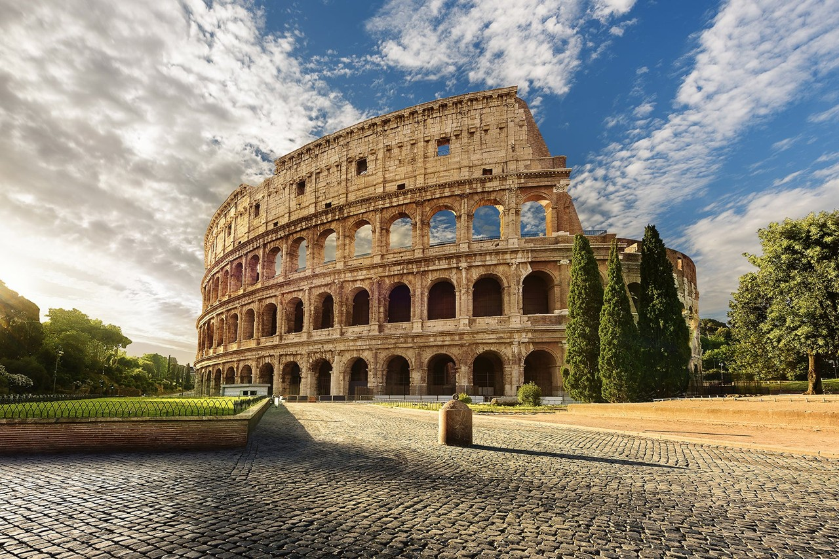
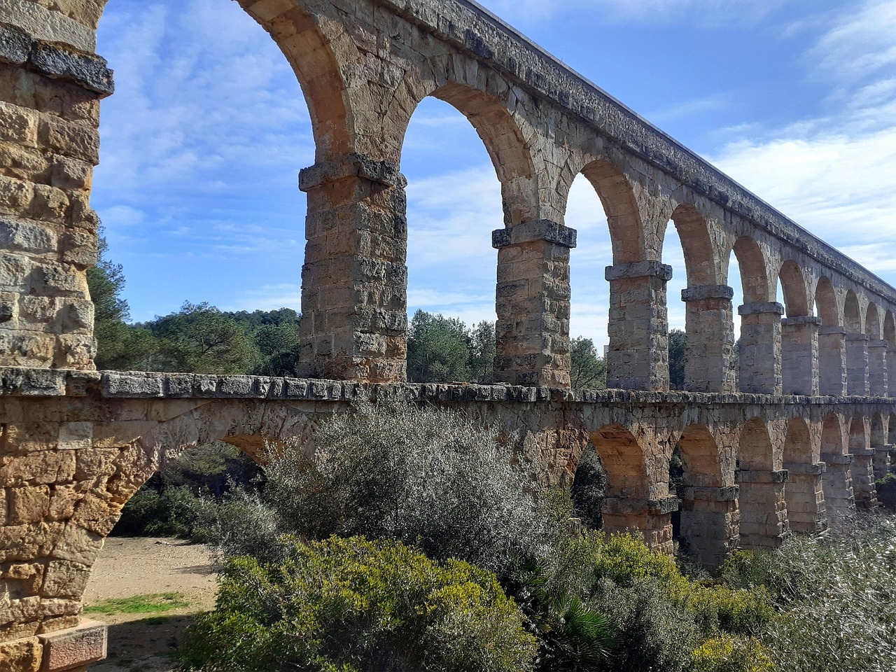
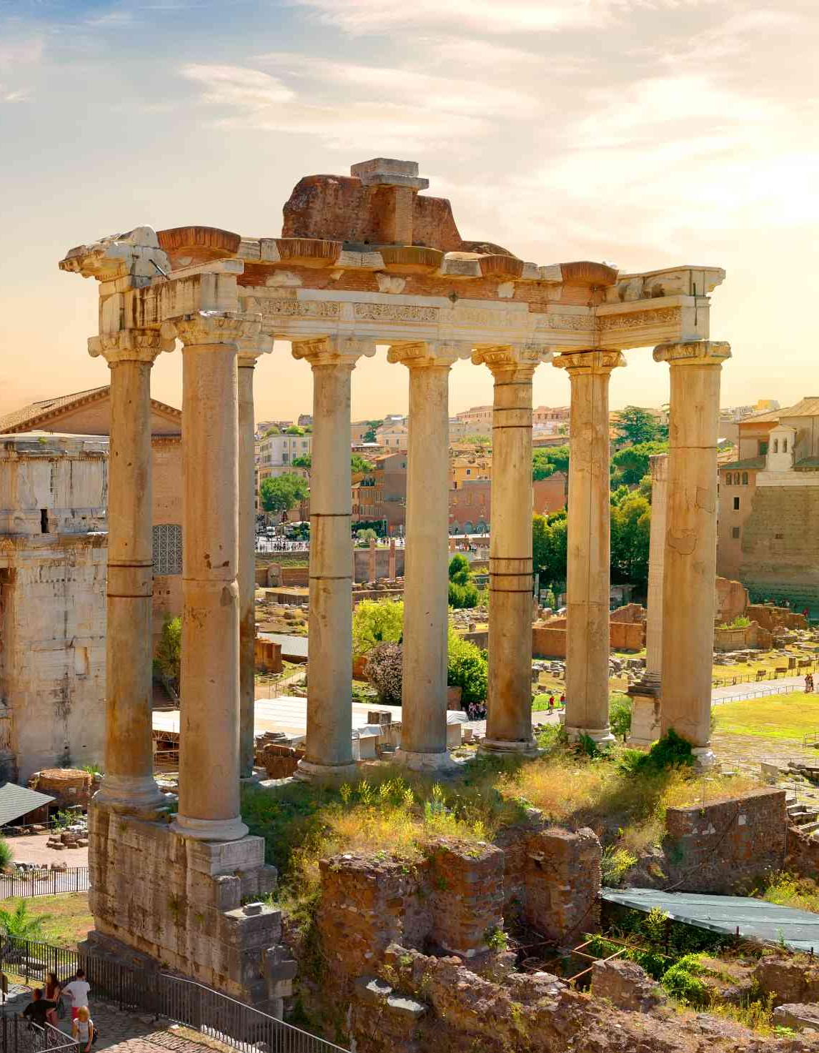
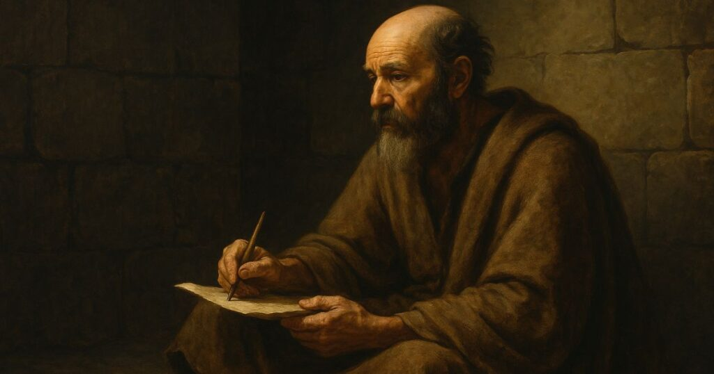
To all those in Rome…

Slide 2
Romans 8:1
There is “no condemnation” for those who are in Christ Jesus.
There is also “no separation” for those who are loved by Christ Jesus.
Romans 8:39

Slide 3
Romans 8:3
“in the likeness of sinful flesh…”
“in order that the righteous requirement of the law might be fulfilled in us…”
Romans 8:4

Slide 4

The Spirit empowers our faith unto salvation
Faith →
Abraham
Romans 4:17
Spirit →

Slide 5
Sanctification.
Romans 6:19
“For just as you once presented your members as slaves to impurity and to lawlessness leading to more lawlessness, so now present your members as slaves to righteousness leading to sanctification.

Slide 6
The Spirit of God brings LIFE to our mortal bodies.
Romans 8:11
Set our minds on the Spirit
Romans 8:5
Consider the Gospel
→ at all times
→ in all places

Slide 7
Put to death the deeds of the flesh by…
Rejoicing over reconciliation (5:10-11)
Not allowing sin to dominate you (6:12)
Choosing to follow the Spirit (8:12, 14)
Do your best to express Christ in you …in spite of yourself!
Be the best expression of your true self

Slide 8
Sonship.
Romans 8:14-15
“For all who are led by the Spirit of God are sons of God. For you did not receive the spirit of slavery to fall back into fear, but you have received the Spirit of adoption as sons, by whom we cry, ‘Abba! Father!’”

