Slide 1
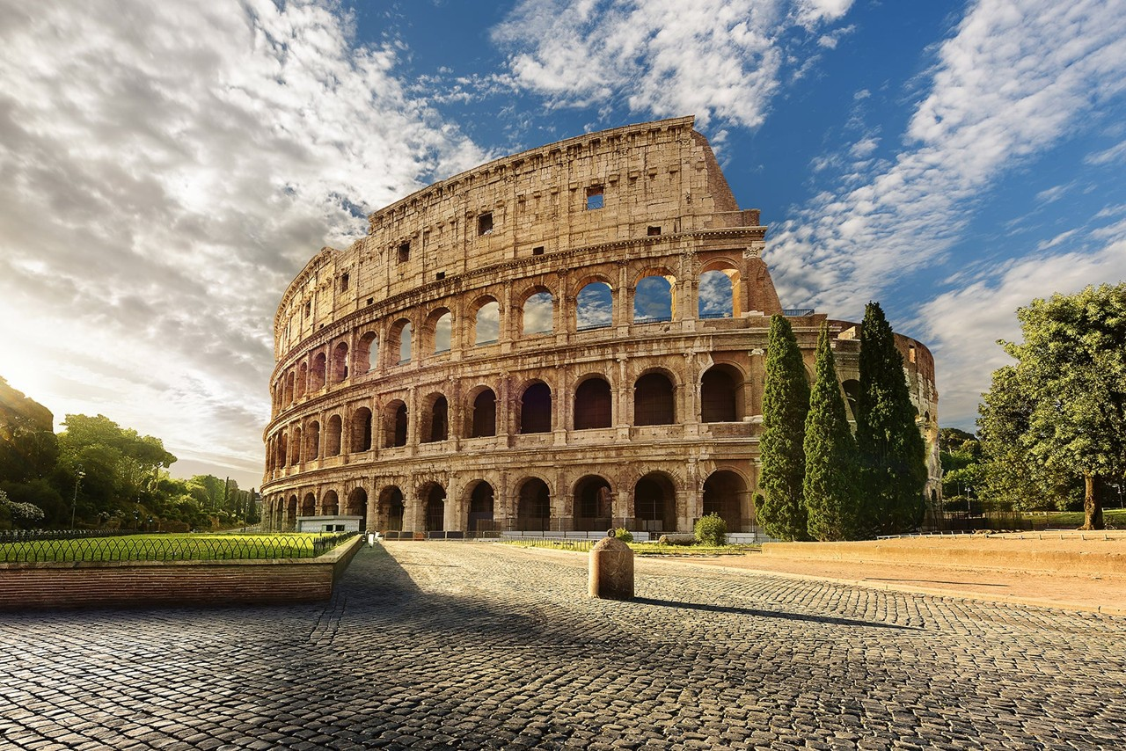
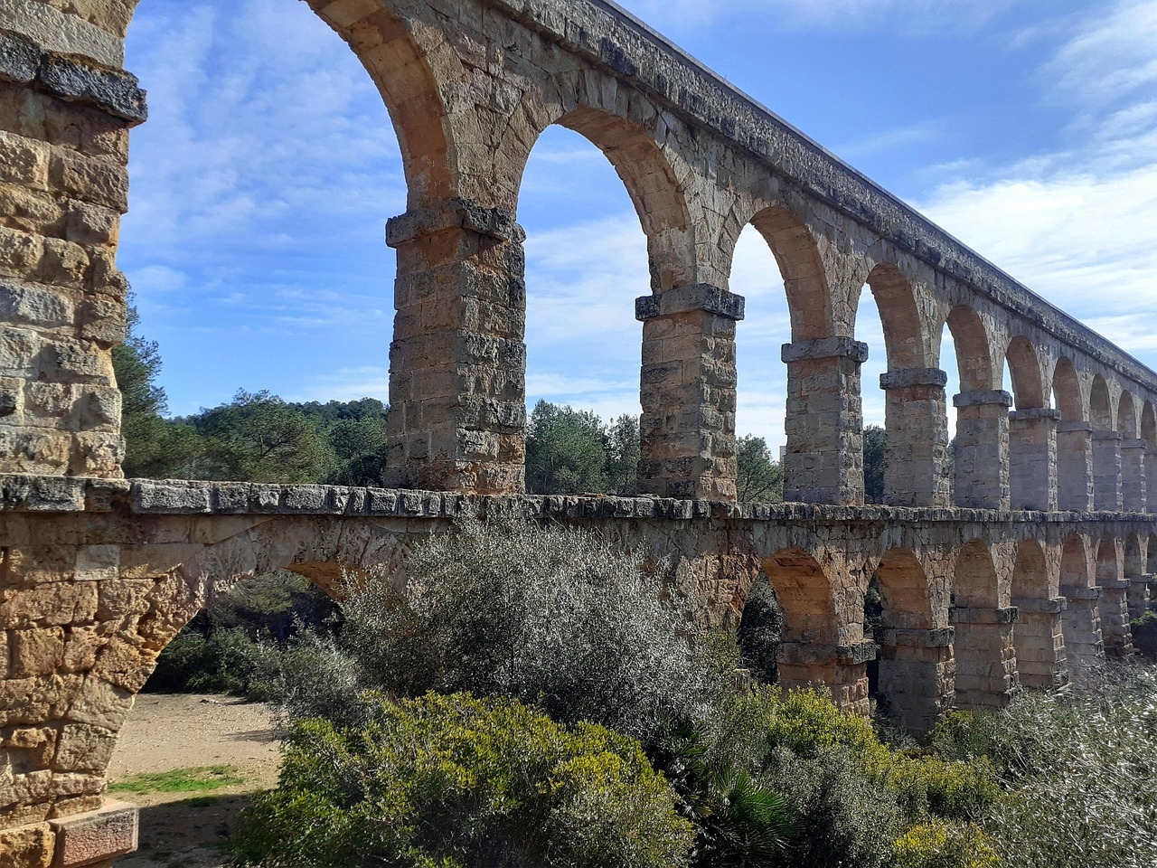
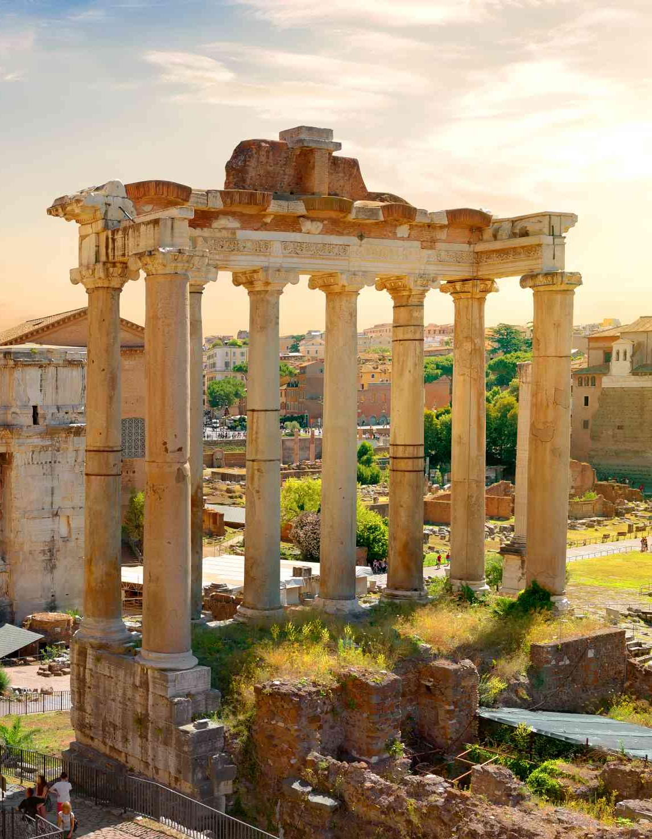
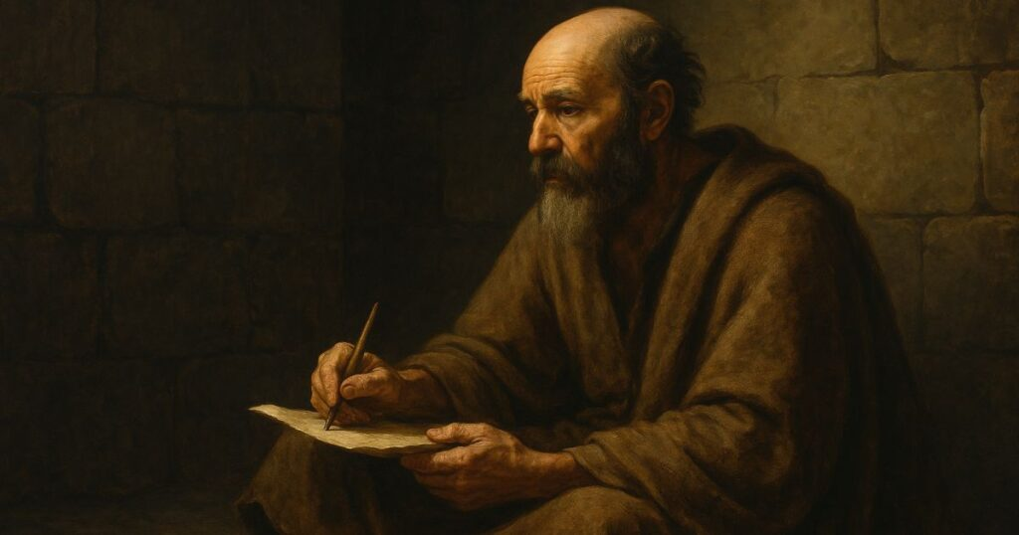
To all those in Rome…

Slide 2
Romans 5:1
“…since we have been justified by faith, we have peace with God through our Lord Jesus Christ.”
“For if while we were enemies we were reconciled to God by the death of His Son, much more, now that we are reconciled, shall we be saved by His life. More than that, we also rejoice! …having now received reconciliation.”
Romans 5:10-11

Slide 3
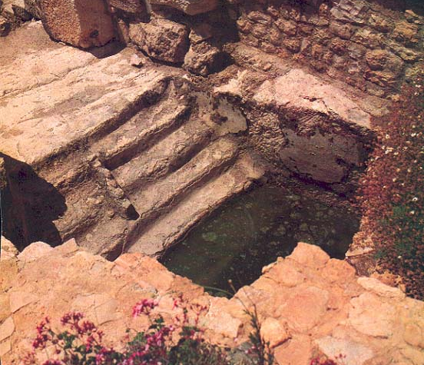

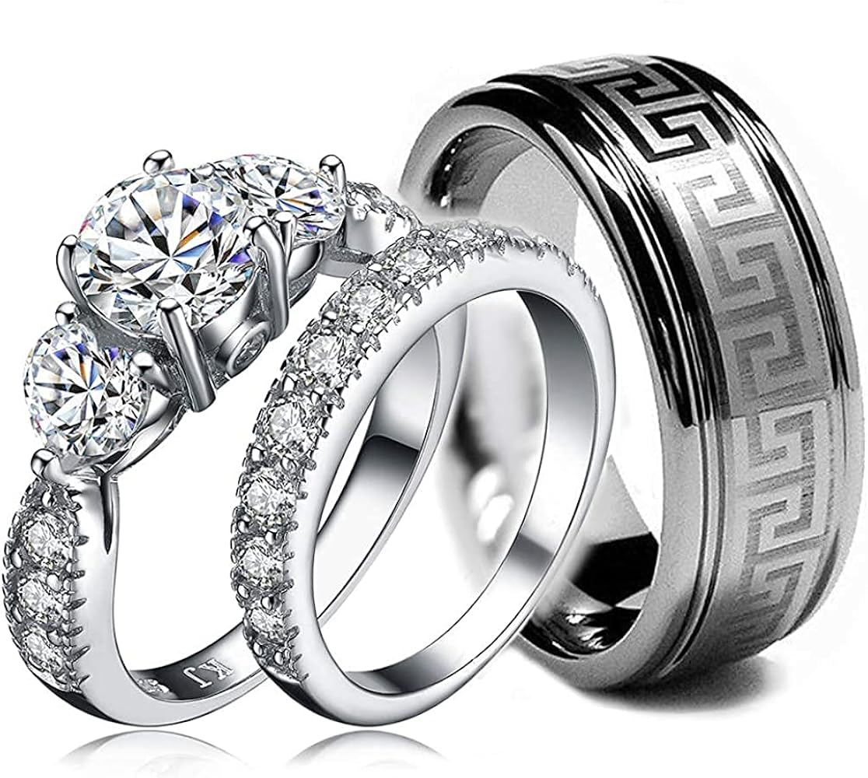
Three illustrations used:
Baptism (6:1-14)
Slavery (6:15-23)
Marriage (7:1-6)

Slide 4
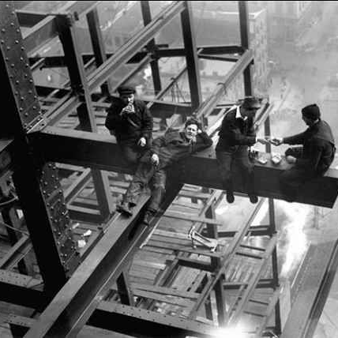
Lifeway Christian Resources
(adapted from the Holman Concise
Bible Commentary)
“By AD 63, there were
some 3 million slaves (400,000 in the city of Rome) of a total population
of 7.5 million Romans.”

Slide 5
Romans 6:15-23
Under new management!
“But thanks be to God, that you who were once slaves of sin have become obedient from the heart to the standard of teaching to which you were committed, and, having been set free from sin, have become slaves of righteousness.” – (Romans 6:17-18)

Slide 6
Romans 6:15-23
Under new management!
“But now that you have been set free from sin and have becomes slaves of God, the fruit you get leads to sanctification and its end, eternal life. For the wages of sin is death, but the free gift of God is eternal life in Christ Jesus our Lord.” – (Romans 6:22-23)

