Slide 1
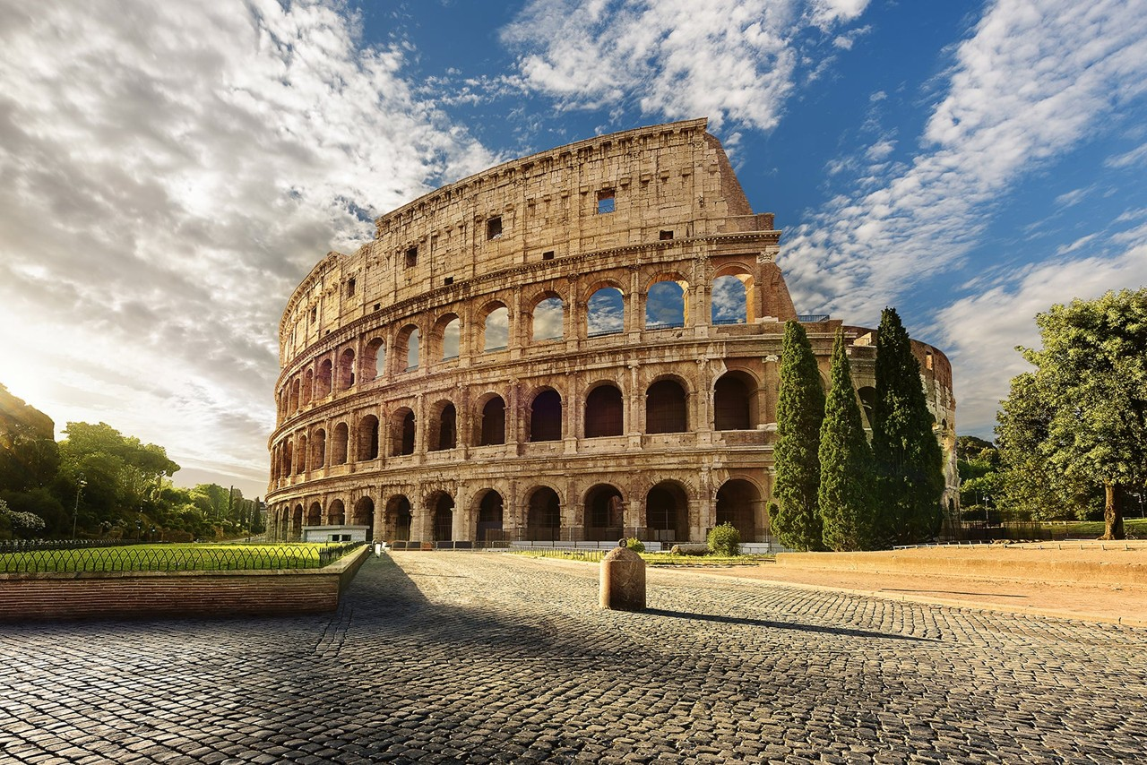
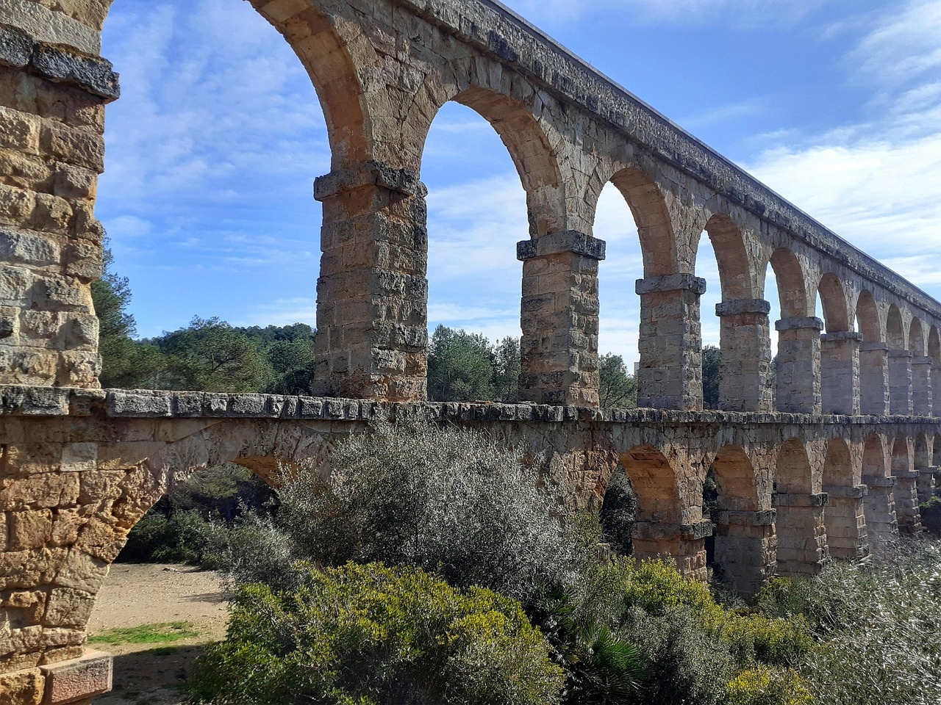
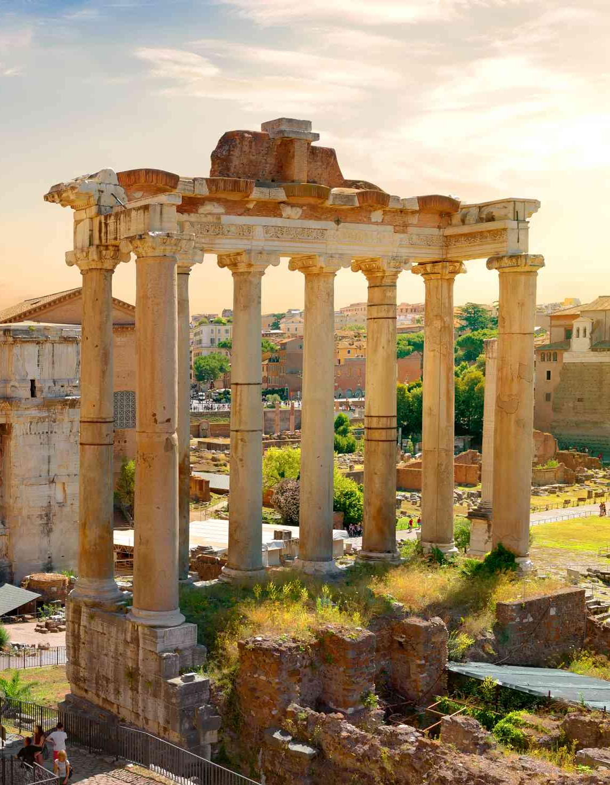
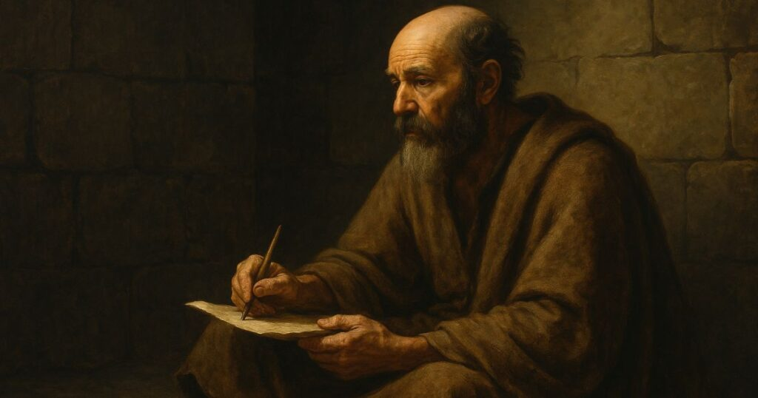
To all those in Rome…

Slide 2
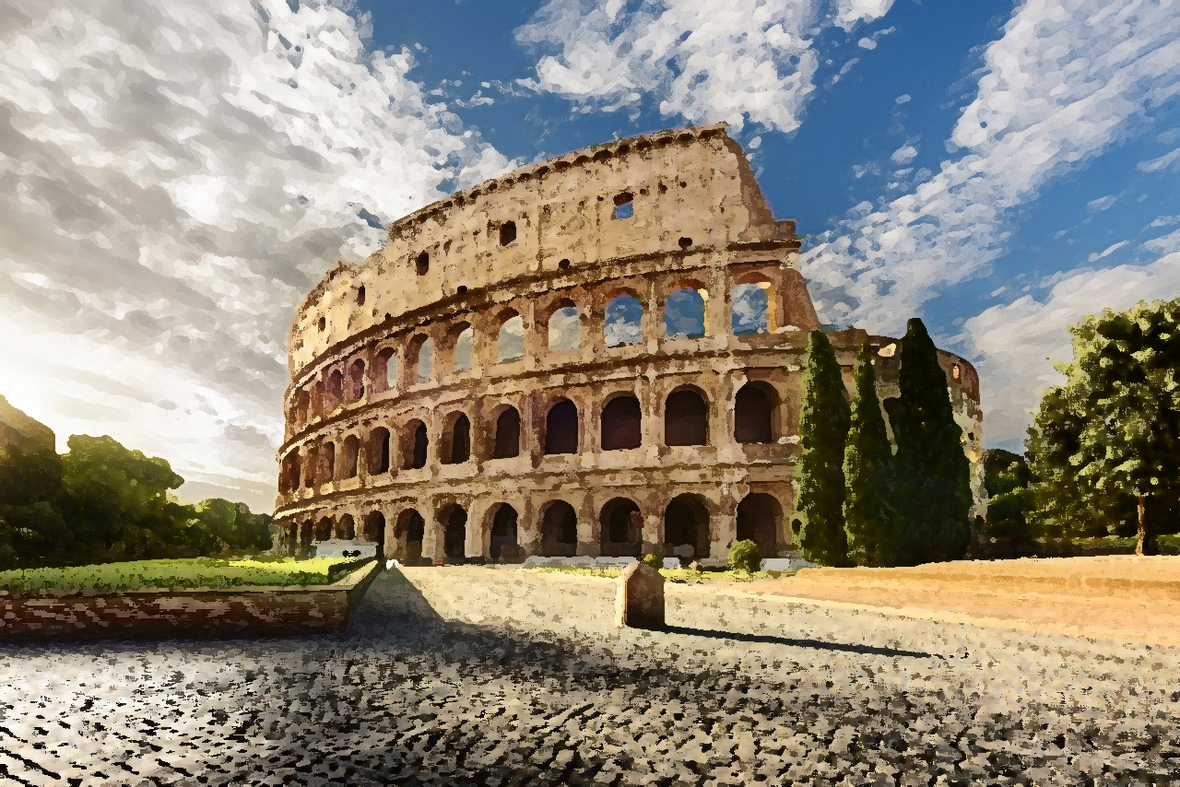
Romans 4:17
“I have made you the father of many nations” —in the presence of the God in whom he believed, who gives life to the dead AND calls into existence the things that do not exist.”
God makes alive the dead!
God fills the void full!

Slide 3
Romans 5:12-14
“Therefore, just as sin came
into the world…
death spread…
death reigned.”
text

Slide 4
Romans 5:15-17
“But the free gift
is not like the trespass…
grace abounded…
abundance of grace.”
much more!

Slide 5
Romans 5:19
“For as by one man’s disobedience the many were made sinners, so by the one Man’s obedience the many will be made righteous.”
grace abounded all the more!

