Slide 1
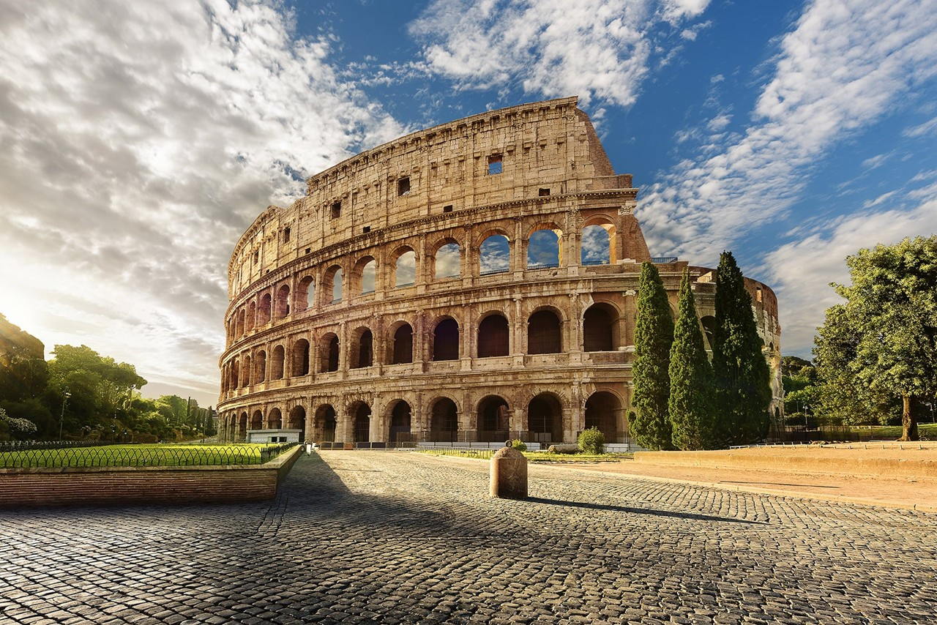
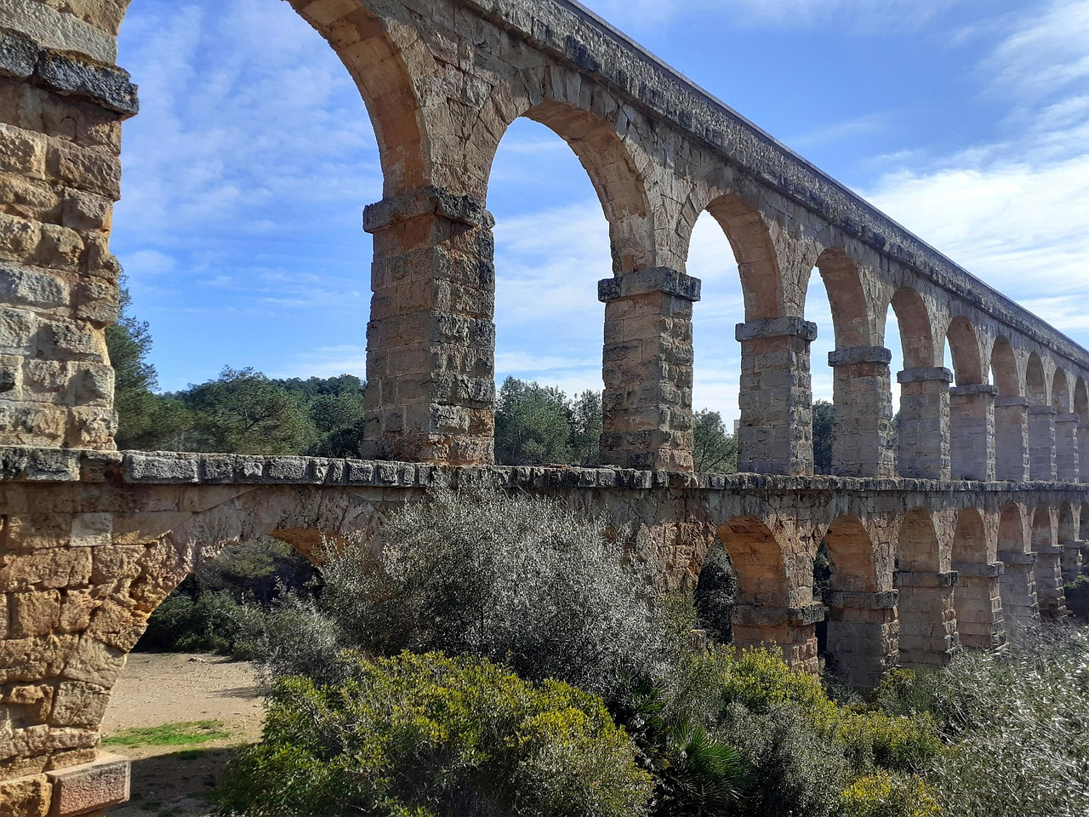
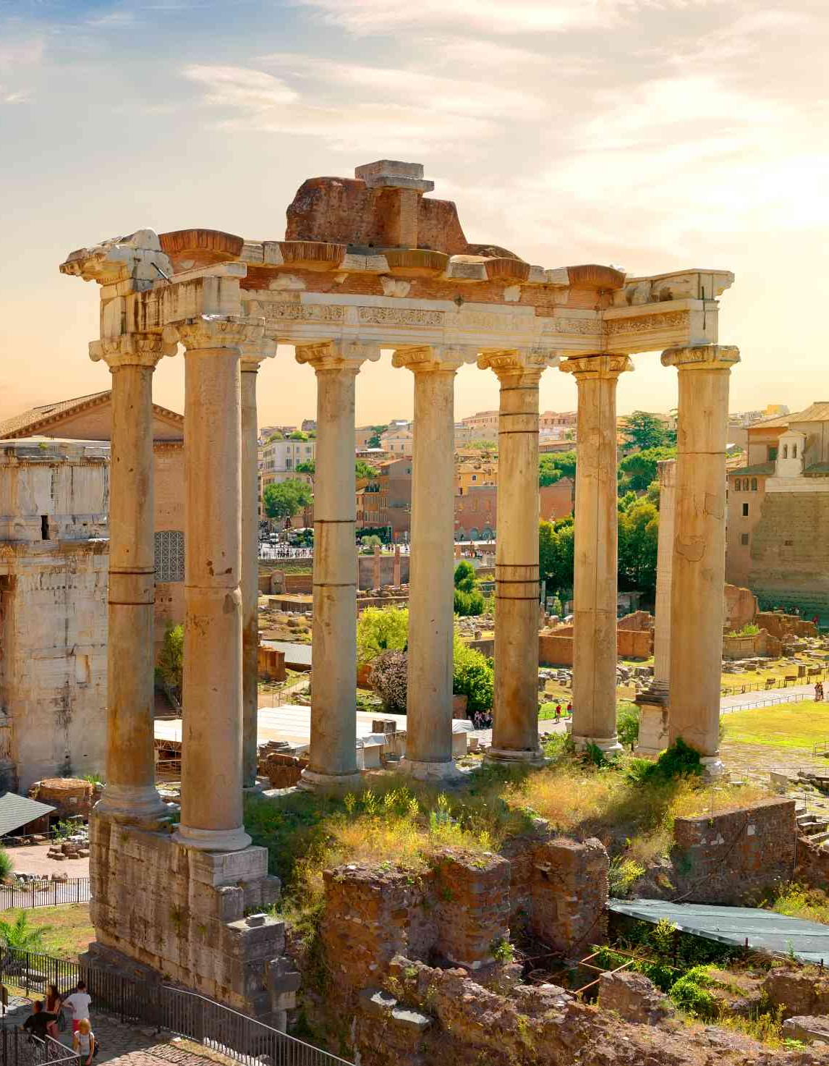
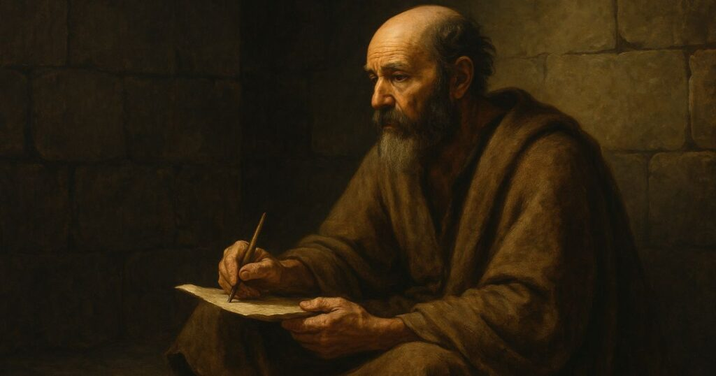
To all those in Rome…

Slide 2
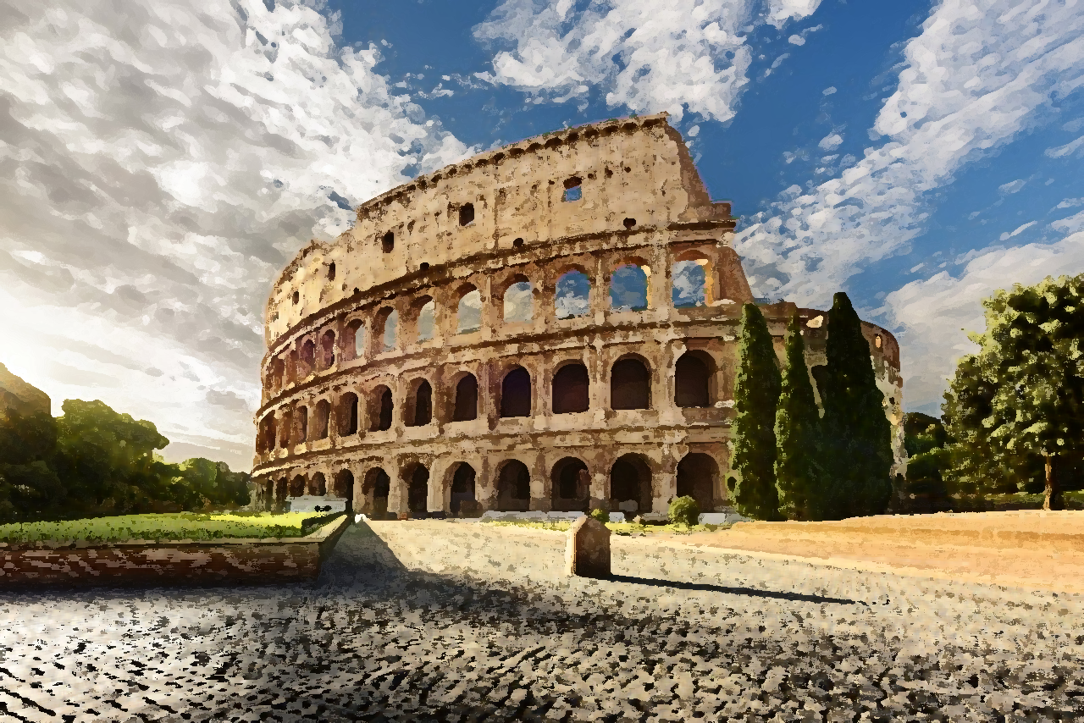
Or do you presume on the riches of His kindness and forbearance and patience, not knowing that God’s kindness is meant to lead you to repentance?
Romans 2:4
“For I am not ashamed of the Gospel, for it is the power of God save…”
Romans 1:16

Slide 3
2:6 -God judges everyone equitably
2:7 –in well-doing, seek for = eternal life
2:8 -Those who do evil → wrath
2:9 -Wrath → those who do evil
2:10 –glory/honor/peace = doing good
2:11 -God judges impartially
Highlights God’s impartial judgment: the Jew… the Greek

Slide 4
They suppress the truth.
What can be known about God is plain to them.
His invisible attributes are clearly perceived.
They know God, but they won’t worship Him.
They even know God’s righteous decree and that death is deserved because of sin.

Slide 5
“In all evangelism, I find it a constant encouragement to say to myself, ‘The other person’s conscience is on my side.’”
“Human beings are moral beings by creation… not only do we experience an inner urge to do what we believe to be right, but we also have a sense of guilt and remorse when we have done what we know to be wrong.”
John Stott, The Message of Romans

Slide 6
“And I will vindicate the holiness of My great name, which has been profaned among the nations, and which you have profaned among them. And the nations will know that I am the Lord, declares the Lord God, when through you I vindicate My holiness before their eyes.”
Ezekiel 36:23

Slide 7
Deuteronomy 10:16
Circumcise your heart and be stubborn no longer.
And the Lord your God will circumcise your heart and the heart of your offspring, so that you will love the Lord your God with all your heart and with all your soul, that you may live.
Deuteronomy 30:6
Jeremiah 9:25-26
I will punish all those who are circumcised merely in the flesh— Egypt, Judah, Edom, the sons of Ammon, Moab… and all the house of Israel are uncircumcised in heart.

Slide 8
Galatians 2:16
“...yet we know that a person is not justified by works of the law but through faith in Jesus Christ.”
“Know then that it is those of faith who are the sons of Abraham. And the Scripture, foreseeing that God would justify the Gentiles by faith, preached the gospel beforehand to Abraham, saying, ‘In you shall all the nations be blessed.’”
Galatians 3:7-8, 29
“And if you are Christ’s, then you are Abraham’s offspring, heirs according to promise.”

