Slide 1
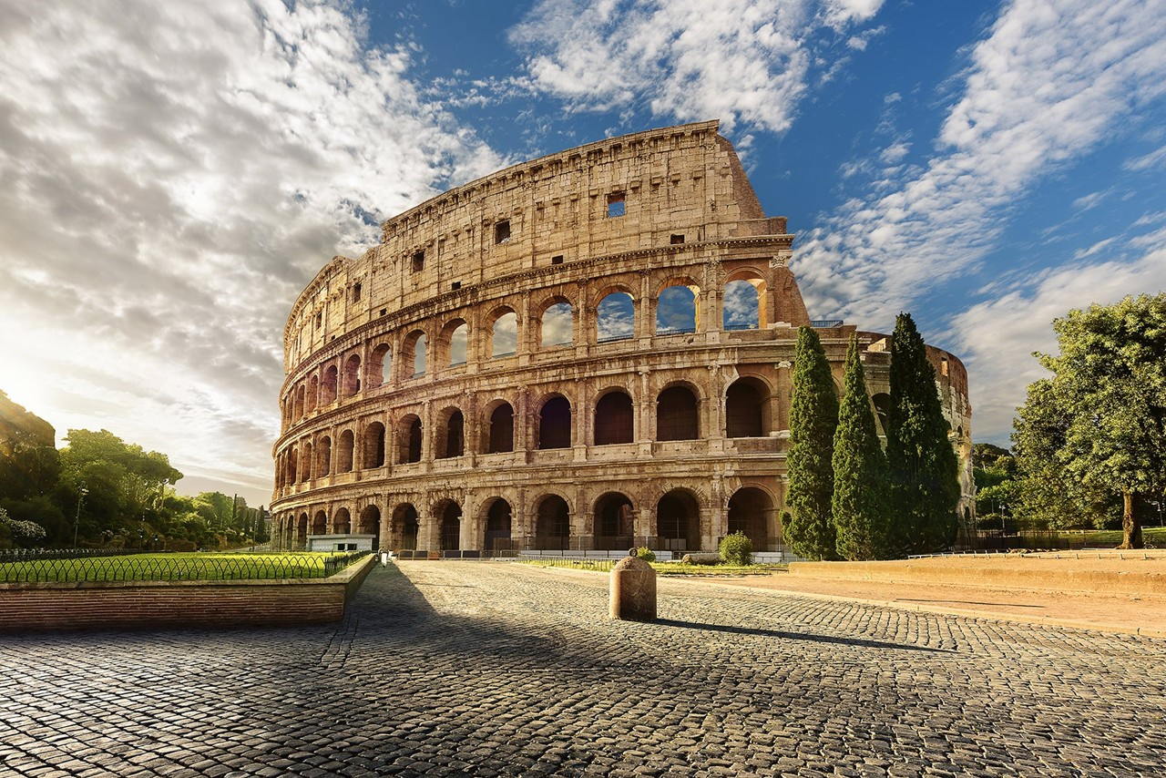
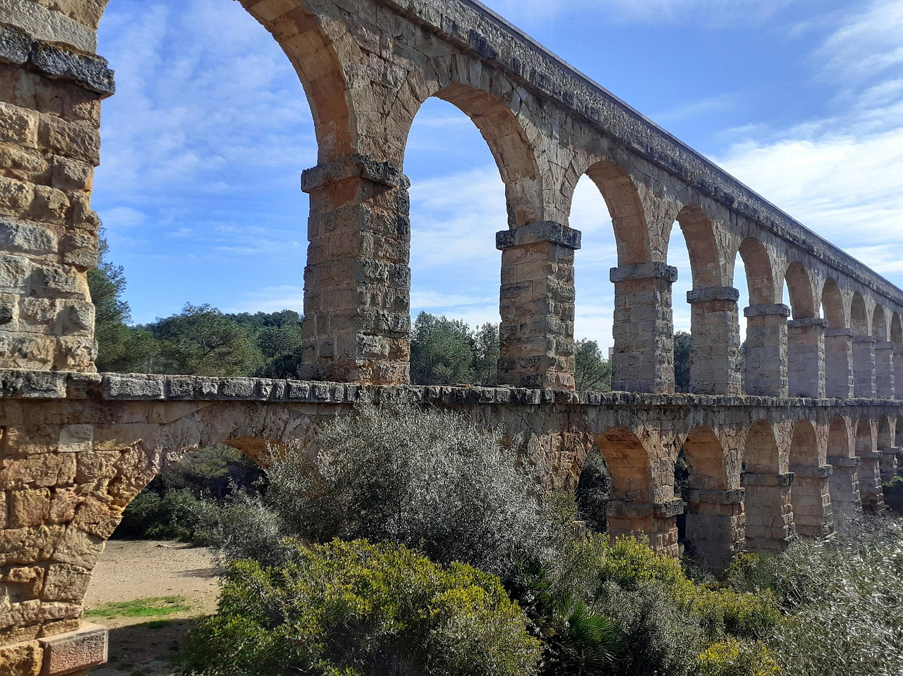
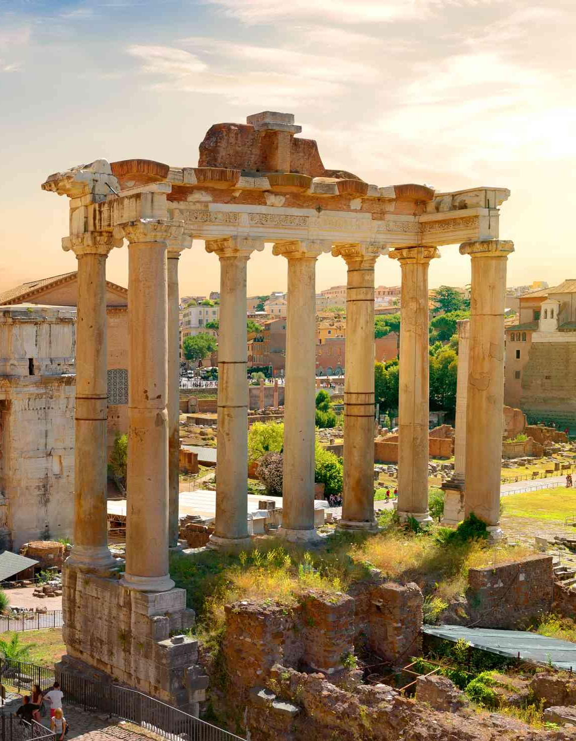
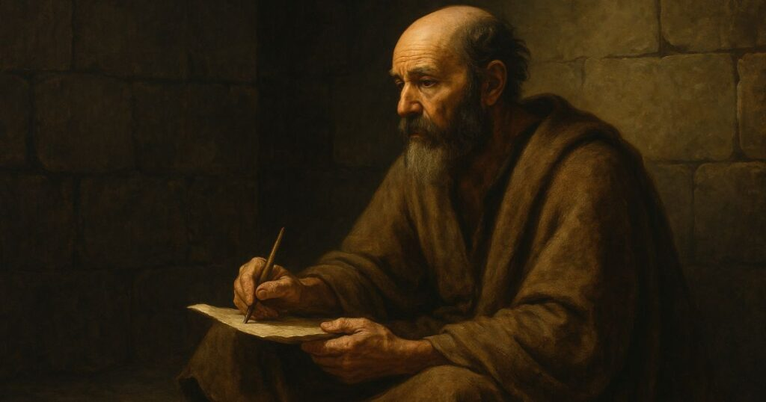
To all those in Rome…

Slide 2
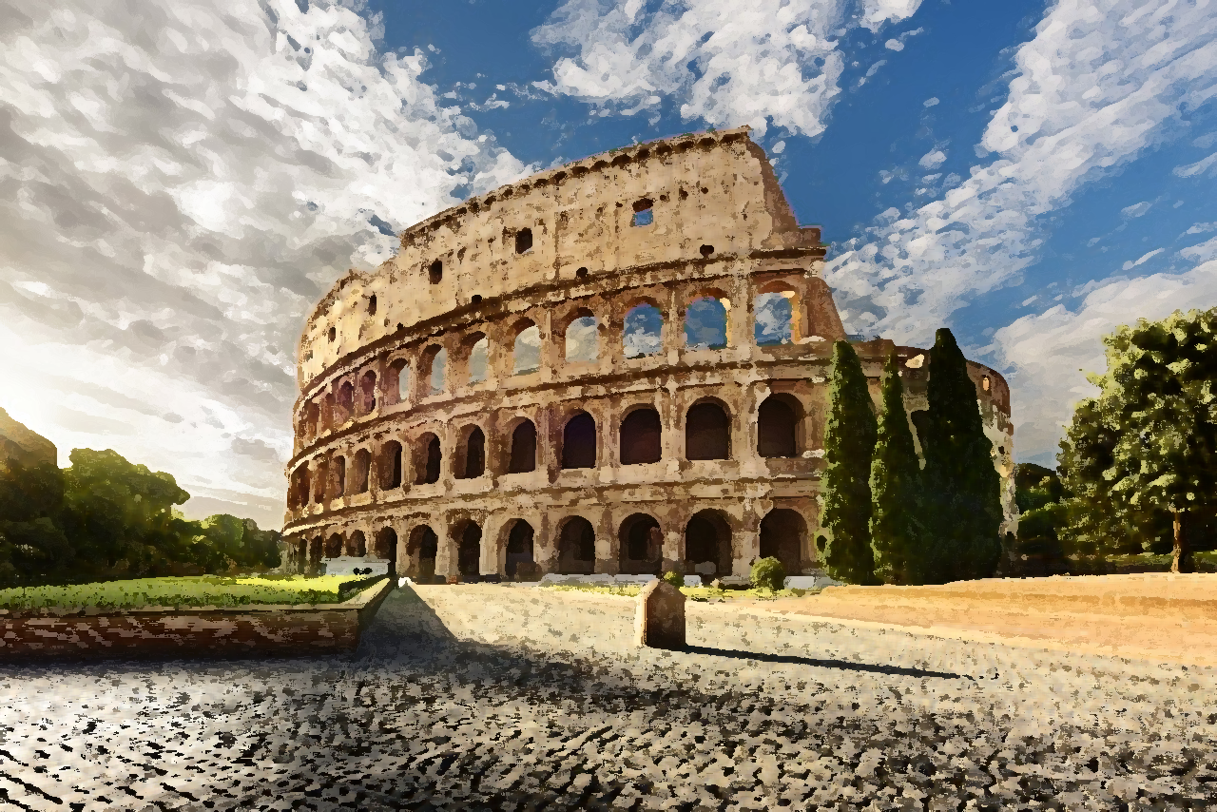
Paul begins with gratitude:
“…because your faith is proclaimed
in all the world.”
Romans 1:8-17

Slide 3
Paul continues with prayer:
“…without ceasing I mention you
always in my prayers”
Romans 1:8-17

Slide 4
“…strive together with me in your prayers to God on my behalf, that I may be delivered from the unbelievers in Judea, and that my service for Jerusalem may be acceptable to the saints.”
Romans 15:30-31

Slide 5
Paul desires to impart a gift:
“...to strengthen you, that we may be
mutually encouraged by each other’s faith”
Romans 1:8-17

Slide 6
Priestly Service: to facilitate worship, to teach the Law, and to maintain the spiritual integrity of God’s people
“…because of the grace given me by God to be a minister of Christ Jesus to the Gentiles in the priestly service of the gospel of God.”
Romans 15:15

Slide 7
Paul emphasizes his mission:
“I am under obligation both
to Greeks and to barbarians,
to the wise and to the foolish.”
Romans 1:8-17

Slide 8
Paul focuses on faith:
“For I am not ashamed of the gospel,
for it is the power of God for salvation”
Romans 1:8-17

Slide 9
“…whom God put forward as a propitiation by His blood, to be received by faith.” (Romans 3:25)
“But now the righteousness of God has been manifested apart from the law… the righteousness of God through faith in Jesus Christ for all who believe.
Romans 3:21-22

