Slide 1
All roads lead to Rome!
Paul’s conversion, ministry & dedication

Slide 2
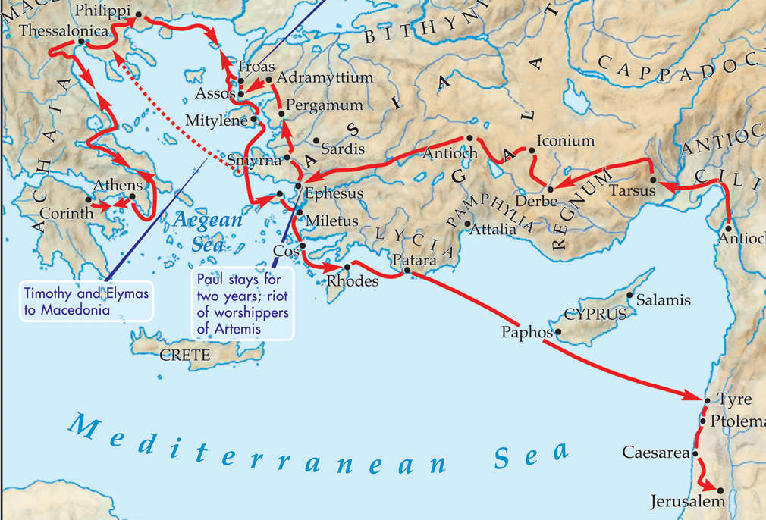
All roads lead to Rome!
Paul’s Third Missionary Journey (Acts 18:23 – 20:38)

Slide 3
All roads lead to Rome!
“…if only I may finish my course and the ministry that I received from the Lord Jesus, to testify to the gospel of the grace of God.”
Acts 20:24

Slide 4
All roads lead to Rome!
“What are you doing…? For I am ready not only to be imprisoned but even to die in Jerusalem for the name of the Lord Jesus.”
Acts 21:13

Slide 5
All roads lead to Rome!
“So then, whether we live or whether we die, we are the Lord’s.”
Παῦλος δοῦλος
Χριστοῦ Ἰησοῦ
Paul, a slave,
Romans 14:8
belonging to Christ Jesus
“Let the will of the Lord be done!”
Romans 1:1

Slide 6

All roads lead to Rome!
“…teaching about the Lord Jesus Christ with all boldness and without hindrance.”
Acts 28:31

