Slide 1

Enduring Praise
Psalm 89
Declaration | Proclamation | Invocation

Slide 2
Enduring Praise
The HESED of Yahweh is forever; I will sing of it from generation to generation. Your faithfulness, I will make known with my mouth.

Slide 3
Enduring Praise
Blessed are the people who know the festal shout, who walk, O Lord, in the light of Your face, who exult in Your name all the day and in Your righteousness are exalted.
(Psalm 89:15-16)

Slide 4
Enduring Praise
The Person of the Covenant
The Provision because of the Covenant
The Penalty imbedded within the Covenant

Slide 5
The PERSON of the Covenant
“When your days are fulfilled and you lie down with your fathers, I will raise up your offspring after you, who shall come from your body, and I will establish his kingdom. He shall build a house for My name, and I will establish the throne of his kingdom forever.”
[2 Samuel 7:12-13 & 1 Chronicles 17:11-12]

Slide 6
The PERSON of the Covenant
The Noahic Covenant – Genesis 9
The Abrahamic Covenant – Genesis 15
The Mosaic Covenant – Exodus 19
The Davidic Covenant – 2 Samuel 7
The New Covenant – Jeremiah 31

Slide 7
The PROVISION because of the Covenant
“My steadfast love I will keep for him forever, and My covenant will stand firm for him. I will establish his offspring forever and his throne as the days of the heavens.”
[Psalm 89:28-29]

Slide 8
The PENALTY imbedded within the Covenant
“If his children forsake My law…”
“I will be to him a father, and he shall be to Me a son. When he commits iniquity, I will discipline him with the rod of men, with the stripes of the sons of men.”
[Psalm 89:30 & 2 Samuel 7:14]

Slide 9
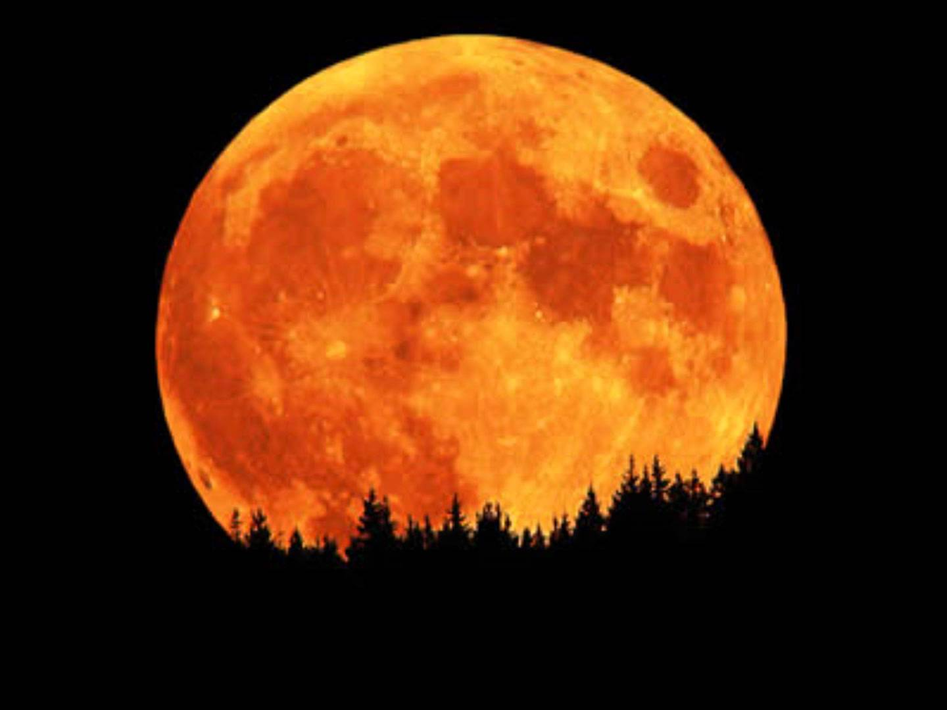
The PENALTY imbedded within the Covenant
“Like the moon it shall be established forever, a faithful witness in the skies.”
(Psalm 89:37)

