Slide 1

Peter’s Earthly Ministry | Acts
Finding Boldness
Acts 4:5-22

Slide 2
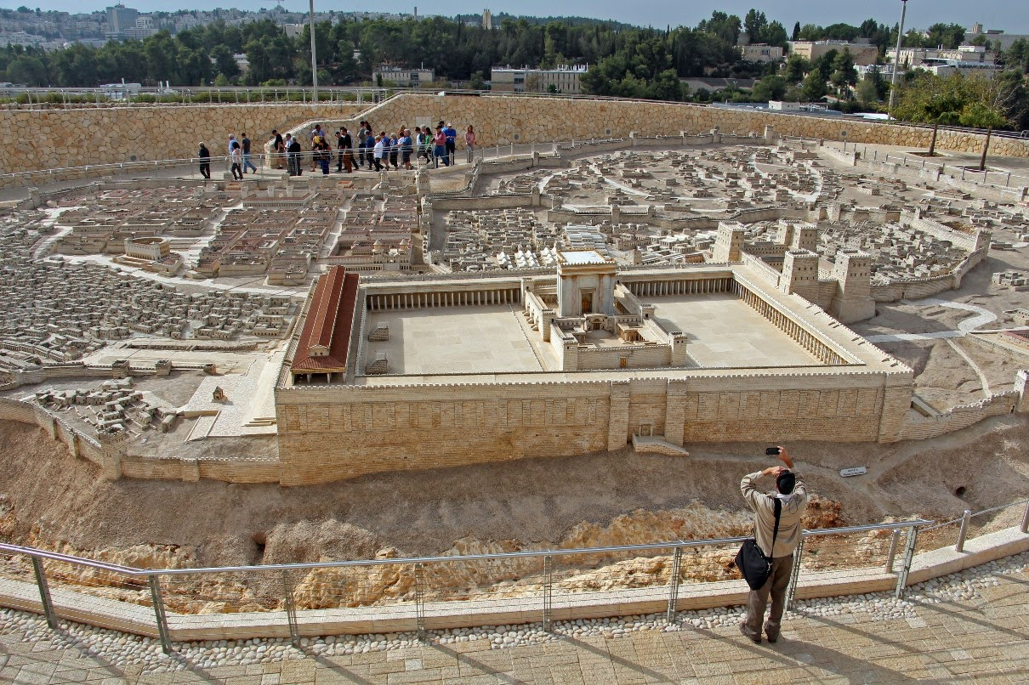
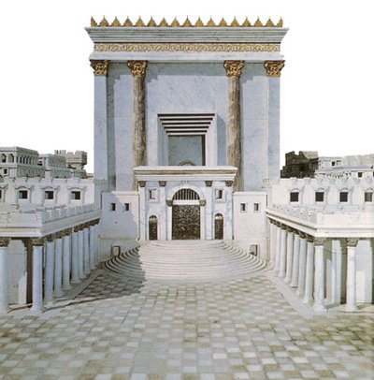
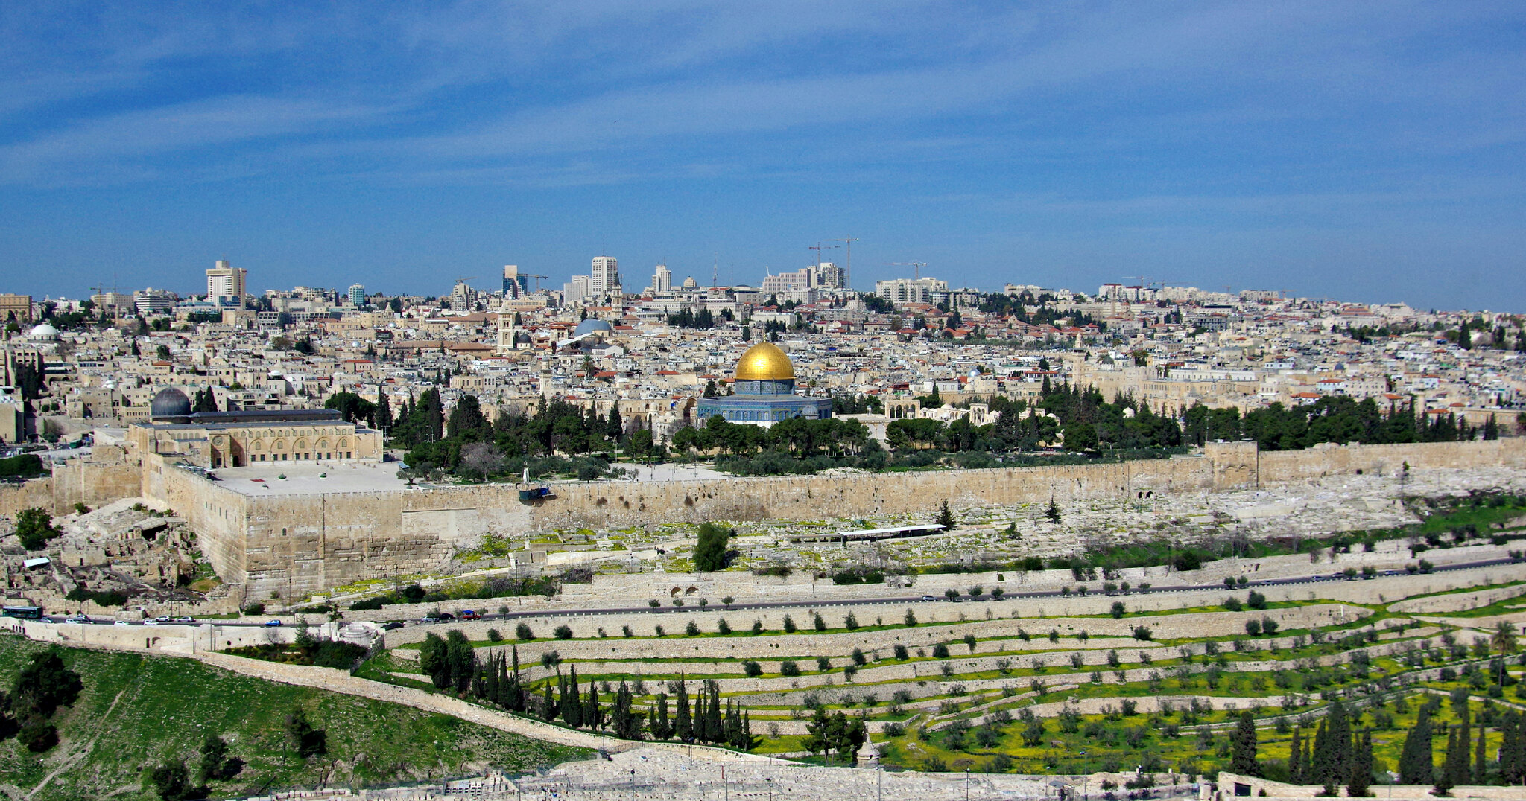
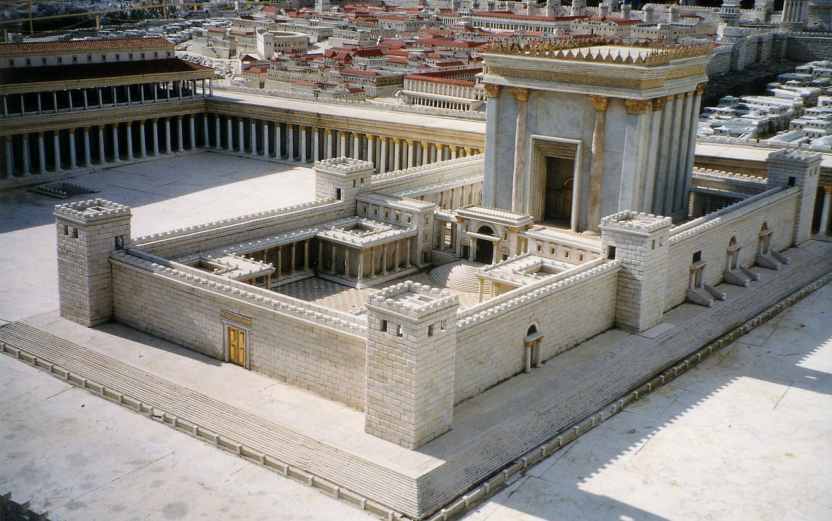

Slide 3
A man so familiar by those within the city walls that he is only part of the backdrop for many of the scenes in the final week of Jesus’s earthly ministry. We are blind to him, and yet Jesus surely sees him, knowing full well that when his time for physical healing comes, it will result in the spiritual healing for thousands.

Slide 4
God sees you. He knows you. He loves you!
In our waiting, in our pleading, may we remain obedient, trusting His faithful love and relying upon His favorable providence.
Seek God’s Kingdom first and His righteousness, and all these things that fill our hearts with fear and anxiety will be taken care of. It’s the heathen who seek for earthly provisions void of God’s providence, but we are not to be so distorted.
(Matthew 6:25-34)

Slide 5
BOLDNESS reckless
FAITH
fear
“…for we cannot but speak of what we have seen and heard.”
(Acts 4:19-20)
The unseen current that drives all things that are seen is faith upon the fact of the resurrection.
What changes these men is the finality of Jesus’s purpose in redemption: His death on the cross and the resulting mighty victory in resurrection!

Slide 6
Romans 6:4 – We were buried therefore with Him by baptism into death, in order that, just as Christ was raised from the dead by the glory of the Father, we too might walk in newness of life.
For our sake He made Him to be sin who knew no sin, so that in Him we might become the righteousness of God. – 2 Corinthians 5:21
Galatians 2:20 – I have been crucified with Christ. It is no longer I who live, but Christ who lives in me. And the life I now live in the flesh I live by faith in the Son of God, who loved me and gave Himself for me.
He was foreknown before the foundation of the world but was made manifest in the last times for the sake of you who through Him are believers in God, who raised Him from the dead and gave Him glory, so that your faith and hope are in God. – 1 Peter 1:20-21

Slide 7
No longer are they driven to panic as in the storm on the Sea of Galilee. No longer are they defined by fear as by their flight from the Garden of Gethsemane. Instead, here they stand, resolute upon the fact of Christ’s death and resurrection, replacing recklessness with boldness based on history and removing fears with faith built on facts.

Slide 8
“And when they had prayed, the place in which they were gathered together was shaken, and they were all filled with the Holy Spirit and continued to speak the word of God with boldness.”
(Acts 4:31)
Boldness is found in applying faith

