Slide 1

Surrendering to Christ | 1 Peter
A Little Longer (Part 2)
1 Peter 5:8-14

Slide 2
And after you have suffered a little while…
(1 Peter 5:10)
restore | confirm | strengthen | establish
Everyone then who hears these words of Mine [Jesus] and does them will be like a wise man who built his house on the rock. And the rain fell, and the floods came, and the winds blew and beat on that house, but it did not fall, because it had been founded on the rock.
Matthew 7:24-25

Slide 3
I have written briefly to you, exhorting and testifying that this is the true grace of God.
Stand firm in it.
(1 Peter 5:12)
Therefore, take up the whole armor of God, that you may be able to withstand (aka, “resist”) in the evil day, and having done all, to stand firm.
Ephesians 6:13

Slide 4
How to do this…
Peter gives us a final picture of Body Life within the framework of the church as he closes his letter.
He sends greetings from those gathered
He encourages them to greet one another
He offers peace for all who are in Christ
The Christian Faith is embarked upon with faithful Christians.

Slide 5
Though you have not seen Him, you love Him. Though you do not now see Him, you believe in Him and rejoice with joy that is inexpressible and filled with glory, obtaining the outcome of your faith, the salvation of your souls.
1 Peter 1:8-9

Slide 6
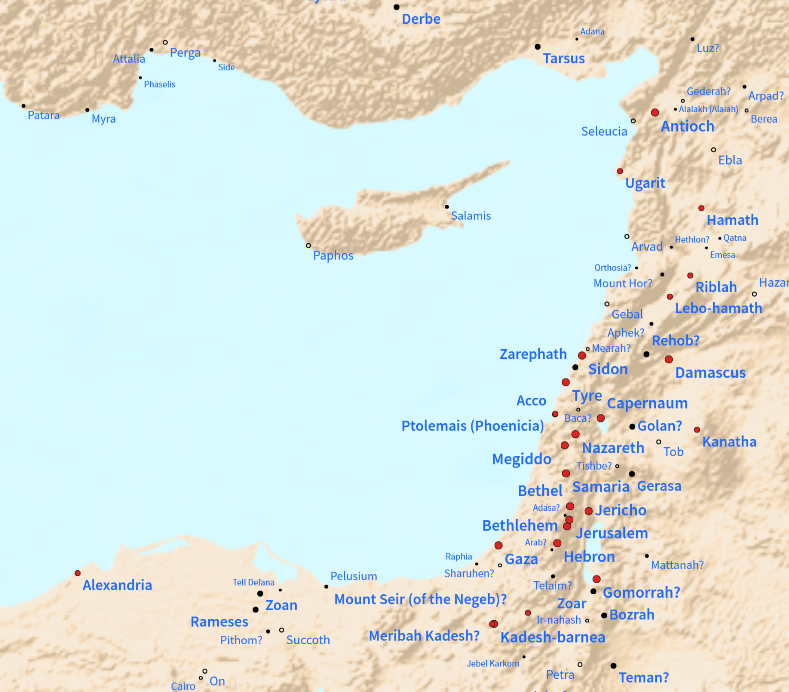
Cyprus
Paul and Barnabas + John-Mark
(Acts 13:4-14 around 46 A.D.)

Slide 7
Then they seized Him [Jesus] and led Him away, bringing Him into the high priest’s house, and Peter was following at a distance…
And immediately, while he was still speaking, the rooster crowed. And the Lord turned and looked at Peter. And Peter remembered the saying of the Lord, how He had said to him, “Before the rooster crows today, you will deny Me three times.”
And he went out and wept bitterly.
Luke 22:54-62

Slide 8
Investment Ministry – 1 Peter 5:12-14
We are not our own…
We are not on our own…
The way forward is by investing in our own…
2 Timothy 2:2 | Titus 2:2-8 | Hebrews 12:1 | James 5:14-16

