Slide 1
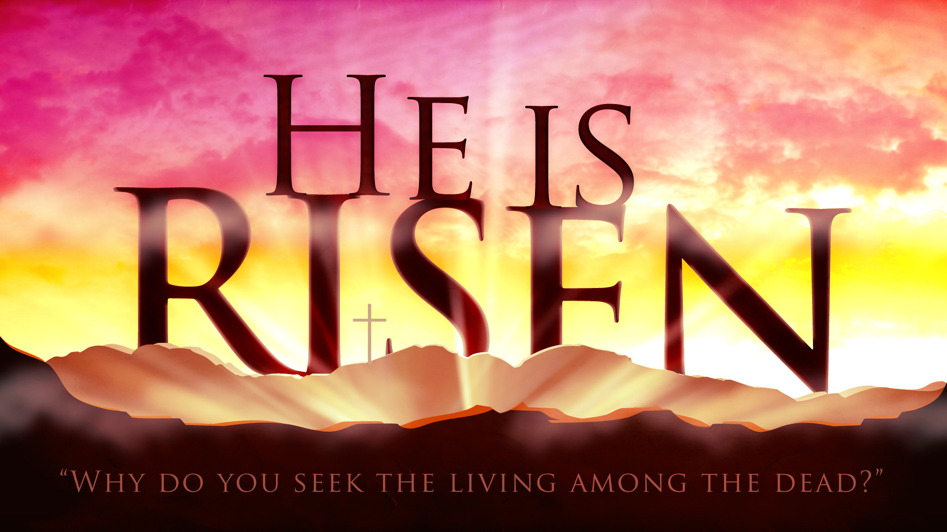

Slide 2
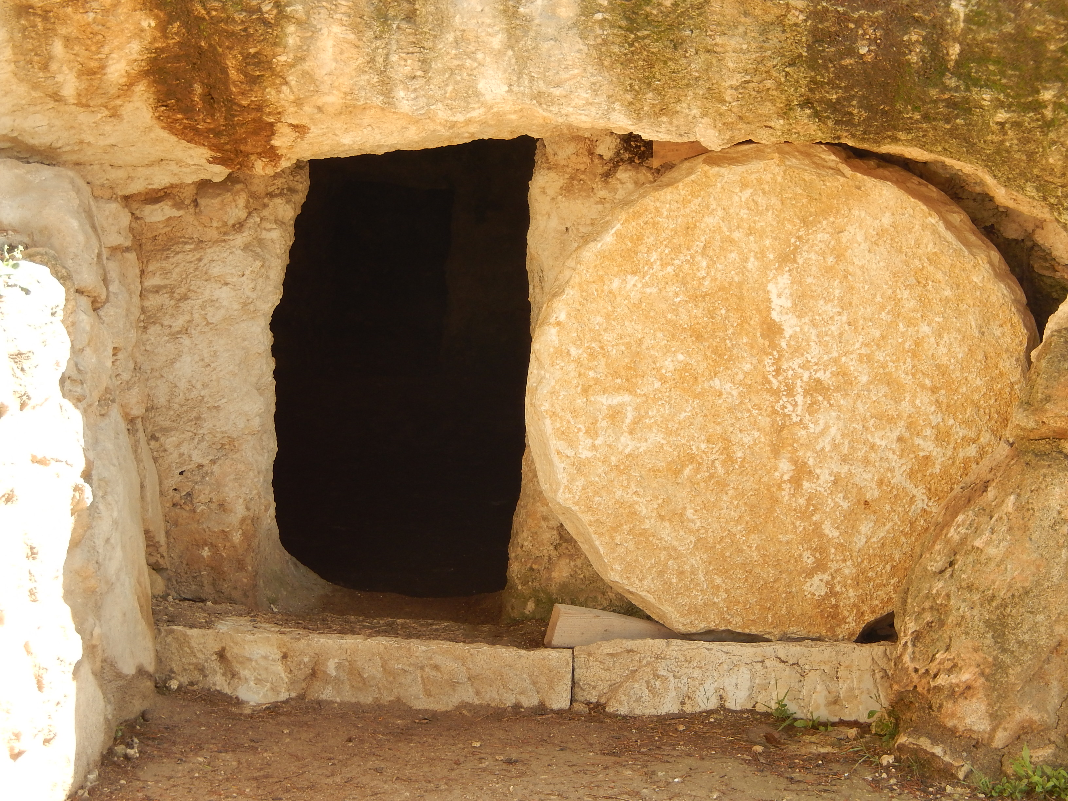
Resurrection
the Marvel
&
the Message
Luke 24:36-49

Slide 3

And taking the twelve, He said to them,
“See, we are going up to Jerusalem, and everything that is written about the Son of Man by the prophets will be accomplished. For He will be delivered over to the Gentiles and will be mocked and shamefully treated and spit upon. And after flogging Him, they will kill Him, and on the third day He will rise.”
Luke 18:31-33

Slide 4
And they told him, “Joseph is still alive, and he is ruler over all the land of Egypt.” And his heart became numb, for he did not believe them.
Genesis 45:26

Slide 5
MARVEL describes an unexpected surprise and complete wonder at the mystery they’re experiencing. They had no idea they would ever see Jesus again, yet the very fact their disbelief is recorded in Scripture demonstrates their inability to fabricate such events.
The joy in that room must have been palpable!

Slide 6
Concerning this salvation, the prophets who prophesied about the grace that was to be yours searched and inquired carefully, inquiring what person or time the spirit of Christ in them was indicating when he predicted the sufferings of Christ and the subsequent glories.
1 Peter 1:10-11

Slide 7
The MESSAGE of the apostles through the power of the Spirit enables anyone who believes and puts their faith in Jesus to gain access into His kingdom, and we read this throughout the rest of the book of Acts and the letters of the New Testament.
Faith in Jesus is the fruition of their message!

Slide 8
Come, all who are thirsty…
Incline your ear, and come to Me;
Hear, that your soul may live; and I will make with you an everlasting covenant…
Seek the Lord while He may be found; call upon Him while He is near…
for He will abundantly pardon.
Isaiah 55:1, 3, 6-7

