Slide 1

Surrendering to Christ | 1 Peter
A Joyful Response (Part 2)
1 Peter 4:12-19

Slide 2

The Heidelberg Catechism
“God’s providence is His almighty and ever present power, whereby, as with His hand, He still upholds heaven and earth and all creatures, and so governs them that leaf and blade, rain and drought, fruitful and barren years, food and drink, health and sickness, riches and poverty, indeed, all things, come not by chance but by His fatherly hand.”

Slide 3
Wayne Grudem
“The readers are encouraged to see God’s good purpose behind their difficulties, enabling them to grow stronger in faith and give more glory to God.”
“For You, O God, have tested us; You have tried us as silver is tried. You brought us into the net; You laid a crushing burden on our backs; You let men ride over our heads; we went through fire and through water; yet You have brought us out to a place of abundance.”
Psalm 66:10-12 (ESV)

Slide 4
Acts 5:41 – they were counted worthy to suffer
Acts 16:25 – Paul and Silas were praying and singing
Philippians 2:17 – Even if I am to be poured out as a drink offering upon the sacrificial offering of your faith, I am glad and rejoice with you all.
James 1:2 – Count it all joy
Hebrews 12:2 – Jesus, who for the joy that was set before Him, endured the cross

Slide 5
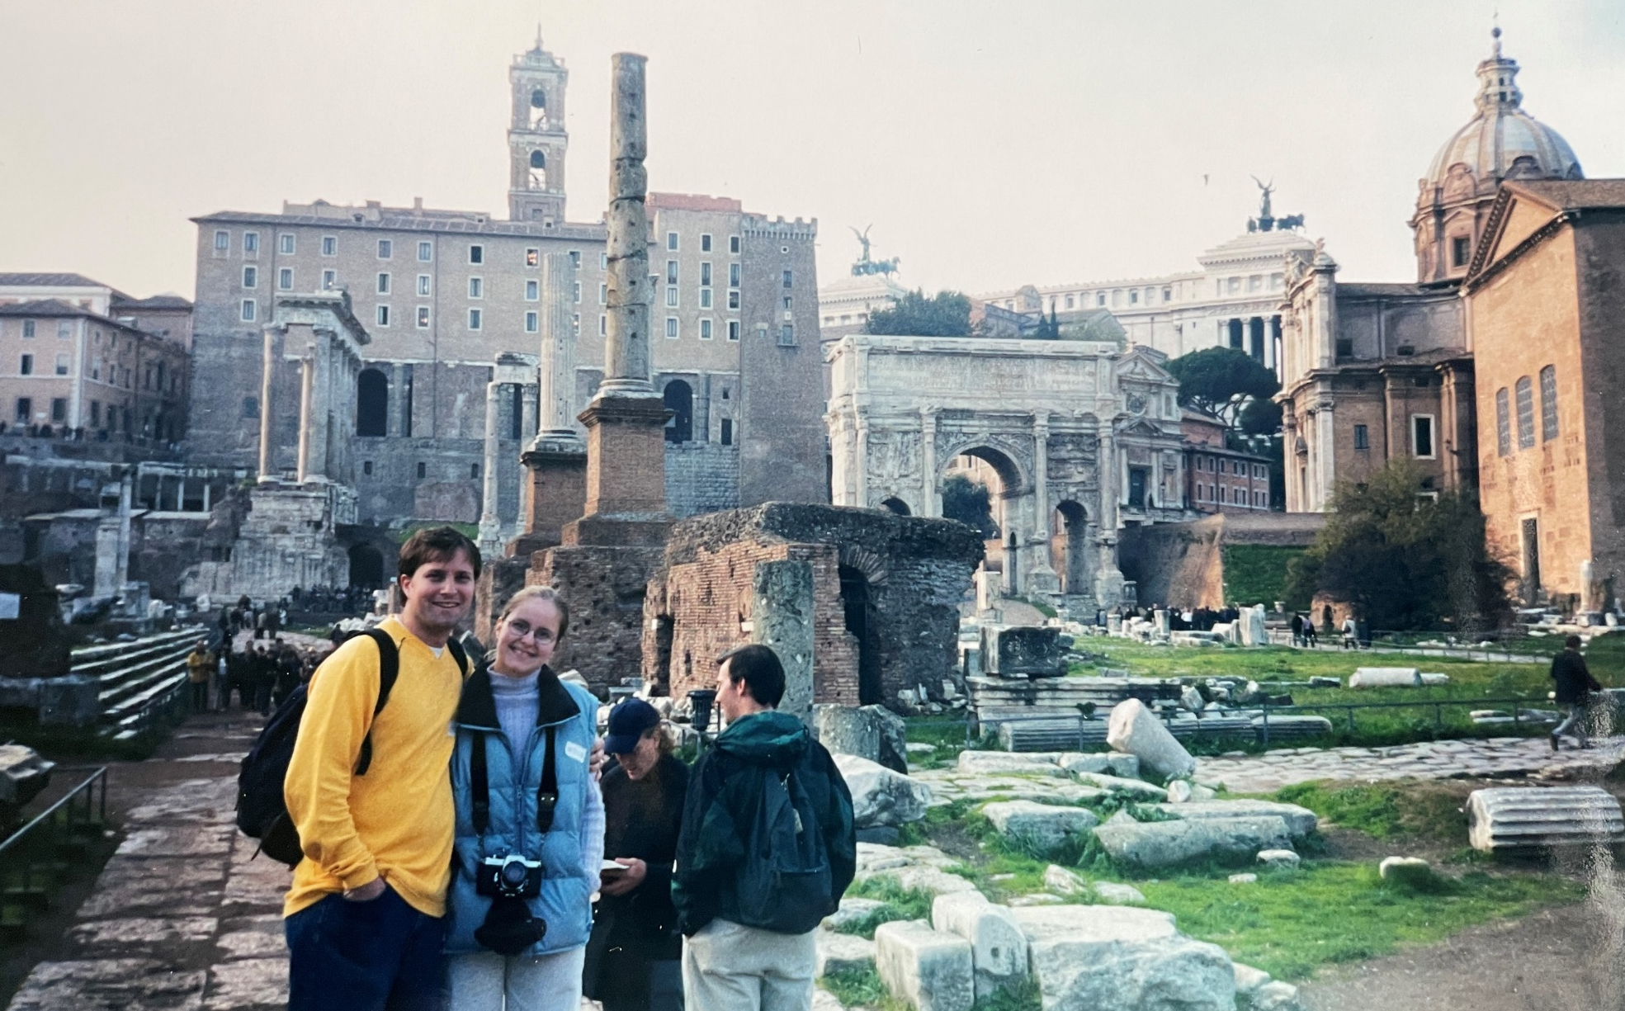
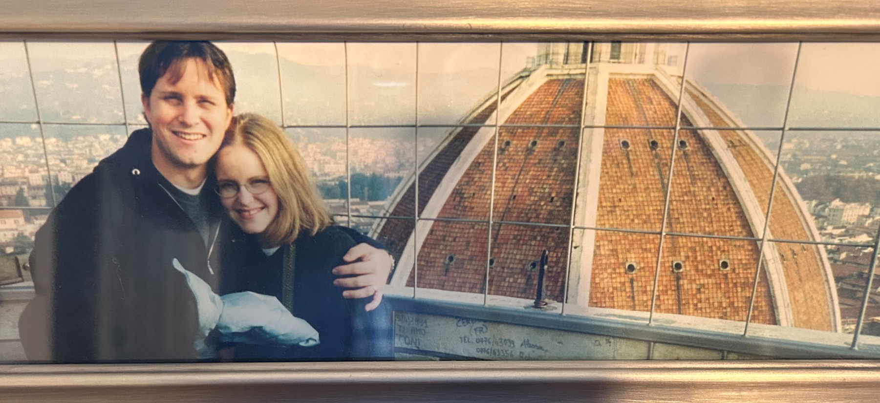
“…but no matter how hard Rome tried, Christianity didn’t stop. In fact, persecution probably made Christianity even stronger.”
“As Foxe’s Book of Martyrs notes, ‘Though persecuting malice raged, yet the Gospel shone with resplendent brightness and, firm as an impregnable rock, withstood the attacks of its boisterous enemies with success.’”

Slide 6
The Heidelberg Catechism
“We can be patient in adversity, thankful in prosperity, and with a view to the future we can have a firm confidence in our faithful God and Father that no creature shall separate us from His love.”
“In God’s good providence, you’ve called at a bad time.”

Slide 7
Robert Mulholland, Cornerstone Bible Commentary (CBC) on 1 Peter
“The glory of Christ is more than a future hope, however. It is also a present possession. In the Holy Spirit Christ’s glory is already revealed, for the Spirit is sent from his throne.”
“…the glory that rested alone in God, that shekinah presence dwelling among his people [Exodus 40], was first given to his Messiah in Isaiah 11:2 and now rests upon them in further fulfillment of the spread of God’s glory to the church.”
The Message of 1 Peter, by Edmund Clowney

Slide 8
Hebrews 12:2
…looking to Jesus, the founder and perfecter of our faith, who for the joy that was set before Him endured the cross, despising the shame, and is seated at the right hand of the throne of God.
…despising the shame
“On the cross Jesus was treated as valueless, being mocked and ridiculed. He, however, turned the experience inside out, ‘scorning the scorn’…”
“The cross was insignificant compared to the joy set before our Lord.”
NIV Application Commentary (Hebrews), by George Guthrie

Slide 9
“Peter seems to have the prophecy of Malachi particularly in view, for it combines the thought of God’s coming to his temple with the double purpose of his judgment: to purify his worshippers and to consume the wicked.”
–1 Peter (Clowney)
Malachi 3:1-5
2 Thessalonians 1:5-12
Hebrews 10:26-31
“The last days have begun, and the judgment God is sending to earth has been inaugurated. The persecution that has come upon Peter’s readers is part of that ‘refining fire,’ and God is using it to purge his people.”
–1 Peter (CBC, Robert Mulholland)

