Slide 1

Surrendering to Christ | 1 Peter
A Joyful Response (Part 1)
1 Peter 4:12-19

Slide 2

A Mysterious Reality | 1 Peter 3:18 – 4:6
Peter writes to encourage the churches,
not to confuse them.
Total victory and true hope are at the heart
of what Peter is emphasizing.
Escape from pending doom is guaranteed
despite the powers of doom.

Slide 3
Gospel-Centered URGENCY
“The end of all things is at hand…” (1 Peter 4:7)
The prophet Joel proclaims, “And it shall come to pass that everyone who calls on the name of the Lord shall be saved.” Peter preaches on the Day of Pentecost, “Repent and be baptized everyone of you in the name of the Lord Jesus for the forgiveness of your sins, and you will receive the gift of the Holy Spirit!”
We live today in the reality of Joel 2:32
and the invitation of Acts 2:38.

Slide 4
Where love abounds in a fellowship of Christians…
True love is the secret to
gruntled hospitality.
Biblical love motivates us to
serve others.
Sacrificially serving hospitable love
glorifies Jesus.

Slide 5
Wayne Grudem
“The readers are encouraged to see God’s good purpose behind their difficulties, enabling them to grow stronger in faith and give more glory to God.”
“For You, O God, have tested us; You have tried us as silver is tried. You brought us into the net; You laid a crushing burden on our backs; You let men ride over our heads; we went through fire and through water; yet You have brought us out to a place of abundance.”
Psalm 66:10-12 (ESV)

Slide 6
Acts 5:41 – they were counted worthy to suffer
Acts 16:25 – Paul and Silas were praying and singing
Philippians 2:17 – Even if I am to be poured out as a drink offering upon the sacrificial offering of your faith, I am glad and rejoice with you all.
James 1:2 – Count it all joy
Hebrews 12:2 – Jesus, who for the joy that was set before Him, endured the cross

Slide 7
David Walls & Max Anders
“Joy, in its most sublime meaning, is a deep confidence that God is in control of every area of our lives, even the painful places. The fullness of joy comes from a deep sense of the presence of God in a person’s life. Joy occurs when our pain drives us to depend upon God.”
Luke 6:22-23

Slide 8
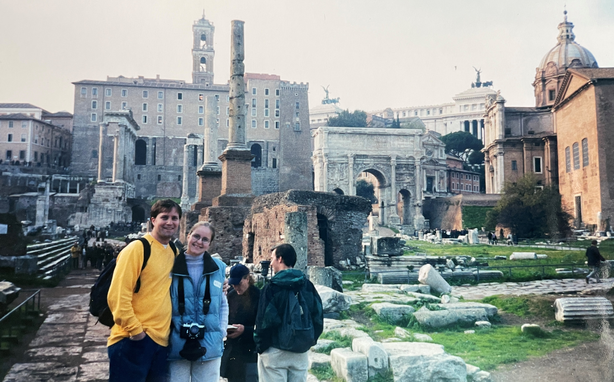
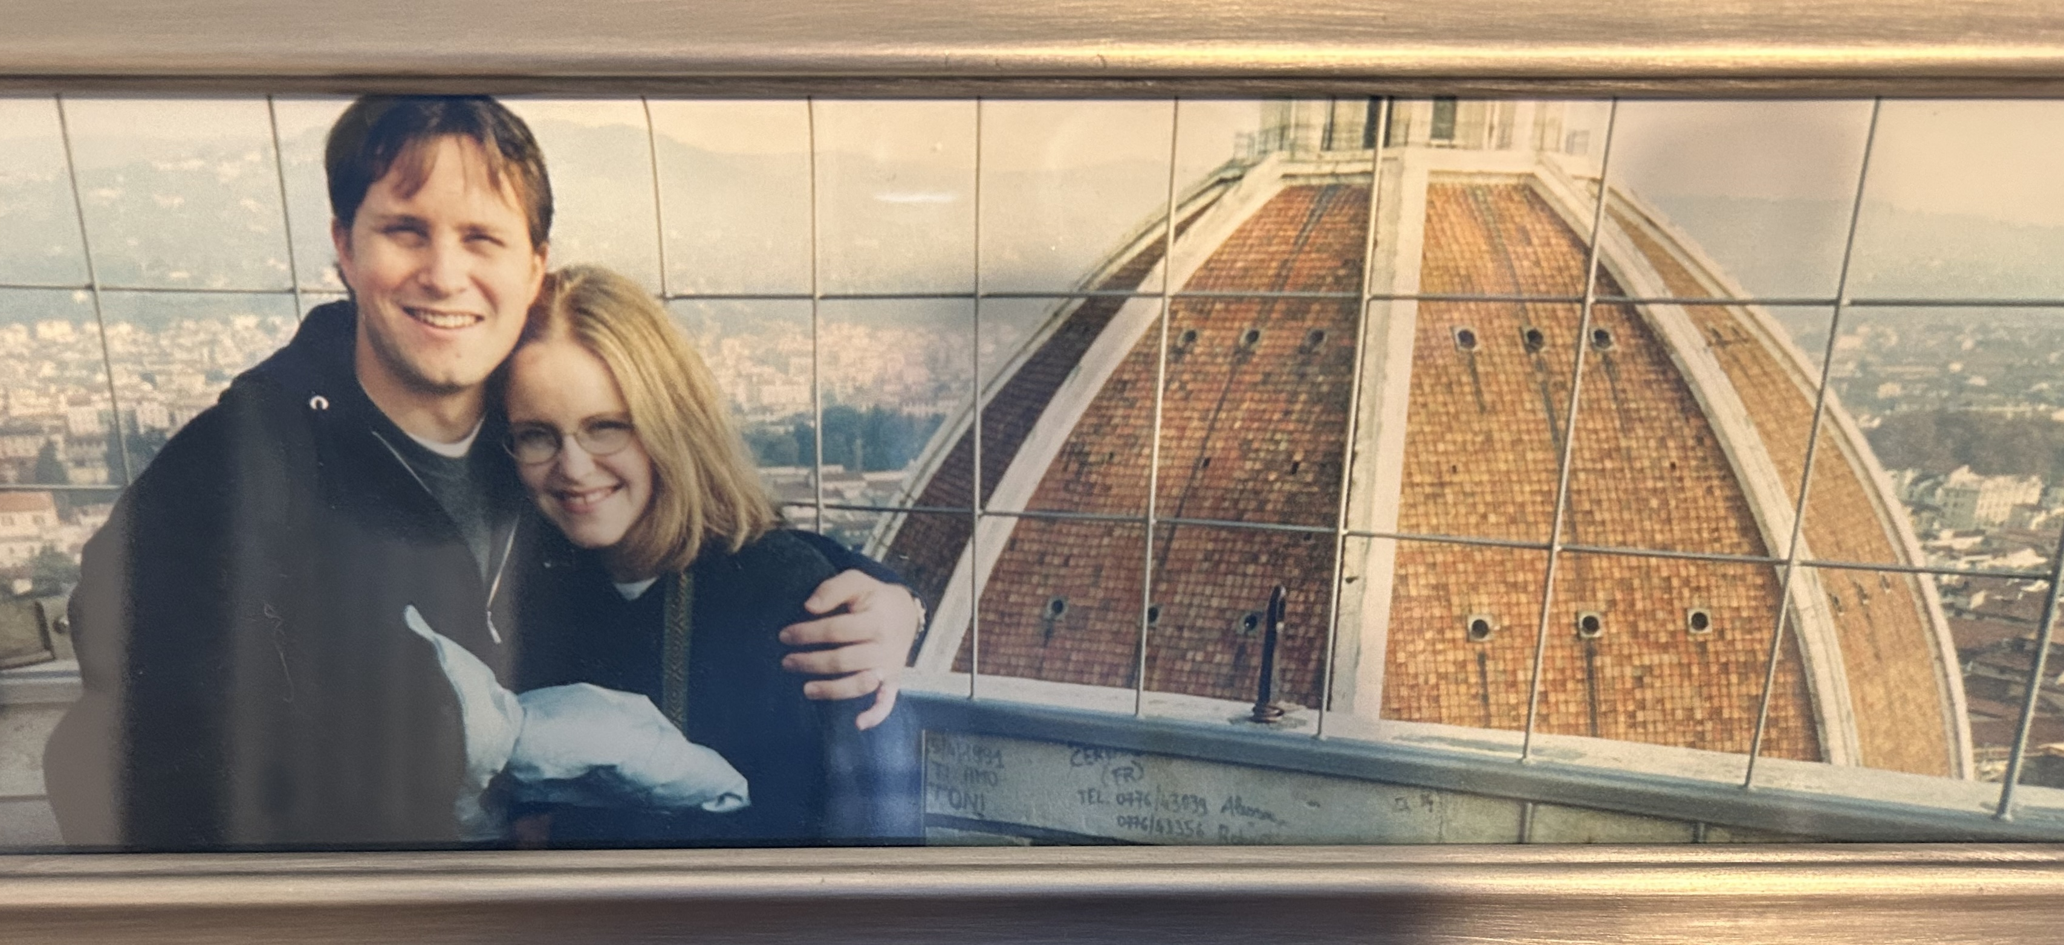
“If Christians didn’t conform to the Roman religion, or at least accept it in addition to their own personal devotion to Christ, Rome saw itself as being robbed of pax deorum (the goodwill of the gods)… From their perspective, just by holding on to their beliefs, Christianity was disrespecting the very gods that let Rome maintain its empire at all.”
“…Christianity was understood as a mystery cult that was threatening the cultural unity by denying the values of Roman religion and since the practice of Roman religion was a public affair that supported the state, denying the value of this practice was treason.”

Slide 9
“…but no matter how hard Rome tried, Christianity didn’t stop. In fact, persecution probably made Christianity even stronger.”
“As Foxe’s Book of Martyrs notes, ‘Though persecuting malice raged, yet the Gospel shone with resplendent brightness and, firm as an impregnable rock, withstood the attacks of its boisterous enemies with success.’”

