Slide 1
REVELATION
God on His Throne
Revelation 4:1 to 11

Slide 2
Reading Chapter 4
We are going to read chapter 4 of Revelation in its entirety.
As we do, I want you to put aside interpretations, meanings, and symbols and concentrate on what is actually being shown to John in this passage, GOD IN ALL HIS GLORY; GOD SEATED HIS THRONE.
The emphasis is GOD, not creatures, or elders or surroundings, or environment, GOD.
Chapters 2 & 3 have revealed that Jesus was aware of the tribulation to which the 1st Century Christians in Asia Minor were being subjected.
In chapters 4 and 5 the revelation will be that neither the Jewish High Priest* nor the Roman Emperor** is in control: GOD is all powerful, aware and in complete control regardless of events occurring on earth.
GOD has His plans and purposes, and He will, ultimately, carry out those plan and purposes.
Notes:
*If you believe Revelation to have been written at the early, Neronian, date.
**If you believe Revelation to have been written at the later, Domitian, date.

Slide 3
Revelation 4:1 to 3
(1) After these things I looked, and behold, a door standing open in heaven, and the first voice which I had heard, like the sound of a trumpet speaking with me, said, “Come up here, and I will show you what must take place after these things.”
(2) Immediately I was in the Spirit; and behold, a throne was standing in heaven, and One sitting on the throne.
(3) And He who was sitting was like a jasper stone and a sardius in appearance; and there was a rainbow around the throne, like an emerald in appearance.

Slide 4
Revelation 3:4 to 6
(4) Around the throne were twenty-four thrones; and upon the thrones I saw twenty-four elders sitting, clothed in white garments, and golden crowns on their heads.
(5) Out from the throne come flashes of lightning and sounds and peals of thunder. And there were seven lamps of fire burning before the throne, which are the seven Spirits of God;
(6) and before the throne there was something like a sea of glass, like crystal; and in the center and around the throne, four living creatures full of eyes in front and behind

Slide 5
(7) The first creature was like a lion, and the second creature like a calf, and the third creature had a face like that of a man, and the fourth creature was like a flying eagle.
(8) And the four living creatures, each one of them having six wings, are full of eyes around and within; and day and night they do not cease to say, “HOLY, HOLY, HOLY is THE LORD GOD, THE ALMIGHTY, WHO WAS AND WHO IS AND WHO IS TO COME.”
(9) And when the living creatures give glory and honor and thanks to Him who sits on the throne, to Him who lives forever and ever,

Slide 6
Revelation 3:4 to 6
(10) the twenty-four elders will fall down before Him who sits on the throne, and will worship Him who lives forever and ever, and will cast their crowns before the throne, saying,
(11) “Worthy are You, our Lord and our God, to receive glory and honor and power; for You created all things, and because of Your will they existed, and were created.”

Slide 7
The Great I AM
This vision is of God, the Almighty: I AM, showing His magnificence to man using visions and signs so that man can begin to comprehend His magnificence, His wonder, His glory, His brilliance, His power.
God is the center and the focus of the vision: everything else is there to magnify and emphasize His splendor.

Slide 8
Roper’s Interpretation
David L. Roper:
“The glory and grandeur of the vision exceeded anything John could have imagined. Half-blinded by the brilliance and bewildered by the spectacle, he strove to sort out the scene before him. At center stage was a massive throne, the dais of the Almighty. Pulsating from the throne were the dazzling colors of the rainbow. Encircling the throne was a ring of smaller thrones. On those thrones were aged men, white-robed and golden-crowned, their craggy faces bathed in celestial radiance.”
“Without warning, an ominous rumbling of thunder and jagged flashes of lightening came from the throne. Then seven lamps flared up at the foot of the throne startling John. Between him and that raw power was a vast shining expanse – and John was glad of the distance. His heart was pounding so hard that it seemed as if it might burst from his chest.”

Slide 9
Majesty and Glory
Psalms 8 – “O Lord, our Lord, How majestic is Thy name in all the earth, Who hast displayed Thy splendor above the heavens! … O LORD, our Lord, How majestic is Thy name in all the earth!”
Psalms 24 – “The earth is the LORD'S, and all it contains, The world, and those who dwell in it. … Who is the King of glory? The LORD strong and mighty, The LORD mighty in battle. … Who is this King of glory? The LORD of hosts, He is the King of glory. Selah.”

Slide 10
The Forever King
Psalms 47 – “… For the LORD Most High is to be feared, A great King over all the earth. … For God is the King of all the earth; Sing praises with a skillful psalm. God reigns over the nations, God sits on His holy throne. The princes of the people have assembled themselves as the people of the God of Abraham; For the shields of the earth belong to God; He is highly exalted.”
Psalms 93 – “The LORD reigns, He is clothed with majesty; The LORD has clothed and girded Himself with strength; Indeed, the world is firmly established, it will not be moved. Thy throne is established from of old; Thou art from everlasting. … Holiness befits Thy house, O LORD, forevermore.”

Slide 11
Giving God His Due
On a personal note, and in my humble opinion, we need more of this in our assemblies today.
We need to remember and express to God and to one another that we acknowledge His majesty, His magnificence, His wonder, His glory, His brilliance, His holiness, His reign.
We may not fully understand or appreciate Him completely; however, we need to express who and what HE is as best we can more often.

Slide 12
Throne Scenes
God’s throne is referenced many times in scripture but only four times are we provided with any type of insight concerning the heavenly throne and He who sits on that throne in heaven.
I Kings 22:19
Isaiah 6:1
Ezekiel 1:26
Daniel 7:9
Revelation 4:1

Slide 13
Micaiah’s Vision
Between 873 and 853 Ahab was king of Israel (the northern kingdom) while Jehoshaphat was king of Judah (the southern kingdom).
In the last year of his reign, Ahab attempted to convince Jehoshaphat to join with him to attack Ramoth-gilead “to take it out of the hand of the king of Aram” – I Kings 22:3.
Jehoshaphat, after 400 men prophesy, “Go up, for the Lord will give it into the hand of the king” (I Kings 22:6) insists that they seek out a prophet of the LORD, so Ahab sends for Micaiah who promptly prophesies, “I saw all Israel Scattered on the mountains, Like sheep which have no shepherd. And the LORD said, ‘These have no master. Let each of them return to his house in peace.’”
In I Kings 22:19 we read, “And Micaiah said, "Therefore, hear the word of the LORD. I saw the LORD sitting on His throne, and all the host of heaven standing by Him on His right and on His left.”

Slide 14
Ahab then tries to explain that the prophet simply did not like him, saying, “Did I not tell you that he would not prophesy good concerning me, but evil?”
The prophet then explains what he says has nothing to do with personal prejudices, like or dislikes: it has to do with speaking as directed from the thorn of God.
What we learn here is that the LORD is on His throne and there is a great host standing on His right and left and the prophet MUST speak as directed from that throne regardless of whether that message is “good” or “bad” concerning the king.

Slide 15
Isaiah’s Vision
Isaiah prophesied between 740 and 690 Isaiah 6 was probably written in either 735 or 727.
In Isaiah 6:1 to 4 we read:
“In the year of King Uzziah's death, I saw the Lord sitting on a throne, lofty and exalted, with the train of His robe filling the temple. Seraphim stood above Him, each having six wings; with two he covered his face, and with two he covered his feet, and with two he flew. And one called out to another and said, "Holy, Holy, Holy, is the LORD of hosts, The whole earth is full of His glory." And the foundations of the thresholds trembled at the voice of him who called out, while the temple was filling with smoke.”

Slide 16
Seraphim
Seraphim is plural – there were more than one.
This is the only time – here in verse 2 and again in verse 6 – this word is used in scripture.
According to the ISBE, the root is used in Numbers 21:6, 8, Deuteronomy 8:15 where the word is rendered “fiery serpent” and in Isaiah 14:29, and 30:6 where it is translated simply “serpent” by the NASB but “flying fiery serpent” by most other translations.
Nergal, meaning “the burner or destroying flame” an epithet of which was sharrapu, was the Babylonian god of war, death, and scorching heat.
In Egypt eagle-lion-shaped figures called seref have been discovered guarding a grave.

Slide 17
“above HIM”
What is so interesting is the link fire has with:
purification (Revelation 3:18 and I Peter 1:7)
destruction (II Peter 3:7 and Matthew 13:40)
and punishment (Revelation 20:14 & 15 and Revelation 21:8) in scripture.
While we learned in I Kings that the LORD sat on a throne and the throne was surrounded by “all the host of heaven standing by Him on His right and on His left,” here in Isaiah these seraphim “Stood above HIM.”

Slide 18
Position not Rank
The word used here for “above” is used 9 times in Isaiah and is translated by the NASB as, “above,” three times, “heaven,” four times, and “upward,” twice.
The Expositors Bible say, “Around (not above, as in the English version) were ranged the hovering courtiers, of what shape and appearance we know not, except that they veiled their faces and their feet before the awful Holiness.”
The position of the seraphim is not intended to show superiority or rank, it is simply stating the position, geographically, of the seraphim in relation to Him who was seated: if superiority or rank is indicated it is much more important to observe HE is seated while the seraphim “stood.”

Slide 19
Message and Call
In Isaiah the first five chapters are concerned with why the book was written: Judah is about to be taken into captivity because, “they have revolted against Me … My people do not understand … Alas, sinful nation, People weighed down with iniquity, Offspring of evildoers, Sons who act corruptly! They have abandoned the LORD, They have despised the Holy One of Israel, They have turned away from Him. Where will you be stricken again, As you continue in your rebellion?” (Isaiah 1:1 to 5)
Chapter 6 of Isaiah looks at and describes the call of Isaiah to preach to those about to go into captivity: imagine being raised and believing the promises of an everlasting throne in Jerusalem and then the walls fall, the temple is destroyed, and the people are captives of a foreign king.

Slide 20
The Seraphim
The seraphim “stood.” This indicates that they are ready to serve the One on the throne, to do His bidding, His will.
Other than to say that each of the seraphim had six wings, a face, and feet we are offered no other physical description.
We know that with two wings they covered their face and with another two covered their feet while two were used to fly.
Concerning these six wings most commentators agree, “Six wings – rapidity in carrying out God’s orders, God’s will. In the Holy Presence, however, the Seraphim covered his face with his wings from the intolerable effulgence of Divine Glory; another pair of wings covered the feet, soiled in their various ministrations, unmeet for all pure presence; while the third pair of wings sustained him in his place near the throne. Ceaseless activity in God’s service.” (Butler)

Slide 21
Emphasis
As Jim McGuiggan overserves, “What had been filling Isaiah’s eye until now was the throne on which Uzziah sat. What God shows him is his throne on which he sits. Isaiah has been believing in God and the king. He needs to trust in God as or who is the King!”
The emphasis here in Isaiah 6:1 to 7 is that the LORD remains on His throne despite what is occurring in Judah, and the Supreme One is calling, directing and inspiring Isaiah to preach to a people about to undergo great tragedy and tribulation.

Slide 22
Ezekiel’s Vision
While Ezekiel’s vision is included in the entire first chapter, verses 26 to 28, the fourth part of the vision specifically describes the throne of God and the One who sits on that throne.
“Now above the expanse that was over their heads there was something resembling a throne, like lapis lazuli in appearance; and on that which resembled a throne, high up, was a figure with the appearance of a man. Then I noticed from the appearance of His loins and upward something like glowing metal that looked like fire all around within it, and from the appearance of His loins and downward I saw something like fire; and there was a radiance around Him. As the appearance of the rainbow in the clouds on a rainy day, so was the appearance of the surrounding radiance. Such was the appearance of the likeness of the glory of the LORD. And when I saw it, I fell on my face and heard a voice speaking.”

Slide 23
Ezekiel’s Lifetime
While Isaiah had prophesied and warned the people of Judah captivity was coming, Ezekiel was one of those Jews who experienced and lived through the defeat and fall.
Having been born in 627/26 at the age of 17 Ezekiel would have witnessed:
Jeremiah and his prophesying concerning the coming judgment of Jerusalem and the people of Judah;
the coming of Nebuchadnezzar fresh off his victory over the Egyptian and Assyrians under Pharoah Necho at the battle of Carchermish;
Ezekiel, if he did not personally witness certainly was aware of the deportations in 605 and 597 including that of Daniel and his three companions;
the complete defeat and fall of Jerusalem including the destruction of the temple in 587.

Slide 24
RESEMBLING
First note that Ezekiel describes this whole thing as something resembling.
We have to remember, God is spirit, John 4:24, and we mortals, occupants of the physical world cannot know or understand fully the “spirit world.”
The best we can do is imagine using imagery that we know and understand and that is what happens in all these visions of God and His throne.
Ezekiel 1 to 7 was, in all probability, written in 593, AFTER the first and second deportions but PRIOR to the final defeat and complete (not UTTER) destruction of Jerusalem and the temple.
Many Jews continued to believe God would never destroy the city and remove the glory from the temple.
Others were downcast and despondent having lost all hope in the LORD who, they felt had abandoned them.

Slide 25
Trusting in God
Ezekiel, however, while declaring the final fall and destruction of Jerusalem and the temple, is a book of hope and promise: God IS in control and while He will allow His chosen people to be led captive (chapters 1 to 24) He WILL eventually destroy the nations (chapters 25 to 32) and comfort and restore the people who will believe and trust in Him (chapters 34 to 48).
So, once again we see God allowing His prophet to see a representation of the heavenly throne and He who occupies that throne, to sanctify and authorize the message of that prophet.

Slide 26
Daniel 7
Daniel 7 contains, as its primary subject, the future history of the kingdoms of Babylon, Mede/Persia, Greece, Rome and the Kingdom of God in a “dream and vision” of Daniel sometime around 540 BC.
Daniel’s dream and vision is parallel to the dream Nebuchadnezzar had in Daniel 2 although the symbols are different.
Where Nebuchadnezzar saw a statue of gold, silver, bronze and iron & clay, Daniels saw four beasts: one was like a lion with wings, one resembled a bear, one was like a leopard with four wings and four heads, while the last, the fourth, was described simply as “dreadful and terrifying and extremely strong; and it had large iron teeth” and, “it has ten horns.”

Slide 27
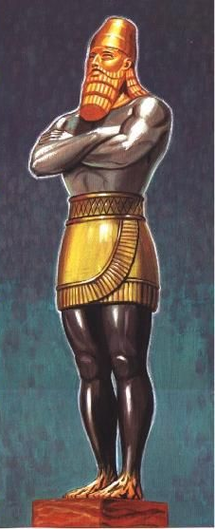
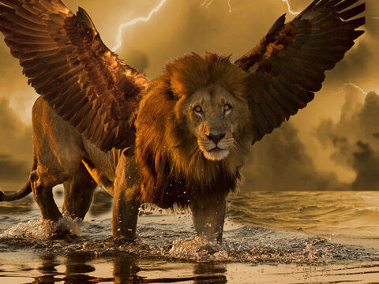

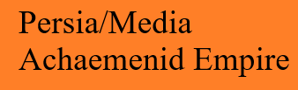
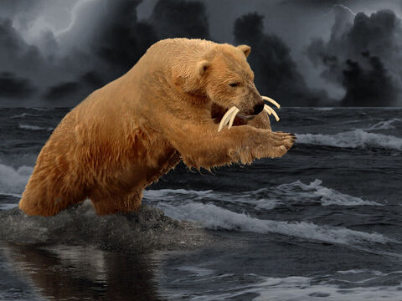

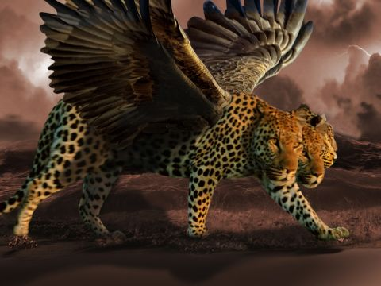

The Two Visions
fourth undescribed beast

Slide 28
Daniel’s dream also includes a brief description of the 11th king of the Roman kingdom: “While I was contemplating the horns (the ten horns of the final beast or kingdom – jrr), behold, another horn, a little one, came up among them, and three of the first horns were pulled out by the roots before it; and behold, this horn possessed eyes like the eyes of a man, and a mouth uttering great boasts.”

Slide 29
Throne Scene of Daniel
“I kept looking Until thrones were set up, And the Ancient of Days took His seat; His vesture was like white snow, And the hair of His head like pure wool. His throne was ablaze with flames, Its wheels were a burning fire. A river of fire was flowing And coming out from before Him; Thousands upon thousands were attending Him, And myriads upon myriads were standing before Him; The court sat, And the books were opened.”(Daniel 7:9-10)

Slide 30
Ancient of Days
Thrones is plural and is puzzeling because we never find out who occupies these throne other than the One Throne of the Ancient of Days.
The Ancient of Days signifies the LORD:
Job 36:26 – The number of His years is unsearchable.
Psalms 90:2 – Even from everlasting to everlasting, Thou art God.
Psalms 93:3 – Thy throne is established from of old: Thou are from everlasting.
Psalms 102: 24 to 27 – Thy years are throughout all generations … But Thou art the same, and Thy years will not come to an end.
Isaish 41:4 – I, the Lord, and the first and with the last, I am He.

Slide 31
Dress White
As God takes His seat, He is dressed in clothes that are white as snow, signifying His total purity and His celestial glory.
Psalms 51:7 – Purify me with hyssop, and I shall be clean; Wash me, and I shall be whiter than snow.
Isaiah 1:18 – Come now, and let us reason together," says the LORD, Though your sins are as scarlet, They will be as white as snow; Though they are red like crimson, They will be like wool.
Matthew 17:2 – And He was transfigured before them; and His face shone like the sun, and His garments became as white as light.
Matthew 28:3 – And his appearance was like lightning, and his garment as white as snow
Revelation 1:14 – And His head and His hair were white like white wool, like snow; and His eyes were like a flame of fire;

Slide 32
His head was like pour wool symbolizing the wisdom of an aged one.
Revelation 1:14 – And His head and His hair were white like white wool, like snow; and His eyes were like a flame of fire;
Job 12:12 – Wisdom is with aged men, With long life is understanding.
Luke 11:49 – For this reason also the wisdom of God said, 'I will send to them prophets and apostles, and some of them they will kill and some they will persecute,
1Corinthians 1:21 – For since in the wisdom of God the world through its wisdom did not come to know God, God was well-pleased through the foolishness of the message preached to save those who believe.
1Corinthians1:24 – but to those who are the called, both Jews and Greeks, Christ the power of God and the wisdom of God.
1Corinthians 2:7 – but we speak God's wisdom in a mystery, the hidden wisdom, which God predestined before the ages to our glory;
Ephesians 3:10 – in order that the manifold wisdom of God might now be made known through the church to the rulers and the authorities in the heavenly places.

Slide 33
The throne in Daniel’s vision was ablaze, and its wheels were a burining fire.
This is an indication that His righteous but ferocious judgement is about to be doled out.
It was not uncommon “in ancient Near East for thrones of kings and gods to have wheels.”*
Additionally a river of fire flows from the throne indicating the wrath of God that is to be poured out on the fourth empire (Rome), Daniel 7:11.
Psalms 18:8 – Smoke went up out of His nostrils, And fire from His mouth devoured; Coals were kindled by it.
Psalms 50:3 – May our God come and not keep silence; Fire devours before Him, And it is very tempestuous around Him.
Psalms 97:3 – Fire goes before Him, And burns up His adversaries round about.
Notes:
* Miller as quoted by Myers, Pryor, and Rechtin in Daniel, “Truth for Today Commentary” p. 232.

Slide 34
Thus, what we see is that each and every time man is provided with a likeness of God and His throne, it is used to verify, certify, and authenticate that:
God is in control, and all things are done with His knowledge, foresight and oversight;
the message following that image is from God the omnipotent, omniscience, omnipresent.

Slide 35
Looking
“After these things” indicates, very simply, that what John is about to see in chapter 4 comes after the vision of Jesus among the lampstands and after he, John, had been given the seven letters: chronology is not the aim here, the order in which he received the vision is.
John “looked.” This is another indication of how the message from God was received.
This message did not come forth on the breath of God (inspiration – II Timothy 3:16 & 17) but it was delivered in visions that John could see as he looked.

Slide 36
What Heaven?
The first thing John sees is “a door open in heaven.”
As Ogden observes, “The vision John saw was heavenly or spiritual; not earthly. He saw a door opened in heaven. The door was in heaven; not into heaven. The door was opened to invite John’s presence.”
McGuiggan makes the argument that here heaven is not simply a location where God is but “it means a state rather than a locality.” McGuiggan points out that in Revelation 12:12 John is told, “Therefore rejoice heavens and ye that dwell in them” further pointing out that in Revelation 13:6 the beast “opened his mouth in blasphemies against God, to blaspheme His name, and His tabernacle, that is, them that dwell in heaven.”

Slide 37
Context
Mounce points out “To slander the name of God is to speak evil of all that He is and stands for. The name sums up the person. His dwelling place is His ‘tabernacle’ (KJV and others). In Revelation 21:3 a loud voice from the throne declares, “Behold! the tabernacle of God is among men, and He shall dwell among them …”
Wallace however takes this to be “the place of God’s residence” and “the source of all revelation.” (Daniel 4:26; John 1:51; John 3:27; Romans 1:18; I Peter 1:12; Matthew 16:17)
While I acknowledge McGuiggan’s argument and realize that the spirit of God dwells in us, Romans 8:9 and I Corinthians 3:16, because of the vision and what is revealed in the following verses of chapter 4 I tend to lean toward Wallace’s position.

Slide 38
The LORD’S Throne
The LORD’s throne is in heaven: even as David sat on the throne in Jerusalem Psalms 11:4, says, “The LORD is in His holy temple; the LORD'S throne is in heaven; His eyes behold, His eyelids test the sons of men.”
The LORD’s throne was always intended to be in heaven with God ruling over His creation.
However, because of the free will of man God set a king over His people and established His throne and temple in Jerusalem. (Deuteronomy 17:14 & 15; I Samuel 8:5-7; I Samuel 8:19-20; I Samuel 12:19).
It was not that man forced God to change His plans and place a king over His people: the fact is God had His predetermined plan (Ephesians 1:3 to 6) which included the rebelliousness of the people and the ascension of David and ultimately David’s offspring, Jesus, the Christ, the Messiah.

Slide 39
Be Careful What You Ask For
The free will of man is seen vividly in I Samuel 8.
In that chapter Samuel has grown old, his sons have been appointed judges over Israel and they, Samuel’s sons, are turning “aside after dishonest gain,” taking “bribes” and perverting “justice,” I Samuel 8:3.
In verse 5 the elders of Israel say, “Now appoint a king for us to judge us like all the nations.”
When Samuel voiced his displeasure to God, God responded in verse 7, “Listen to the voice of the people in regard to all that they say to you, for they have not rejected you, but they have rejected Me from being king over them.”

Slide 40
Man’s Way vs. God
Despite the warning from God given through Samuel in verses 11 to 18, “the people refused to listen to the voice of Samuel, and they said, ‘No, but there shall be a king over us, that we also may be like all the nations, that our king may judge us and go out before us and fight our battles’” (I Samuel 8:19 & 20).
God allowed man to have His way, but it was not God’s way: Hosea 13:11 says, “I gave you a king in My anger, And took him away in My wrath.”
This is another example of man and his free will and man using that free will to turn from dependence on God to dependence on something else: in this case an earthly king.
God knew the results of man’s desire but because God allows man to have free will God granted them a king.

Slide 41
Instructions for a King
Deuteronomy 17:16 & 17:
But he [the king – jrr] shall not multiply horses to himself, nor cause the people to return to Egypt, to the end that he should multiply horses: forasmuch as the LORD hath said unto you, Ye shall henceforth return no more that way. Neither shall he multiply wives to himself, that his heart turn not away: neither shall he greatly multiply to himself silver and gold.

Slide 42
Foretelling the King
I Samuel 8:11 to 14:
(11) This will be the procedure of the king who will reign over you: he will take your sons and place them for himself in his chariots and among his horsemen and they will run before his chariots.
(12) And he will appoint for himself commanders of thousands and of fifties, and some to do his plowing and to reap his harvest and to make his weapons of war and equipment for his chariots.
(13) He will also take your daughters for perfumers and cooks and bakers.
(14) And he will take the best of your fields and your vineyards and your olive groves and give them to his servants.

Slide 43
Continued
I Samuel 8:15 to 18:
(15) And he will take a tenth of your seed and of your vineyards and give to his officers and to his servants.
(16) He will also take your male servants and your female servants and your best young men and your donkeys, and use them for his work.
(17) He will take a tenth of your flocks, and you yourselves will become his servants
(18) Then you will cry out in that day because of your king whom you have chosen for yourselves, but the LORD will not answer you in that day.

Slide 44
Man and his way!
Despite these dire warnings, all of which were fulfilled, we read in I Samuel 8:19 & 20:
“Nevertheless, the people refused to listen to the voice of Samuel, and they said, ‘No, but there shall be a king over us, that we also may be like all the nations, that our king may judge us and go out before us and fight our battles.’”
Sometime idols are not made of wood, stone, gold, or silver.
Remember Laodicea: the sin lay in dependence on something other that God and the same is true here as the people put their hope, their trust, and their alligence in a human, earthly, physical king instead of in the LORD.
This vision shows us that the LORD is, in fact, on His everlasting throne in heaven and all – everything – is in His control.

Slide 45
The Trumpet Speaks
The voice which John hears here in Revelation 4:1 is the same voice he heard in Revelation 1:10, “I was in the Spirit on the Lord's day, and I heard behind me a loud voice like the sound of a trumpet …”
Again, the sound of a trumpet is to gain ones attention but it also serves as a warning! PAY ATTENTION!

Slide 46
The Voice Speaks
“Come up here, and I will show you what must take place after these things.”
Come up here: From the following verses we see John is allowed to “come up” and to see from where these visions originate, the throne of God.
Haley points our, “Since these events would affect the inhabitants of the earth – the saints of God and the sinners of Satan – but be controlled from heaven, the seer would be able to understand and make know from the viewpoint of both heaven and earth.”

Slide 47
I will show you …
Again, we see the manner in which the message is unveiled.
It is not inspired in the sense of the remainder of the Bible, but it is to be shown, to be signified.
And the signs come from the throne of God.
Thus these signs and visions are just as true, just as trustworthy, just as much from God as the rest of the inspired scripture.

Slide 48
… what must take place …
Mounce says the word “must” here means, “it is binding, it is necessary, it is proper; it is inevitable.”
Matthew used this word in Matthew 16:21 when he wrote, “From that time Jesus Christ began to show His disciples that He must go to Jerusalem, and suffer many things from the elders and chief priests and scribes, and be killed, and be raised up on the third day.”
Matthew is indicating that while it was necessary, it is an absolute certainty.
Just a surely as Jesus was going to go to Jerusalem to suffer, be killed and to be raised up on the third day, just as surely the things unveiled to John are going to happen.

Slide 49
… after these things.
This indicates that, from John’s perspective the things shown him will occur in the future.
Couple this with Revelation 1:1, “The Revelation of Jesus Christ, which God gave Him to show to His bond-servants, the things which must shortly take place …” and Revelation 22:6, “These words are faithful and true"; and the Lord, the God of the spirits of the prophets, sent His angel to show to His bond-servants the things which must shortly take place.” we see the events of the entire book of Revelation are going to occur, without failure, in the near future, not decades or centuries later.
This will be a foretelling of events that will take place just as surely as Jesus going to Jerusalem to face the cross.
It is dictated from God, and nothing is going to stop these events from occurring, and nothing is going to change them.

Slide 50
Immediately I was in the Spirit
As soon as John hear the voice and the instructions from the voice, without any type of delay – instantaneously – John was “in the Spirit.”
We saw – and considered – this phrase in Revelation 1:10 where John was “in the Spirit.”

Slide 51
I was in the Spirit
What does this mean? Well, it could mean,
  John was attuned to the teaching of the Spirit (see Galatians 5:16, 25; I Peter 4:6; Revelation 2:7, 11, 17, 29, 3:16, 13, 22);
  John was worshipping “in the spirit” (see John 4:23-24, Philippians 3:3);
  John was in the process of receiving a revelation from the Holy Spirit (see I Corinthians 14:2, 32).
  John could be identifying John’s visionary posture (see Revelation 4:2, 17:3, 21:10 – see also II Corinthians 12:2 to 4).

Slide 52
In the Revelation
This phrase, in the spirit is used twenty times in the New Testament, four in Revelation:
Revelation 1:10 – I was in the Spirit on the Lord's day, and I heard behind me a loud voice like the sound of a trumpet …
Revelation 4:2 – Immediately I was in the Spirit; and behold, a throne was standing in heaven, and One sitting on the throne.
Revelation 17:3 – And he carried me away in the Spirit into a wilderness; and I saw a woman sitting on a scarlet beast, full of blasphemous names, having seven heads and ten horns.
Revelation 21:10 – And he carried me away in the Spirit to a great and high mountain, and showed me the holy city, Jerusalem, coming down out of heaven from God, having the glory of God.

Slide 53
In the spirit
Because of the capitalization of the letter “S” in “Spirit” many immediately jump to the conclusion that this means the Holy Spirit and therefore John was under the influence of the Holy Spirit – i.e. in the process of being inspired.
There is no punctuation in the original and the individual letters of the words are all capital letters.
This message was not inspired but signified – while both are from God, there is a vast difference.
In each case when this phrase is used in Revelation, John immediately receives a vision.

Slide 54
Visions
In Revelation 1:10 John is about to see Jesus among the lampstands.
In Revelation 4:2 John sees the throne of God in all His splendor.
In Revelation 17:3 John is going to see the vision of the woman sitting on the scarlet beast.
In Revelation 21:10 John is going to see the “the holy city, Jerusalem, coming down out of heaven from God.”
Based on these instances John is in a situation, in a position, in a posture, and in an attitude which would allow him to receive a vision.

Slide 55
The Centerpiece
What John sees, as described in the last portion of verse 2 and then in verse 3 is the centerpiece, the heart, the focus of the vision: GOD on His throne surrounded by all the majesty, wonder, and awe one can possibly imagine.
Again, try to describe God in all his majestic glory!
We cannot because we are human, and we do not understand the spiritual world.
What is being revealed to John in this image is then described to us in human terms so we can try to understand just how majestic, regal and imposing God is.

Slide 56
Jasper and Sardius
The One sitting on the throne – John DOES NOT identify Him specifically at this point as God but readily accepts Him as such – is described as being in appearance “like a jasper stone and a sardius.”
A jasper stone was the last stone in the fourth row of stones and precious minerals found in the breastplate worn by the Jewish High Priest – Exodus 28:17 to 21.
Some speculate that the “ruby,” the first stone in the first row of the breastplate is identified here in Revelation 4:3 as the sardius, or the carnelian depending on the translation. The NIV actually translates the Greek word here as ruby.

Slide 57
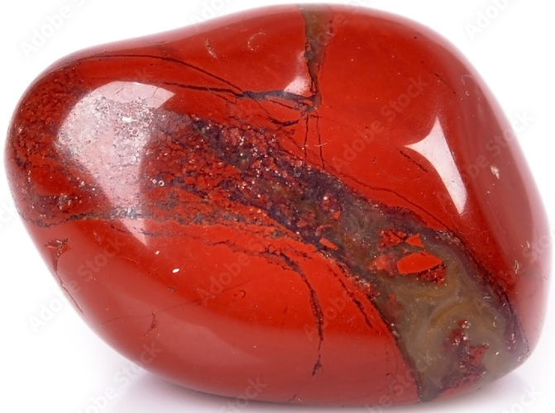
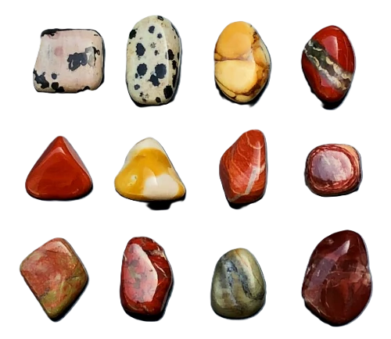
Jasper
Jasper is both a stone and gemstone, a stone which can be cut and used in jewelry.
It is a microcrystalline variety of quartz and thus a stone, but it can also be cut and polished making it a gemstone.
Jasper is known for its opaque appearance and can be found in several different colors including red, yellow, brown, and green.
It supposedly represents absolute purity and perfection.

Slide 58
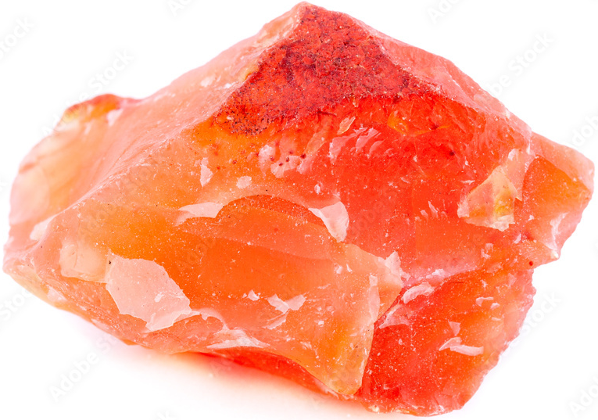
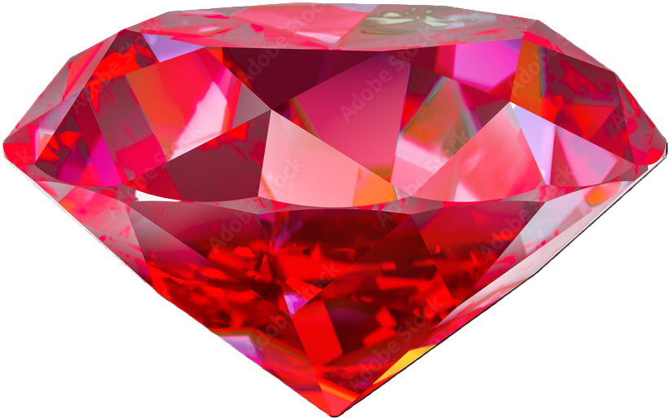
Sardius
The sardius was ruby red in color and, according to some, signifies God as redeemer.
Some identify this as carnelian because it is also found with a “flesh” tone at times.

Slide 59
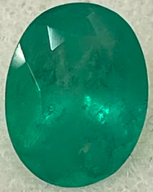
A rainbow like an emerald
Ezekiel included a likeness to a rainbow in his description of in Ezekiel 1:26 to 28.
This rainbow “shone like an emerald” which is green and green here allegedly symbolizes life.
Later we will see that pale green represents sickness and death.
The rainbow itself was not green but it “shone like an emerald.”
The rainbow, of course, is a sign to man of God’s covenant with man to never again destroy the world by water: it is thus a sign of His covenant and, according to some, indicates His promise of eternal life.

Slide 60
24 Thrones
The first thing mentioned in verse 5 is twenty-four thrones.
Twenty-four is significant because it is a multiple of twelve which is three (the number signifying God – the Father, Son, and Holy Spirit) multiplied by four (the number signifying the physical world as in the four corners of the earth or the four winds).
The twenty-four thrones surrounding THE THRONE emphasize the reign, the majesty, and the authority possessed by the one sitting on THE THRONE over both the spiritual and the physical.

Slide 61
What do we know?
First, we know there are 24 thrones and 24 elders.
Second, the thrones, generally speaking, in Scripture symbolize kingly power and dignity.
Third, since they are wearing “white garments” they are overcomers and their names will not be erased from the book of life – Revelation 3:5, and they are clothed, and the shame of their nakedness is not revealed – Revelation 3:18.
Fourth, on their heads are golden crowns: that is victor’s crowns showing they have won, they have overcome: these are not crowns which signify the power to rule.

Slide 62
24 Elders
There is much speculation over who these elders are and what they represent.
The text nowhere specifically identifies these elders despite the fact that they are mentioned twleve times in the book of Revelation.
Coffman, Hailey and Wallace say they represent the twelve tribes of Israel and the 12 apostles.
Roper makes the case that these elders represent the saints who have overcome and who have received the promised blessings of the letters to the angels of the churches.
McGuiggan indicates that they represent “the church,” the “royal priesthood” of I Peter 2:9.
Ogden who sees chapter 4 as an “Old Testament throne scene” says they indicate the 24 orders of the priests of the Old Testament order established by David in I Chronicles 25.

Slide 63
Obesrvations
These elders cannot be “earthly kings” because they are in heaven surrounding the throne of God and these are victor’s crowns not crowns signifying authority, rule, or the right to reign.
God did, at times, use earthly kings to accomplish His will, see Pharoah and Joseph (Genesis 40), Nebuchadnezzar and Cyrus (II Chronicles 36 & Ezra 1).
He even used Rome, the emperor of Rome and the Roman army to “utterly destroy” Jerusalem, the temple and the Jewish establishment.
However, God NEVER indicated that those kings were the recipient of eternal life and therefore that they occupied thrones in His presence.

Slide 64
What do I THINK?
I can see the argument presented by all the men listed above but none of these truly satisfy me.
I want to tend toward the position presented by Ogden because he is so good with his interpretation of Revelation, but I see not true way to see these elders as representing the division established by David concerning the priests.
I can see the arguments presented by Coffman, Hailey, Wallace, Roper, or McGuiggan: all have their strong points, however I have some problem(s) with them all, including.
In the end, the position I have the least problems with is that these twenty-four elders are simply representing the saved – particularly of the Old Testament since this is an Old Testament throne scene – the victors who have overcome.

Slide 65
Who are they?
Whoever they are and whoever or whatever they represent, they are not exercising authority as a king – they are victors wearing victor’s crowns – and they are subject to the “One sitting on the throne” in Revelation 4:2 and that is the most important point to be taken from this passage: GOD IS SUPREME, HE IS OVER ALL.

Slide 66
Revelation 4:5 & 6
Four things of note stand out in verses 4 & 6:
lightening and sounds and thunder;
seven lamps of fire;
a sea of glass like crystal;
four living creatures.

Slide 67
Lightning, Sounds, Thunder
These symbolize the power, might, majesty, energy, justice and wrath of God all rolled up in one phrase.
Significantly this depicts a storm is brewing.
Throughout the Bible thunder and lightning frequently portray God’s presence, Exodus 19:16; 20:18, etc.
Frequently this presence indicates coming judgement and, to those who have disobeyed or ignored Him, the wrath to come.
Sounds is reminiscence of Mt. Sinai, Exodus 19:18 & 19: “Now Mount Sinai was all in smoke because the LORD descended upon it in fire; and its smoke ascended like the smoke of a furnace, and the whole mountain quaked violently. When the sound of the trumpet grew louder and louder, Moses spoke and God answered him with thunder.”

Slide 68
Seven Lamps of Fire
John sees, “seven lamps of fire burning before the throne.”
We do not have to wonder what these seven lamps of fire are because we are told, they are “the seven Spirits of God.”
This is, just as it was in Revelation 1:4 & 3:1, the Holy Spirit.
Seven is the number of completeness or wholeness.
In Revelation 5:6 the Lamb is said to have “seven horns and seven eyes, which are the seven Spirits of God, sent out into all the earth.”

Slide 69
LIGHT!
Here we see a perfect example of commentators getting too booged down in unspecified details: there is somewhat of a great debate over the word translated “lamp” by the NASB.
Should it be lamp or torch, see John 18:3.
The fact is, it really makes no difference.
The original word is the word from which we get our English word “lamp” but the fact is whether it is translated lamp or torch is not the question: the emphasis is on the idea that the word designates a device – a lamp or a torch – that produces and provides light.
Ephesians 5:13 – “But all things become visible when they are exposed by the light, for everything that becomes visible is light.”
I Corinthians 2:10 – “For to us God revealed them through the Spirit; for the Spirit searches all things, even the depths of God.”

Slide 70
ONE GOD
The point is, and what is being said here in Revelation 4:5, as far as Jim Reynolds is concerned, is that God is present (flashes of lightning and sounds and peals of thunder) and through the Holy Spirit (seven lamps burning before the throne, which are the seven Spirits of God) everything is illuminated and therefore all things are seen and laid open to Him: there is NOTHING the Holy Spirit does not see or know and what the Holy Spirit sees and knows the Father and the Son (Lamb) see and know because, “HEAR, O ISRAEL! THE LORD OUR GOD IS ONE LORD,” Mark 12:29 and “You believe that God is one. You do well; the demons also believe, and shudder,” James 2:19.
Proverbs 15:3 – “The eyes of the LORD are in every place, Watching the evil and the good.”

Slide 71
A Sea
Between John and the throne was a “sea of glass like crystal.”
Both Ogden and McGuiggan see this sea as a symbolic reference to the Solomon’s brazen sea – I Kings 7:23 and II Chronicles 4:2.
The purpose of Solomon’s “sea” was for the priests to cleanse and purify themselves before entering the temple.
According to Roper, most glass in the 1st century was “dark and opaque” rather than “crystal” with carries the idea of the glass being perfectly clear as we know it today.
Job 28:17 equates gold and glass as equals, or near equals in value.

Slide 72
Sea in Revelation
“Sea” in Revelation always refers to the part of the earth covered by water except here in Revelation 4:6, again in Revelation 15:2, where it is used in a similar fashion, And I saw, as it were, a sea of glass mixed with fire, and those who had come off victorious from the beast and from his image and from the number of his name, standing on the sea of glass, holding harps of God, and finally in Revelation 21:1.

Slide 73
Your Mind’s Eye
I think Roper makes a valid point when he says asks his readers to, “Visualize the scene that John saw reflected in the vast shimmering expanse called a “sea.” Placid lakes can provide an awesome reflection of stately trees, majestic mountains, and a cloud filled sky. How much more awe-inspiring was the scene that filled John’s senses; twenty-four thrones with their distinguished occupants; four fantastic creatures; seven blazing torches; the stately throne with it dazzling lights, ominous clouds, and flashing lightning – all mirrored in a sea of glass.”

Slide 74
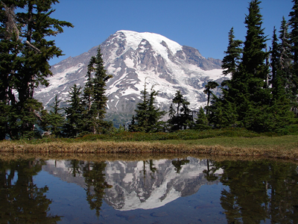
Underwhelming Reflection!

Slide 75
Sea of Glass
In Revelation 15:2 John will see, “a sea of glass mixed with fire, and those who had come off victorious from the beast and from his image and from the number of his name, standing on the sea of glass, holding harps of God.”
In Revelation 21:1 we will read, “And I saw a new heaven and a new earth; for the first heaven and the first earth passed away, and there is no longer any sea.”
Based on these two verses and particularly Revelation 21:1 I see the sea of glass as being a separation between God – heaven, the spiritual realm – and man in the physical realm.
This the sea of glass like crystal accomplishes two things: it reflects and adds to the glory and majesty of God and it serves as a separation between the physical and spiritual realms.

Slide 76
Four Living Creatures
John saw, “in the center and around the throne,” four living creatures.
“Living creatures” here is one word.
The KJV has “beasts”, but “creatures” or “animal” is the much better translation as in Hebrews 13:11, II Peter 2:12, and Jude 1:10 where this same word is translated “animal.”
These four living creatures are very similar to those seen by Ezekiel in Ezekiel 1:1 to 28.
Again, we see here the problem commentators have of getting bogged down with too many specifics.
Over time these four creatures have been said to be the “four evangelists” Matthew, Mark, Luke and John; or the symbols for the four divisions of Israel in formation marching through the wilderness; the four principal signs of the zodiac; representative of the untold number of living creatures in God’s creation; or the entire animate creation.

Slide 77
Ezekiel and the Four Creatures
In Ezekiel 1, Ezekiel, a priest and therefore of the tribe of Levi, was “in the land of the Chaldeans by the river Chebar” when, “the hand of the LORD came upon him.”
Ezekiel 1:4 to 28 is a vision of God and His majesty: so majestic, so mighty, so powerful, so awe enspiring was this vision that Ezekiel “fell on my face” (verse 28) when he saw it.
A large portion of the vision is taken up with a description of “four living beings”, verse 5.
Later in Ezekiel 10:1 these living beings will be identified as cherubim, which is the plural of cherub – “Then I looked, and behold, in the expanse that was over the heads of the cherubim something like a sapphire stone, in appearance resembling a throne, appeared above them.”

Slide 78
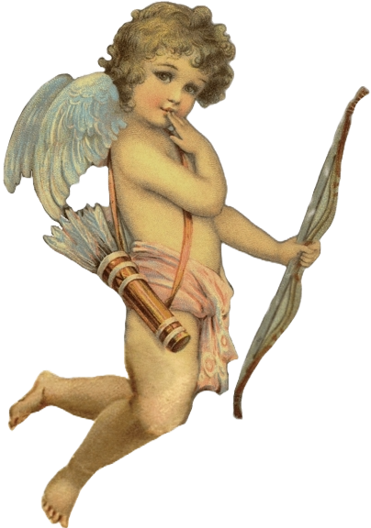
CHERUB
What do you think of when I say “cherub”?
People I spoke with instantly described something like the picture to the right – maybe a little chunkier but basically a sweet, baby shape, often much like cupid.
At times, they are pictured as guardian angels protecting the innocent human from demons and danger.

Slide 79
Don’t be misinformed!
We need to get that picture out of our heads.
Cherubim are first mentioned in Genesis 3:24, “So He drove the man out; and at the east of the garden of Eden He stationed the cherubim, and the flaming sword which turned every direction, to guard the way to the tree of life.”
The next time cherubim are mentioned is in Exodus 25 when God is giving instructions concerning the construction of the Arc of the Covenant.
In Exodus 25, two cherubim are to be constructed above and covering the mercy seat.
The ten curtains in the tabernacle made “of fine twisted linen and blue and purple and scarlet material,” each were to be made with cheribim – Exodus 26:1.
In Exodus 26:31, God gave instructions, “And you shall make a veil of blue and purple and scarlet material and fine twisted linen; it shall be made with cherubim, the work of a skillful workman.”

Slide 80
God and Cherubim
Numbers 7:29 says, “Now when Moses went into the tent of meeting to speak with Him, he heard the voice speaking to him from above the mercy seat that was on the ark of the testimony, from between the two cherubim, so He spoke to him.”
In I Samuel 4:4 we see God “sits above the cherubim” that are at each end of the Arc of the Covenant and above the mercy seat: further in II Samuel 6:2 we see, “the LORD of hosts … is enthroned above the cherubim.”
When David praised God for delivering “him from the hand of all his enemies and from the hand of Saul,” David said God, “rode on a cherub.” – II Samuel 22:11 & Psalms 18:10.

Slide 81
Cherubim in the Temple
When Solomon built the temple, “in the inner sanctuary he made two cherubim of olive wood” and “he placed the cherubim in the midst of the inner house”, I Kings 6:23 & 27.
Cherubim were engraved, woven, and embossed throughout the temple, I Kings 6 & 7.
In I Kings 8:6, “the priests brought the ark of the covenant of the LORD to its place, into the inner sanctuary of the house, to the most holy place, under the wings of the cherubim.”
Of the 44 times cherubim are found in the Old Testament up to and including the book of Isaiah it is found using one of the descriptions noted so far.

Slide 82
Cherubim are Fierce
In Ezekiel cherubim are found 30 times in 22 verses all referencing back in some way or another to what we read concerning them in Ezekiel 1.
I have said all this about cherubim to say this: THEY ARE NOT CUTE LITTLE ROLLY POLLY CUPID IMATATORS!!!

Slide 83
Mission and Praise
Ezekiel is seeing, just as John does in Revelation 4, a vision of the glory of God, but it is the glory of God being manifested in His coming in just judgement.
The cherubim are His chariot, His battle wagon, His vehicle of righteousness.
In Revelation 4 the living creatures are the closest beings to the One who is enthroned, and their task is to exclaim and declare endlessly the righteousness and unapproachableness of the LORD when they repeat over and over and over, “HOLY, HOLY, HOLY is THE LORD GOD, THE ALMIGHTY, WHO WAS AND WHO IS AND WHO IS TO COME.”
These are fierce guardians, unafraid of anyone or any thing – physical or spiritual except God Himself.

Slide 84
Likeness
Coffman notes, “We may safely set aside, therefore, the ancient interpretations” because “There is practically nothing that can be fully known about these living beings in God's presence. John's description of what he saw in this vision of God's throne is not a photographic depiction, but an impressionistic view.”
The four living creatures all were, “full of eyes in front and behind” signifying their all-seeing, and thus their all-knowing nature.
The living creatures are LIKE a lion, LIKE a calf, had a face LIKE that of a man, and LIKE a flying eagle.

Slide 85
Comparable
“like” does not necessarily mean “looked or looks like.”
This word was frequently used by Jesus in parables when He said, “the kingdom of heaven is like …”.
Outside of Revelation John used this word only twice and both times it was used to show a comparison, not to describe how someone or something looks.
John 8:55 – “and you have not come to know Him, but I know Him; and if I say that I do not know Him, I shall be a liar like you, but I do know Him, and keep His word.”
John 9:9 – “Others were saying, ‘This is he,’ still others were saying, ‘No, but he is like him.’ He kept saying, ‘I am the one.’”

Slide 86
like a lion
The lion has long been recognized as the king of the jungle or the king of beasts: this is symbolic of strength (Judges 14:18, II Samuel 1:23 and Isaiah 38:13). The lion’s roar struck fear in the hearts of men (Amos 3:8).
Since this beast is living, we see the strength, the power, the might and the majesty of God’s throne which then demands that He be feared and reverenced.

Slide 87
like a claf
The calf is reminiscence of a young bull, the tender offshoot of the ox.
Where the lion is regal and strong, the calf of the ox has the potential of strength – think of God’s strength and His potential for fierceness, especially when He judges or when He is angered – but He is also humble and meek as demonstrated by Jesus throughout His life – compare John 2:13 to 16 where Jesus makes a scourge to drive the moneychangers from His Father’s house and John 13:1 to 20 where Jesus washes the disciples feet.

Slide 88
a face like that of a man
No other part of this living creatures is described or compared in Revelation 4 except the face, the eyes, and the wings of the third living creature at this point in Revelation.
“face” is often used in scripture to “indicate purpose, mind, conscience, and intelligence (Jeremiah 5:1 to 3; 7:19; 44:11-12; II Corinthians 3:18). If that is the intended meaning of our text, this living being depicts the intelligence of God: His purpose, mind, and conscience.”

Slide 89
like a flying eagle
Known for its swiftness in the attack, the eagle is a bird of prey. Using this symbology God is showing His ability to bring swift judgement, and when necessary, destruction upon His prey.
God is a loving God, no doubt – I John 4:8 & 16.
But man should never fail to recognize and appreciate God is also a just God and is able to carry out every threat, every promise He has ever made – II Thessalonians 1:5 to 8.

Slide 90
Giving Praise
The four living creatures ceaselessly give praise, honor, and glory to God.
And every time the four the four living creatures praise, honor, and glorify God, the twenty-four elders “fall down before Him” and “worship Him.”
Notice – and this is of particular importance as we proceed – it is GOD who is being praised, honor, glorified, and worshiped, NOT the Law, not the High Priest, not the priesthood or the temple: it is not the Roman emperor or anything Roman, it is GOD because, “Thou didst create all things, and because of Thy will they existed, and were created.”

