Slide 1
Finance Report
2025 General Fund
2025 Designated Fund Balance
2026 General Budget
Pastor Compensation & Benefits

Slide 2
2025 general Fund Actuals

Slide 3
2025 Designated Funds

Slide 4
2026 General Fund Budget

Slide 5
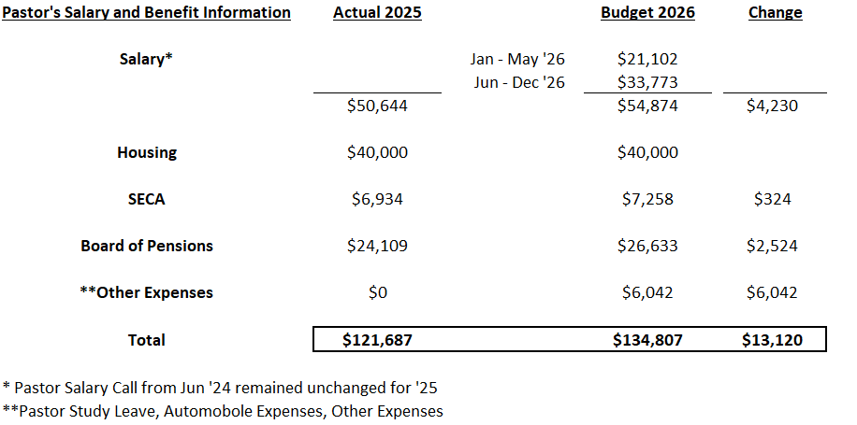
Pastor’s 2026 Comp & Benefits

Slide 6
2025 – Another positive year as we met our income goal (up ~8% from ’24) and managed our expenses well!
Designated Funds are in a good position as we enter 2026 with expected increase / growth in Facilities Reserve through the gifts of the 3 year Legacy Campaign
2026 Budget represents further growth in income and ability to commit more to Mission and our Staff during a continued time of economic uncertainty!
Overall Summary
Your continued generous giving and support is greatly appreciated and is enabling MdS to make a positive difference in our community and create a Legacy!

