Slide 1
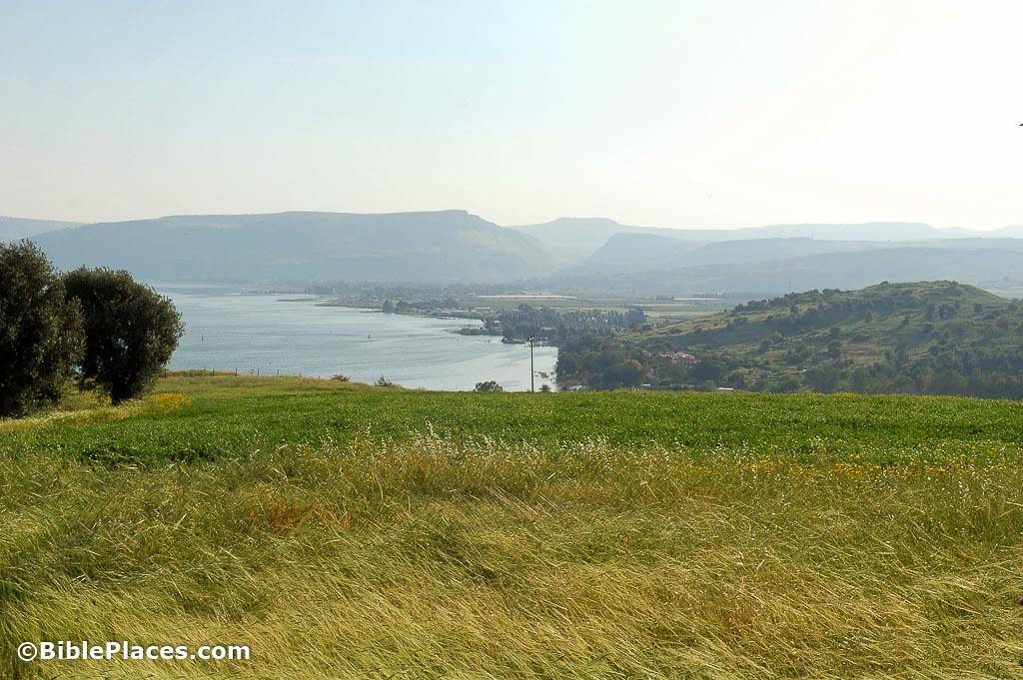
Matthew 7
…Conclusion of the Sermon on the Mount…

Slide 2
Chapter 5 addressed personal relationships. Chapter 6 addressed personal righteousness. Chapter 7 addresses personal responsibility.
7:1-5 – The responsibility to be slow finding fault in others.
The word for “judge” here implies contempt.
Jesus’ teaching instructs us to look first at ourselves.

Slide 3
7:6 – The responsibility to not waste time and effort on those who are hostile to the gospel.
7:7-11 – The responsibility to pray without ceasing.
7:12 – The responsibility to treat all others with love.
7:13-14 – The responsibility to be discerning.
7:15-20 – The responsibility to assess pastors and teachers.
7:21-23 – The responsibility to assess ourselves first.
7:24-29 – The responsibility to hold ourselves accountable.

