Slide 1
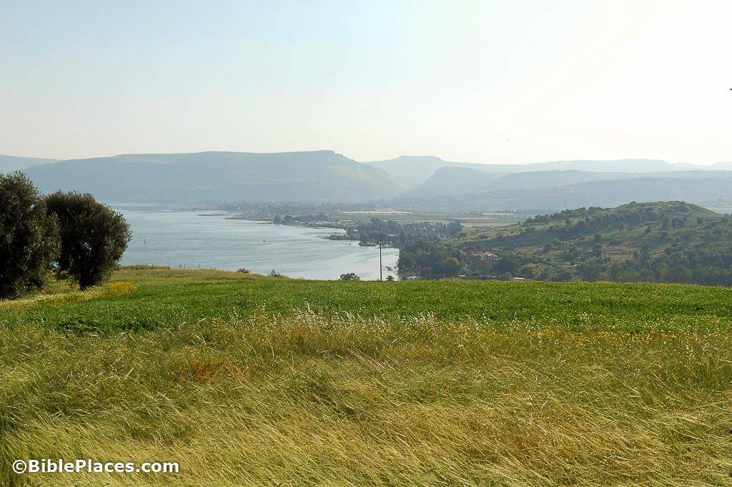
Matthew 6
…Continuation of the Sermon on the Mount…

Slide 2
Chapter 5 addressed personal relationships.
Chapter 6 addresses personal righteousness.
6:1-18 – Warnings about practicing righteousness.
1-4: Practicing true righteousness when giving.
5-13: Practicing true righteousness when praying.
14-15: Practicing true righteousness by forgiving.
16-18: Practicing true righteousness when fasting.

Slide 3
6:19-24 – Cautions about earthly treasures.
6:25-34 – The unnecessary burden of anxiety

