Slide 1
Welcome to Walk With the Word Matthew 19

Slide 2
Prayer Focus for Persecuted Christians
Afghanistan

Slide 3
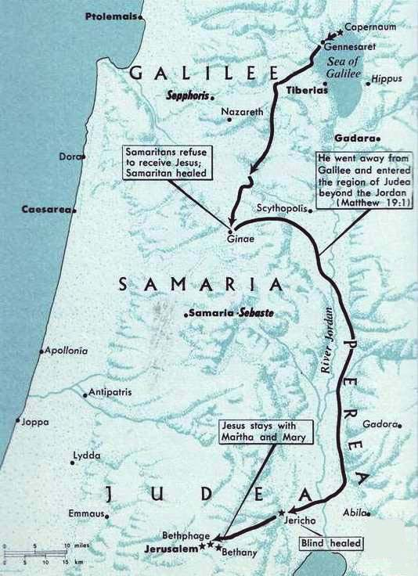

Slide 4
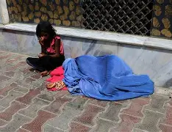

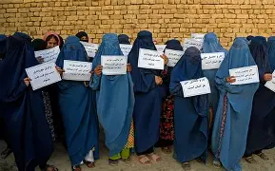
19:1-2 – Jesus begins His journey to Jerusalem, which is ultimately His journey to the cross.
19:3-12 –The hypocrisy of the Pharisees: seeking to justify their unbiblical practice of divorce.
The Pharisees and their abuse of women.

Slide 5
19:1-2 – Jesus begins His journey to Jerusalem, which is ultimately His journey to the cross.
19:3-9 –The hypocrisy of the Pharisees: seeking to justify their unbiblical practice of divorce.
The Pharisees and their abuse of women.
Jesus affirms the scriptural teaching on marriage: one flesh. In other words, in God’s eyes the “two” are “one.”
Marriage: a “type” and symbol of the Godhead.
19:10-12: Jesus compares commitment to that of eunuchs.

Slide 6
19:13-15 – The faith of children should be reflected in the faith of Jesus’ followers.
19:16-26 – Jesus’ sad encounter with the rich young ruler.
19:27-30 – The disciples’ deception of having left everything to follow Jesus: they’re thinking rewards, not the cost.

