Slide 1

Session 1: Kingdom Come

Slide 2
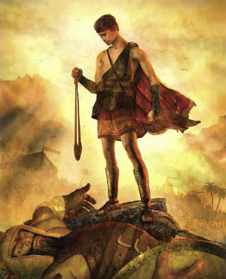
David—the good old days (c.1000 B.C.)

Slide 3
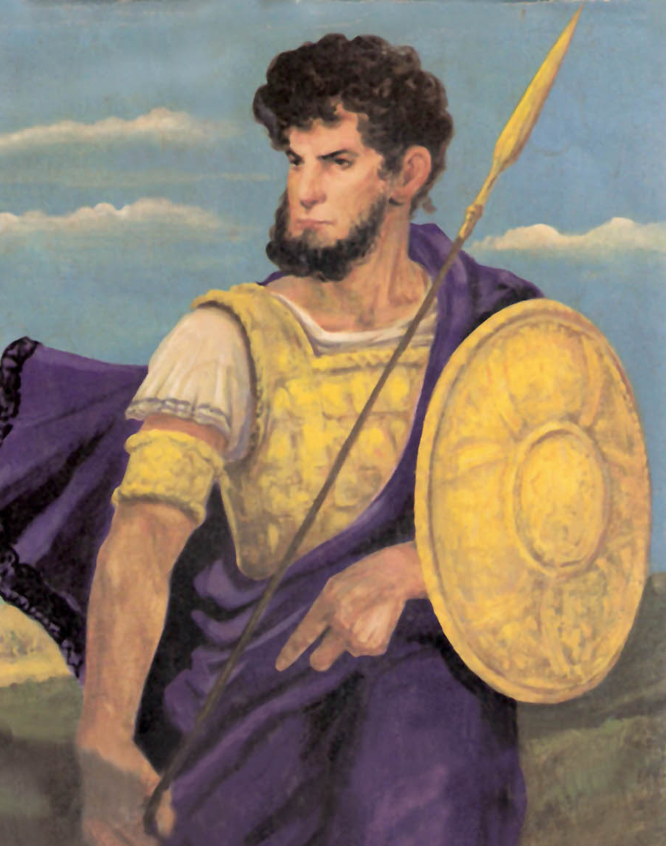
Kicking Butt and Taking Names.

Slide 4
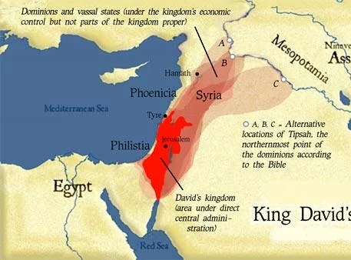
The O.G. Kingdom of Israel, under David and Solomon

Slide 5
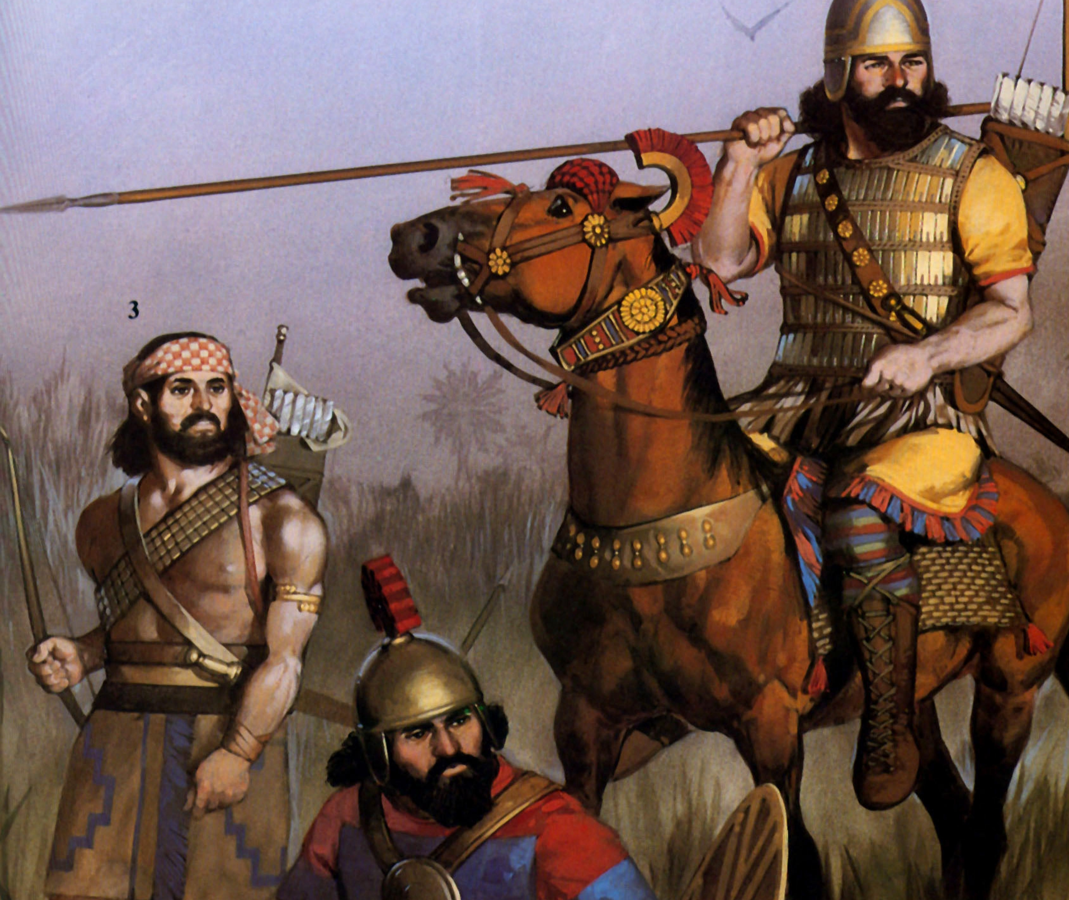
The Assyrians

Slide 6
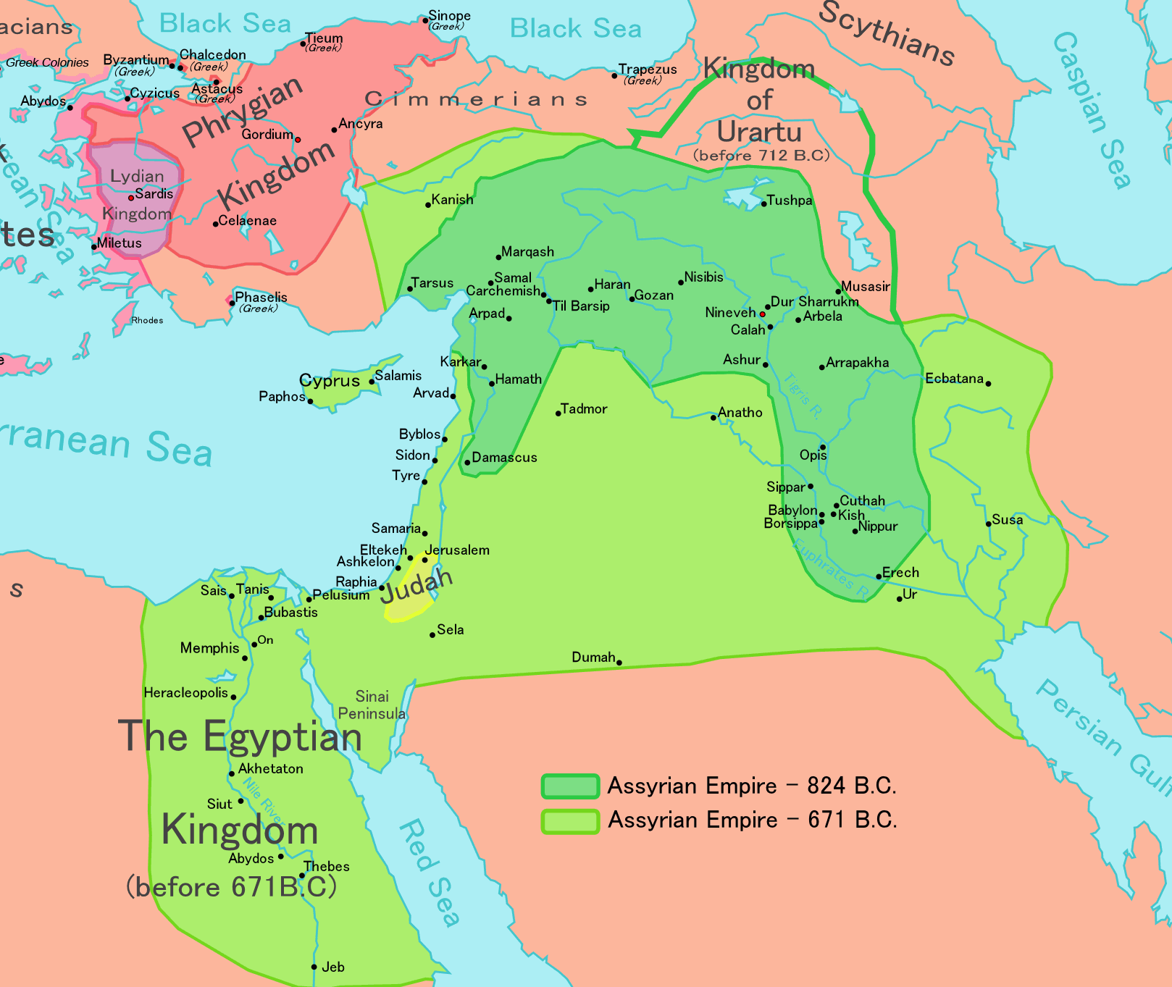
The Assyrian Kingdom

Slide 7
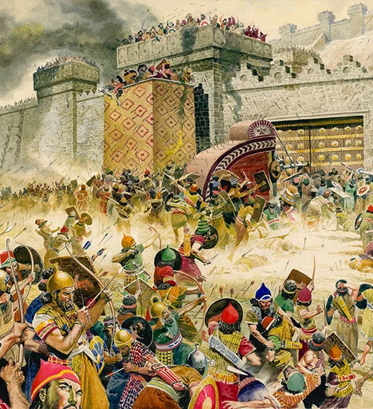

Israel Taken Captive
In 722 BC, Israel is taken captive and never returns.

Slide 8
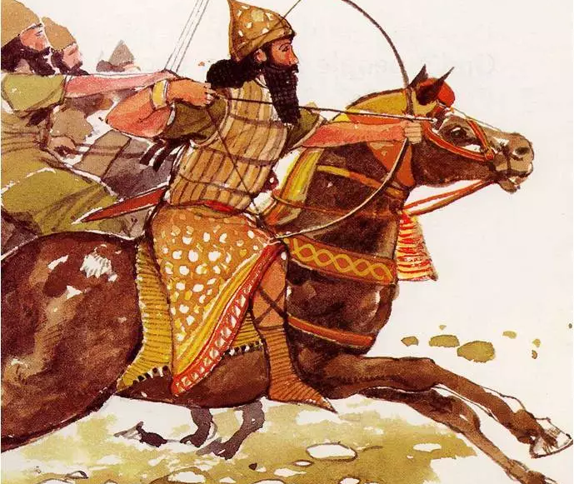
The Babylonians

Slide 9
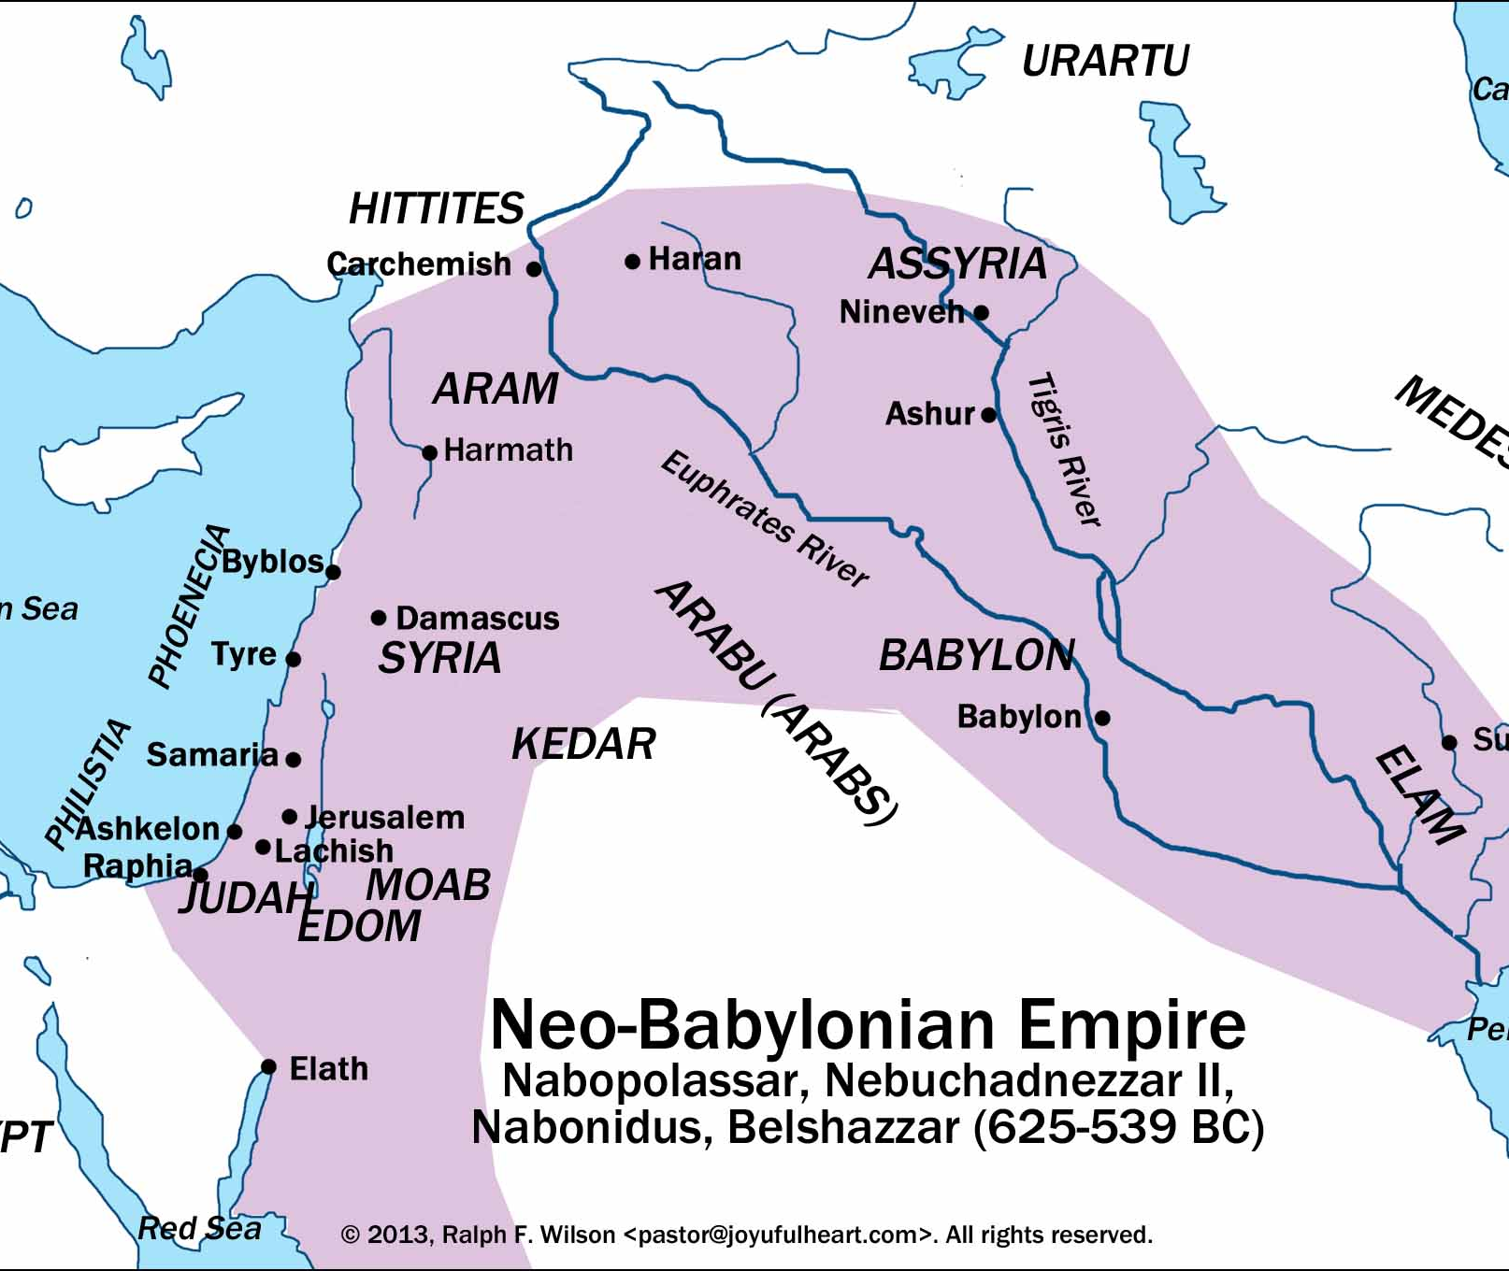
The Babylonian Kingdom

Slide 10
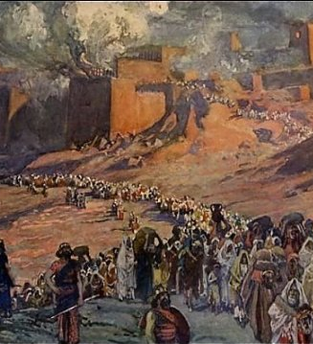
The Exile
In 586-7 B.C., Judah was taken by Babylon, but with the promise of a return

Slide 11
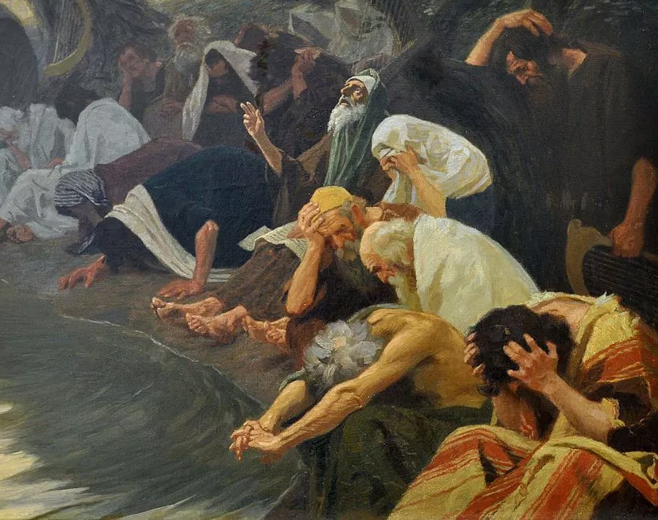
By the waters of Babylon we sat down and wept…
Jews spent 70 years in Babylon

Slide 12
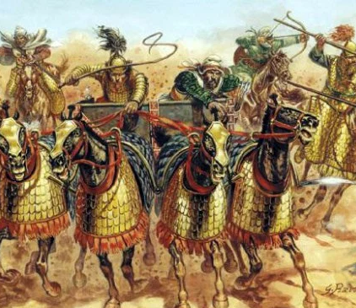
The Persians! (539 BC)

Slide 13
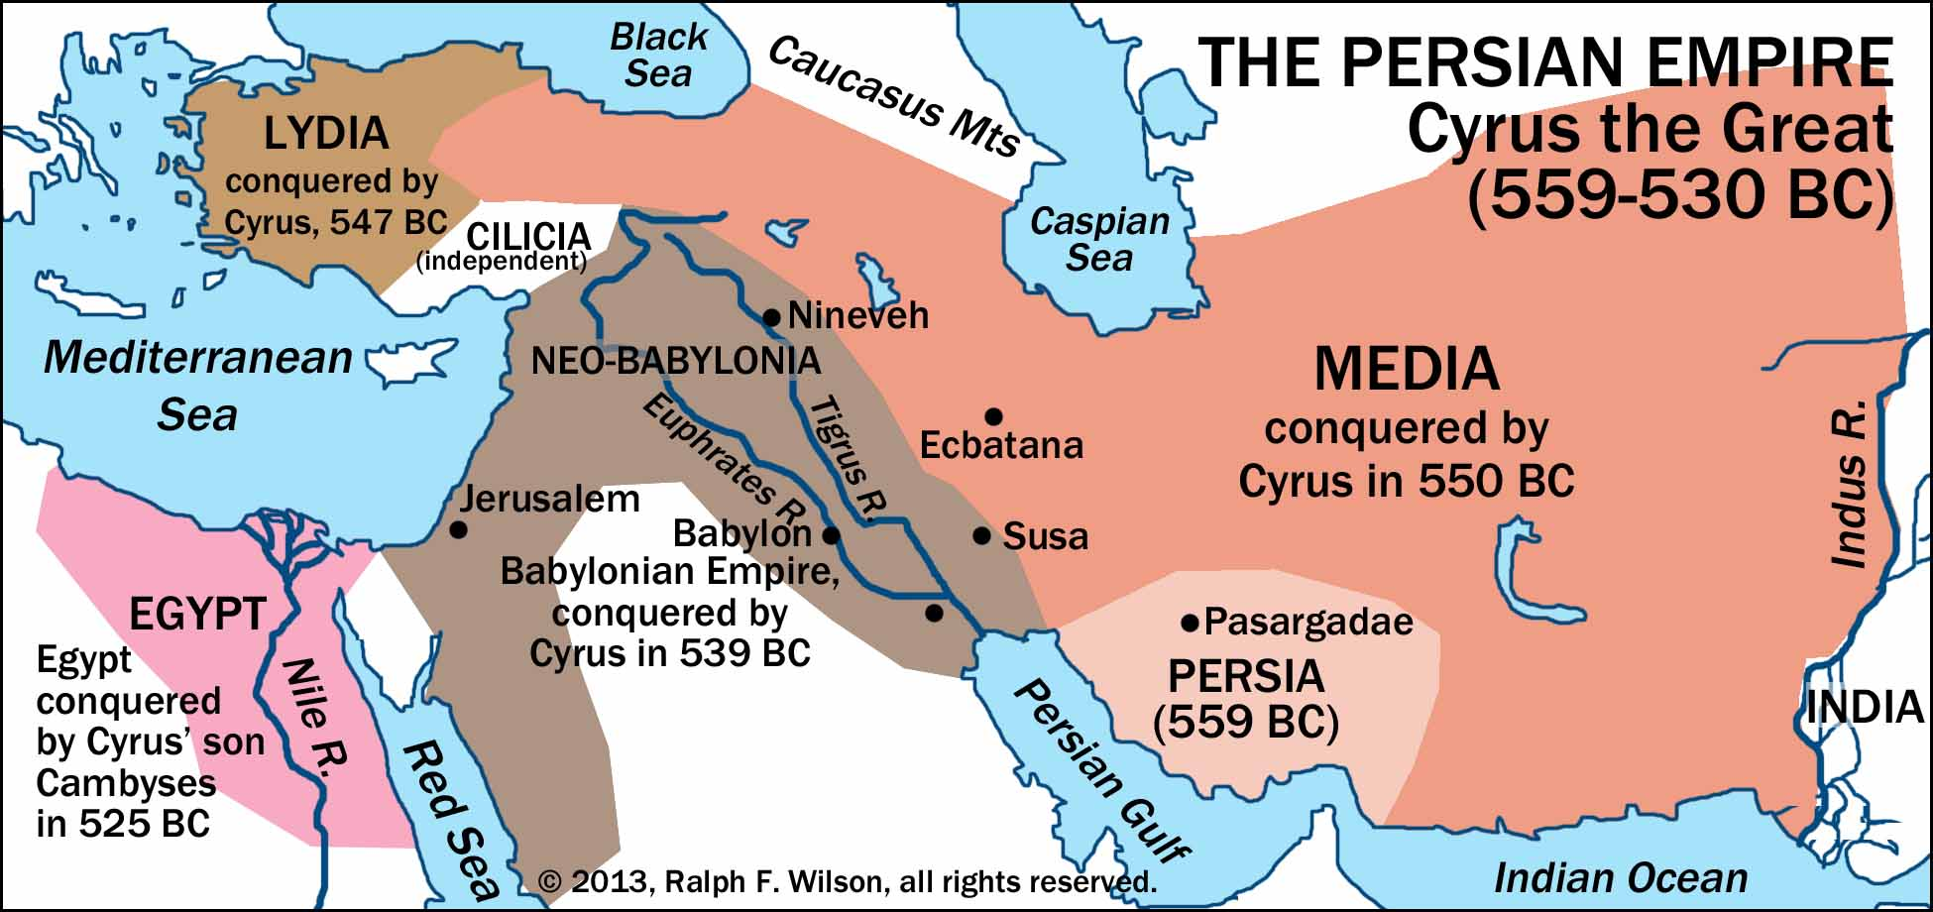
The Persian Kingdom

Slide 14
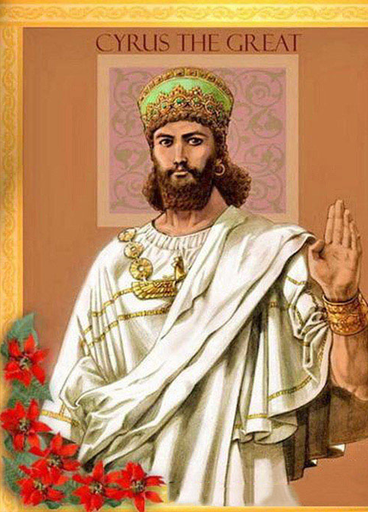
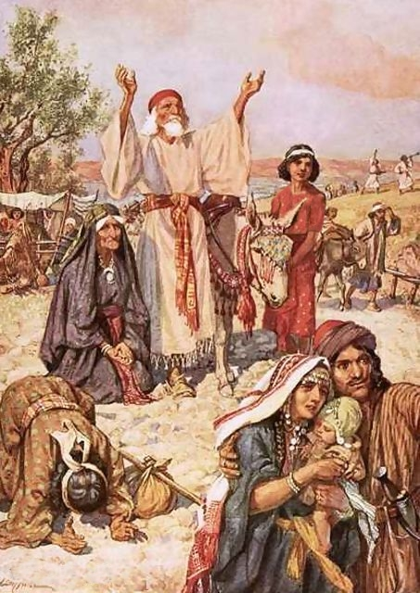
In 539 BC,
Cyrus the Great invades Babylon and says, “You can go home” to the Jews!

Slide 15
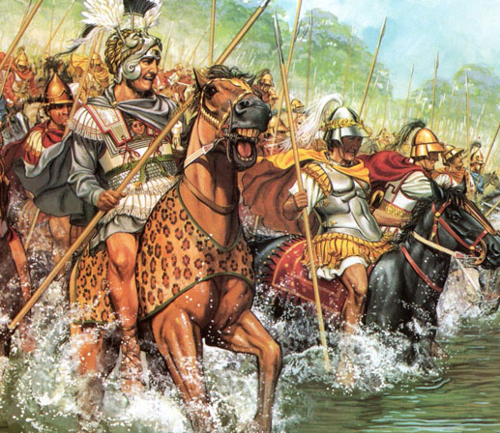
But…
Alexander and the Greeks!
(332 BC)

Slide 16
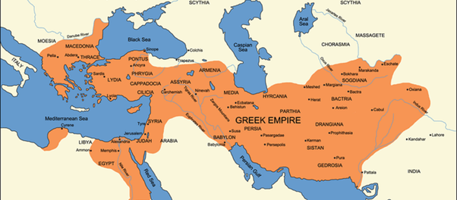
The Greek Kingdom

Slide 17
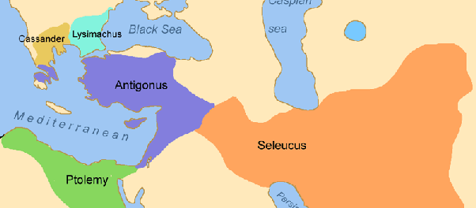
The Split… (around 300 BC)

Slide 18
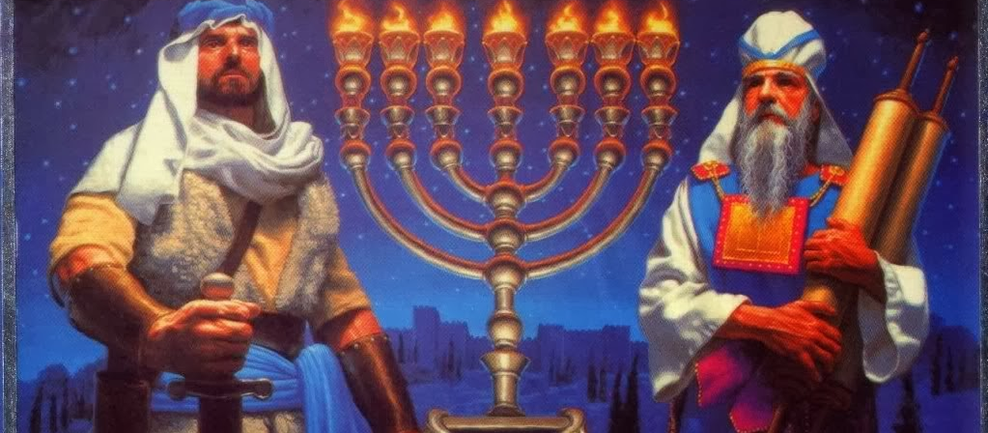
The Maccabean Revolt (164 BC)

Slide 19
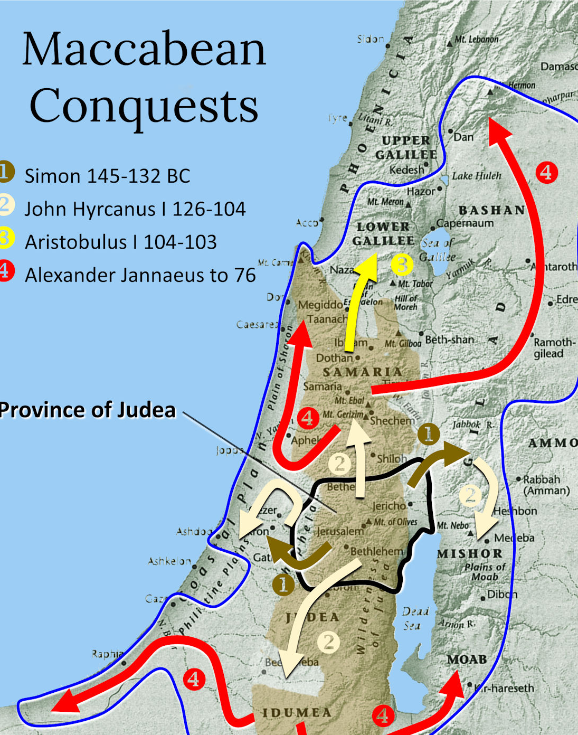
The Return of the
Kingdom of Israel!

Slide 20
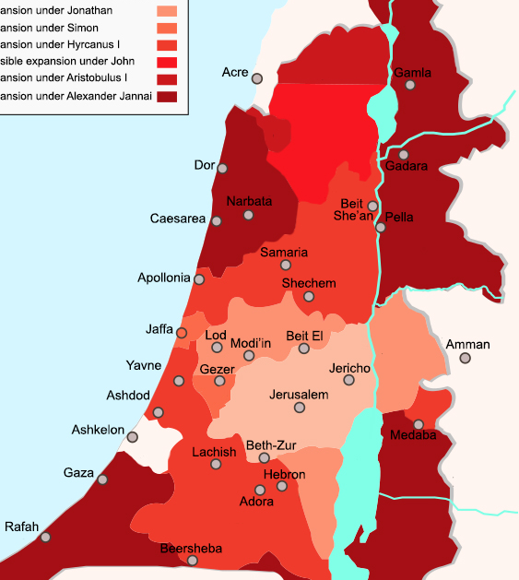
The Hasmodean Dynasty

Slide 21
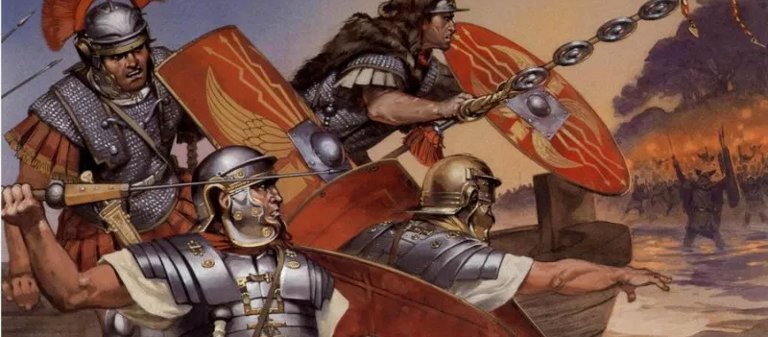
But…the Romans.

Slide 22
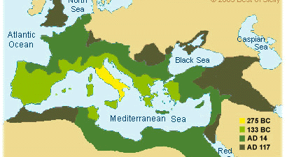
The Roman Kingdom

Slide 23
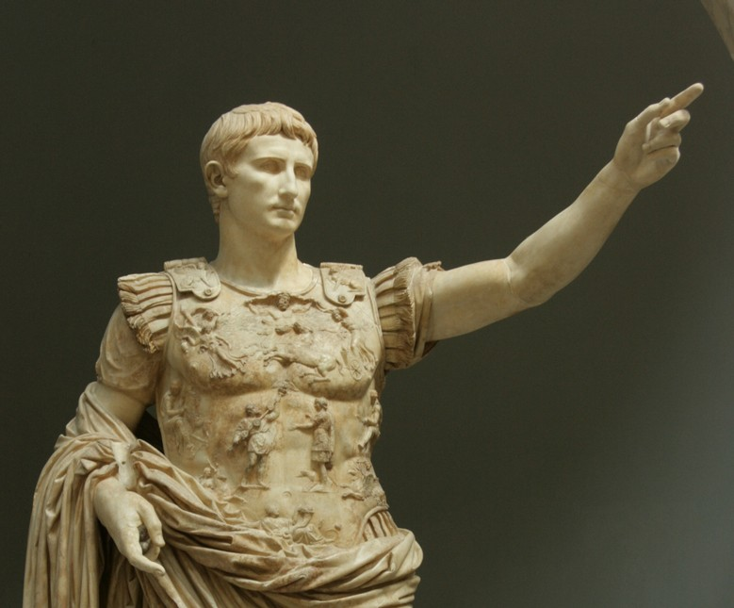
Caesar Augustus…“I’m cool and I know it.”

Slide 24
The Good News and the “Son of God”
The most divine Caesar…we should consider equal to the Beginning of all things…; for when everything was falling [into disorder] and tending toward dissolution, he restored it once more and gave to the whole world a new aura; Caesar…and who being sent to us and our descendants as Savior, has put an end to war and has set all things in order; and [whereas,] having become [god] manifest (phaneis), Caesar has fulfilled all the hopes of earlier times …in surpassing all the benefactors who preceded him…, and whereas, finally, the birthday of the god [Augustus] has been for the whole world the beginning of good news (euangelion) concerning him [therefore let a new era begin from his birth]. (OGIS 2.#458)

Slide 25
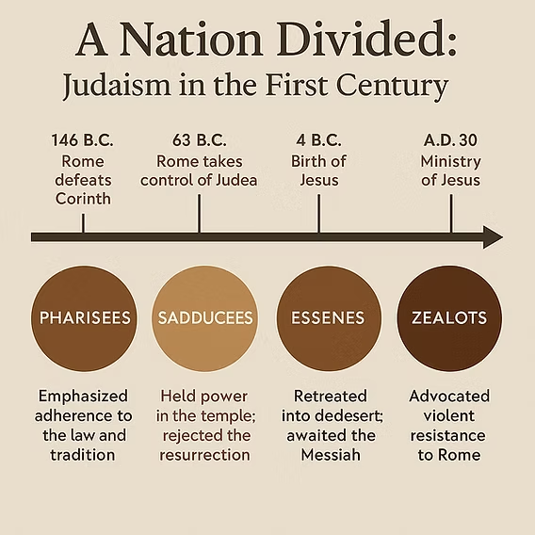
4 Responses to Reclaim the Kingdom of David (and of God)

Slide 26
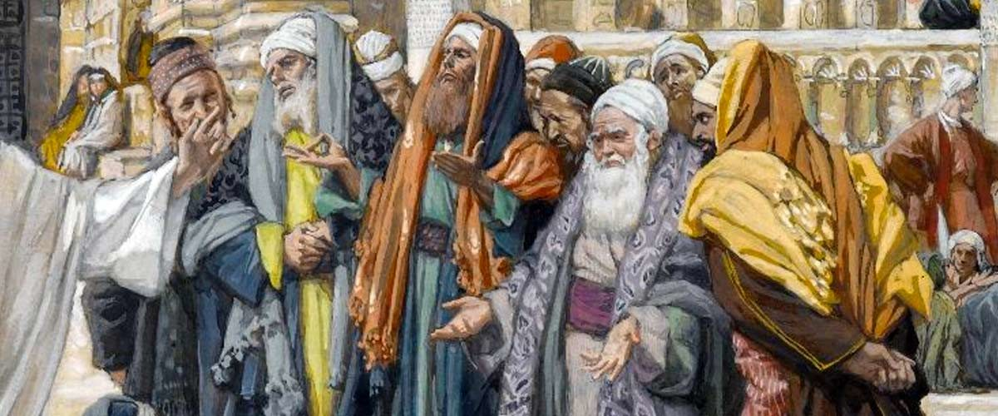
The Sadducees: We give up on the Kingdom of God.

Slide 27
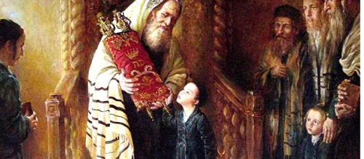
The Pharisees: We keep rules to bring God’s Kingdom

Slide 28
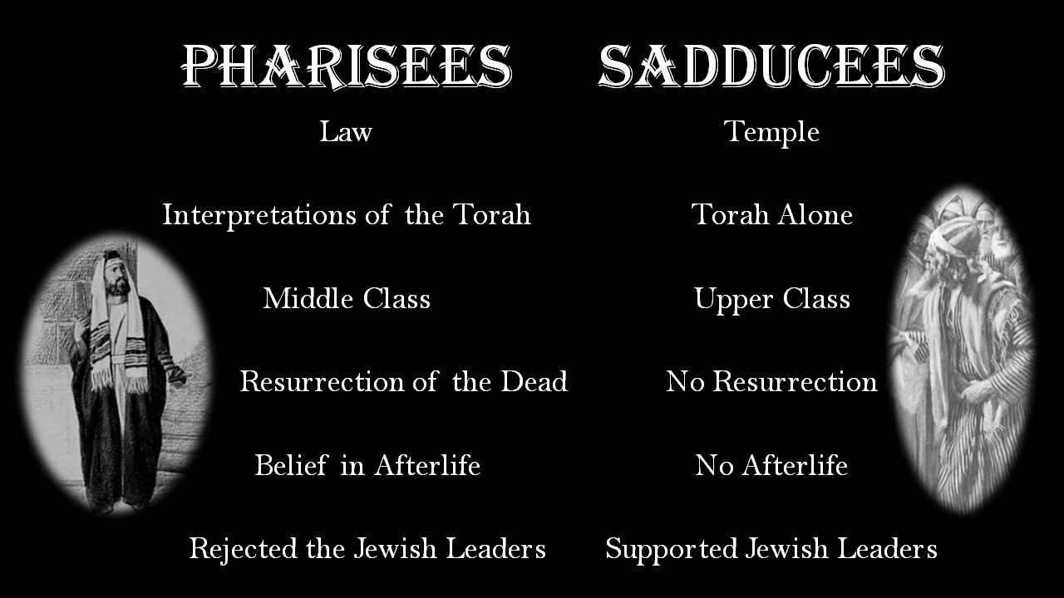
Pharisees vs. Sadducees

Slide 29
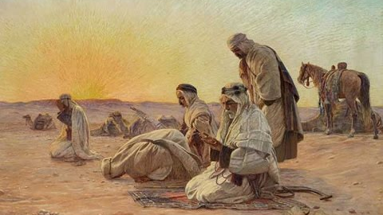
The Essenes: We wait for the Kingdom of God (just for us)

Slide 30
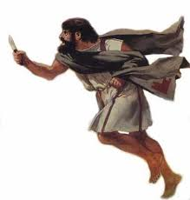
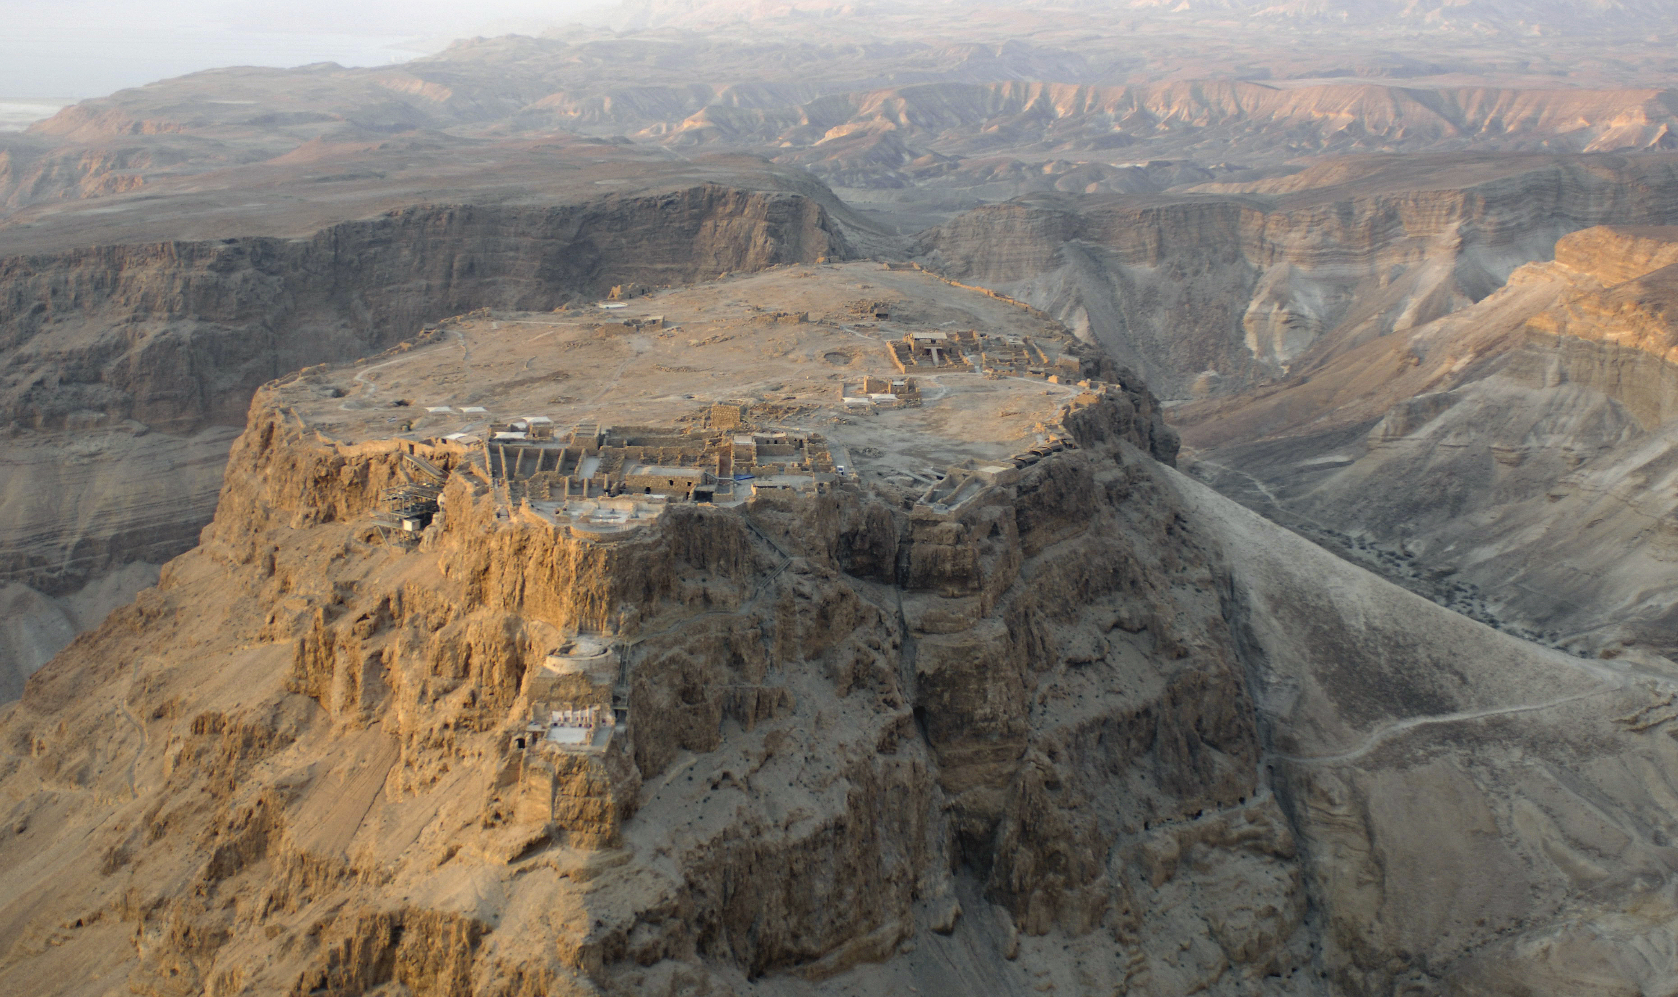
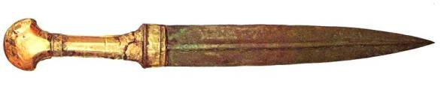
The Zealots: We slit Roman throats.

Slide 31
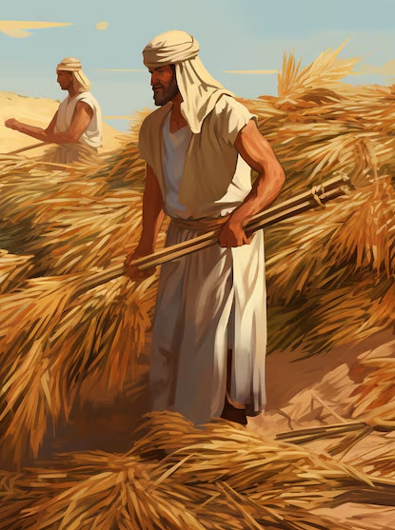
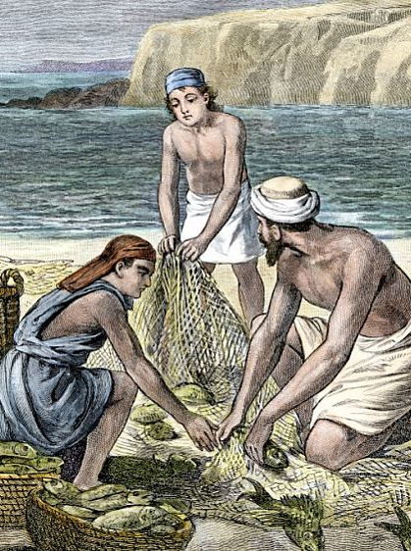
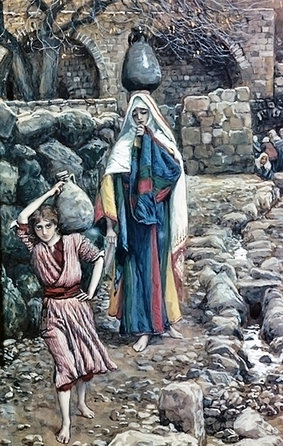
Normal Society: When Will God Defeat Our Enemies and Restore the Kingdom?

Slide 32
Ancient Prophecies
“The scepter will not depart from Judah,
nor the ruler’s staff from between his feet,
until He comes to whom it belongs
and the obedience of the nations is His” (Genesis 49:10)
“I see him, but not now; I behold him, but not near. A star will come out of Jacob; a scepter will rise out of Israel . . . a ruler will come out of Jacob . . .” (Numbers 24:17,19)

Slide 33
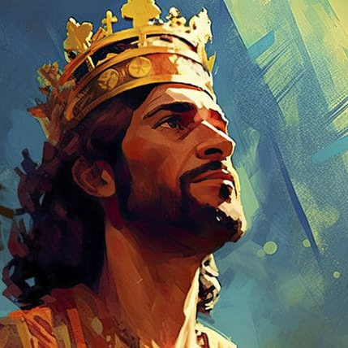
The Son of David
“When your days are over and you rest with your ancestors, I will raise up your offspring to succeed you, your own flesh and blood, and I will establish his kingdom. He is the one who will build a house for my Name, and I will establish the throne of his kingdom forever” (2 Samuel 7:12-13)

Slide 34
A Mighty King
“You are my Son, today I have become your Father. Ask of me, and I will make the nations your inheritance; the ends of the earth your possession. You will rule them with an iron scepter, you will dash them to pieces like pottery.” (Psalm 2;7-9)
“Here is my servant, whom I uphold, my chosen one in whom I delight; I will put my Spirit on him and he will bring justice to the nations . . . He will not falter or be discouraged till he establishes justice on earth…” (Isaiah 42:1-4)

Slide 35
A Global Ruler! (Isaiah 9:5-7)
…Every warrior’s boot used in battle
and every garment rolled in blood
will be destined for burning,
will be fuel for the fire.
⁶ For to us a child is born,
to us a son is given, and the government will be on his shoulders.
And he will be called
Wonderful Counselor, Mighty God,
Everlasting Father, Prince of Peace.
⁷ Of the greatness of his government and peace
there will be no end.
He will reign on David’s throne
and over his kingdom,
establishing and upholding it
with justice and righteousness
from that time on and forever.
The zeal of the Lord Almighty
will accomplish this.

Slide 36
Daniel’s Clock
“Know therefore and understand, that from the going forth of the command to restore and build Jerusalem until Messiah the Prince, there shall be seven weeks and sixty-two weeks; The street shall be built again, and the wall, even in troublesome times. And after the sixty-two weeks Messiah shall be cut off, but not for Himself, and the people of the prince who is to come shall destroy the city and the sanctuary.” (Daniel 9:26-27)
Daniel, one of the ancient magi of the Chaldeans, gets the heads up about the timing of Messiah’s coming, and the fact that would be “cut off” before the destruction of the second temple. Counting from the order to rebuild Jerusalem, it would be 7 weeks + 62 “weeks” – 483 years.

Slide 37
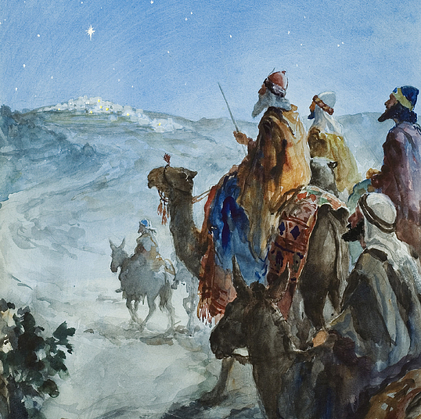
Isaiah 60: No More Conquest
Some day, God would restore Israel
“Nations will come to your light, and kings to the brightness of your dawn.”
The nations were to come, bearing “gold and frankincense”

Slide 38
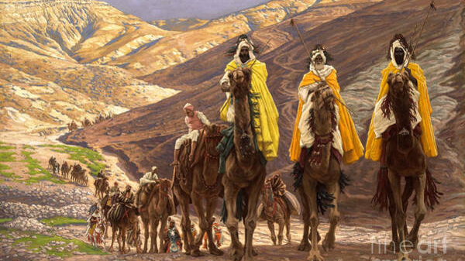
Has the Kingdom of David Finally Come?

