Slide 1

Town Hall Presentation for
Phase 2 Building Project for St. Paul’s Church & School

Slide 2
Agenda
Summary of Ministry Needs
Summary of Building Committee Progress
Planned Building Design
Phase 2 - Cost Estimates
Next Steps and Probable Timeline

Slide 3
Summary of Ministry Needs –
Pastor Thomas

Slide 4
Building Committee Progress

Slide 5
St. Paul’s Building Committee Members
Kim Temme -Accountant & Former St. Paul’s Treasurer
Emily Scanlon -Architect
Louis Vandeloecht -Architect
Bruce Kothe -St. Louis County Building Engineer
Tim Unger -Building Structural Engineer
Mark Cannon -St. Paul’s President & Finance Exec
John Piedimonte -Construction Firm Owner
Carol Markway -Chairperson- St. Paul’s Board of Properties
MaryBeth DeVasto -Staff, Manager Food Services
Dawn Walker -Staff, School Principal
Dan Sterling -Staff, History Teacher & Athletic Director
Whitney Wade -Staff, Lead for Living Stone Service & Music Teacher
Matt Gerhardt - Staff, St. Paul’s Kantor & Music Teacher
Steve Brosch -Staff, St. Paul’s Facilities Manager
Pastor Thomas -Staff, St. Paul’s Sr. Pastor
Dave Ziegler -Chairman of St. Paul’s Building Committee
Greg Goebel Ittner-CordoganClark - Principal Design Director for Education
Rick Keisker Ittner-CordoganClark – Vice President

Slide 6
Committee Progress To Date
Selected Committee Members
Confirmed Ittner-CordoganClark as achitecural firm for Phase 2
Determine Key Objectives of Phase 2
Contracted for Schematic Design
Selected Construction Management & Contractor at Risk Process for Project
Selected Three(3) bidders
Solicited and Received three(3) Proposals & Cost Estimates
Evaluation of Bids is On-Going

Slide 7
Planned Building Design

Slide 8
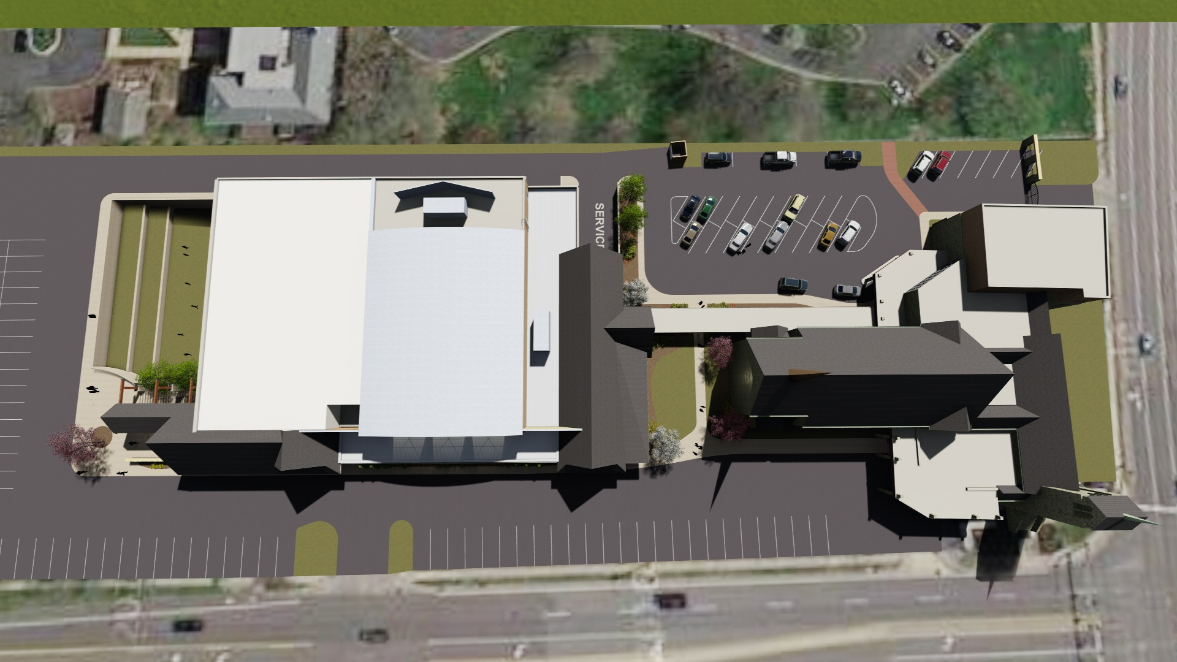
CONNECTION
CLASSROOMS
GYM
LIVING
STONE
SCHOOL
ENTRY
Master Plan (Jan 2017)

Slide 9
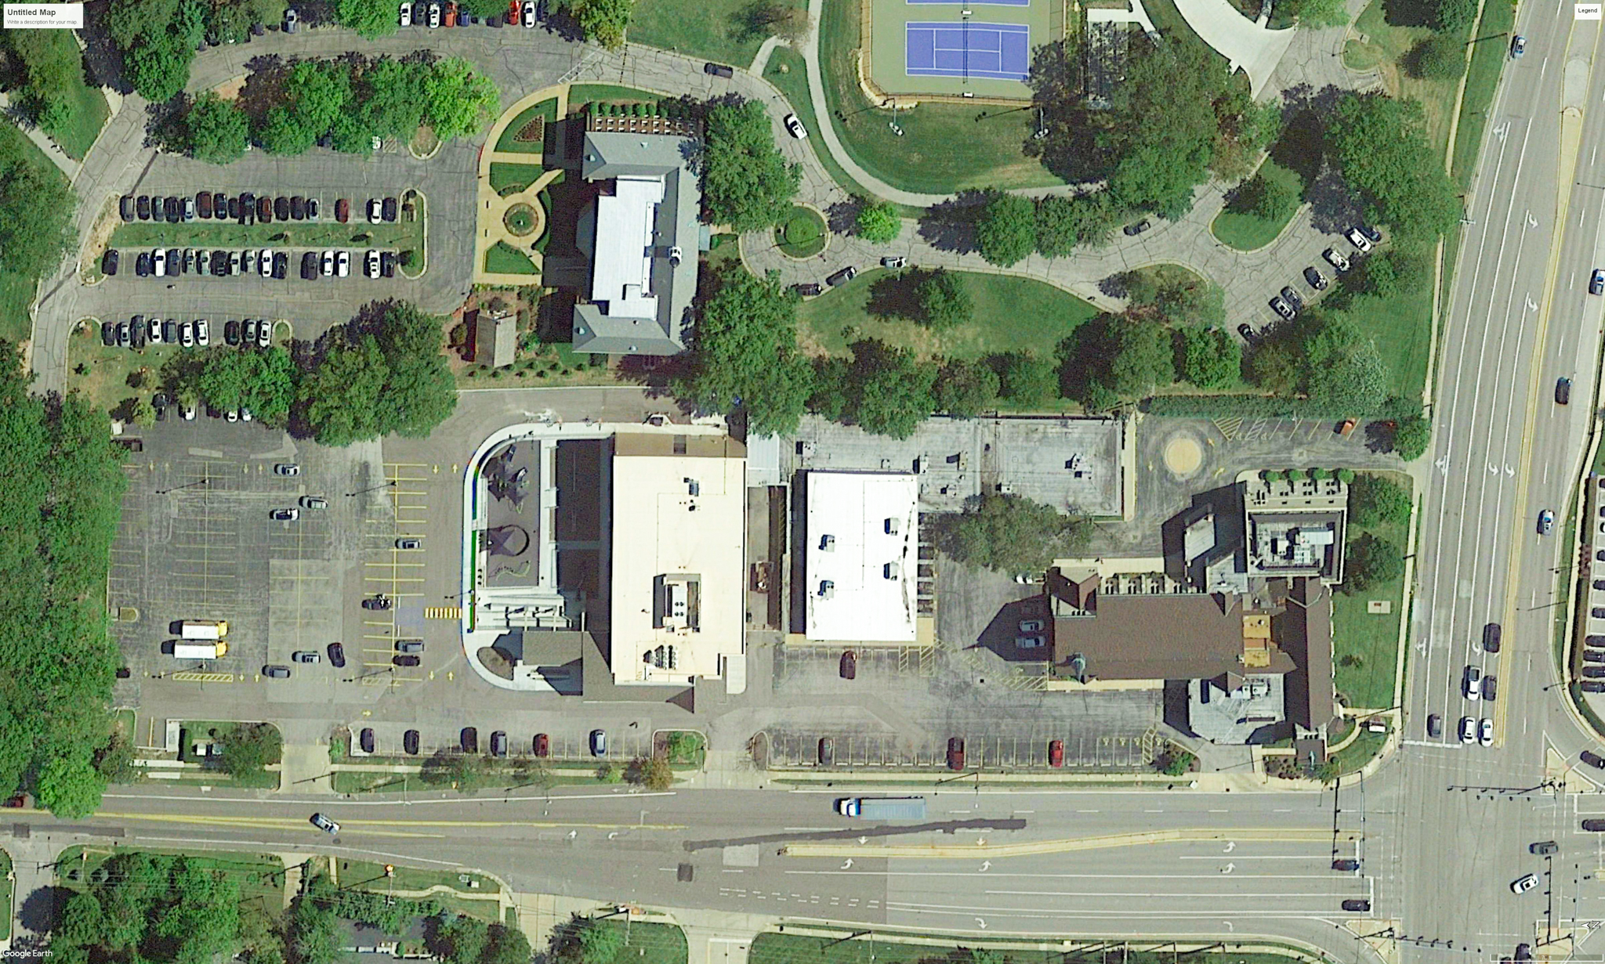
Site Plan (2022)

Slide 10
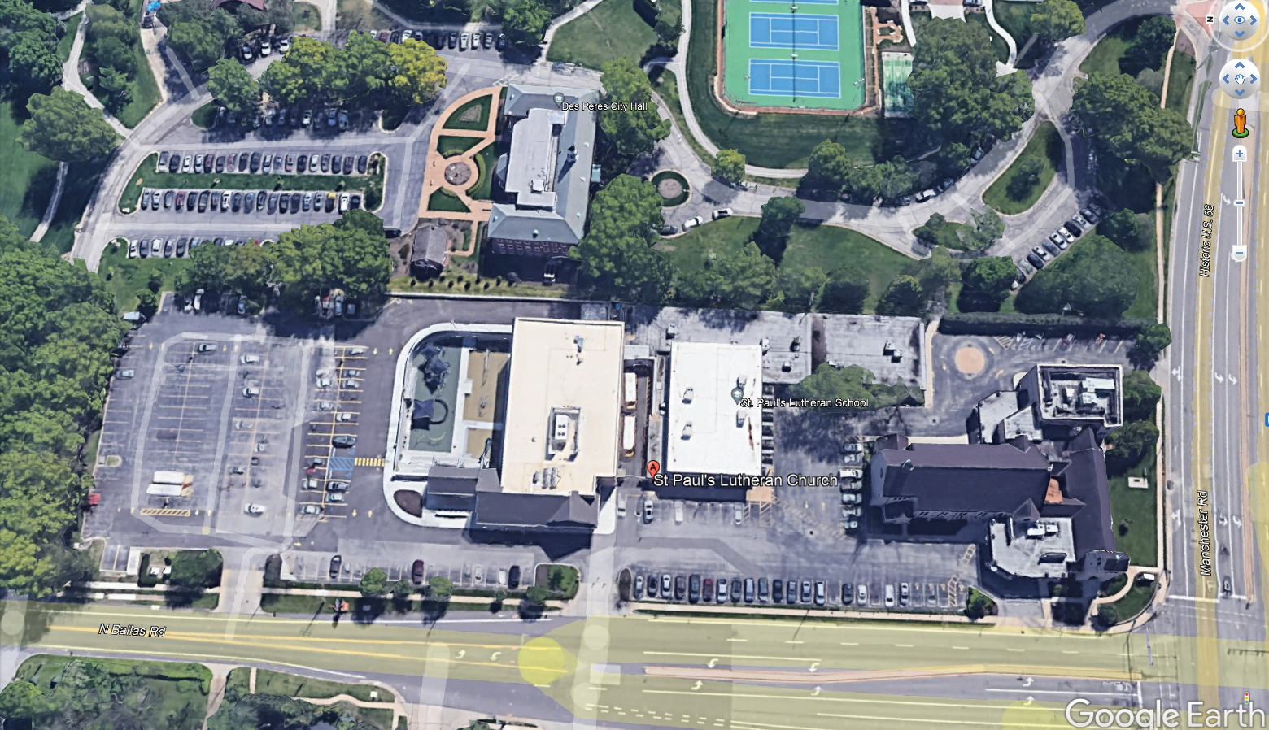
PHASE 1
PHASE 2
COMPLETE
Let’s continue the progress
Site Plan (2022)

Slide 11
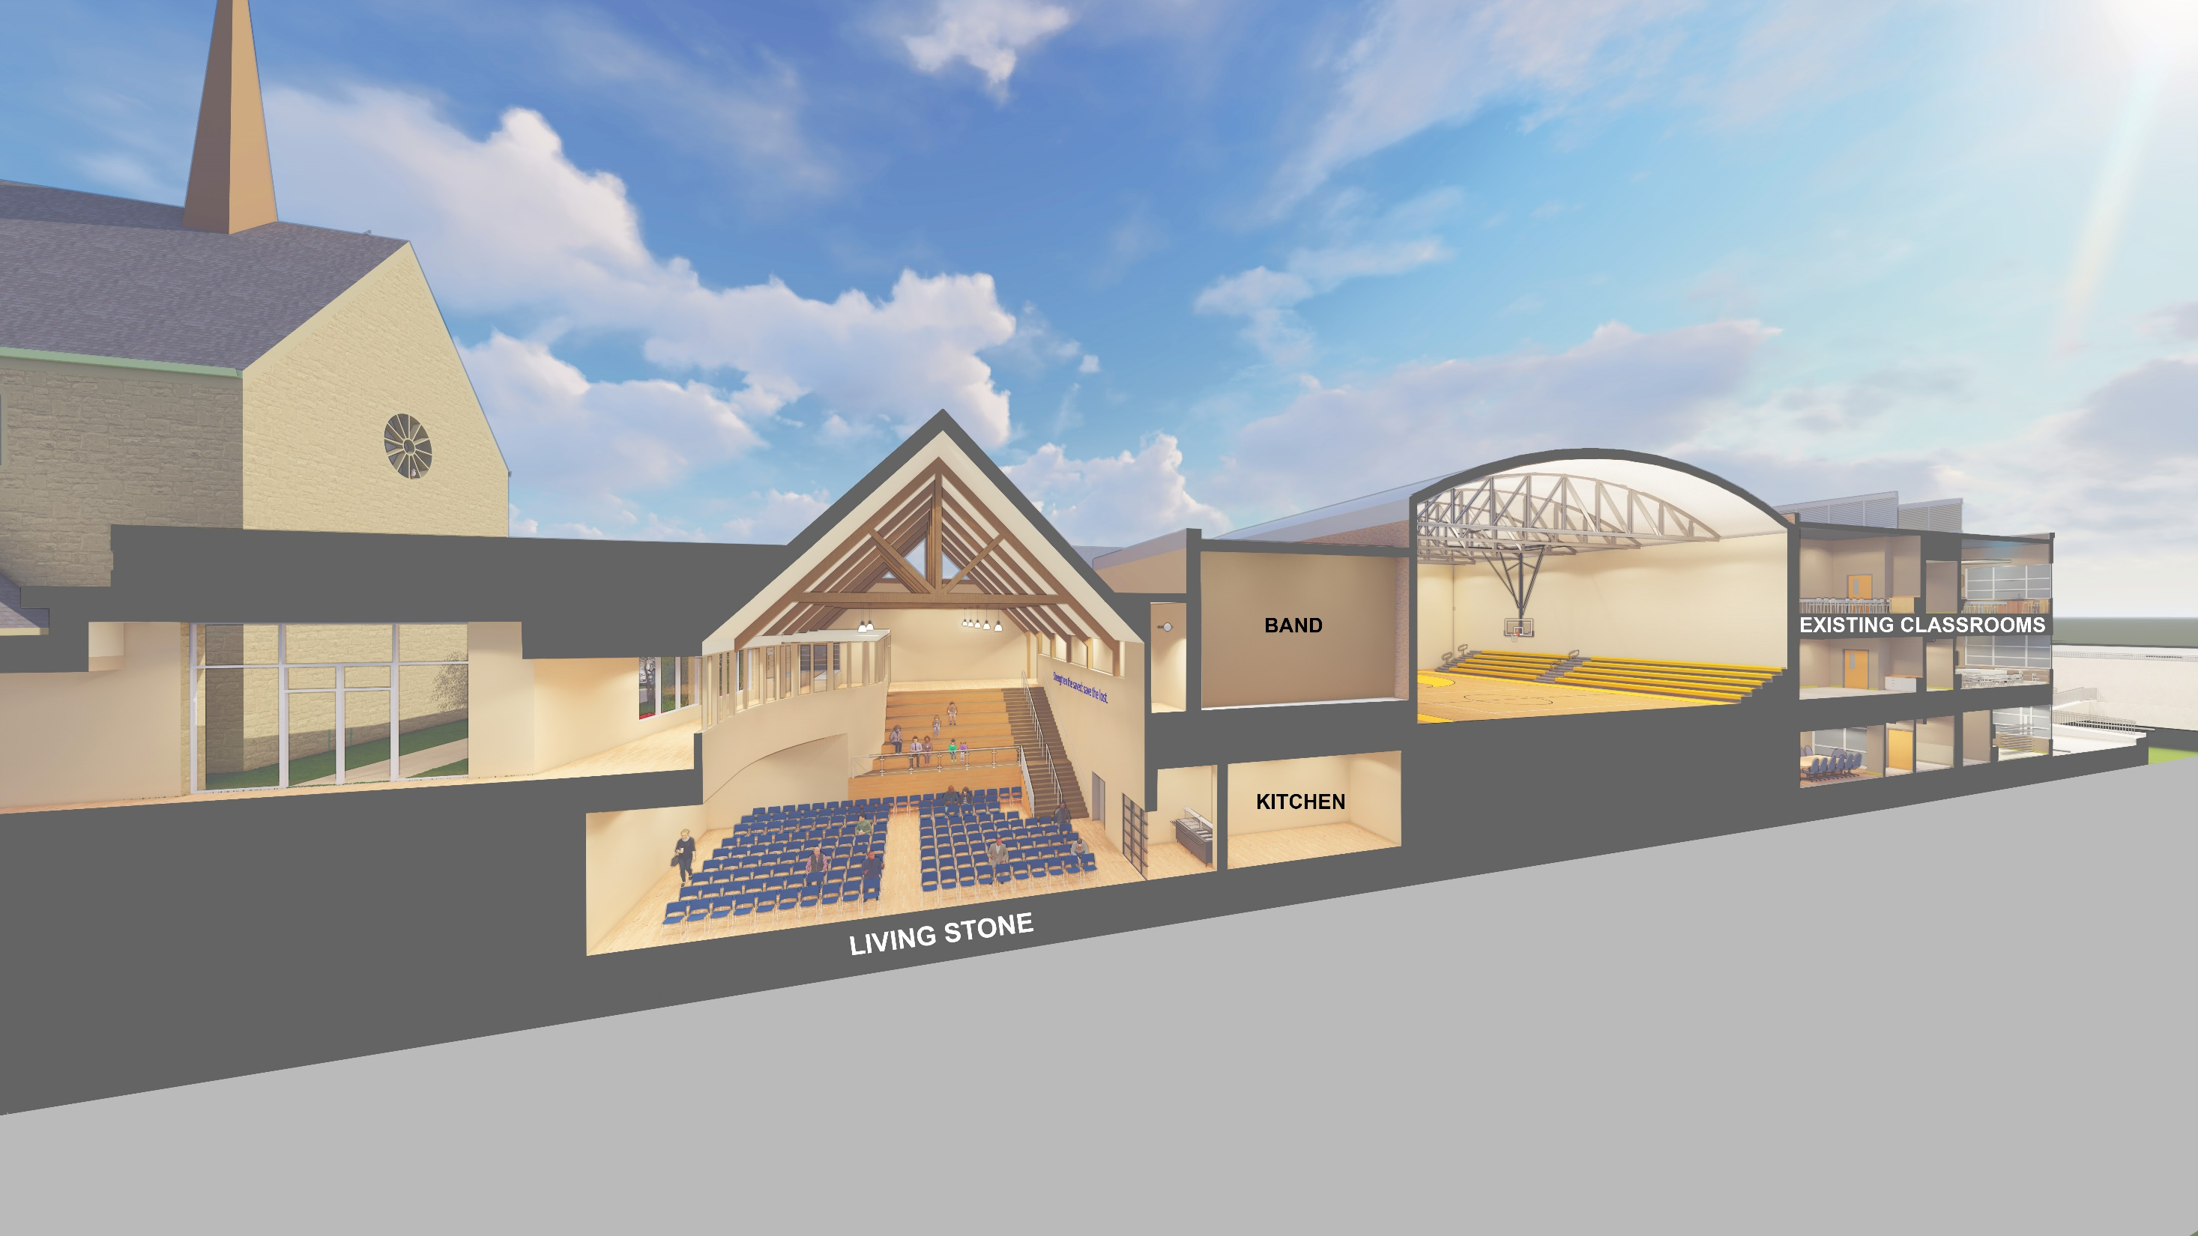

Slide 12
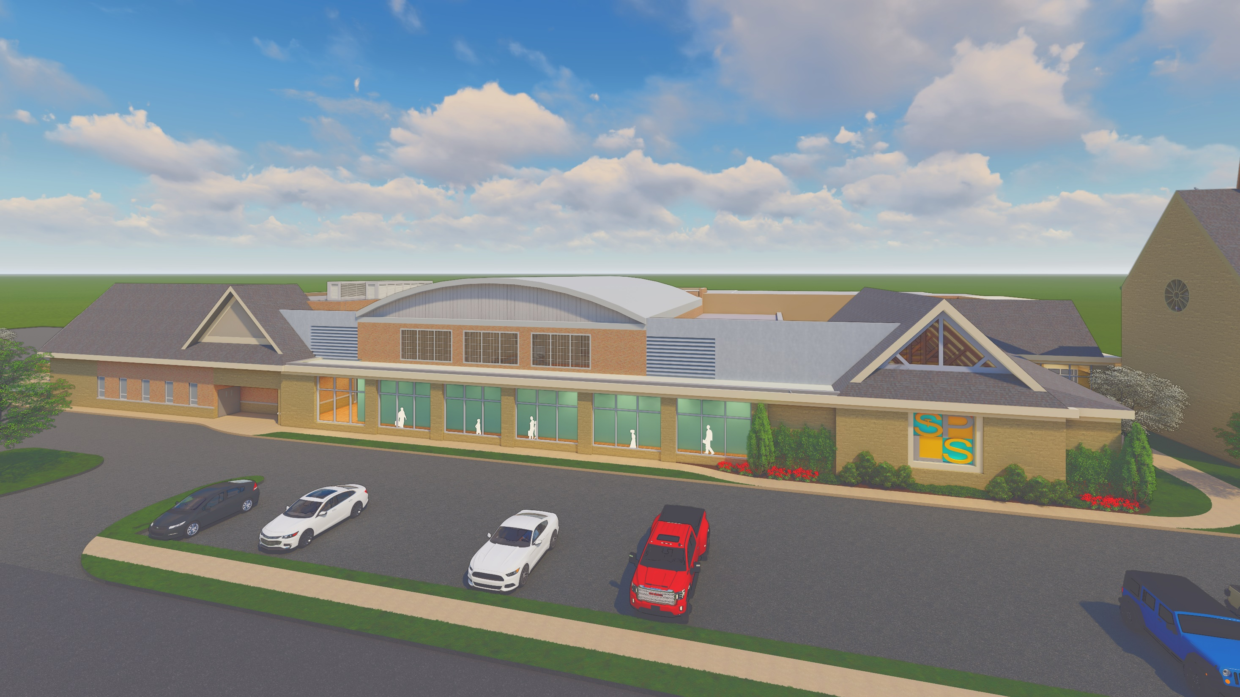

Slide 13
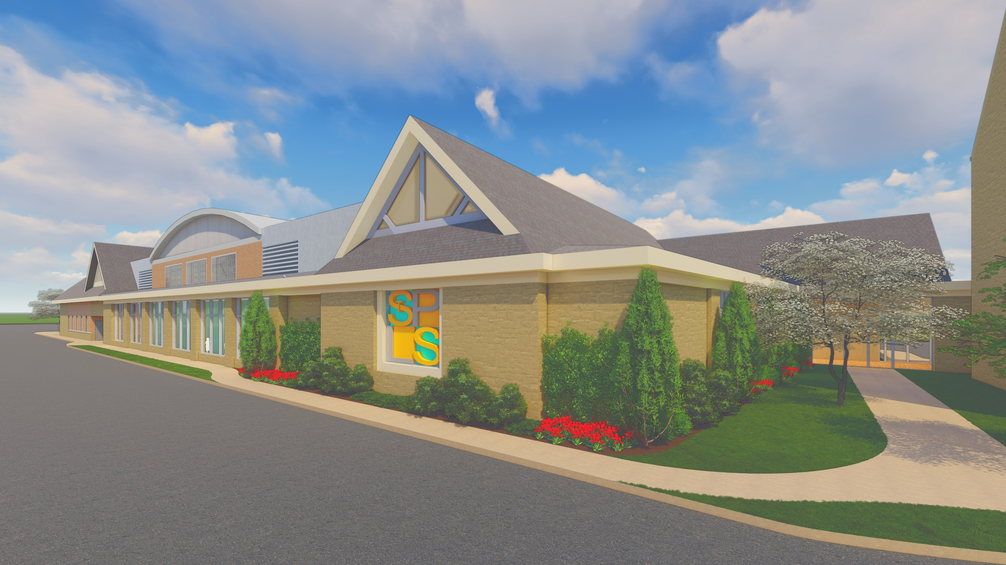

Slide 14
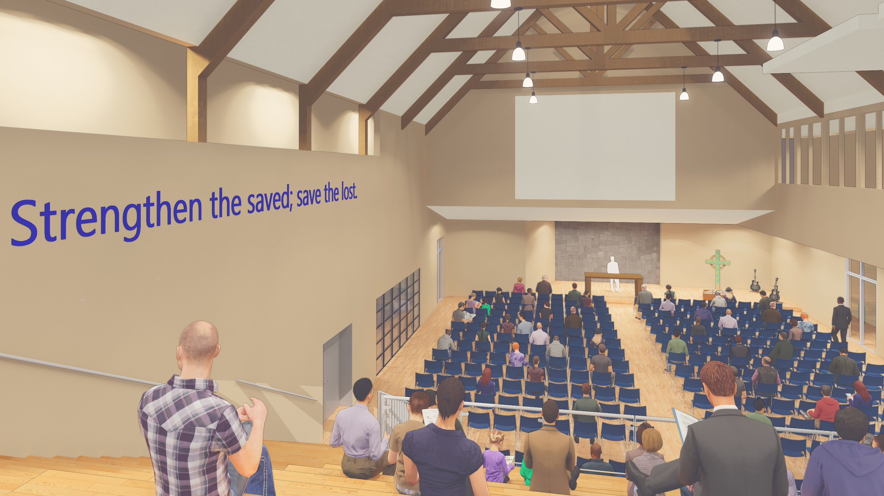

Slide 15
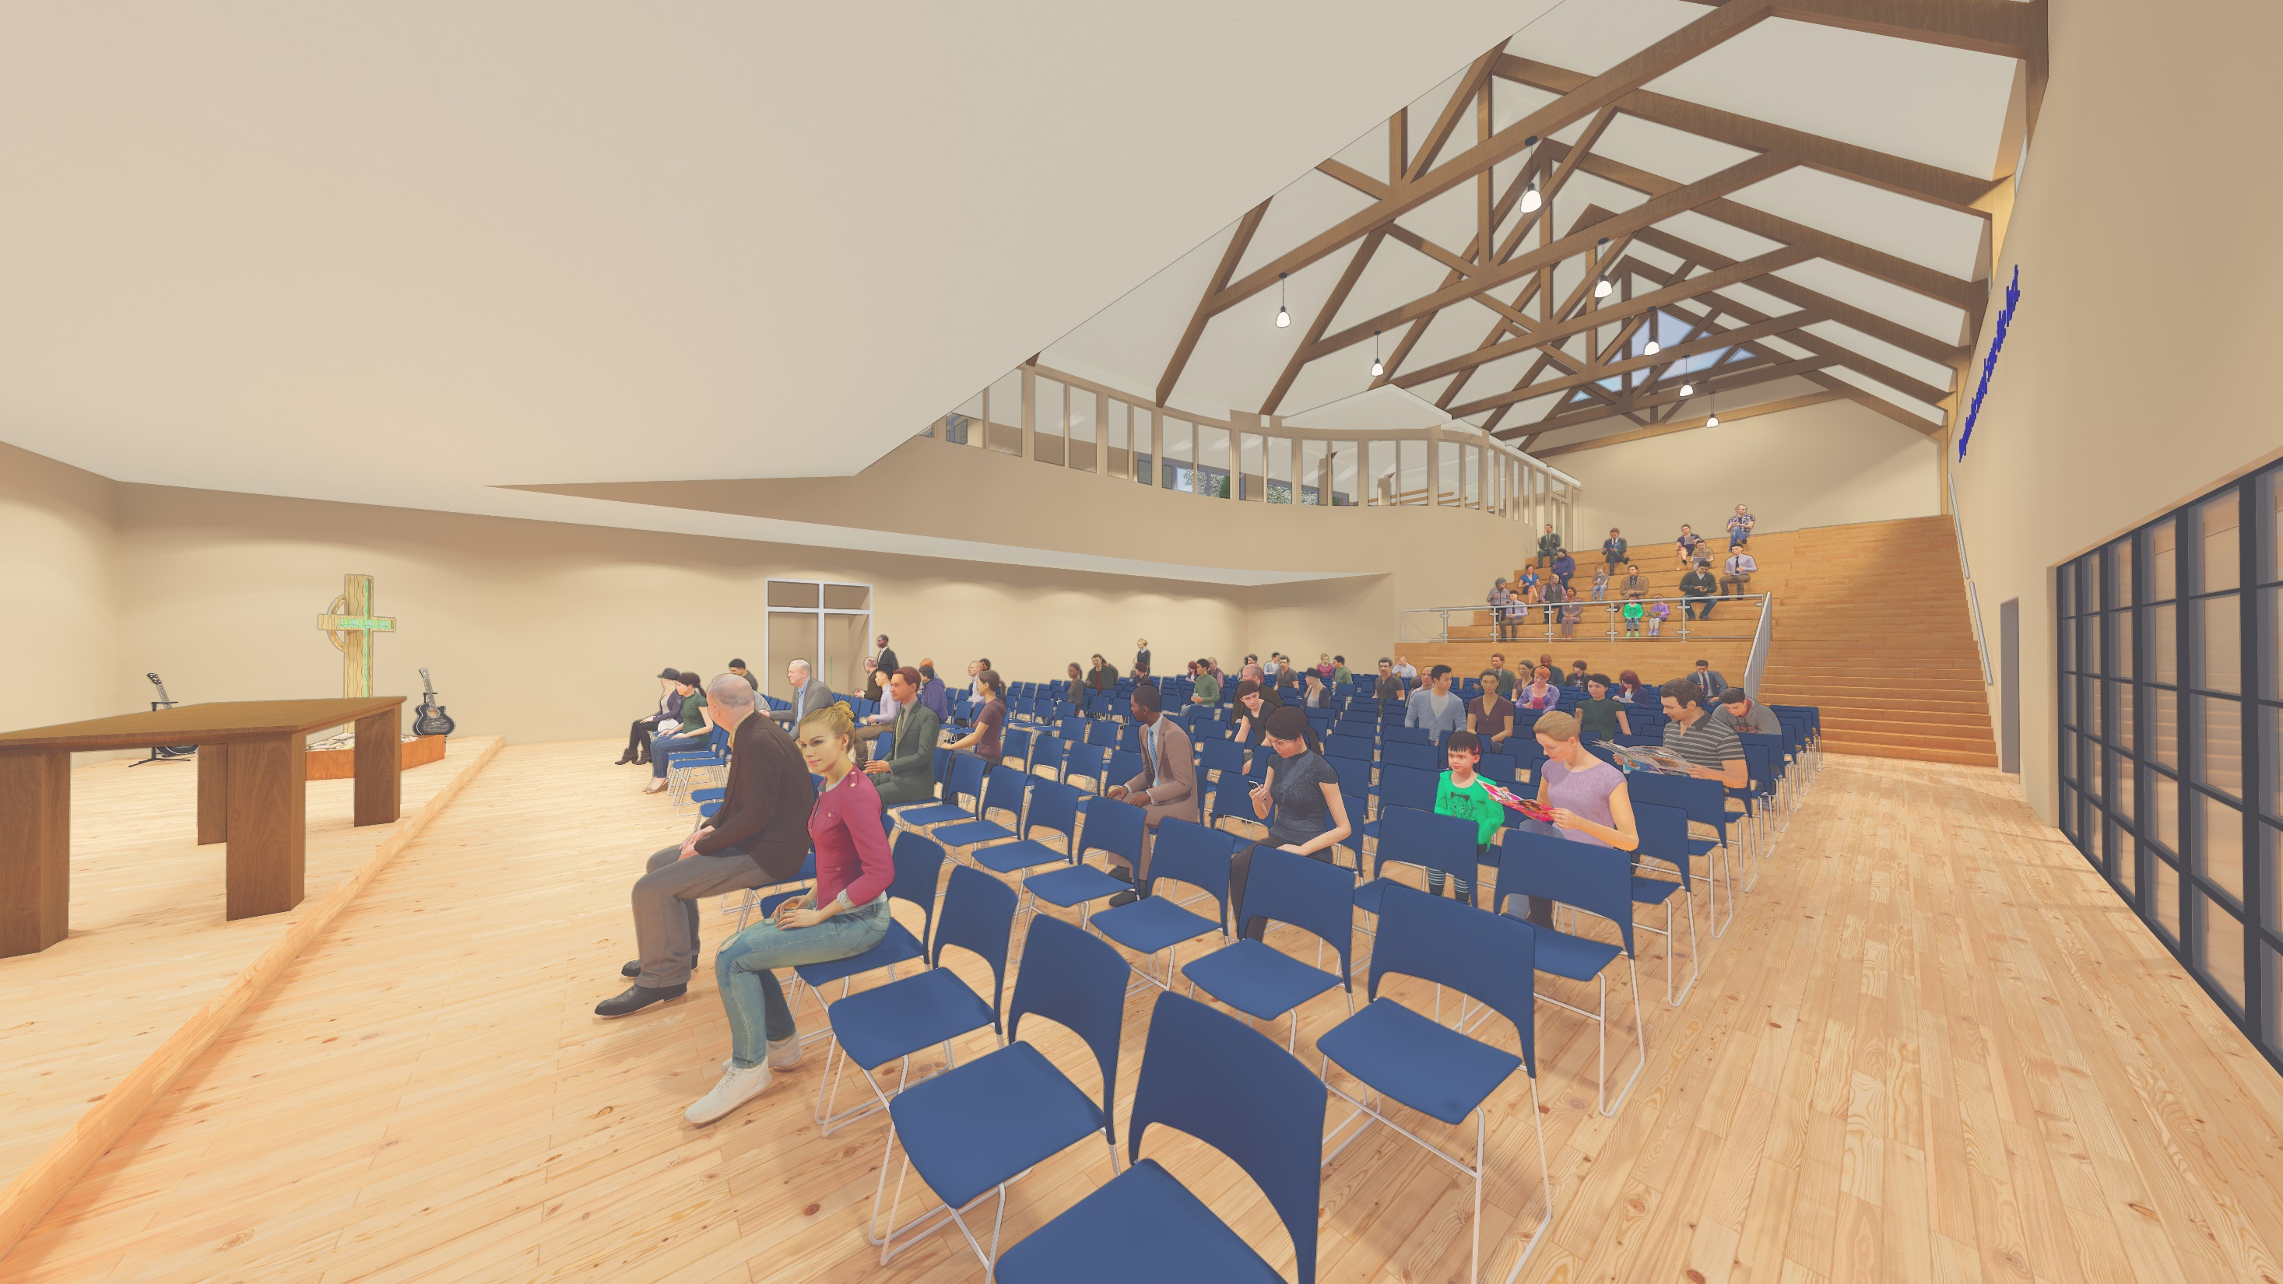

Slide 16
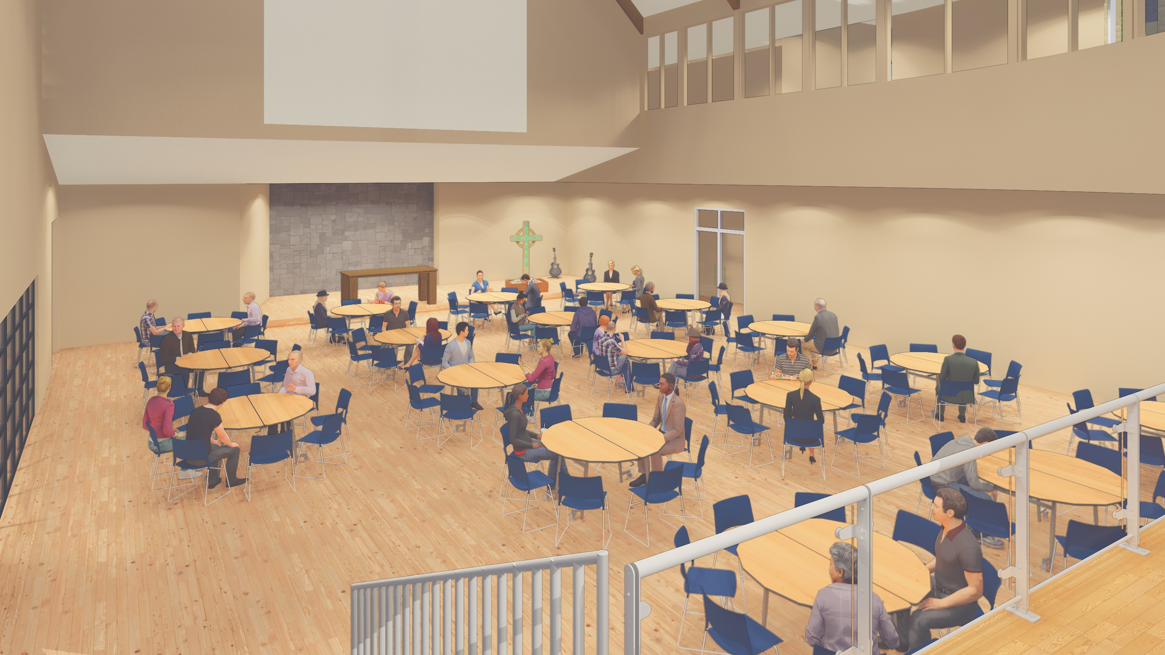

Slide 17
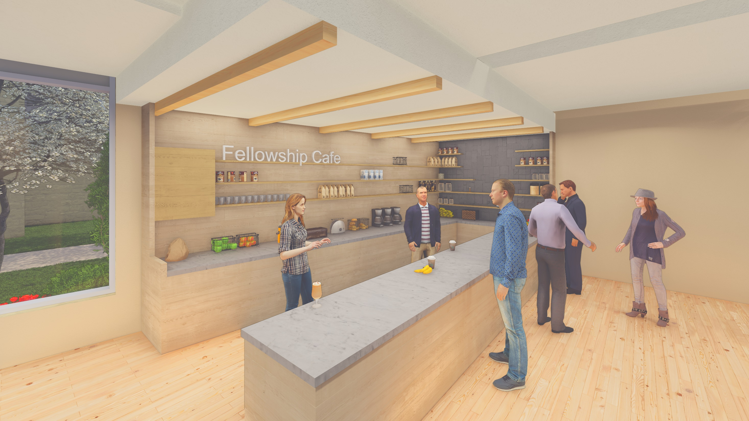

Slide 18
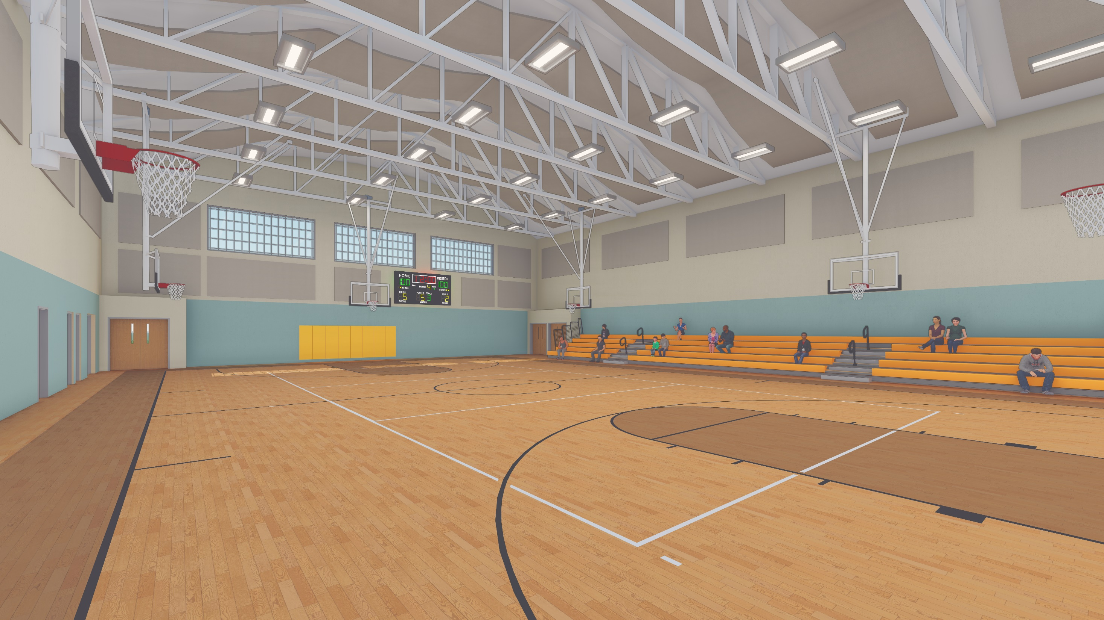

Slide 19
Site Plan (2022)

Slide 20
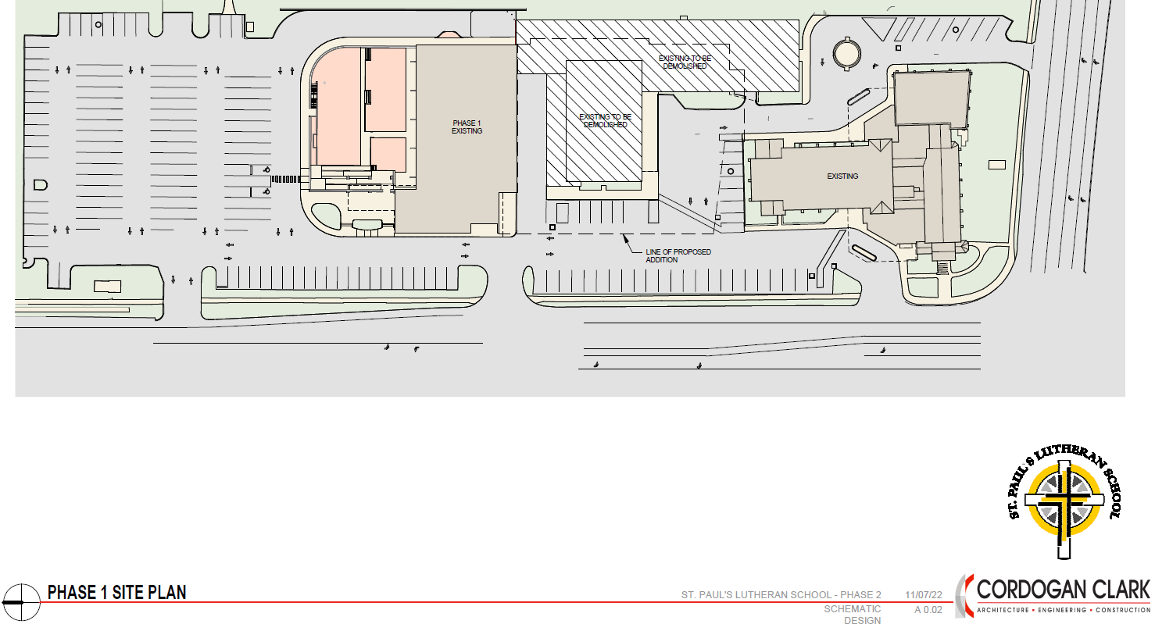
190 Existing Parking Spaces (2022)

Slide 21
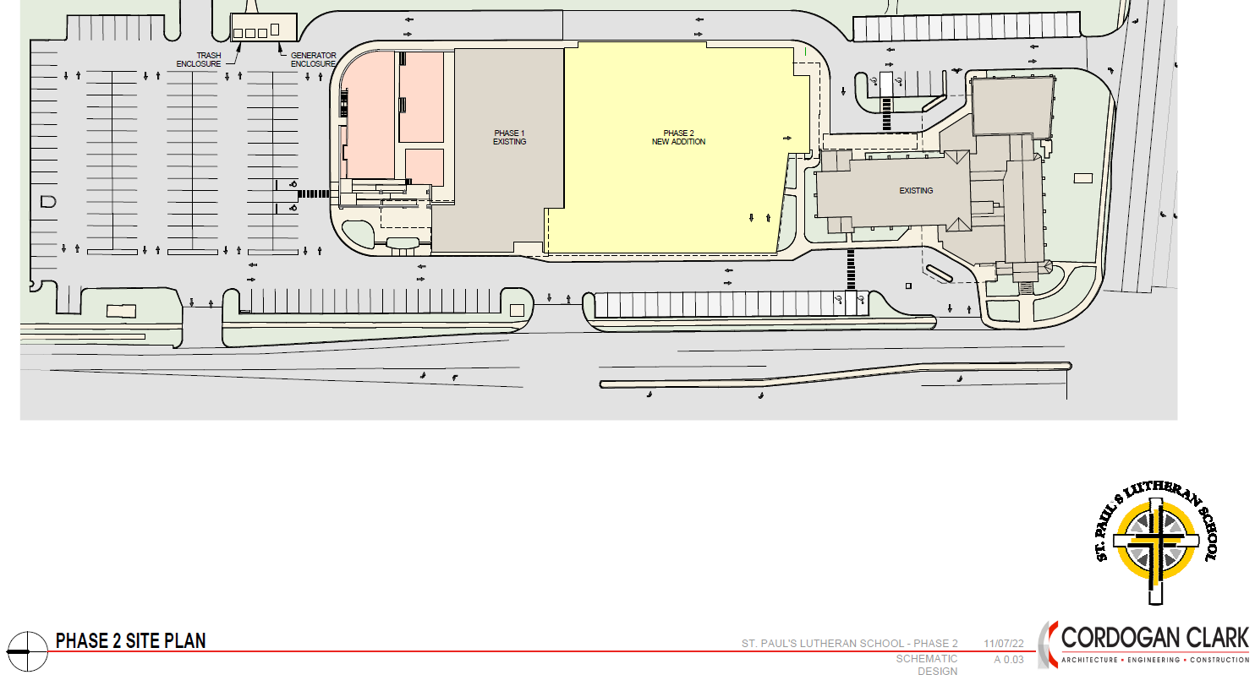
190+/- Proposed Parking Spaces (Phase 2 Design)

Slide 22
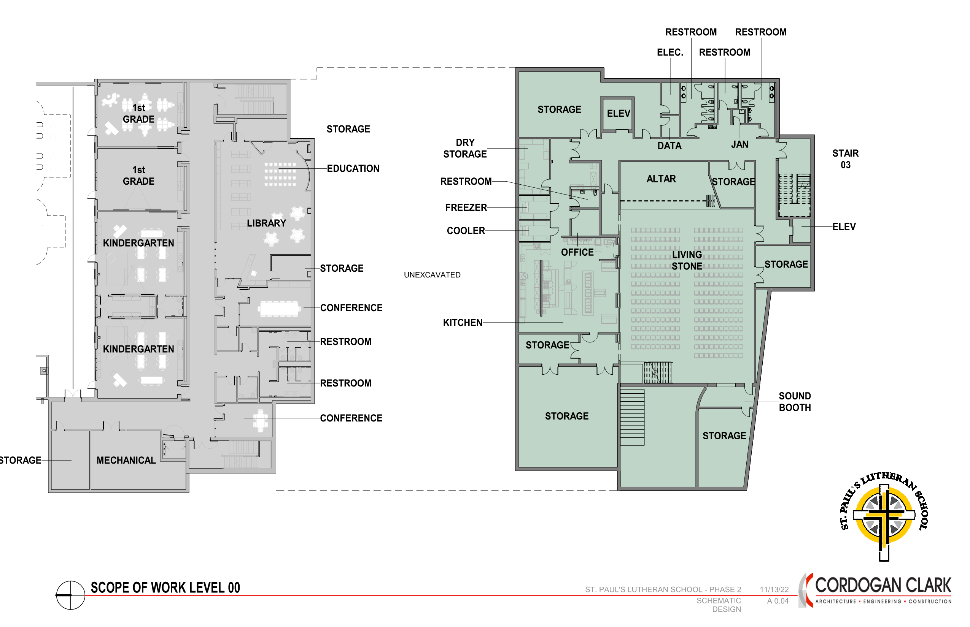
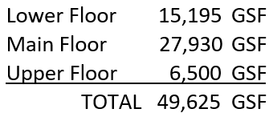
15,195 gsf (New Construction)

Slide 23
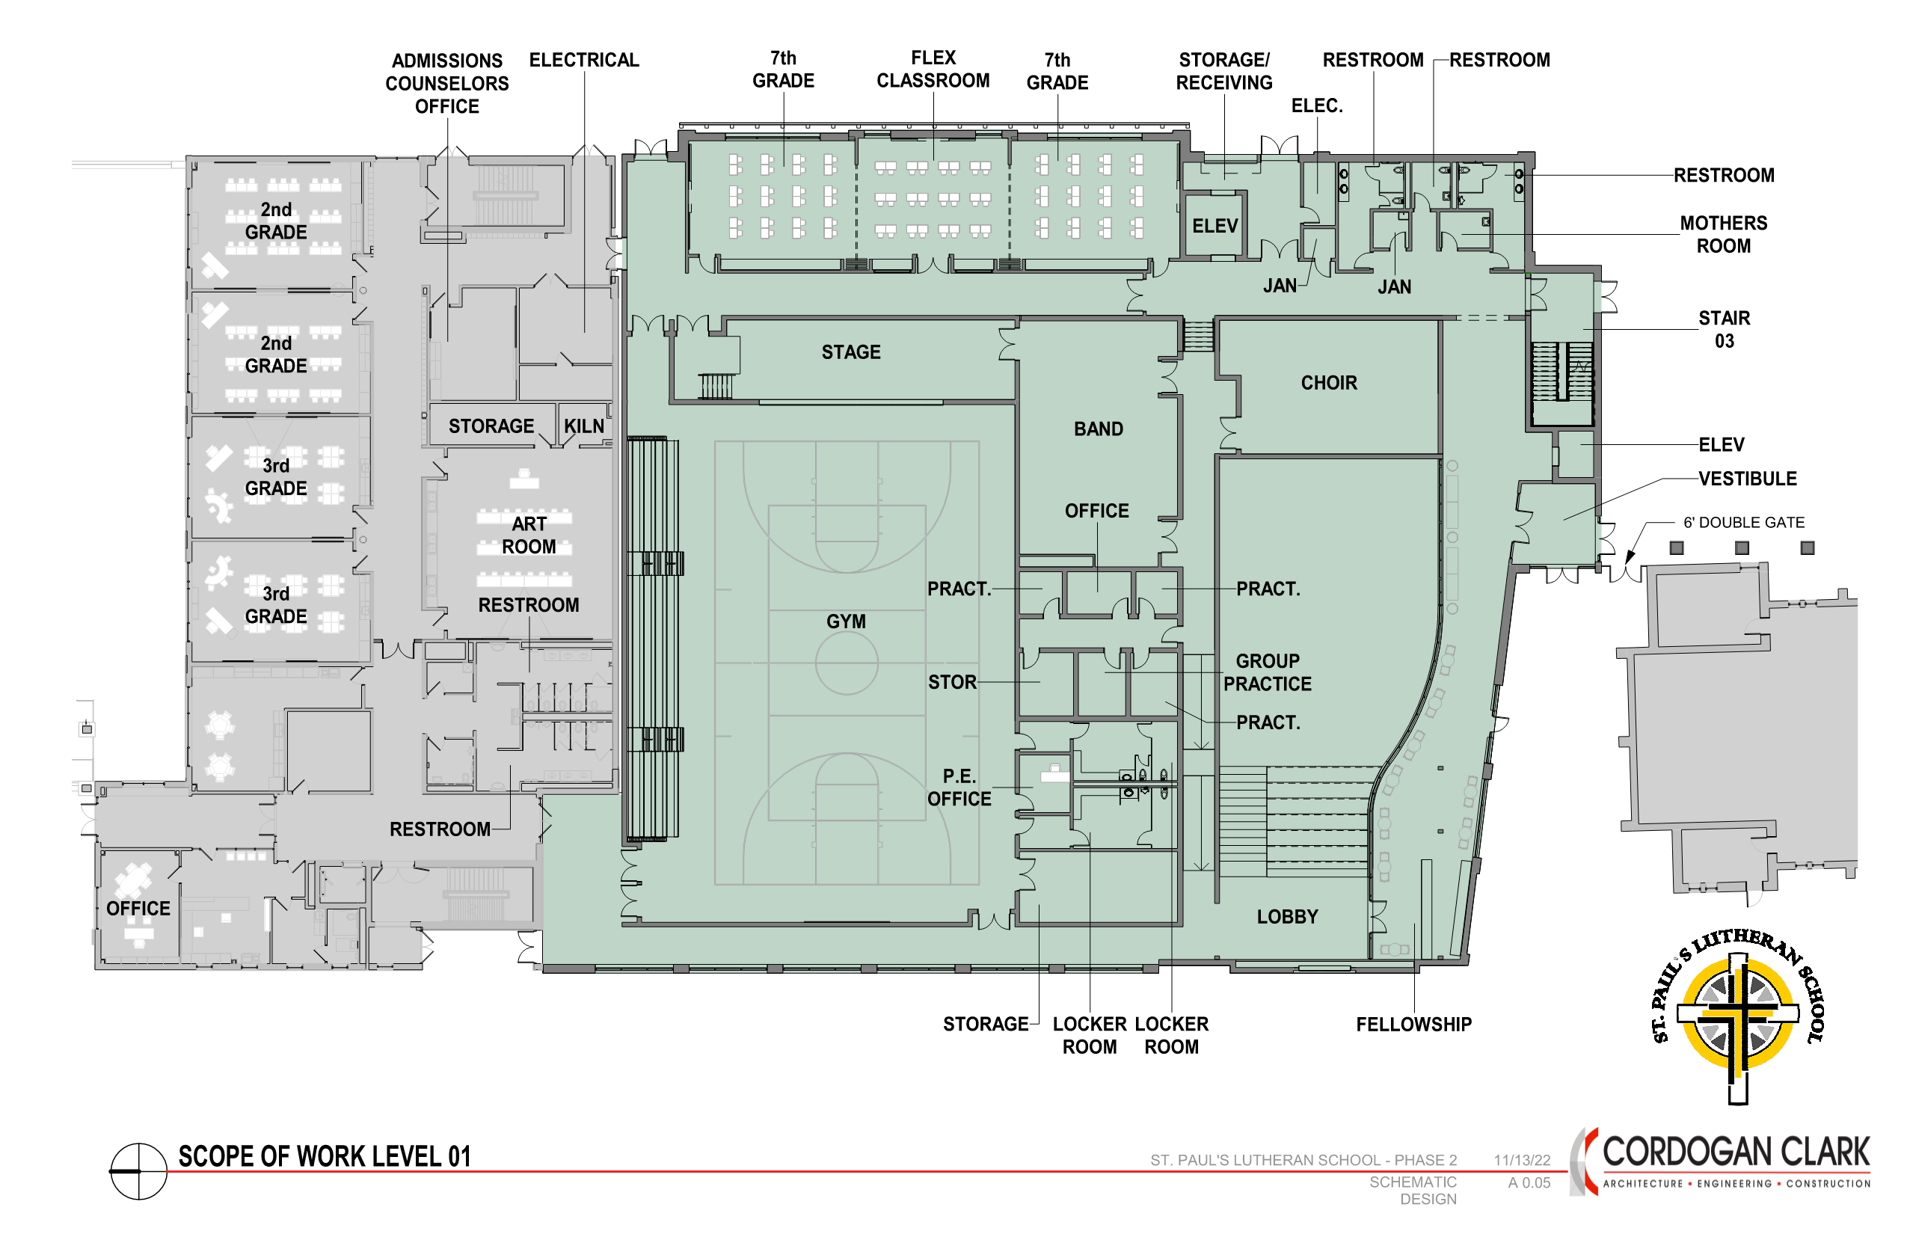
27,930 gsf (New Construction)

Slide 24
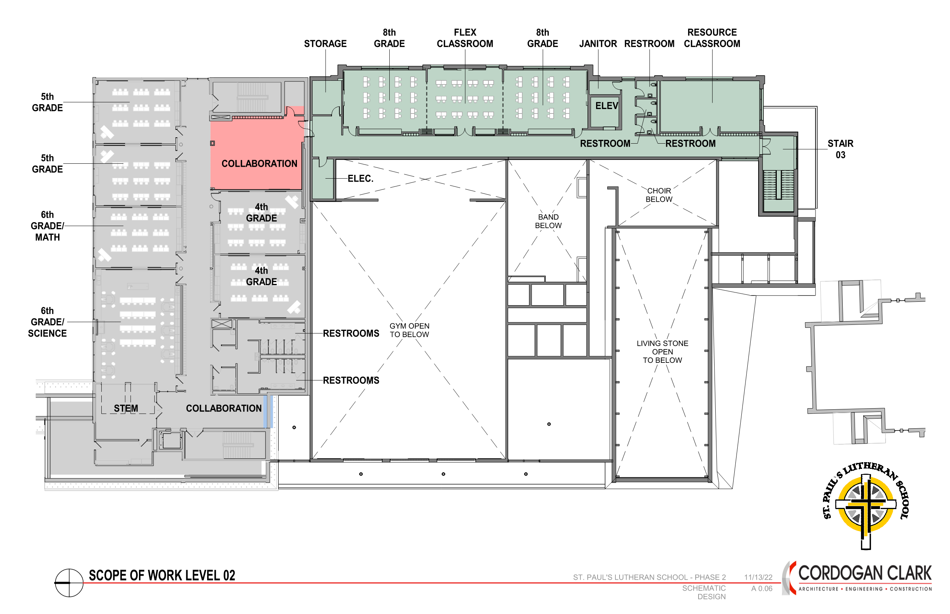
6,500 gsf (New Construction)

Slide 25
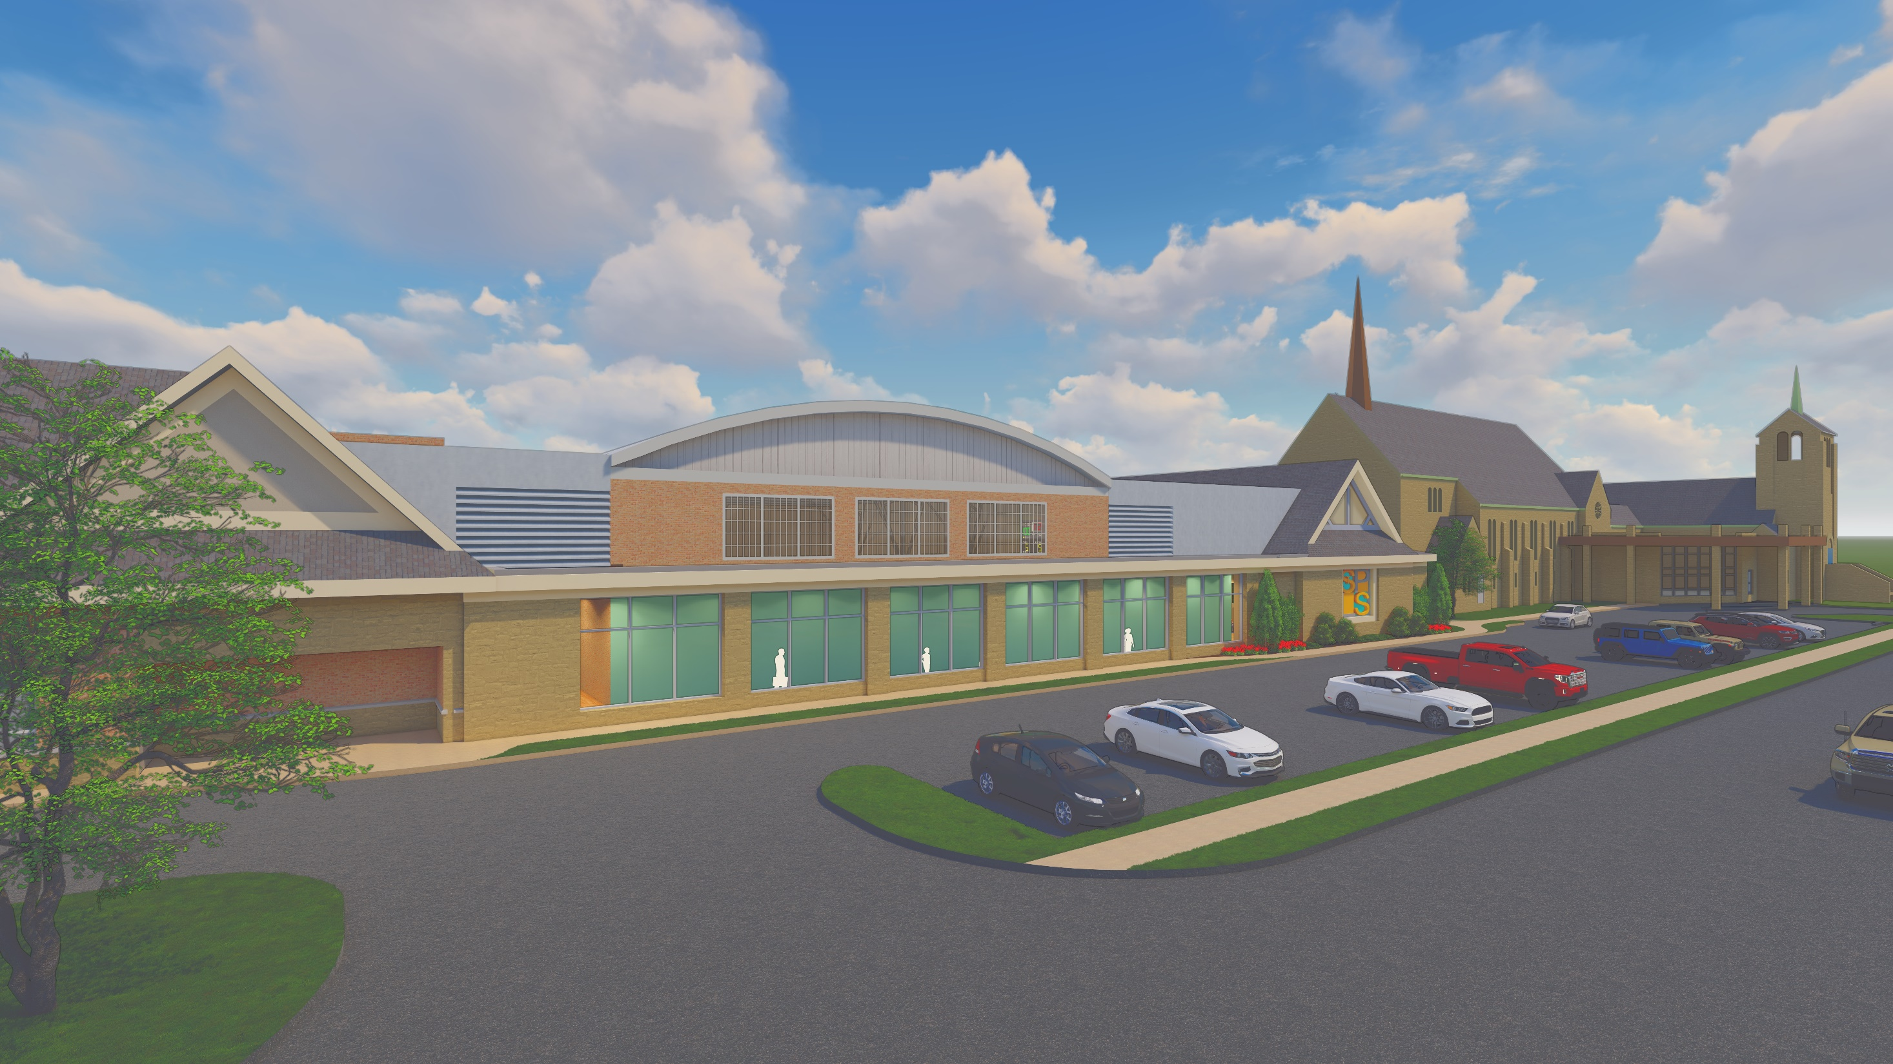

Slide 26
Cost Estimates and Next Steps

Slide 27
Cost Estimates and Next Steps for Phase 2
Based on Four Construction Firm Estimates
Total Construction estimates are $17M-$21M
Next Steps
  Confirm the Validity of Estimates
  Evaluate Potential Building Scope Reductions and Value Engineering Savings
  Step 1 - Update Project Plan and Provide Motion to Voters for Pre-Construction Design and Campaign Fund Raising on 26 March
  Step 2- Final Building Go-Ahead Presentation & VOTE in November 2023

