Slide 1
Trustees
Members 2016
Dennis Kempke, President
Dale McCart, Vice-President
Brentley Ary, Secretary
Ginny Bilanchone
Steve Georgi
Travis Heflin
Mitzi Holmes
Gbolahan Ogunbiyi

Slide 2
Action Items
Completed Nov-Jan
2016-7

Slide 3
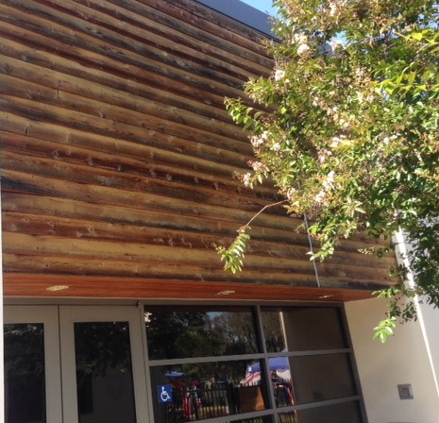
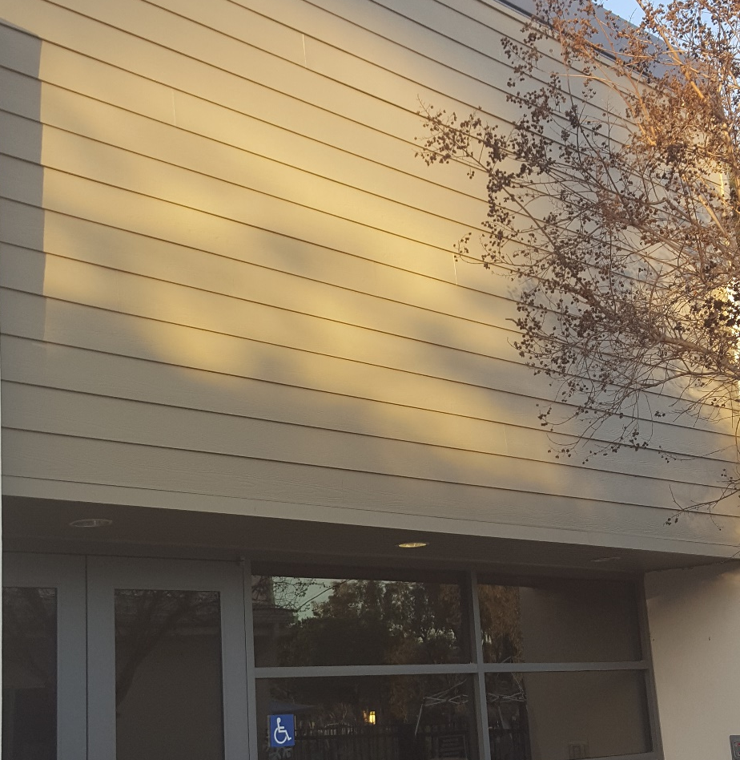
Education Bldg. Wood Siding Repair
Replacement: Hardiplank
Deteriorated Siding

Slide 4
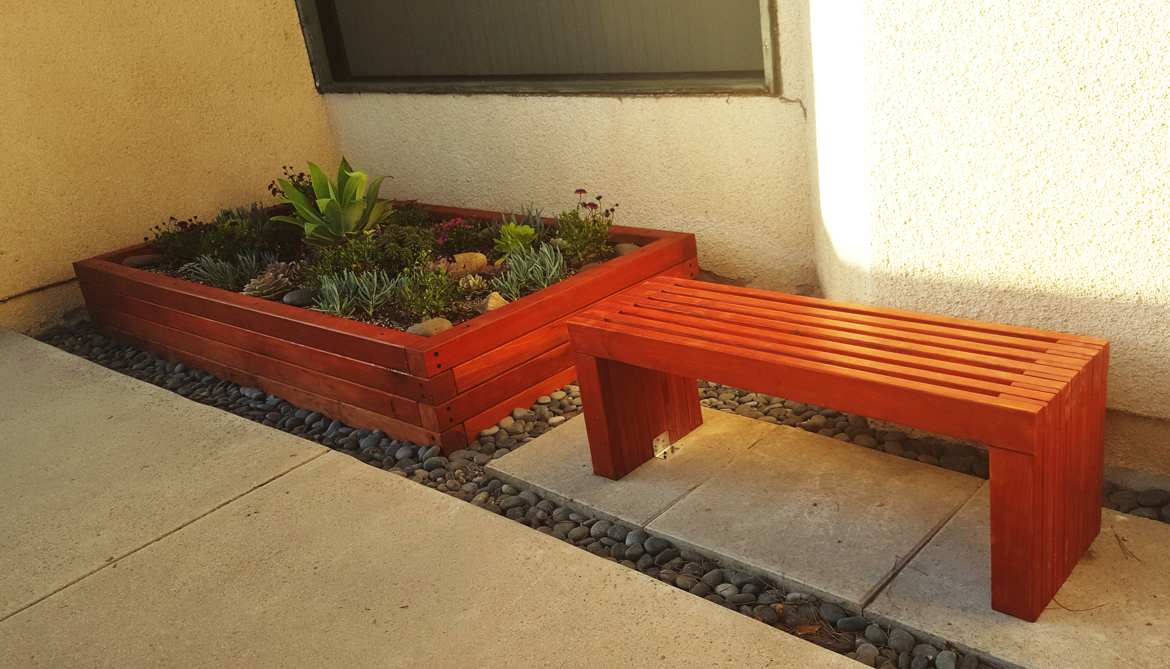
Eagle Scout Project
Raised bed planter and bench in Fellowship Hall patio (West/University side)

Slide 5
City of Irvine Claim of Eminent Domain
Street widening / install turn lane
12-foot section of corner at
Culver & University
Negotiated settlement of $12,100

Slide 6
Major Action Items in Progress

Slide 7
in progress...
Patio Cover Replacement
and
Coffee Service Area Upgrade

Slide 8
Project History
Landscape Dynamics hired to develop
a conceptual design for the project
Comments solicited / fundraising
Trustees made changes to project plan
based on suggestions and cost
estimates
Two parts

Slide 9
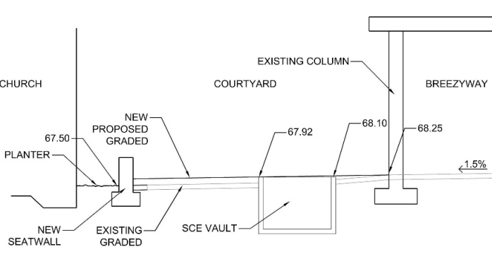
Planned Patio Grading

Slide 10
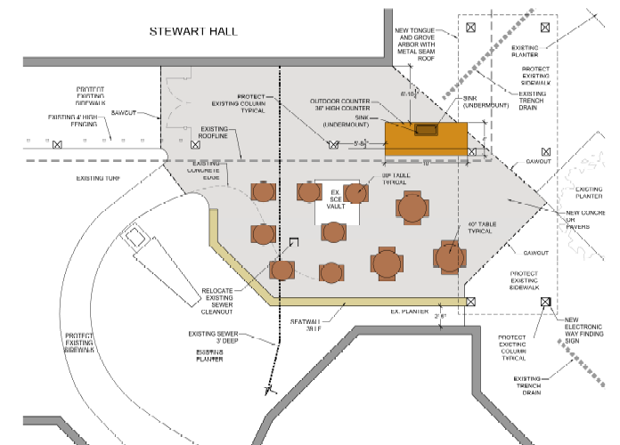
Patio Concept
Sanctuary

Slide 11
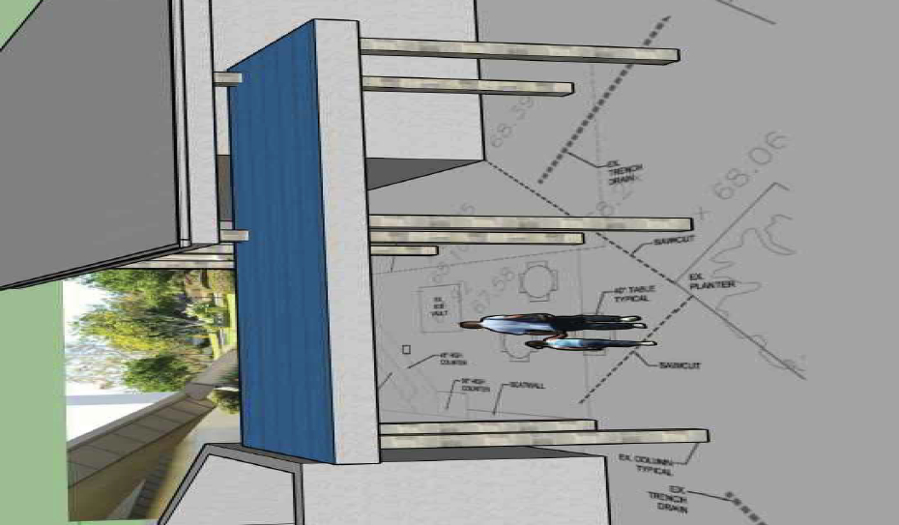
Patio Cover Concept

Slide 12
Project Status:
Rough Schedule
Doc. completion-to Plan Check
Construction doc. authorized
Construction start
Solicit bids
Jan
May
Mar

Slide 13
Patio Roof
Separate project as owner/builder
Construction drawings by
Trustee Gbolahan Ogunbiyi, P.E.

Slide 14
Funding:
Rough cost estimate: $89,658
Available funds: $86,963
$43,955 (Pledges)
$43,008 (Trustee funds)

Slide 15
in progress...
Sanctuary Electrical-Lighting Upgrade
Upcoming opportunities:
Persian New Year Picnic Parking: April 2
Pride Day (work day): before Easter

